Slide 1
Lesson # 3
Light Sensor

Slide 2
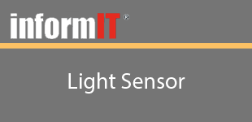
Lesson # 3
Objectives
Learn how to get access to the light sensor
Learn how to determine if the light sensor is available on your device
Learn how to get the Lux Level via Eventing
Learn how to get the Lux Level via Polling

Slide 3

Lesson # 3
Summary
Learned how to get access to the light sensor
Learned how to determine if the light sensor is available on your device
Learned how to get the Lux Level via Eventing
Learned how to get the Lux Level via Polling
Next Lesson: Gyrometer

