Slide 1
Lesson # 4
Settings Contract

Slide 2
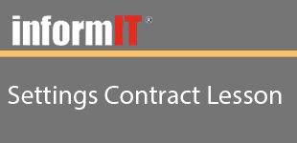
Lesson # 4
Objectives
Learn how to get access to the Settings Pane for the current view
Learn how to define which settings options your view or application will expose
Learn how to launch the settings pane and interact with controls on the pane

Slide 3

Lesson # 4
Summary
Learned how to get access to the Settings Pane for the current view
Learned how to define which settings options your view or application will expose
Learned how to launch the settings pane and interact with controls on the pane

