Slide 1
Lesson # 4
Gyrometer Sensor

Slide 2
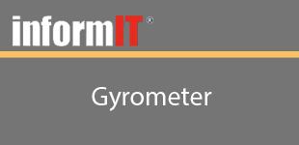
Lesson # 4
Objectives
Learn how to get access to the Gyrometer sensor
Learn how to determine if the Gyrometer sensor is available on your device
Learn how to get the X, Y and Z axis readings via Eventing
Learn how to get the X, Y and Z axis readings via Polling

Slide 3
Lesson # 4
Summary
Learned how to get access to the Gyrometer sensor
Learned how to determine if the Gyrometer sensor is available on your device
Learned how to get the X, Y and Z axis readings via Eventing
Learned how to get the X, Y and Z axis readings via Polling
Next Lesson: Accelerometer

