Slide 1
Lesson # 5
Toast Notifiations

Slide 2
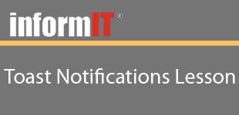
Lesson # 5
Objectives
Learn how to enable toast notifications inside your application
Learn how to send a basic, plain text toast
Learn how to send a toast with an image
Learn how to schedule a toast to be sent at some point in the future

Slide 3
Lesson # 5
Summary
Learned how to enable toast notifications inside your application
Learned how to send a basic, plain text toast
Learned how to send a toast with an image
Learned how to schedule a toast to be sent at some point in the future

