Slide 1
Lesson # 1
Lap Around Windows 8

Slide 2
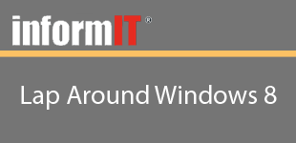
Lesson #1
Objectives
Learn about some of the overall design changes in Windows 8
Learn how live tiles will change the way you communicate with your users
Learn how the system charms and contracts are used
Learn how application bars are used
Learn how application state is used to change the layout of your application

Slide 3
Lesson #1
Summary
Learned about some of the overall design changes in Windows 8
Learned how live tiles will change the way you communicate with your users
Learned how the system charms and contracts are used
Learned how application bars are used
Learned how application state is used to change the layout of your application
Next Lesson: Lap Around Visual Studio 2012

