Slide 1
Lesson # 1
Introduction to MVVM

Slide 2
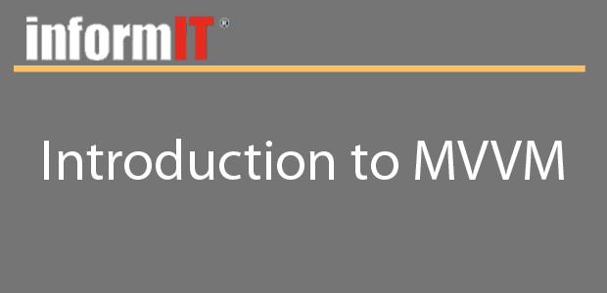
Lesson #1
Objectives
Learn the ideas and concepts behind the MVVM Design Pattern
Learn how the Code Behind is to be avoided if at all possible
Learn how to refactor non-MVVM code to use the MVVM pattern

Slide 3
Lesson #1
Summary
Learned about the MVVM Design Pattern
Learned how to use a ViewModel to drive our View
Learned how to refactor your code to be MVVM driven
Next Lesson: Displaying data w/ Databinding

