Slide 1
Lesson # 3
Commanding in MVVM

Slide 2
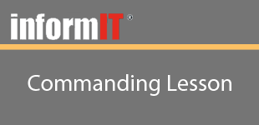
Lesson # 3
Objectives
Learn how the Commanding works
Learn about the ICommand interface and how it is powerful
Learn how to handle and process basic commands
Learn how to handle argument driven commands
Learn how to use the ‘Can Execute’ feature of Commanding

Slide 3
Lesson # 3
Summary
Learned how Commanding and the ICommand interface
Learned how to handle and process basic commands
Learned how to handle argument driven commands
Learned how to use the ‘Can Execute’ feature of Commanding

