Slide 1
Porting the ToDo Listing Screen
Derik Whittaker
Twitter: @derikwhittaker
Notes:
Hello and welcome to module 2 of Html for the XAML developer
In this module we will kick off our transition from being a XAML developer to an HTML developer by getting our hands dirty and pounding out some code. We will start by focusing on the skills need to port a potion of the ToDo listing screen over to HTML. This will be the first of 2 modules focused solely on this screen.

Slide 2
Agenda
Create our first Knockout View Model
Knockout vs XAML ViewModel
Create our first HTML View
Compare layout in HTML vs XAML
Fetch data via ajax from our Web API endpoint
Ajax vs RestClient
Apply styles to an HTML element via Knockout
Knockout css binding vs StyleConverters
Formatting data via Computed Observables
Knockout computed vs Formatters
Notes:
Now is the time to start having fun lets roll up our sleeves and begin cranking out code
[SHOW ANIMATION NOW]
We are going to start off by building our first real view model with knockout js and Typescript. We will compare the differences between a XAML View Model and a Knockout View Model in order understand where they are similar and where they are different.
[SHOW ANIMATION NOW]
Following this we will create our first view built using HTML. While building our HTML view we will take a look at the reference XAML application to see how our experience laying out views in XAML will actually help us while building HTML views
[SHOW ANIMATION NOW]
Next we will take a look at how to use Ajax to query a Web Api endpoint in order to get data for the application from a remote service. Once we have received the data from the api we will learn how to store our data in the view model so it can be displayed to the user.
[SHOW ANIMATION NOW]
After this we will take a look at how to dynamically change the style of UI element by using knockout js. We will learn that the mechanics of change styles may be different in XAML and HTML, the concepts are 100% the same.
[SHOW ANIMATION NOW]
Finally we will complete this module by taking a look at how to format text output, such as a date string, for display in our UI.

Slide 3
END OF Overview Slides

Slide 4
Agenda
Creating our View Model
Creating our HTML View
Fetching data via Ajax
Applying styles to an HTML element via Knockout
Formatting data via Computed Observables
Notes:
It is time to take get our hands dirty and look at how we build our first knockout view model

Slide 5
Implementing our View Model
No need to implement INotifyPropertyChanged
No need to raise Property Changed events on each property
Properties must be Knockout Observables to be found
Knockout Observables are treated as methods not as ‘properties’
Notes:
When creating view models w/ typescript and knockout there are a few things we should discuss up font
[show animation]
First item to know is that unlike in XAML applications a knockout based view model does not need to implement INotifyPropertyChanged in order to have its changes bubble up to the UI. We will illustrate this in an upcoming slide
[show animation]
Another fact to know is that properties in a knockout view model do not need to be wired up to manually raise any type of property changed event. This is nice because having to wire this code up for evey property in XAML is bunch of wasted ceremony in my opinion.
[show animation]
Since we do not need to manually raise any type of changed event notification for a given property, how does the UI know about our changes. In knockout all bound properties must be observable properties maintained by knockout. We will take a look at this in an upcoming slide
[show animation]
One huge pain point for any new HTML/Knockout developer is going to be how you interact w/ an observable property. In xaml these properties are truly properties and not methods. However with knockout you must use properties as methods and if you try to use them as C# style properties things will simply not work. We will examine this in an upcoming slide.

Slide 6
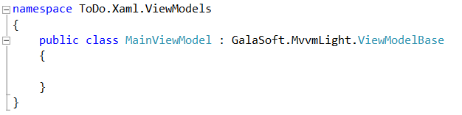
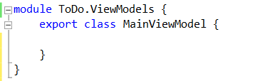
Our First View Model
Silverlight View Model
Typescript View Model
Implements
INotifyPropertyChanged
No need to implement
INotifyPropertyChanged
Notes:
[SHOW ANIMATION]
Here is a View Model declaration, this is something you should be very familiar with. We have a namespace declared along with a class
[SHOW ANIMATION]
You can see that this class inherits off a base view model, in our case a VM from the MVVM light framework. What makes the fact that this view model inherits off a base VM special is the fact that what we are really trying do is have our Vm implement the INotifyPropertyCHanged interface. The INotifyPropertyChanged interface is the mechanism in XAML which allows binding to work.
How would we implement our View Model in the HTML world using typescript?
[SHOW ANIMATION]
If we look at our View Model declaration now, this should look similar to you, but with out one little detail.
[SHOW ANIMATION]
There is no need to implement INotifyPropertyChanged. The reason we do not need to do anything special is because Knockoutjs is going to handle all this for us. This removes the need for us to clutter up our classes and allows us to have cleaner code to work.
As you can see, declaring a view model in typescript is pretty much identical to how you would declare on it in XAML

Slide 7
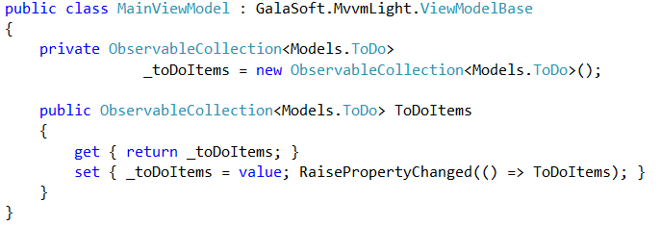

Our First Observable Property
Silverlight Property
Typescript View Model w/ Knockout js
Implements
Observable Collection
Must manually raise
Property Changed
Implements
Observable Array
No need to raise any
Property Changed
Notes:
We have created our View Model, but what good is a View model if we do not have any properties or method in it.
[SHOW ANIMATION]
In Silverlight if you were to create a property and make it observable you would have something as you see now.
[Show animation]
We would have a property backing field which is an observable collection. This means we are not able to use an auto property in our VM which really is a shame.
[show animation]
The setter of our preoprty would also need to some how raise a notification changed event to signal to the UI that something has changed. This is done here via the RaisePropertyChanged method which is a helper method that is part of MVVM light.
How would we implement our Property in the HTML world using Knockout js?
[show animation]
In the Typescript/knockout world we would still have to declare our property
[show animation]
And this property would have to be an observable.
[show animation]
However, unlike in XAML there is NO need to have a backing field OR to manually have to signal that our property has changed, all of this is taken care of for you via knockout.
As you can see the implementation of a property is a bit different between XAML and Typescript w/ knockout. But different in a good way if you ask me. I have never liked the fact that I have to go through the ceremony of raising changed events and with knockout I do not need to

Slide 8

Breaking down our Observable Property
Property Name
Property Initializer
Property Type
Notes:
In the previous slide we took a look at our observable property. This property declaration in Typescript contains 3 points
and I wanted to circle back and break down our syntax just a bit more.
[show animation]
The first thing we have to do of course is give our property a name. In our case we named it ToDos
[show animation]
The next part of our property is its type. In our case here we are going to tell the type script compiler we are using an KnockoutObservableArray. This allows the typescript compiler to perform static checking in our code.
[show animation]
The last part of our property is where we are initializing our value and actually making it an observable array. This is critical and is something we will be doing over and over again.

Slide 9
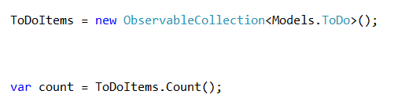
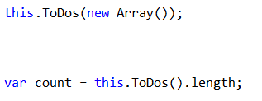
Using an Observable Property
Silverlight Property
Typescript View Model w/ Knockout js
Sets Value
Gets Value
Sets Value
Gets Value
Notice we access these like methods NOT properties
Notes:
[show animation]
On the first slide I said that the way we access properties in a C# view model is very different from the way we access them in a knockout view model.
[show animation]
In C# if we want to set a value to a property or get a value from a property you would use syntax as seen here
[show animation]
However, when using knockout observables we cannot access these as traditional properties we must access these as methods
[show animation]
As you can see here we are pushing values to our underlying observable in the same way as if we were calling a method, and we are getting values out of the value by calling it as a method.

Slide 10
END OF Overview Slides

Slide 11
Agenda
Creating our View Model
Creating our HTML View
Fetching data via Ajax
Applying styles to an HTML element via Knockout
Formatting data via Computed Observables
Notes:
We have our view model created but what fun is a view model if we do not have a view to bind it to? Lets get started and build our first View in HTML.

Slide 12
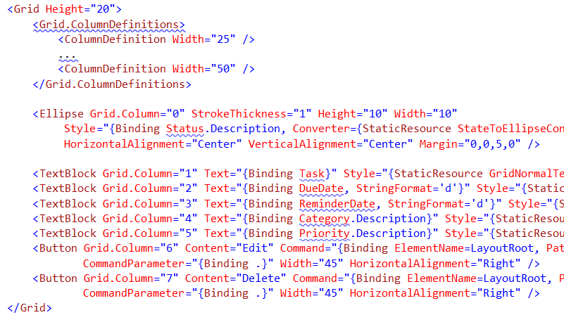
Implementing our View
XAML View
Must declare EACH column/row up front
Create UI Control for each data point.
Assign row/column index
Bind each element to the View Model
Notes:
Our first view is going to be a straight forward grid which lists our data. I suspect that this code should look very familure to you so I am not going to go into great details explaining it here.
[show animation]
The xaml you see on screen is the body of a data template for a list box.
[show animation]
As you know w/ xaml any time you work with a grid you have to manually declare EVERY ROW and EVERY column, this is a royal pain.
[show animation]
Once you have your grid columns and rows setup you will need to create a UI element for each data point. You will also have to assign the element a column or row index in order for the layout to look right. I don’t know about you but I often find my self adding columns and then having to remember to change the index in every UI element.
[show animation]
Once you have your UI elements indexed correctly we can bind to our underlying VM by using the standard binding syntanx.

Slide 13
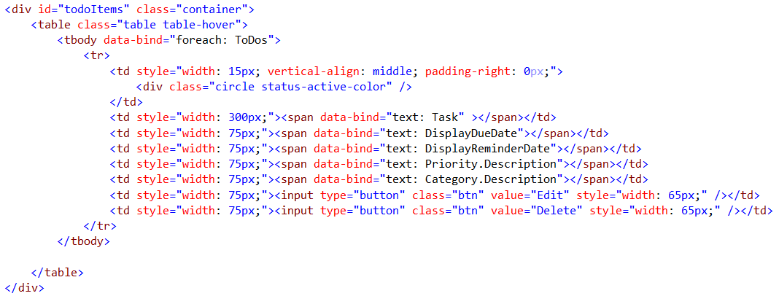
Implementing our View
HTML View
Use a table and bind our collection to it via the ‘foreach’ control flow binding
Bind to property in the view model
Notes:
[show animation]
Here is the same view but built w/ HTML and knockout
[show animation]
The first thing we should point out is how we are going to bind our underlying collection to the table. When using knockout we can use the ‘foreach’ control flow binding which will allow you to duplicate a section of markup for each element in a collection.
Along with the foreach binding pay attention to the fact we are using a html table here rather than the list box we used in XAML. One advantage to using a table here vs the XAML equivalent is that there is NO need to declare our column or row definitions ahead of time, I feel this makes for cleaner markup.
[show animation]
Once you have your columns setup you can use knockout to bind observables in your viewmodel to the corresponding UI elements. This binding is very similar to the way you would do it in XAML so this should be pretty natural for you.

Slide 14
END OF Overview Slides

Slide 15
Agenda
Creating our View Model
Creating our HTML View
Fetching data via Ajax
Applying styles to an HTML element via Knockout
Formatting data via Computed Observables
Notes:
We have looked at how to create our view mode as well as how to create our view but how to do we get data from our server to display to our users. When building HTML applications we want to use ajax in order to get data. We are going to look at how we can use jquery and ajax to accomplish this goal.

Slide 16
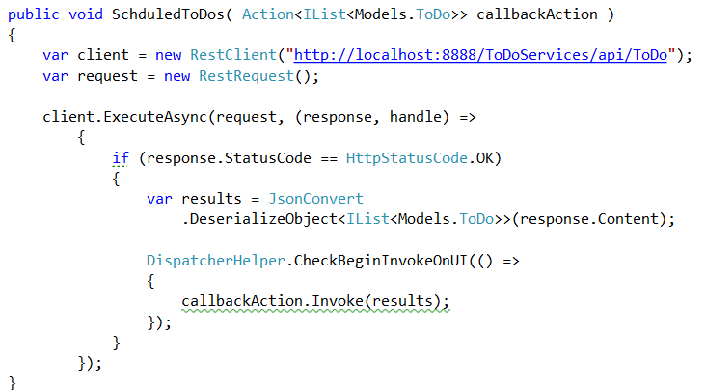
Fetching Remote Data
Using RestClient in C#
Web Api Route
Async request to get data
Response callback
Pushing to UI thread
Notes:
[show animation]
When building xaml based applications there are many ways to fetch data from a service. A common way is to use a library such as RestClient. Restclient provides a way to easily get or post data from a provided uri.
[show animation]
As you can see we have provided a URI to our web api endpoint and we are planning on doing a HTTP get.
[show animation]
Because this is a Silverlight application and because we do not want to block the UI thread we need to make an async call to our endpoint in order to fetch our data.
[show animation]
Once our call comes back we validate that the status is correct we need to do something useful with our results, such as deserialize them into a result model. Once we have our result model we need to dispatch our data back onto the UI thread as seen here. Once we are on our UI thread we have free reign to do anything we want with our data.

Slide 17
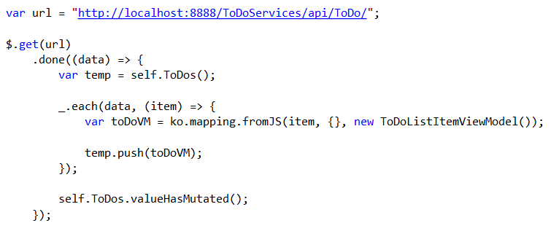
Fetching Remote Data
Using jQuery
Web Api Route
Ajax ‘get’ to the web api route
Ajax call back to handle processing
Notes:
[show animation]
Using jquery and ajax is fetch remote data is the accepted best practice for gathering data. And If you look at our code here it should look very familure to the code we just looked at using the rest client
[show animation]
With jquery, like the REST client I need to provid a URI to our web api endpoint we are using in order to do an HTTP get.
[show animation]
Also like RESTclient I need to make a call to some method and provide it the URI to access. IN our case we are going to use the jquery .get method which will do the ajax calls behind the seens.
[show animation]
And still like the RESTClient example I need to provide a completion call back which is accomplished via the .done deferral. Once my data has been pushed back into my deferral I am able to process it in any way I see fit. One slight difference here is there is NO need to dispatch back on to the UI thread which saves the hassel

Slide 18
END OF Overview Slides

Slide 19
Agenda
Creating our View Model
Creating our HTML View
Fetching data via Ajax
Applying styles to an HTML element via Knockout
Formatting data via Computed Observables
Notes:
Now we have data to display in our UI however it is not quit styled the way we would like it so lets take a look at how you can conditionally style ui elements using knockout js.

Slide 20
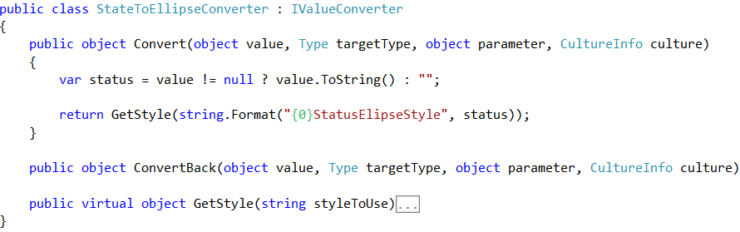
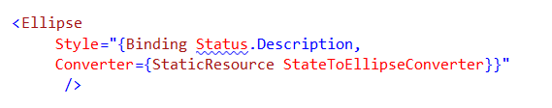
Changing Styles on the Fly
Custom Class implements IValueConverter
Silverlight Value Converter
XAML Implementation
Value to ‘test’ against
provided
Bound property to ‘test’ against
Invoking the IValueConverter
Notes:
[show animation]
When building user interfaces in XAML it is pretty common to need to change the look and feel of your element based on data point. In xaml this is really simple to do with a style converter
[show animation]
When building a style converter the first thing we have to do is create a class which implements the IValueConverter interface. Once we have our class implemented we simply need to implement both methods convert and convert back. These methods are where the decision logic for our convert lives.
[show animation]
When using a value converter of course you can bind to a data point and this is provided to you via the value parameter. Once you have this parameter you can use it in any way you see fit in order to determine what style to return.
[show animation]
We have reviewed how to create our style converter now it is time to take a look at how we use this in XAML.
[show animation]
As you can see here we use the Style attriute of a UI element. Inside this attribute we need to bind to our view model but more importantly we need to specify the convert we want to use. Once you have this wired up correctly you can not dynamically change the look and feel of our ui element at runtime.

Slide 21
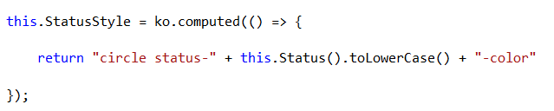

Changing Styles on the Fly
Knockout Computed Method
HTML Implementation
Computed Observable
Triggers off another Observable
Bound to the Observable
Uses the attr binding key
Notes:
[show animation]
When wanting to change styles in HTML and knockout there really is no direct 1-to-1 mapping but we can still accomplish the same goal.
[show animation]
In knockout we would could solve this problem numerous ways and one way is to create a computed method to bind to. This computed method would have access to the observable which matters, such as Status and would return the styles as a result set. These styles would then drive the UI to change
[show animation]
When going down this path it is important to understand that a computed will update each time any observable inside of it, such as Status, is updated. This means that when status changes the computed will update and the value of StatusStyle will also change.
[show animation]
We have our computed setup now but how to we us this in the UI?
[show animation]
The first thing we would do is use the knockout data-bind attribute and provide it the StatusStyle observable property
[show animation]
The next thing we would do is need to make sure to use the attr binding with knockout in order to set the correct css class inside our UI element.

Slide 22
END OF Overview Slides

Slide 23
Agenda
Creating our View Model
Creating our HTML View
Fetching data via Ajax
Applying styles to an HTML element via Knockout
Formatting data via Computed Observables
Notes:
Now we have our data displayed in our UI and it has been styled but what do we do if we simply want to format text such as a date field? We can solve this problem with little effort as well so lets see how.

Slide 24


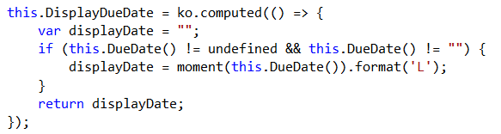
Formatting Data
Can use the built in StringFormat on bound field
Silverlight StringFormat
Knockout Formatting
Can bind to an observable
property
Create a Computed Field to do the formatting
Could also use Custom Bindings in Knockout.
Notes:
[show animation]
When using Silverlight it is pretty easy to format a string value, you can simply use the string format feature built right in to XAML.
[show animation]
Sadly in HTML it is not quite this easy.
[show animation]
In HTML if you want to format something you would still need to bind to it as you see here
[show animation]
However we need to do a bit of work in the view model. Once again we can solve this problem in multiple ways but the simplest may be to use a computed observable. In our computed observable we would provide any logic needed in order to get the data formatted correctly and returned for binding.
[show animation]
I mentioned we could solve this multiple ways. Another way we could solve this is by using custom bindings in knockout, we will take a look at how to do this later in the course.

Slide 25
END OF Overview Slides

Slide 26
Summery
Created our View Model
Created our HTML View
Learned how to use jQuery and Ajax to fetch remote data
Learned how to apply styles via Knockout
Learned how to apply formatting via Knockout
Notes:
In this module we kicked of our transition from being a XAML developer to an HTML developer by writing some code.
We first took a look at how create our first view model. When building our view model we compared our Typscript/knockout VM to a XAML based one in order to understand where they are similar and where they are different
Next we created our first view in HTML. When creating our view we reviewed our reference XAML view and then took a look at how to reproduce that view in HTML.
After this we learned how to use jquery and ajax to fetch remote data from our WEB api endpoint.
Finally we rounded out the module by learning how to use knockout to apply styles to UI elements as well as how to format text for display.
In the next module we will continue to focus on our todo listing screen. However, we are going to kick it up a notice and at learn how to do more client side proessing.

