Slide 1
Porting the ToDo Listing Screen
Derik Whittaker
Notes:
Hello and welcome to module 2 of Html for the XAML developer
In this module we will kick off our transition from being a XAML developer to an HTML developer by getting our hands dirty and pounding out some code. We will start by focusing on the skills need to port a potion of the ToDo listing screen over to HTML. This will be the first of 2 modules focused solely on this screen.

Slide 2
Agenda
Create our first Knockout View Model
Knockout vs XAML ViewModel
Create our first HTML View
Compare layout in HTML vs XAML
Fetch data via ajax from our Web API endpoint
Ajax vs RestClient
Apply styles to an HTML element via Knockout
Knockout css binding vs StyleConverters
Formatting data via Computed Observables
Knockout computed vs Formatters
Notes:
Now is the time to start having fun lets roll up our sleeves and begin cranking out code
[SHOW ANIMATION NOW]
We are going to start off by building our first real view model with knockout js and Typescript. We will compare the differences between a XAML View Model and a Knockout View Model in order understand where they are similar and where they are different.
[SHOW ANIMATION NOW]
Following this we will create our first view built using HTML. While building our HTML view we will take a look at the reference XAML application to see how our experience laying out views in XAML will actually help us while building HTML views
[SHOW ANIMATION NOW]
Next we will take a look at how to use Ajax to query a Web Api endpoint in order to get data for the application from a remote service. Once we have received the data from the api we will learn how to store our data in the view model so it can be displayed to the user.
[SHOW ANIMATION NOW]
After this we will take a look at how to dynamically change the style of UI element by using knockout js. We will learn that the mechanics of change styles may be different in XAML and HTML, the concepts are 100% the same.
[SHOW ANIMATION NOW]
Finally we will complete this module by taking a look at how to format text output, such as a date string, for display in our UI.

Slide 3
END OF Overview Slides

Slide 4
Agenda
Creating our View Model
Creating our HTML View
Fetching data via Ajax
Applying styles to an HTML element via Knockout
Formatting data via Computed Observables
Notes:
It is time to take get our hands dirty and look at how we build our first knockout view model

Slide 5
Implementing our View Model
No need to implement INotifyPropertyChanged
No need to raise Property Changed events on each property
Properties must be Knockout Observables to be found
Knockout Observables are treated as methods not as ‘properties’
Notes:
When creating view models w/ typescript and knockout there are a few things we should discuss up font
[show animation]
First item to know is that unlike in XAML applications a knockout based view model does not need to implement INotifyPropertyChanged in order to have its changes bubble up to the UI. We will illustrate this in an upcoming slide
[show animation]
Another fact to know is that properties in a knockout view model do not need to be wired up to manually raise any type of property changed event. This is nice because having to wire this code up for evey property in XAML is bunch of wasted ceremony in my opinion.
[show animation]
Since we do not need to manually raise any type of changed event notification for a given property, how does the UI know about our changes. In knockout all bound properties must be observable properties maintained by knockout. We will take a look at this in an upcoming slide
[show animation]
One huge pain point for any new HTML/Knockout developer is going to be how you interact w/ an observable property. In xaml these properties are truly properties and not methods. However with knockout you must use properties as methods and if you try to use them as C# style properties things will simply not work. We will examine this in an upcoming slide.

Slide 6
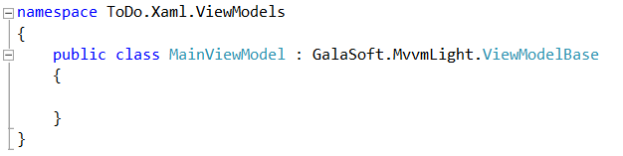
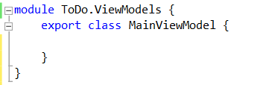
Our First View Model
Silverlight View Model
Typescript View Model
Implements
INotifyPropertyChanged
No need to implement
INotifyPropertyChanged
Notes:
[SHOW ANIMATION]
Here is a View Model declaration, this is something you should be very familiar with. We have a namespace declared along with a class
[SHOW ANIMATION]
You can see that this class inherits off a base view model, in our case a VM from the MVVM light framework. What makes the fact that this view model inherits off a base VM special is the fact that what we are really trying do is have our Vm implement the INotifyPropertyCHanged interface. The INotifyPropertyChanged interface is the mechanism in XAML which allows binding to work.
How would we implement our View Model in the HTML world using typescript?
[SHOW ANIMATION]
If we look at our View Model declaration now, this should look similar to you, but with out one little detail.
[SHOW ANIMATION]
There is no need to implement INotifyPropertyChanged. The reason we do not need to do anything special is because Knockoutjs is going to handle all this for us. This removes the need for us to clutter up our classes and allows us to have cleaner code to work.
As you can see, declaring a view model in typescript is pretty much identical to how you would declare on it in XAML

Slide 7
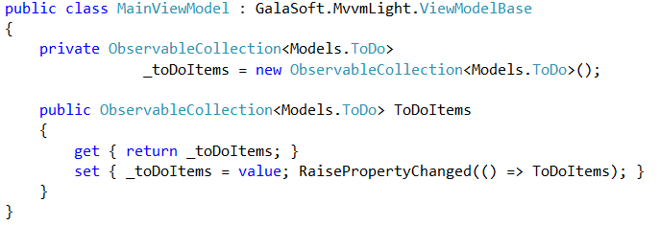

Our First Observable Property
Silverlight Property
Typescript View Model w/ Knockout js
Implements
Observable Collection
Must manually raise
Property Changed
Implements
Observable Array
No need to raise any
Property Changed
Notes:
We have created our View Model, but what good is a View model if we do not have any properties or method in it.
[SHOW ANIMATION]
In Silverlight if you were to create a property and make it observable you would have something as you see now.
[Show animation]
We would have a property backing field which is an observable collection. This means we are not able to use an auto property in our VM which really is a shame.
[show animation]
The setter of our preoprty would also need to some how raise a notification changed event to signal to the UI that something has changed. This is done here via the RaisePropertyChanged method which is a helper method that is part of MVVM light.
How would we implement our Property in the HTML world using Knockout js?
[show animation]
In the Typescript/knockout world we would still have to declare our property
[show animation]
And this property would have to be an observable.
[show animation]
However, unlike in XAML there is NO need to have a backing field OR to manually have to signal that our property has changed, all of this is taken care of for you via knockout.
As you can see the implementation of a property is a bit different between XAML and Typescript w/ knockout. But different in a good way if you ask me. I have never liked the fact that I have to go through the ceremony of raising changed events and with knockout I do not need to

Slide 8

Breaking down our Observable Property
Property Name
Property Initializer
Property Type
Notes:
In the previous slide we took a look at our observable property. This property declaration in Typescript contains 3 points
and I wanted to circle back and break down our syntax just a bit more.
[show animation]
The first thing we have to do of course is give our property a name. In our case we named it ToDos
[show animation]
The next part of our property is its type. In our case here we are going to tell the type script compiler we are using an KnockoutObservableArray. This allows the typescript compiler to perform static checking in our code.
[show animation]
The last part of our property is where we are initializing our value and actually making it an observable array. This is critical and is something we will be doing over and over again.

Slide 9
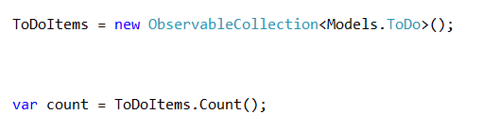
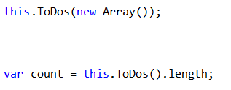
Using an Observable Property
Silverlight Property
Typescript View Model w/ Knockout js
Sets Value
Gets Value
Sets Value
Gets Value
Notice we access these like methods NOT properties
Notes:
[show animation]
On the first slide I said that the way we access properties in a C# view model is very different from the way we access them in a knockout view model.
[show animation]
In C# if we want to set a value to a property or get a value from a property you would use syntax as seen here
[show animation]
However, when using knockout observables we cannot access these as traditional properties we must access these as methods
[show animation]
As you can see here we are pushing values to our underlying observable in the same way as if we were calling a method, and we are getting values out of the value by calling it as a method.

Slide 10
END OF Overview Slides

Slide 11
Agenda
Creating our View Model
Creating our HTML View
Fetching data via Ajax
Applying styles to an HTML element via Knockout
Formatting data via Computed Observables
Notes:
Now is the time to start having fun lets roll up our sleeves and begin cranking out code
[SHOW ANIMATION NOW]
We are going to start off by building our first real view model with knockout js and Typescript. We will compare the differences between a XAML View Model and a Knockout View Model in order understand where they are similar and where they are different.
[SHOW ANIMATION NOW]
Following this we will create our first view built using HTML. While building our HTML view we will take a look at the reference XAML application to see how our experience laying out views in XAML will actually help us while building HTML views
[SHOW ANIMATION NOW]
Next we will take a look at how to dynamically change the style of UI element by using knockout js. We will learn that although they way in which we change styles is different between XAML and HTML the concepts are 100% the same.
[SHOW ANIMATION NOW]
Finally we will complete this module by taking a look at how to use Ajax to query a Web Api endpoint. Once we have received the data from the api we will learn how to store our data in the view model so it can be displayed to the user.

Slide 12
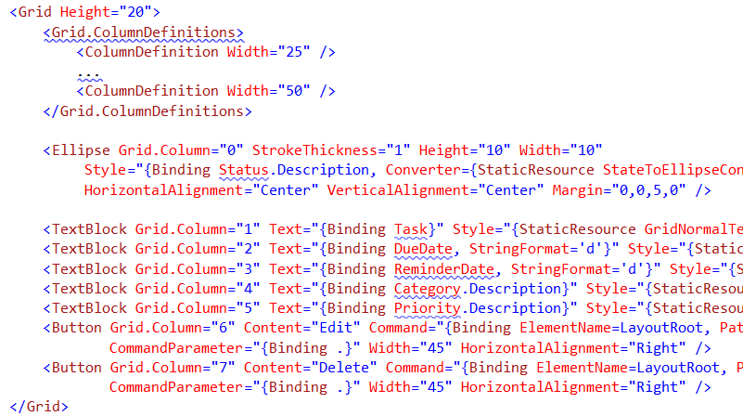
Implementing our View
XAML View
Must declare EACH column/row up front
Create UI Control for each data point.
Assign row/column index
Bind each element to the View Model
Notes:
Indicate this grid is inside the datatemplate for a list box

Slide 13
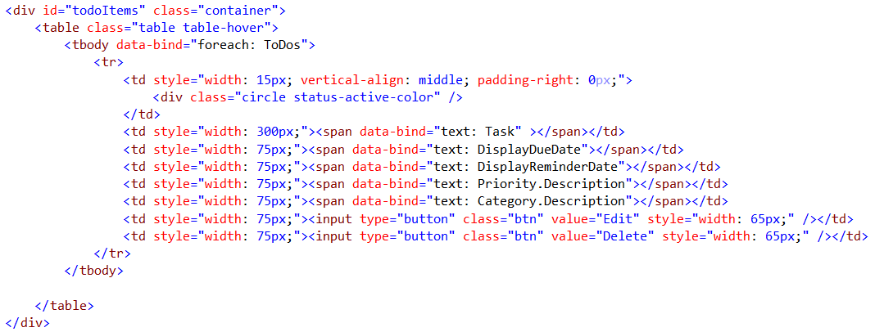
Implementing our View
HTML View
No need to declare column/rows upfront
Bind to property in the view model

Slide 14
END OF Overview Slides

Slide 15
Agenda
Creating our View Model
Creating our HTML View
Fetching data via Ajax
Applying styles to an HTML element via Knockout
Formatting data via Computed Observables
Notes:
Now is the time to start having fun lets roll up our sleeves and begin cranking out code
[SHOW ANIMATION NOW]
We are going to start off by building our first real view model with knockout js and Typescript. We will compare the differences between a XAML View Model and a Knockout View Model in order understand where they are similar and where they are different.
[SHOW ANIMATION NOW]
Following this we will create our first view built using HTML. While building our HTML view we will take a look at the reference XAML application to see how our experience laying out views in XAML will actually help us while building HTML views
[SHOW ANIMATION NOW]
Next we will take a look at how to dynamically change the style of UI element by using knockout js. We will learn that although they way in which we change styles is different between XAML and HTML the concepts are 100% the same.
[SHOW ANIMATION NOW]
Finally we will complete this module by taking a look at how to use Ajax to query a Web Api endpoint. Once we have received the data from the api we will learn how to store our data in the view model so it can be displayed to the user.

Slide 16
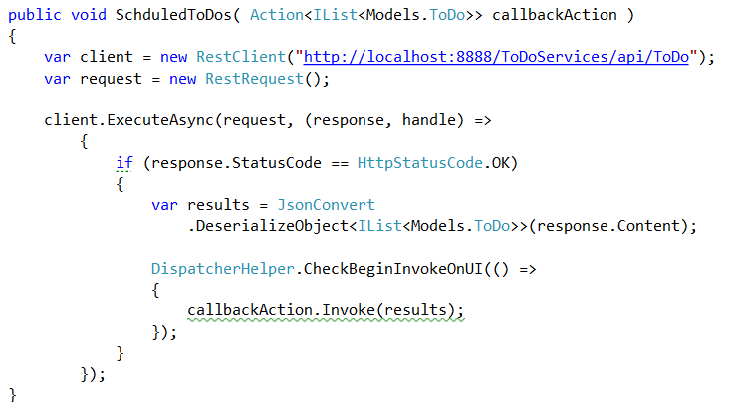
Fetching Remote Data
Using RestClient in C#
Web Api Route
Async request to get data
Response callback
Pushing to UI thread

Slide 17
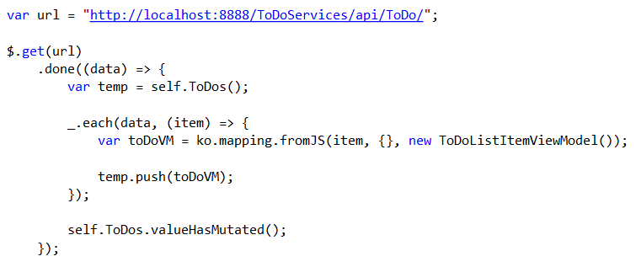
Fetching Remote Data
Using jQuery
Web Api Route
Ajax ‘get’ to the web api route
Ajax call back to handle processing

Slide 18
END OF Overview Slides

Slide 19
Agenda
Creating our View Model
Creating our HTML View
Fetching data via Ajax
Applying styles to an HTML element via Knockout
Formatting data via Computed Observables
Notes:
Now is the time to start having fun lets roll up our sleeves and begin cranking out code
[SHOW ANIMATION NOW]
We are going to start off by building our first real view model with knockout js and Typescript. We will compare the differences between a XAML View Model and a Knockout View Model in order understand where they are similar and where they are different.
[SHOW ANIMATION NOW]
Following this we will create our first view built using HTML. While building our HTML view we will take a look at the reference XAML application to see how our experience laying out views in XAML will actually help us while building HTML views
[SHOW ANIMATION NOW]
Next we will take a look at how to dynamically change the style of UI element by using knockout js. We will learn that although they way in which we change styles is different between XAML and HTML the concepts are 100% the same.
[SHOW ANIMATION NOW]
Finally we will complete this module by taking a look at how to use Ajax to query a Web Api endpoint. Once we have received the data from the api we will learn how to store our data in the view model so it can be displayed to the user.

Slide 20
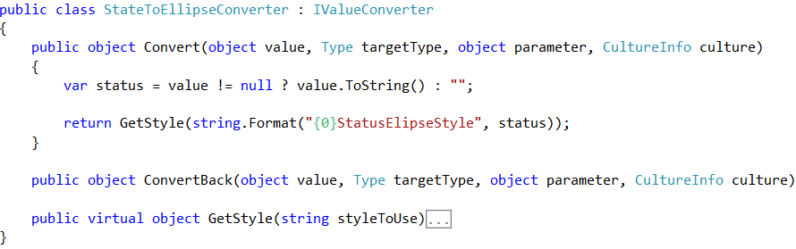
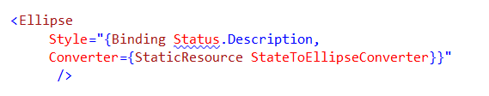
Changing Styles on the Fly
Custom Class implements IValueConverter
Silverlight Value Converter
XAML Implementation
Value to ‘test’ against
provided
Bound property to ‘test’ against
Invoking the IValueConverter

Slide 21
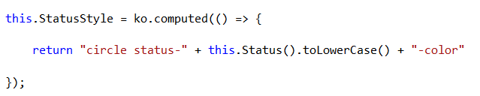

Changing Styles on the Fly
Knockout Computed Method
HTML Implementation
Computed Observable
Triggers off another Observable
Bound to the Observable
Uses the attr binding key

Slide 22
END OF Overview Slides

Slide 23
Agenda
Creating our View Model
Creating our HTML View
Fetching data via Ajax
Applying styles to an HTML element via Knockout
Formatting data via Computed Observables
Notes:
Now is the time to start having fun lets roll up our sleeves and begin cranking out code
[SHOW ANIMATION NOW]
We are going to start off by building our first real view model with knockout js and Typescript. We will compare the differences between a XAML View Model and a Knockout View Model in order understand where they are similar and where they are different.
[SHOW ANIMATION NOW]
Following this we will create our first view built using HTML. While building our HTML view we will take a look at the reference XAML application to see how our experience laying out views in XAML will actually help us while building HTML views
[SHOW ANIMATION NOW]
Next we will take a look at how to dynamically change the style of UI element by using knockout js. We will learn that although they way in which we change styles is different between XAML and HTML the concepts are 100% the same.
[SHOW ANIMATION NOW]
Finally we will complete this module by taking a look at how to use Ajax to query a Web Api endpoint. Once we have received the data from the api we will learn how to store our data in the view model so it can be displayed to the user.

Slide 24


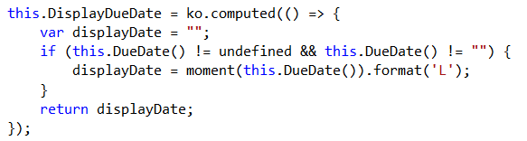
Formatting Data
Can use the built in StringFormat on bound field
Silverlight StringFormat
Knockout Formatting
Can bind to an observable
property
Create a Computed Field to do the formatting
Could also use Custom Bindings in Knockout.

Slide 25
END OF Overview Slides

