Slide 1
Maintaining Task ToDo Items – Part 1
Derik Whittaker
Twitter: @derikwhittaker
Notes:
Hello and welcome to module 4 of Html for the XAML developer
In this module we are going to shift our focus from fetching and listing our ToDo Items to being able to maintain them. We will learn the skills needed for you to be able to add new ToDo Items along with Maintain exiting ones.

Slide 2
Agenda
Creating our Maintenance Dialog
Building our HTML view
Setup our Maintenance View Model
Setting up the View Model
Working with Selection Options
XAML Combo box vs HTML Select
Working with Date Fields
Handling Date data types
Notes:
In this module we are going to take a look at 7 different areas.
[show animation]
The first thing we are going to do is build the raw html for our maintenance dialog. When building our html we will pay attention to how we can use the Twitter Bootstrap library provide some of our functionality
[show animation]
Next we will shift to working on our base view model. Initially we are going to create just a simple view model which we will extend in later lessons.
[show animation]
After this we are going to explore how to use knockout js to setup and populate or data selection combo boxes. When setting up these selection boxes we will learn how to bind a collection to the control as well as how to define which value it displays to the user.
[show animation]
Following this we are going to learn how to work with date fields in our data entry form. Dates can be painful as the built in support is not truly cross browser yet. We will take a look at 2 different ways to work with date controls in our lesson.

Slide 3
Agenda
Creating a new ToDo Item
Adding a new ToDo Item
Maintaining an existing ToDo Item
Editing an existing ToDo Item
Saving the ToDo Item
Performing an HTTP Post to save data
Notes:
[show animation]
We will continue on by learning how to setup our application to allow us to create a new ToDo item. In this we will setup our initial bindings for our data entry process
[show animation]
Next we will work on the ability to edit an existing ToDo item. Editing an item will involve making a remote fetch to get a clean, fully populated instance of our item prior to editing.
[show animation]
Finally we will learn how to save our new created or maintained todo item by doing an HTTP Post to our web api endpoint.

Slide 4
END OF Overview Slides

Slide 5
Agenda
Creating the Maintenance Dialog
Setting up the Maintenance View Model
Working with Selection Options
Working with Date Fields
Creating a new ToDo Item
Maintaining an existing ToDo Item
Saving the Data
Notes:
We should do 2 things before we get started building our maintenance dialog. First lets take a look at what we are planning to build so we will have a solid understanding of our objectives, and second we need to understand how to build this with HTML

Slide 6
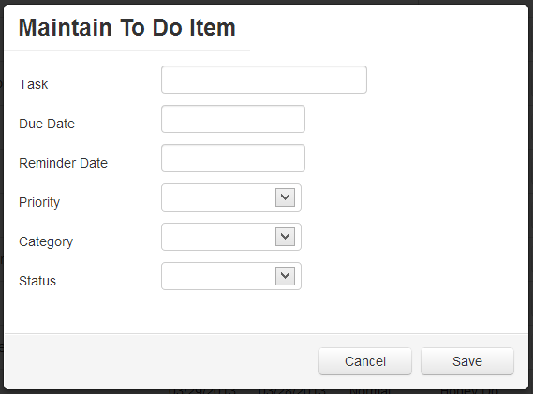
Creating the Maintenance Dialog
Hidden Div displayed
as dialog via
Bootstrap
Date Fields
Selection Dropdowns
Notes:
Here is what we expect to build by the end of this course.
[show animation]
Here is our end result dialog, which is a hidden div inside our main html file. This div will be displayed by using jQuery and Bootstrap. Inside this div we will have all the text entry fields needed in order to add or edit our content
[show animation]
As you can see here we have 2 date fields. In an upcoming lesson we are going to focus on how to handle data entry of dates in HTML as there are multiple ways we can work with date fields
[show animation]
We are also going to look at how we can use knockout to bind and populate a collection of data to Cour selection combo boxes.

Slide 7
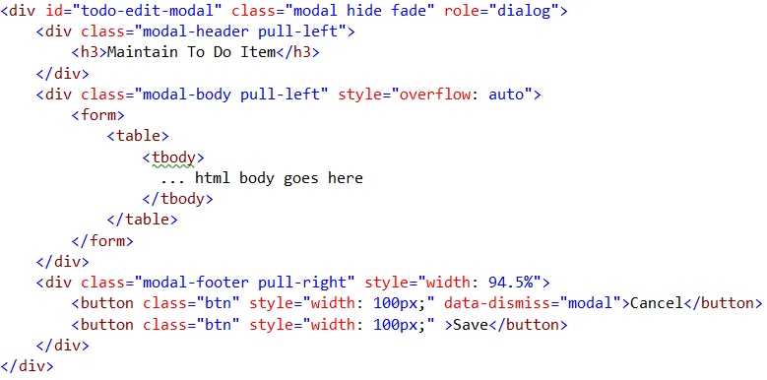
Creating the Maintenance Dialog
Unique name allows
us to interact w/ the
div
Dialog HTML
Bootstrap classes to
allow showing as a
dialog
Notes:
Here is a subset of our HTML dialog and there are 2 areas of interest we should pay attention to
[SHOW ANIMATION]
The first thing we should pay attention to is the ID of our div. This id is gong to be how we access and interact with this html segment
[Show animation]
The next thing we should look at is the various classes are being used in our div. All of these classes are from the twitter bootstrap library. I am not going to go very deep into how to use twitter bootstrap as there is already an excellent course on how to use Twitter bootstrap in the pluralsight library
[show animation]
The first class, modal, is used to provide styling information to our entire div when it is displayed
[show animation]
The next class, hide, will enable this div to be hidden by default, this is critical as we only want to show this markup when it is requested
[show animation]
The last class, fade, is used to handle the transition effects when the div is being displayed.

Slide 8
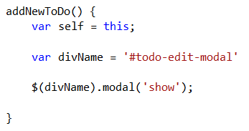
Creating the Maintenance Dialog
Showing the Dialog
Method to handle
our open click event
Name of our HTML
div which represents
our layout
Using jQuery and
Bootstrap to show
the div as a modal
Notes:
Now that we have a basic understanding of the html we are going to build, we might as well understand how we are going to display this markup to our user
[show animation]
The first thing we are going to need to do is create a method in our main view model. This method will be triggered by a click event and will display our markup to our users
[show animation]
Inside our method we need are first going to declare our div name, this is the ID attribute we looked at on the previous slide. The hash in front of the name is indicate to jQuery that we are trying to access a element by its ID value.
[show animation]
Next we need to use our div name to select our html, then instruct the modal method to show our div. The modal method is a javasript helper found in the bootstrap library

Slide 9
END OF Overview Slides

Slide 10
Agenda
Creating the Maintenance Dialog
Setting up the Maintenance View Model
Working with Selection Options
Working with Date Fields
Creating a new ToDo Item
Maintaining an existing ToDo Item
Saving the Data
Notes:
Now that we have shelled out our view, we need to spend some time on the views underlying view model

Slide 11
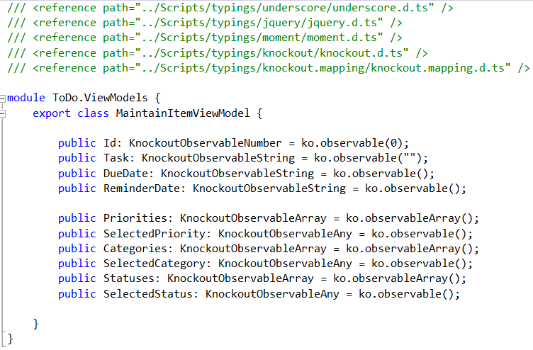
Setting up the Maintenance View Model
Add all of our Typescript
definition files
Create all our
observables
Notes:
Our initial view model is going to be pretty straight forward.
[show animation]
We are going to first add all our needed Typescript definition reference files.
[show animation]
Next we are going to create our various properties needed to handle our user input. Some of these properties will be simple observables and others will be arrays used for our selection drop downs

Slide 12
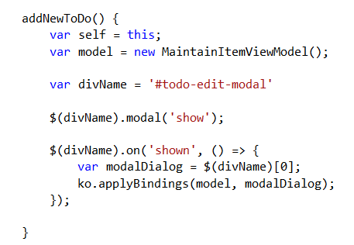
Setting up the Maintenance View Model
Binding our model to the View
Update our addNewToDo
logic to bind our editable
view model
Bind our new ViewModel
to our view
Notes:
We that we have our shell view model created, now we need to bind it to our view
[show animation]
We are going to go back to ur addNewToDo method which is in our main view model and extend it just a bit.
[show animation]
We are going to need to create an instance of our maintain item view model. Once we have an instance of our view model created, we need to create listener for the ‘shown’ event for our modal dialog. Inside our event handler we will bind our view to the html by using applybindings. This time we will not only provide our view model, but also the html element we want to bind to.

Slide 13
END OF Overview Slides

Slide 14
Agenda
Creating the Maintenance Dialog
Setting up the Maintenance View Model
Working with Selection Options
Working with Date Fields
Creating a new ToDo Item
Maintaining an existing ToDo Item
Saving the Data
Notes:
Now that we have our view and view model setup, we need to spend some time working on getting our Selection Dropdowns to populate correctly

Slide 15
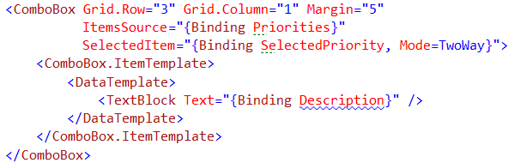
Working with Selection Options
Defining our Selection box in XAML
We bind to our underlying
Collection for display
We bind to a Selected Item
property for usage later
We setup our datatemplate
to display the correct
property on the object
Notes:
When using a selection combo in XAML your markup may look something like you see here
[show animation]
You would bind your itemsource to some collection on your view model, this wll populate the combo box.
[show animation]
Next you would setup the SelectedItem binding in order to store the selected item. You would also have to remember to set the mode == to twoway
[show animation]
Finally, if you are bound to a collection of objects, you will most likely create a data template to define which property, or properties, you want displayed for each instance of the underlying collection.

Slide 16
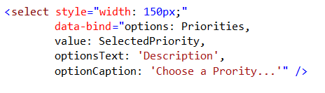
Working with Selection Options
Defining our Selection box in HTML
We bind to our underlying
Collection for display
We bind to a Selected Item
property for usage later
We setup to bind to the
correct property for
display
Notes:
When using a selection combo in HTML with knockout your markup may look something like you see here
[show animation]
You would use the options binder to bind a collection in your viewmodel to your selection box.
[show animation]
Next you would use the value binder to specify where in your view model to store the value of the selected item.
[show animation]
Finally, you would use the optionsText binder to specify which observable to use when displaying data for each item in the collection.

Slide 17
END OF Overview Slides

Slide 18
Agenda
Creating the Maintenance Dialog
Setting up the Maintenance View Model
Working with Selection Options
Working with Date Fields
Creating a new ToDo Item
Maintaining an existing ToDo Item
Saving the Data
Notes:
Now that we have our view and view model setup, we need to spend some time working on getting our Selection Dropdowns to populate correctly

Slide 19
Working with Date Fields
Using Date in XAML
Built in Date Control
Bind to the Date Property
on the View Model
Notes:
[show animation]
In Silverlight you would use an IValueConverter to toggle visibility state and the code would look something like you see here on screen
[show animation]
The converter you see here will accept a value provided to it via the bound property and will return the correct visibility status based on the evaluation of that value.

Slide 20


Working with Date Fields
Using Date in HTML – Option 1
Input control w/ a type of
Date
Bind to the DueDate
on the View Model
Input type=“Date” is a new HTML 5 standard and is not supported in IE or Firefox
as well as in older browsers
Notes:
[show animation]
In Silverlight you would use an IValueConverter to toggle visibility state and the code would look something like you see here on screen
[show animation]
The converter you see here will accept a value provided to it via the bound property and will return the correct visibility status based on the evaluation of that value.

Slide 21


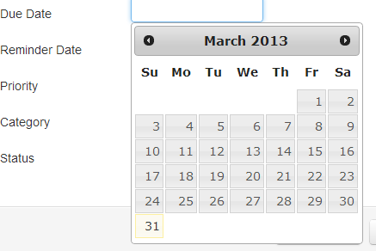
Working with Date Fields
Using Date in HTML – Option 2
Input control w/ a type of
Text, the default
Bind to the DueDate
on the View Model
Use jQuery UI to create and format the date picker
What the picker looks like
Notes:
[show animation]
In Silverlight you would use an IValueConverter to toggle visibility state and the code would look something like you see here on screen
[show animation]
The converter you see here will accept a value provided to it via the bound property and will return the correct visibility status based on the evaluation of that value.

Slide 22
END OF Overview Slides

Slide 23
Agenda
Two Way, Real Time, Text Binding
Client Side Filtering
Advanced UI Styling
Visibility State of UI elements
Deleting Data
Computed Totals
Notes:
In most applications there will be a need to delete application data. We are going to take a look at how we would delete data via an HTTP post using jquery and ajax. We will compare how this would be accomplished if we were doing this in silverlight

Slide 24
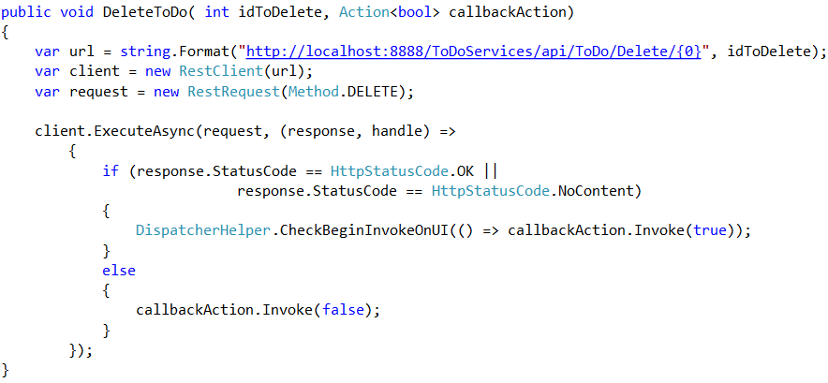
Deleting Data
Making the call in Silverlight
Service to perform the delete
Client to make the service call
Evaluate the response and take some action
Notes:
If you are using Silverlight and needed to make an http post you may have code which looks a bit like you see here
[show animation]
The first thing we would need to do is determine the http endpoint to call in order to perform our delete
[show animation]
Next we would need to create some sort of connection to this endpoint, here we are using Rest client which is a .net library for working with restful end points
[show animation]
Finally we would make the call asynchronisly and would wait for the response. Once we received our call back we would check some status indicator in order to process the result. Depending on the returned status we would either process he results successfully or handle some sort of error condition.

Slide 25
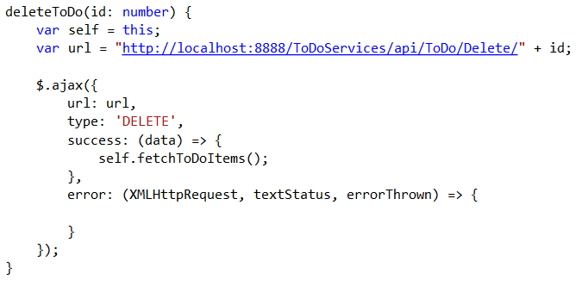
Deleting Data
Making the call in Typescript
Service to perform the delete
Make the call via jQuery and Ajax
Evaluate the response and take some action
Notes:
When using Typescript and jQuery our code would look quite similar to that in c# and Silverlight.
[show animation]
We still need to know the address of our end point to connect to.
[show animation]
We would need to use some library to make our remote call to perform the action, in our case we are going to use the jquery ajax library
[show animation]
Finally you would need to process the results from the call. Again based on the status returned you would either handle successful results or process some sort of failure.

Slide 26
END OF Overview Slides

Slide 27
Agenda
Two Way, Real Time, Text Binding
Client Side Filtering
Advanced UI Styling
Visibility State of UI elements
Deleting Data
Computed Totals
Notes:
When building applications often times you will be needed to calculate summary data to display to the users. We are going to take a look at how we can use our javascript skills to accomplish this in html.

Slide 28
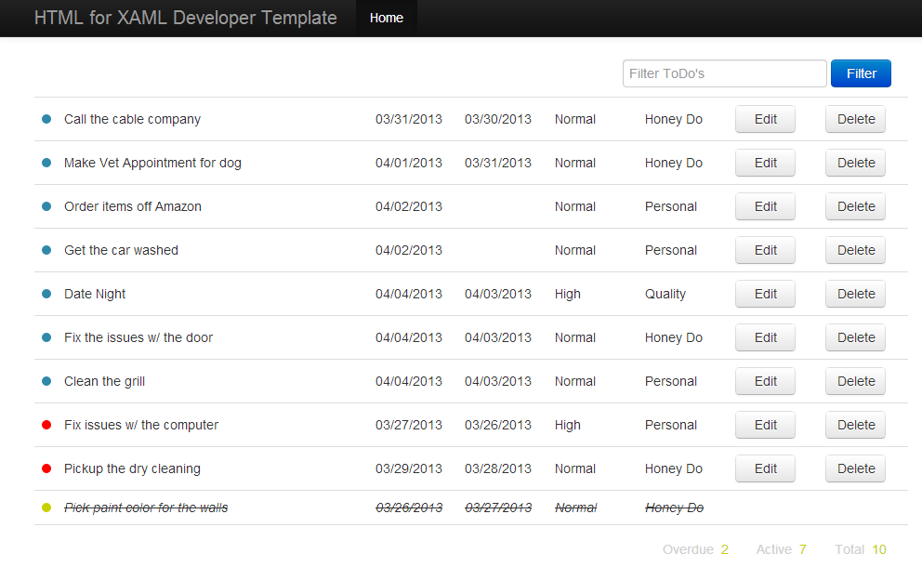
Computed Totals
Notes:
If we review our final application one more time, you should notice down at the bottom of the screen we are going to calculate totals for out ToDo items. We want to be able to display to our users how mean items are currently in each state. We are going to use both knockout js as well as underscore js to accomplish this.

Slide 29

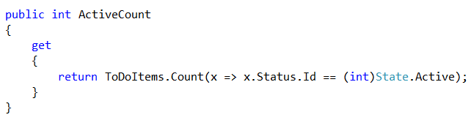
Computed Totals
Computing totals in Silverlight View Model
Raise Notifications to the UI to rebind the properties
Backing field to calculate the summary values
Notes:
When computing totals in a xaml view model there are 2 things you need to do.
[show animation]
The first thing you are going to have to do is signal to the UI that your backing property has been updated. You would do this wen the underling collection which holds your data has been modified.
[show animation]
The next thing you need to do is create your computed total property. Inside your property you typically have logic as you see here which will perform a count on your collection via linq and return this computed value so it can be bound to the UI.

Slide 30

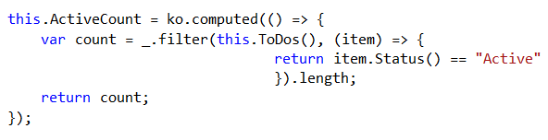
Computed Totals
Computing totals in Typescript View Model
Declare our Knockout computed fields
Computed field using underscore JS to summarize the value
Will recalculate when the ToDo’s collection is modified
Notes:
When computing totals with knockout in your typescript view model there are 2 things you need todo.
[show animation]
The first thing you are going need to do is create your knockout computed property. This is the property which is going to be bound to your UI to display the values
[show animation]
The next thing you need to do is implement your computed value. In our computed value we are going to use the filter method which comes with underscore js to calculate the totals. , this is the magic sauce needed to replace your linq statement,.
[show animation]
One more thing I would like to point out is that unlike in xaml there is no need to directly signal the UI to rebind to the computed objservable, This is because when you create a computed observable in knockout it will rebind every time an observable inside the computed value is updated. This is great because it removes some noise from your view model.

Slide 31
END OF Overview Slides

Slide 32
Summery
Learned how to setup Two Way, Real Time, Text Binding
Learned how to do Client Side Filtering
Learned another way to apply styles to your UI elements
Learned how to toggle visibility state of UI elements
Learned how to make http posts to Deleting Data
Learned how to create Computed Totals
Notes:
In this module we continued working on our ToDo listing screen to implement some of the more advanced features.
These items included
Learning how to setup 2way, real time binding in knockout to update your backing properties.
Next we learned how to use knockout and underscore js to enable filter of data on the client..
After this explored another way to use knockout to dynamically update the look and feel of your application by creating a custom binding.
Following this we explored how to toggle the visibility state of a UI element by using the visible binding in knockout.
We then went on to learn how to make HTTP posts in jquery to hit a remote web api endpoint to delete some data.
Finally we rounded out the module by learning how to use knockout to compute summary for our todo listing
In the next module we will focus on learning how we can edit and maintain our individual todo items.

