Slide 1
Porting the ToDo Listing Screen
Derik Whittaker
Notes:
Hello and welcome to module 2 of Html for the XAML developer
In this module we will kick off our transition from being a XAML developer to an HTML developer by getting our hands dirty and pounding out some code. We will start by focusing on the skills need to port a potion of the ToDo listing screen over to HTML. This will be the first of 2 modules focused solely on this screen.

Slide 2
Agenda
Create our first Knockout View Model
Knockout vs XAML ViewModel
Create our first HTML View
Compare layout in HTML vs XAML
Fetch data via ajax from our Web API endpoint
Ajax vs HttpClient
Apply styles to an HTML element via Knockout
Knockout css binding vs StyleConverters
Formatting data via Computed Observables
Knockout computed vs Formatters
Notes:
Now is the time to start having fun lets roll up our sleeves and begin cranking out code
[SHOW ANIMATION NOW]
We are going to start off by building our first real view model with knockout js and Typescript. We will compare the differences between a XAML View Model and a Knockout View Model in order understand where they are similar and where they are different.
[SHOW ANIMATION NOW]
Following this we will create our first view built using HTML. While building our HTML view we will take a look at the reference XAML application to see how our experience laying out views in XAML will actually help us while building HTML views
[SHOW ANIMATION NOW]
Next we will take a look at how to dynamically change the style of UI element by using knockout js. We will learn that although they way in which we change styles is different between XAML and HTML the concepts are 100% the same.
[SHOW ANIMATION NOW]
Finally we will complete this module by taking a look at how to use Ajax to query a Web Api endpoint. Once we have received the data from the api we will learn how to store our data in the view model so it can be displayed to the user.

Slide 3
END OF Overview Slides

Slide 4
Implementing our View Model
No need to implement INotifyPropertyChanged
No need to raise Property Changed events on each property
Properties must be Knockout Observables to be found
Knockout Observables are treated as methods not as ‘properties’

Slide 5
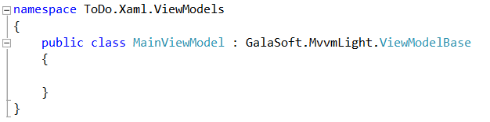
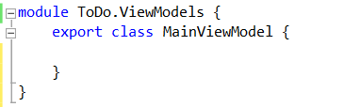
Our First View Model
Silverlight View Model
Typescript View Model
Implements
INotifyPropertyChanged
No need to implement
INotifyPropertyChanged
Notes:
[SHOW ANIMATION]
Here is a View Model declaration, this is something you should be very familiar with. We have a namespace declared along with a class
[SHOW ANIMATION]
You can see that this class inherits off a base view model, in our case a VM from the MVVM light framework. What makes the fact that this view model inherits off a base VM special is the fact that what we are really trying do is have our Vm implement the INotifyPropertyCHanged interface. The INotifyPropertyChanged interface is the mechanism in XAML which allows binding to work.
How would we implement our View Model in the HTML world using typescript?
[SHOW ANIMATION]
If we look at our View Model declaration now, this should look similar to you, but with out one little detail.
[SHOW ANIMATION]
There is no need to implement INotifyPropertyChanged. The reason we do not need to do anything special is because Knockoutjs is going to handle all this for us. This removes the need for us to clutter up our classes and allows us to have cleaner code to work.
As you can see, declaring a view model in xaml is pretty much identical to how you would declare on in Typescript

Slide 6
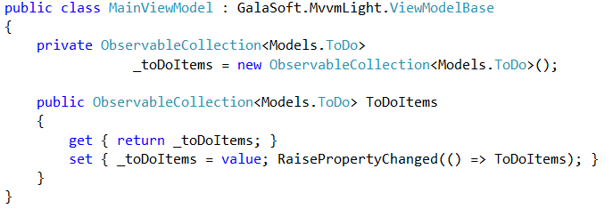

Our First Observable Property
Silverlight Property
Typescript View Model w/ Knockout js
Implements
Observable Collection
Must manually raise
Property Changed
Implements
Observable Array
No need to raise any
Property Changed
Notes:
We have created our View Model, but what good is a View model if we do not have any properties or method in it.
[SHOW ANIMATION]
In Silverlight if you were to create a property and make it observable you would have something as you see now.
[Show animation]
We would have a property backing field which is an observable collection. This means we are not able to use an auto property in our VM which really is a shame.
[show animation]
The setter of our preoprty would also need to some how raise a notification changed event to signal to the UI that something has changed. This is done here via the RaisePropertyChanged method which is a helper method that is part of MVVM light.
How would we implement our Property in the HTML world using Knockout js?
[show animation]
In the Typescript/knockout world we would still have to declare our property
[show animation]
And this property would have to be an observable.
[show animation]
However, unlike in XAML there is NO need to have a backing field OR to manually have to signal that our property has changed, all of this is taken care of for you via knockout.
As you can see the implementation of a property is a bit different between XAML and Typescript w/ knockout. But different in a good way if you ask me. I have never liked the fact that I have to go through the ceremony of raising changed events and with knockout I do not need to

Slide 7

Breaking down our Observable Property
Property Name
Property Initializer
Property Type

Slide 8
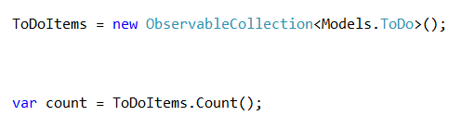
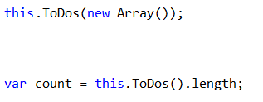
Using an Observable Property
Silverlight Property
Typescript View Model w/ Knockout js
Sets Value
Gets Value
Sets Value
Gets Value
Notice we access these like methods NOT properties

Slide 9
END OF Overview Slides

Slide 10
Implementing our View

Slide 11
END OF Overview Slides

Slide 12
Fetching Remote Data

Slide 13
END OF Overview Slides

Slide 14
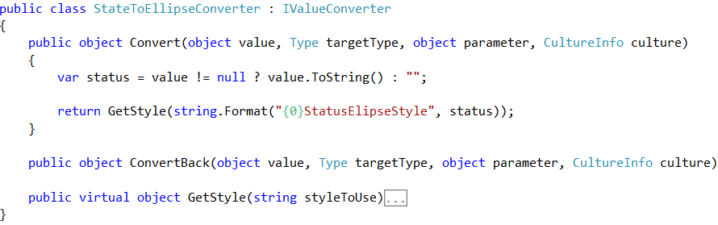
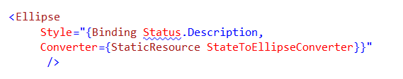
Changing Styles on the Fly
Custom Class implements IValueConverter
Silverlight Value Converter
XAML Implementation
Value to ‘test’ against
provided
Bound property to ‘test’ against
Invoking the IValueConverter

Slide 15
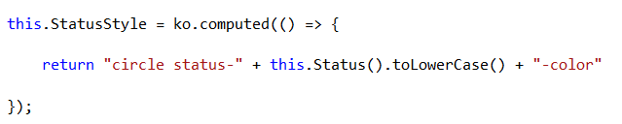

Changing Styles on the Fly
Knockout Computed Method
HTML Implementation
Computed Observable
Triggers off another Observable
Bound to the Observable
Uses the attr binding key

Slide 16
END OF Overview Slides

Slide 17
Formatting Data

Slide 18
END OF Overview Slides

