Slide 1
Solving Quadratic Equations
Dmitri Nesteruk
@dnesteruk

Slide 2
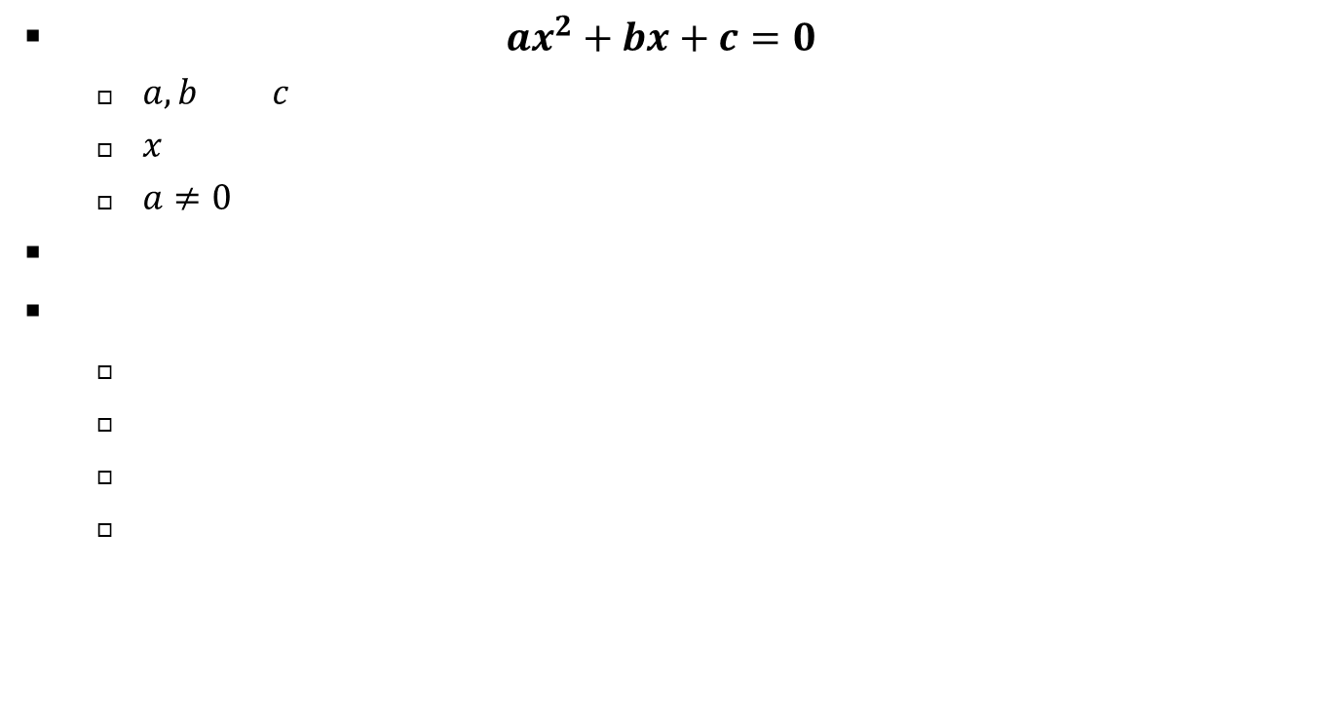
What is a Quadratic Equation?
An equation in the form $ax^{2}+bx+c=0$
  $a, b$ and $c$ are constants
  $x$ is the value to be determined
  $a≠0$
First attempted by Babylonians in 3000BC
Typical uses
  Projectile trajectories
  Investment models over two time periods
  Sound propagation
  Higher-level math stuff (e.g., differential equations)

Slide 3
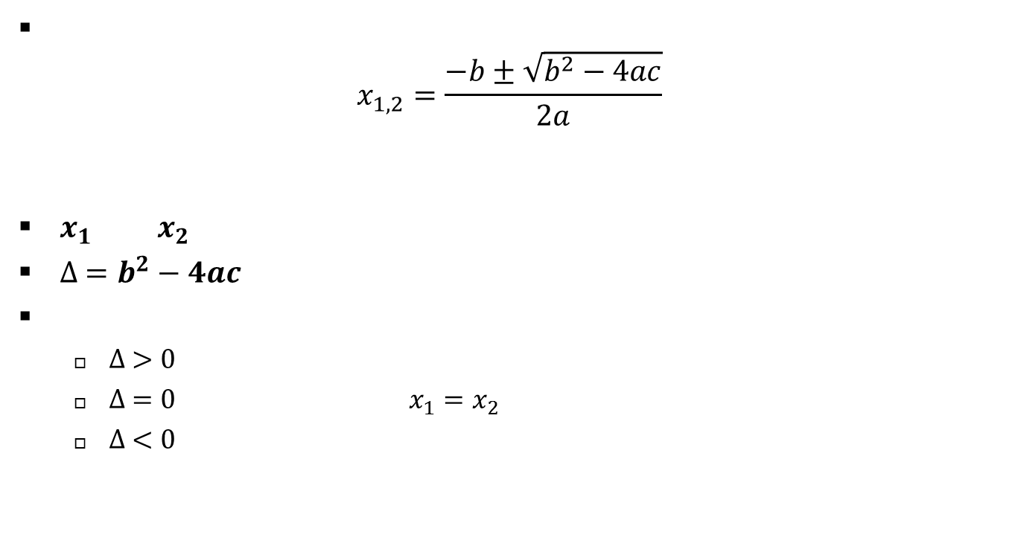
Solving the Quadratic Equation
General solution is
$x_{1,2}=\frac{−b±\sqrt{b^{2}−4ac}}{2a}$
$x_{1}$ and $x_{2}$ are the roots of the equation
${∆ =b}^{2}−4ac$ is called the discriminant
Determines what roots the equation has
  $∆ >0$ – two real roots
  $∆ =0$ – one real root (i.e., $x_{1}=x_{2}$)
  $∆ <0$ – two complex roots

Slide 4
That’s it!
a=1;b=10;c=16;
syms x
solve(a*x*x+b*x+c)
>>
ans =
-2
-8

