Slide 1
Porting the ToDo Listing Screen – Part 2
Derik Whittaker
Twitter: @derikwhittaker
Notes:
Hello and welcome to module 3 of Html for the XAML developer
In this module we are going to continue to focus on the ToDo Listing screen. However this time we are going to focus on the secondary items on the screen such as the filtering of data and more styling. Lets go ahead and get started.

Slide 2
Agenda
Handling Real Time Two way text binding
Knockout valueUpdate vs XAML Behaviors
Filtering Client Side Data
Knockout View Model vs XAML View Model
Knockout Click Binding vs ICommand
Advanced UI Styling
Knockout Custom Bindings vs. Style Converter
Notes:
In this module we are going to take a look at 6 different areas.
[show animation]
The first thing we are going to do is take a look at how to handle 2 way text binding along w/ real time text bindng. We will compare how we can do this with XAML bindings to how we can accomplish this with knockout
[show animation]
Next we will learn how to filter our data on the client side. We will compare the filter via knockout and javasript to how we would do it if we were in our C# View model
[show animation]
After this we explore another way in which we can dynamically apply styles to our ui. We will compare this new method in knockout to the how it could be done by using a style converter

Slide 3
Agenda
Handling Visible State
Knockout Visible vs Visibility Converter
Deleting Client Side Data
Ajax Posting to Web API end point
Computed Totals
Knockout Computed vs View Model Properties
Notes:
[show animation]
We will continue on by learning how to handle visibility state in our application. We will compare how we knockout to toggle visibility to how we can do it by using a value converter in our xaml application.
[show animation]
Next we will take a look at how to delete our data by using Ajax and Web Api.
[show animation]
Finally we will take a look at how we can use computed values to generate a summary field in our application. We will compare the difference between using knockout to compute our values to using a View Model property in Silverlight.

Slide 4
END OF Overview Slides

Slide 5
Agenda
Two Way, Real Time, Text Binding
Client Side Filtering
Advanced UI Styling
Visibility State of UI elements
Deleting Data
Computed Totals
Notes:
It is time to take get our hands dirty again and take a look at how we can handle two way text binding as well as real time when using Knockout. Handing user input via knockout is very , in fact our binding is 2 way be default, which unlike the default in Silverlight. However, like in Silverlight, our update bindings will NOT fire until you leave the text field, which is a pain, however this is an easily solvable problem.

Slide 6
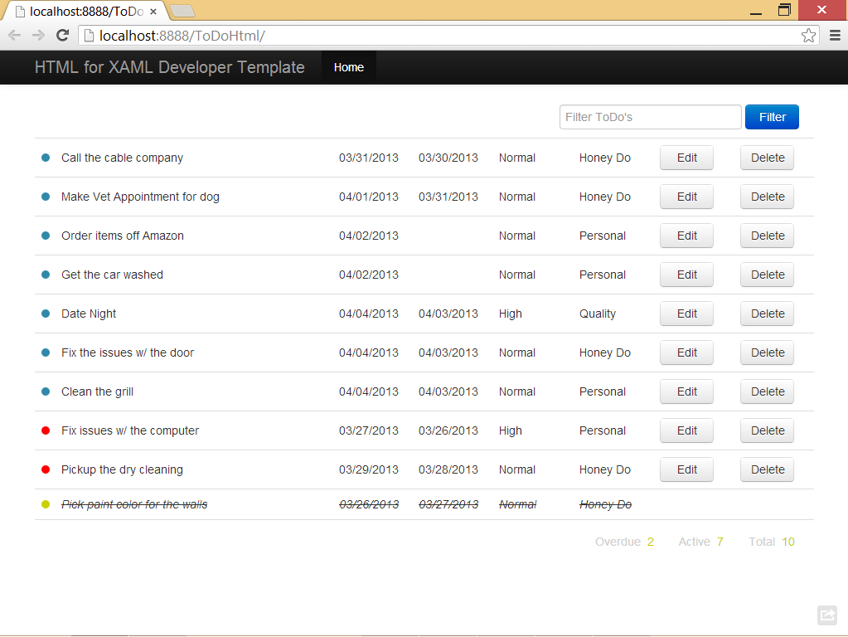
Two Way, real time Text Binding
Notes:
[show animation]
If we take a look at what we expect to build by the end of this module you should notice we are going to have a filter text box which will allow our users to filter our ToDo data on the client. This filter box is going to be our focus right now.

Slide 7


Two Way Text Binding
Setup Binding to our
backing property
Silverlight Text Binding
Knockout/Html Text Binding
Have to explicitly set the
Mode to TwoWay
Setup binding via
data-bind
No need to explicitly set
binding mode
Notes:
[SHOW ANIMATION]
When setting up text binding in Silverlight your code will look something like we see here
[Show animation]
We would setup our binding to our given backing field.
[show animation]
Next we would have to explicitly set our Mode to be TwoWay if we want our text changes to be pushed back into our backing property. This works great, but given that this is not the default mode for text binding it often causes developers to spin their wheels wondering why their text input is not being pushed into their backing property because the forgot to explicitly set the TwoWay mode.
[show animation]
When doing binding with Knockout in Html you would have something like you see now.
[show animation]
You need to setup your binding via the data-bind attribute as well as use the value binder.
[show animation]
But notice, unlike in xaml, there is no need to explicitly set the mode to be 2way as this is the default with knockout.

Slide 8
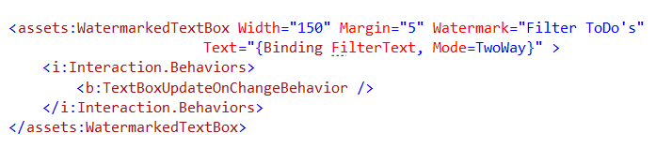

Real Time Binding Update
Silverlight Immediate Update
Knockout Immediate Update
Need to implement a custom behavior
Wire to the valueUpdate browser event
Possible Events:
keyup
keypress
afterKeyDown
User releases a key
Like keyup, but will repeat if key is held
As user types – Best Choice for real-time
Notes:
[show animation]
In xaml applications if you want your bindings to fire in real time rather then when the control loses focus you need to implement custom behaviors to handle this for you.
[show animation]
As you can see here we have a TextBoxUpdateOnChangeBehavior which will listen for the key press events and will manually push the updated text to the underlying view model. This is not too bad because it is an abstracted problem and there is no need to put this inside your view model. However, IMO this is a classic example of something that is simply not needed and introduces ceremony.
[show animation]
When using Knockout there is still some ceremony, but there is no need to create a custom code to handle this ceremony.
[show animation]
All we need to do in knockout is to use the valueUpdate binding and tell it when we want to update. IN our example we are going to use the ‘afterKeyDown’ handler which is the prefered best choice.
[show animation]
Although afterKeyDown is the preferred way to accomplish this, there are 3 total options. The first being on key up, which is when the user releases a key
[show animation]
The next on is keyPress, which is like key up but allows for repating updates if you continue to hold the key down.
[show animation]
The last option, the one we chose, is afterKeyDown. This will fire as the user is typing and will update in real time.

Slide 9
END OF Overview Slides

Slide 10
Agenda
Two Way, Real Time, Text Binding
Client Side Filtering
Advanced UI Styling
Visibility State of UI elements
Deleting Data
Computed Totals
Notes:
Now that we know how to handle 2way binding with real time updating to our view model we should take a look at how to use this in conjunction with client side data filtering.

Slide 11
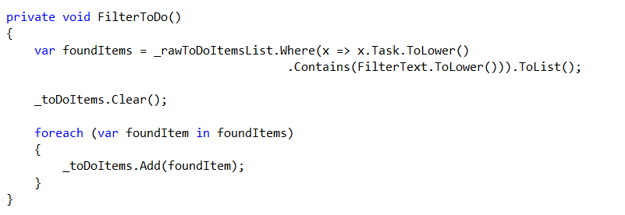
Filtering Client Side Data
Silverlight View Model
Use Linq to filter our data
Set the results to the
bound collection
Notes:
[show animation]
When wanting to do data filtering in your view model you may have some code that looks like you see here
[show animation]
We would take our data listing and use Linq to filter it down based on the filter text provided by the users
[show animation]
Once we have our filtered data we just simply need to add it to our bound collection.

Slide 12
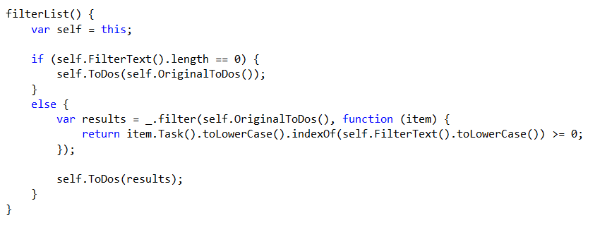
Filtering Client Side Data
Knockout View Model
Use underscore.js to filter
Our data
Set the results to the
bound collection
Notes:
[show animation]
When doing this inside our TypeScript view model the code would look something as you see here
[show animation]
Sadly we cannot use Linq in javascript, however the next best thing is the Underscore js library. This library has a filter method which will reduce a list in the same manor as Linq.
[show animation]
Once we have filtered our list via the filter method all we need to do is populate our underlying list of ToDo’s. By pushing our results into our bound collection our UI will be updated to reflect our new list of ToDo’s

Slide 13
END OF Overview Slides

Slide 14
Agenda
Two Way, Real Time, Text Binding
Client Side Filtering
Advanced UI Styling
Visibility State of UI elements
Deleting Data
Computed Totals
Notes:
In a module 2 we took a look at how to change a UI style by using a custom observable. Now we are going to look at a different, more reusable way to accomplish this task now by creating a custom knockout binding.

Slide 15
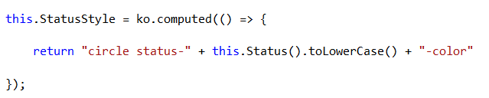
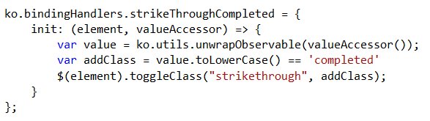

Changing Styles w/ Custom Bindings
Changing Styles via Computed Observables
Changing Styles via Custom Binding
Computed Observable
Add a new Binding to Knockout
Change our underlying style via some logic
Notes:
[show animation]
In the previous module we saw how we could use Computed Observables to return a string which would be put into the class attribute in HTML. The problem with this is that this is not highly reusable and is constrained to a single view model
[show animation]
If we wanted to perform this same action but in a highly reusable way we could use Custom Knockout Bindings.
[show animation]
To create a custom bindings we need to add a new item to the ko.bindingHandlers collection. After we add this we can now use this binding in HTML throughout our application.
[show animation]
Once we have declared our binding we need to implement the init method on the binding. Our Init method accepts 2 arguments, the UI element and its value. This is great because it allows us evaluate a value and take some action on our underlying HTML element.
[show animation]
Implementing our new binding is done using the exact same syntax as other binders such as Value or Text.

Slide 16
END OF Overview Slides

Slide 17
Agenda
Two Way, Real Time, Text Binding
Client Side Filtering
Advanced UI Styling
Visibility State of UI elements
Deleting Data
Computed Totals
Notes:
When building XAML based applications it is very common to use a Boolean to visibility converter to drive the visibility of your UI elements based on a property in your view model.. We can accomplish this same result via knockout but with less code.

Slide 18
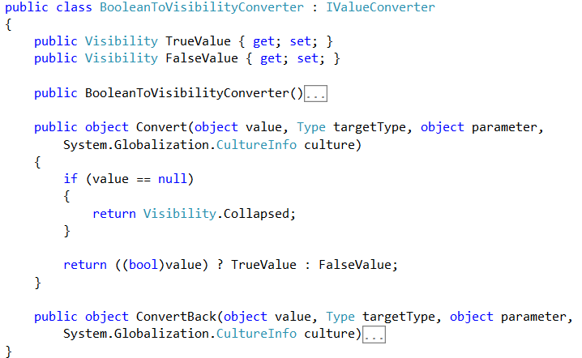
Visibility State of UI Elements
Boolean to Visibility Converter
Typical Boolean to visibility converter
Notes:
[show animation]
In Silverlight you would use an IValueConverter to toggle visibility state and the code would look something like you see here on screen
[show animation]
The converter you see here will accept a value provided to it via the bound property and will return the correct visibility status based on the evaluation of that value.

Slide 19

Visibility State of UI Elements
Visibility binding in Knockout
Use the Visible binding
Statement being evaluated to determine visibility.
This evaluates via the truthly/falsy concepts in JavaScript
Notes:
[show animation]
To accomplish the same result in knockout you would create html like you see here on screen
[show animation]
Knockout has a visible binding which will toggle the associated html DOM element to either be visible or hidden
[show animation]
When using visible binding, you need to provide a statement to be evaluated. In our example we are going to evaluate a text property to see if it matches a predetermined value. There is one special thing should understand about the way this evaluates and that is this does not follow strict true/false lines. This follows the javascript truthly falsly concept which basically means that if it appears true by either having a true Boolean, a true string or a non 0 value it will evaluate as true. However, if it appears false, by either being false, 0, null or undefined value it will resolve to false.

Slide 20
END OF Overview Slides

Slide 21
Agenda
Two Way, Real Time, Text Binding
Client Side Filtering
Advanced UI Styling
Visibility State of UI elements
Deleting Data
Computed Totals
Notes:
In most applications there will be a need to delete application data. We are going to take a look at how we would delete data via an HTTP post using jquery and ajax. We will compare how this would be accomplished if we were doing this in silverlight

Slide 22
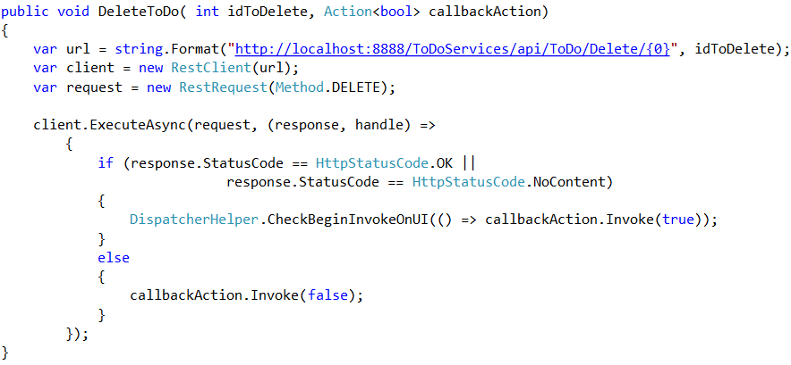
Deleting Data
Making the call in Silverlight
Service to perform the delete
Client to make the service call
Evaluate the response and take some action
Notes:
If you are using Silverlight and needed to make an http post you may have code which looks a bit like you see here
[show animation]
The first thing we would need to do is determine the http endpoint to call in order to perform our delete
[show animation]
Next we would need to create some sort of connection to this endpoint, here we are using Rest client which is a .net library for working with restful end points
[show animation]
Finally we would make the call asynchronisly and would wait for the response. Once we received our call back we would check some status indicator in order to process the result. Depending on the returned status we would either process he results successfully or handle some sort of error condition.

Slide 23
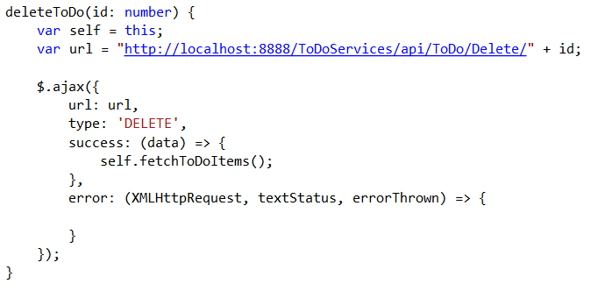
Deleting Data
Making the call in Typescript
Service to perform the delete
Make the call via jQuery and Ajax
Evaluate the response and take some action
Notes:
When using Typescript and jQuery our code would look quite similar to that in c# and Silverlight.
[show animation]
We still need to know the address of our end point to connect to.
[show animation]
We would need to use some library to make our remote call to perform the action, in our case we are going to use the jquery ajax library
[show animation]
Finally you would need to process the results from the call. Again based on the status returned you would either handle successful results or process some sort of failure.

Slide 24
END OF Overview Slides

Slide 25
Agenda
Two Way, Real Time, Text Binding
Client Side Filtering
Advanced UI Styling
Visibility State of UI elements
Deleting Data
Computed Totals
Notes:
When building applications often times you will be needed to calculate summary data to display to the users. We are going to take a look at how we can use our javascript skills to accomplish this in html.

Slide 26
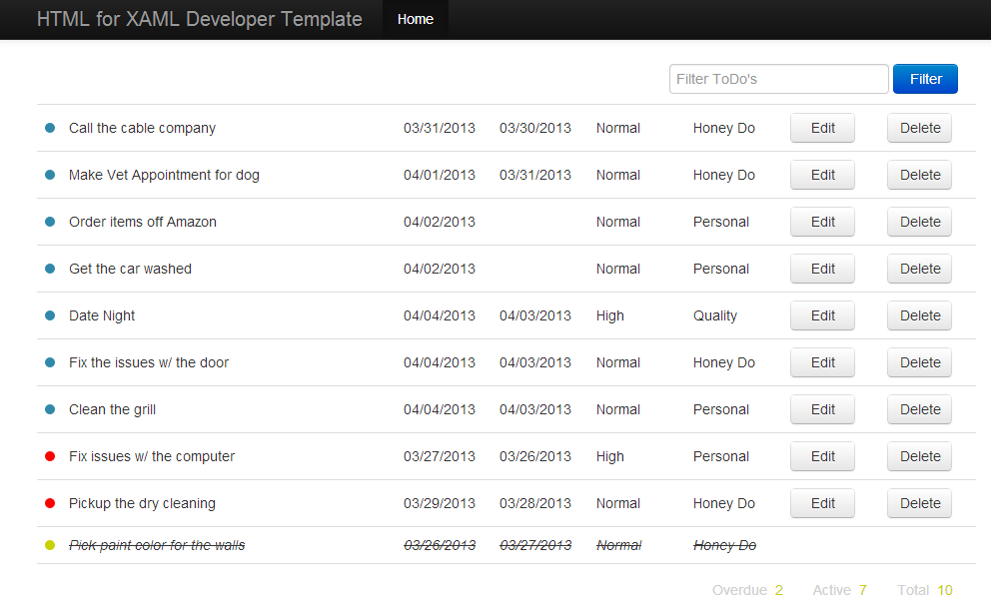
Computed Totals
Notes:
If we review our final application one more time, you should notice down at the bottom of the screen we are going to calculate totals for out ToDo items. We want to be able to display to our users how mean items are currently in each state. We are going to use both knockout js as well as underscore js to accomplish this.

Slide 27

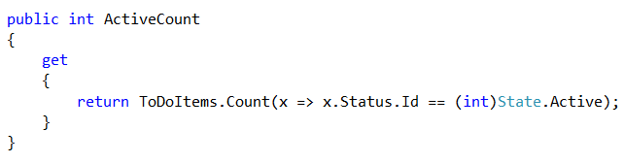
Computed Totals
Computing totals in Silverlight View Model
Raise Notifications to the UI to rebind the properties
Backing field to calculate the summary values
Notes:
When computing totals in a xaml view model there are 2 things you need to do.
[show animation]
The first thing you are going to have to do is signal to the UI that your backing property has been updated. You would do this wen the underling collection which holds your data has been modified.
[show animation]
The next thing you need to do is create your computed total property. Inside your property you typically have logic as you see here which will perform a count on your collection via linq and return this computed value so it can be bound to the UI.

Slide 28

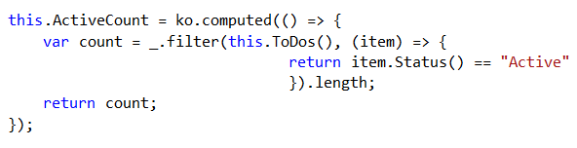
Computed Totals
Computing totals in Typescript View Model
Declare our Knockout computed fields
Computed field using underscore JS to summarize the value
Will recalculate when the ToDo’s collection is modified
Notes:
When computing totals with knockout in your typescript view model there are 2 things you need todo.
[show animation]
The first thing you are going need to do is create your knockout computed property. This is the property which is going to be bound to your UI to display the values
[show animation]
The next thing you need to do is implement your computed value. In our computed value we are going to use the filter method which comes with underscore js to calculate the totals. , this is the magic sauce needed to replace your linq statement,.
[show animation]
One more thing I would like to point out is that unlike in xaml there is no need to directly signal the UI to rebind to the computed objservable, This is because when you create a computed observable in knockout it will rebind every time an observable inside the computed value is updated. This is great because it removes some noise from your view model.

Slide 29
END OF Overview Slides

Slide 30
Summery
Learned how to setup Two Way, Real Time, Text Binding
Learned how to do Client Side Filtering
Learned another way to apply styles to your UI elements
Learned how to toggle visibility state of UI elements
Learned how to make http posts to Deleting Data
Learned how to create Computed Totals
Notes:
In this module we continued working on our ToDo listing screen to implement some of the more advanced features.
These items included
Learning how to setup 2way, real time binding in knockout to update your backing properties.
Next we learned how to use knockout and underscore js to enable filter of data on the client..
After this explored another way to use knockout to dynamically update the look and feel of your application by creating a custom binding.
Following this we explored how to toggle the visibility state of a UI element by using the visible binding in knockout.
We then went on to learn how to make HTTP posts in jquery to hit a remote web api endpoint to delete some data.
Finally we rounded out the module by learning how to use knockout to compute summary for our todo listing
In the next module we will focus on learning how we can edit and maintain our individual todo items.

