Slide 1
Knockout for the XAML developer Working with Input Control
Derik Whittaker
@DerikWhittaker
Notes:
Hello and welcome to module 2 of knockout for the xaml developer, I am your host Derik Whittaker.
We are going to focus our efforts in this module on learning to work with data input controls. We start w/ in put controls as they are the basis for pretty much everything we are going to talk about in this course. When looking at each of our input controls we will show the XAML equivalent syntax along side with the knockout/html syntax in order to level the playing field

Slide 2
Agenda
Text Input Binding
Demo: Basic Bindings
Demo: Value Update Binding
Display Text Binding – Text Binder
Demo: Basic Binding
Demo: Binding without an HTML control
Checkbox/Radio Button Binding – Checked Binder
Demo: Basic Bindings
Selection Binding – Options Binder
Demo: Basic Bindings
Demo: Multi-Select Bindings
Notes:
In this module we are going to cover the basics in regards to working with data –input controls in knockout in an MVVM manor.
[show animation]
The first control we are going to look at is the text input control When looking at this control we will first learn how to setup basic bindings in order to push data from our view model into the control. We will then learn how to we can setup our bindings in order to enable realtime, bi-directional binding between the view and the view model.
[show animation]
The next set of controls we are going to learn about are text display controls. These are controls which do not allow the user to edit data only to view it. In xaml this would be the textblock control while in HTML we will look at the span control, the paragraph control as well as how to bind directly to raw HTML
[show animation]
After this we will explore how to bind to Boolean based controls. These controls consist of the radio button and the check box.
[show animation]
Finally we will wrap up this module by learning how to bind to selection box controls. In xaml this would be the combo box and in html this is the select control. When learning how to setup our bindins to thie controls we will learn not only how to setup basic bindings but we will also learn how to support multi-select bindings.

Slide 3
END OF Overview Slides

Slide 4
Agenda
Text Input Binding - Value Binder
Text Display Binding – Text Binder
Checkbox/Radio Button Binding – Checked Binder
Selection Binding – Options Binder
Notes:
When we start talking about binding to UI controls we might as well start w/ what I would consider the most common control we bind to , the text input control. When we talking about binding regardless of the platform most people will immediate assume we are talking about binding for data input. Now this may or may not actually be the most common control, but it is a great starting point.

Slide 5
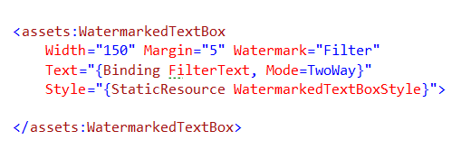
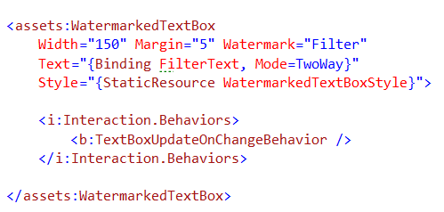
Text Input Binding – Xaml Way
Basic Binding
Binding to FilterText property
Must set mode == two way
Immediate Update Binding
Custom behavior to support immediate updates
Notes:
When we are talking about text input binding in xaml you would have something as you see on the screen.
[show animation]
Our text control has a text attribute and this is the attribute we want to bind to. We would use the standard Binding syntax for XAML as you see here.
[show animation]
You may also notice that I am explicitly setting my mode to 2 way as this is needed in order to have any updated data pushed back into the underlying view model
.
[show animation]
The problem with input binding in xaml is that although it will push data bi-directionally, once you set the mode correct. By default it will only push the data back into the view model once the control loses focus, this is an issue in many cases.
[show animation]
In order to solve this problem it is common for developers to create a custom behavior which does the updates in real time. You can see here we are doing exactly this with my TextBoxUpdateOnChangeBehavior. Although this does work, IMO this is something that develoeprs should not have to create them selves, it should just be built in.

Slide 6

Text Input Binding – Knockout Way
Basic Binding
Value binder
Immediate Update Binding
Value Update Binder
Possible Events:
keyup
keypress
afterKeyDown
User releases a key
Like keyup, but will repeat if key is held
As user types – Best Choice for real-time
Notes:
We know how to implement input binding in XAML, but how do we accomplish the same in Knockout, well the code on the screen ishow?
[show aniation]
The first thing I want to point out is the use of the data-bind attribute. This attribute is used in all knockout binding scenerios and it is the binder which is unique. IN our case we are using the value binder because we are working with an input control. Notice that I do not need to explicity set the mode to be 2way, that is because in Knockout it is 2 way be default
[show animation]
Now I mention that binding knockout is 2 way by default, this is true. Howeve,knockout is similar to XAML in that by default the updated data will not be pushed back into the vm until the control loses focus. However, unlike XAML having the ability to do real time updates is built into the framework.
[show animation]
The way you would force immediate update in knockout is to use the valueUpdate binder and provide it the afterKeyDown value. Doing this will tell knockout to push any updates after the key down event is pressed.
[show animation]
Although using te after key down will accomplish our goal here, in knockout there is multiple real time update events we can listen to. Each of them has their pros and cons and I am simply toing to run through the list here.
The first option I will mention is the keyup event. This will push data back into the view model when the key is released. This means that if you hold the key down the binding will not find until you release the key and ALL the updated values will go at one time.
[show animation]
The next event we can listen to is the keypress, this is like the keyup but this will fire over and over again as you hold your key down.
[show animation]
The last option is our afterkey down event. This is like the keypress, meaning it will push the data as the key is press down, however, this event is asynrhnouse which will provide for better performance. This is also the preferred event to use when doing immediate updates.

Slide 7
END OF Overview Slides

Slide 8
Agenda
Text Input Binding - Value Binder
Text Display Binding – Text Binder
Checkbox/Radio Button Binding – Checked Binder
Selection Binding – Options Binder
Notes:
We have taken a look at how we can bind to input controls, but what about non input controls. IN HTML these are controls like the span or the paragraph tags. As you can expect, binding to these controls is possible and it is very similure to the way we would bind to input ones.

Slide 9

Text Display Binding – Xaml Way
Basic Binding
Text Binding
Notes:
When working with XAML you can bind to a Text block like you see here a the screen. The text block xaml is similar in concept to both the span and paragraph controls, which means they are all controls which allow data to be displayed in a read only fashion
[show animation]
When working with a text block you need to bind to the text attribute using the standard BINDING syntax. Of course because this is a read only control there is no need to set the mode to 2 way.

Slide 10


Text Display Binding – Knockout Way
Basic Binding
Bind to display only controls
Binding w/out Controls
HTML comment blocks
Standard Text Binder
Notes:
When working in knockout still have the ability to bind to non in put controls as the code on the screen illustrates.
[show animation]
When working with non-input controls we are not going to use the value binder as we did with our input controls, but rather we are going to use the text binding. You can see this illustrated here in both the span and the paragraph controls.
[show animation]
Not binding to non-input controls is nice, but what if I wanted to bind directly to raw HTML? Knockout allows for this.
[show animation]
What we need to do is create 2 HTML comment blocks like you see here.
[show animation]
Even though we are in side a comment, we are still in a read only capacity and this means that we are going to use our standard text binding to setup our binding.

Slide 11
END OF Overview Slides

Slide 12
Agenda
Text Input Binding - Value Binder
Text Display Binding – Text Binder
Checkbox/Radio Button Binding – Checked Binder
Selection Binding – Options Binder
Notes:
We have taken a look at how we can bind to controls which allow for the users to enter data as well as controls which simply disply data. What about controls which are Boolean, such as radio buttons or check boxes? Of course knockout supports both of these as expect and they are as easy to use as our other binders.

Slide 13

Checkbox/Radio Button Binding – Xaml Way
Binding
Checked Binding
Notes:
When working in XAML and using Boolean controls such as a check box or a radio button you would setup your binding as you see on the screen.
[show animation]
What we need to do is wire our standard binding syntax to the IsChecked attribute for each control. Once we do this our value will be pushed or pulled from the view model as needed.

Slide 14

Checkbox/Radio Button Binding – Knockout Way
Binding
Bind via the checked binder
Notes:
When using knockout to bind to Boolean values we can use either the checkbox or the radio button html control as you see here on screen
[show animation]
In the spirit of consistency knockout still is using the data-bind attribute to setup its binding. However we are now using the checked binder. This checked binder will allow us to bind our Boolean properties as you would expect to our html controls.

Slide 15
END OF Overview Slides

Slide 16
Agenda
Text Input Binding - Value Binder
Text Display Binding – Text Binder
Checkbox/Radio Button Binding – Checked Binder
Selection Binding – Options Binder
Notes:
We have covered may different input controls and the last one which needs to be covered is the HTML selection control. This control allows you to show a simple list of items to a user for selection in a combo box format.

Slide 17
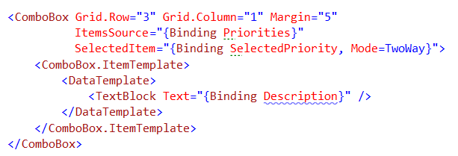
Checkbox/Radio Button Binding – Xaml Way
Binding
Bind to a Collection
Bind to backing field
Format the output
Notes:
When working in XAML and working with a combo box you would have code which looks similar to what you see here on the screen.
[show animation]
The first thing you would do is bind your underlying collection to the ItemsSource attribute using the standing syntax.
[show animation]
Next you would bind to a specific backing field within your view model this backing field will be used to story the value selected by your users..
[show animation]
And last you would typically create a data template where you would put the needed xaml to display the selection data to your user.
Once you have setup these bindings you would have a combo box which could display a collection of items to your users in a simple manor.

Slide 18

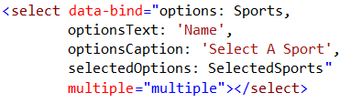
Selection Binding – Knockout Way
Basic Binding
Bind to a Collection
Provide property to display
Provide Backing Field to push selected item into
Multi-Select Binding
Change Backing Field to SelectedOptions
Set Select to allow multiple selection
Notes:
In knockout you can accomplish the same end result as using a combo box in XAML. To accomplish this you would use the select HTML element as you see here on the screen.
[show animation]
The frist thing to point out is how we are binding our collection of data to your control, we are using the options binder
[show animation]
The next thing to point out is the use of the OPtionsText binder. This is how you specify what observable or computed observable to display to the user. One thing to point out here is that you need to encapsulate this name in quotes in order for the binding to work correctly.
[show animation]
Finally if we want to store the selected item in our view model we would use the value binder and provide it the backing property in our VM to push this data to.
[show animation]
Another option we have when working with a select control is to allow the user to select multiple items in the list. To accomplish this you would crate HTML like you see here on the screen. There are 2 items which are different in this scenario which need to be pointed out
[show animation]
The first difference is that if we want to story the list of selection options in a backing vield we must use the selectedOptions cbinder rather than the value one. This will allow us to store a collection of items rather than a single one.
[show animation]
Finaly in order to allow the HTML element to even allow multiple selection we have to tell it to, we do this by setting the multiple attribute as seen here.

Slide 19
END OF Overview Slides

Slide 20
Summary
Learned about the Value Binder
Text Input Controls
Learned about the Text Binder
Text Display Controls
Learned about the Checked Binder
Checkbox/Radio Button Controls
Learned about the Options Binder
Selection Controls
Notes:
In this module took a look at how to bind to 4 different input controls using knockout in an MVVM style. When looking at how to accomplish this we compared the knockout and html syntax needed equivalent XAML syntanx.
We started off by looking at how to bind to a data input control, we learned that in knockout that you can bind to text or textarea controls by using the value binder. We also learned that binding in knockout is bi-directional by default
We then took a look at how to bind to non-input controls such as span or paragraph controls. When binding to these control you use the text binder rather than the value binder.
Next we learned how to bind to Boolean based controls such as the radio button and the check box. In knockout when learned that we use the check binder when binding to Boolean controls.
Finally we eneded the module by learning how to work with the options binder which is used in the select html control. When learning that when using options binder we can bind our collection to the control and push either a single selected value into our view model or multiple values.

