Slide 1
Knockout for the XAML developer Working with Input Control
Derik Whittaker
@DerikWhittaker
Notes:
Hello and welcome to the Html for the XAML developer course, I am your host Derik Whittaker.
In this course we are learn how the skills you have acquired while building Silverlight or WPF applications can be applied to building HTML applications. We will be take a look at an existing Silverlight application and learn how we can port or rebuild this application using HTML. We will specifically focus on the MVVM design pattern while we learn how to apply our skills to HTML. You will learn how your knowledge of View Model layout, Data Binding and Commanding will translate to HTML applications via Knockout js. As well as learn how the concepts of converters and styles can be applied to an HTML application to get the same net result you would expect if you were building a XAML based application.
During this course we are going to look at many different tools and library's and we will explore each of them in enough detail to allow you to get rolling. However we will not be going into great depth in most of the tools as there are other great courses on pluralsight which cover these tools in greater detail.

Slide 2
Agenda
Text Input Binding
Demo: Basic Bindings
Demo: Value Update Binding
Display Text Binding – Text Binder
Demo: Basic Binding
Demo: Binding without an HTML control
Checkbox/Radio Button Binding – Checked Binder
Demo: Basic Bindings
Demo: Control Group Bindings
Selection Binding – Options Binder
Demo: Basic Bindings
Demo: Multi-Select Bindings
Demo: Formatting Display Output

Slide 3
END OF Overview Slides

Slide 4
Agenda
Text Input Binding - Value Binder
Text Display Binding – Text Binder
Checkbox/Radio Button Binding – Checked Binder
Selection Binding – Options Binder

Slide 5
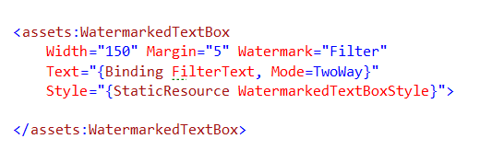
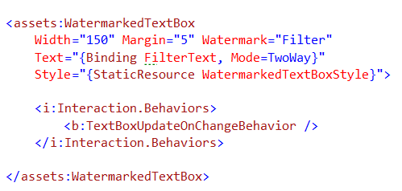
Text Input Binding – Xaml Way
Basic Binding
Binding to FilterText property
Must set mode == two way
Immediate Update Binding
Custom behavior to support immediate updates

Slide 6

Text Input Binding – Knockout Way
Basic Binding
Value binder
Immediate Update Binding
Value Update Binder
Possible Events:
keyup
keypress
afterKeyDown
User releases a key
Like keyup, but will repeat if key is held
As user types – Best Choice for real-time

Slide 7
END OF Overview Slides

Slide 8
Summary
How to leverage our XAML skills for building HTML applications
Learned about the tools we are going to
Built our Asp.Net MVC template project
Implemented a Hello World application
Reviewed our sample applications
Notes:
In this module we explored everything we needed to know in order to get primed for making the transition from being a XAML developer to an HTML developer.
We took a look at how some of you xaml skills, such as binding and commanding, can easily translate to building HTML applications
We learned about many of the tools we will be using through this course, such as Knockout js, typescript and ASP.Net MVC
We built our Asp.Net MVC template project which we will use as our base project during this course
We built a very simple hello world application to demonstrate how to use some of the tools we will be learning about during this course
We ended up by reviewing our reference Silverlight application we are going to be porting over to html in order to better understand our objectives for the course
In the next module we will dive straight in and start the actual port of our reference application to html

