Slide 1
Knockout for the XAML developer Working with Input Control
Derik Whittaker
@DerikWhittaker
Notes:
Hello and welcome to module 2 of knockout for the xaml developer, I am your host Derik Whittaker.
We are going to focus our efforts in this module on learning to work with data input controls.

Slide 2
Agenda
Text Input Binding
Demo: Basic Bindings
Demo: Value Update Binding
Display Text Binding – Text Binder
Demo: Basic Binding
Demo: Binding without an HTML control
Checkbox/Radio Button Binding – Checked Binder
Demo: Basic Bindings
Demo: Control Group Bindings
Selection Binding – Options Binder
Demo: Basic Bindings
Demo: Multi-Select Bindings
Demo: Formatting Display Output

Slide 3
END OF Overview Slides

Slide 4
Agenda
Text Input Binding - Value Binder
Text Display Binding – Text Binder
Checkbox/Radio Button Binding – Checked Binder
Selection Binding – Options Binder

Slide 5
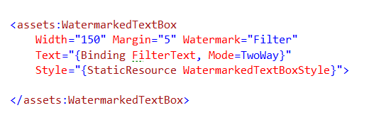
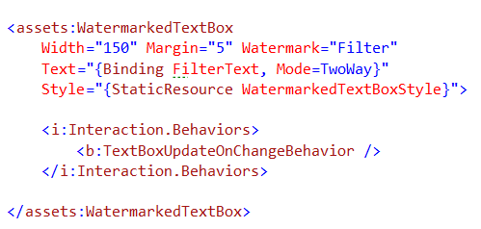
Text Input Binding – Xaml Way
Basic Binding
Binding to FilterText property
Must set mode == two way
Immediate Update Binding
Custom behavior to support immediate updates

Slide 6

Text Input Binding – Knockout Way
Basic Binding
Value binder
Immediate Update Binding
Value Update Binder
Possible Events:
keyup
keypress
afterKeyDown
User releases a key
Like keyup, but will repeat if key is held
As user types – Best Choice for real-time

Slide 7
END OF Overview Slides

Slide 8
Agenda
Text Input Binding - Value Binder
Text Display Binding – Text Binder
Checkbox/Radio Button Binding – Checked Binder
Selection Binding – Options Binder

Slide 9

Text Display Binding – Xaml Way
Basic Binding
Text Binding

Slide 10


Text Display Binding – Knockout Way
Basic Binding
Bind to display only controls
Binding w/out Controls
Bind directly to unformatted text
Standard Text Binder

Slide 11
END OF Overview Slides

Slide 12
Agenda
Text Input Binding - Value Binder
Text Display Binding – Text Binder
Checkbox/Radio Button Binding – Checked Binder
Selection Binding – Options Binder

Slide 13
END OF Overview Slides

Slide 14
Agenda
Text Input Binding - Value Binder
Text Display Binding – Text Binder
Checkbox/Radio Button Binding – Checked Binder
Selection Binding – Options Binder

Slide 15
END OF Overview Slides

Slide 16
Summary
Learned about the Value Binder - Text Input Controls
Learned about the Text Binder - Text Display Controls
Learned about the Checked Binder - Checkbox/Radio Button Controls
Learned about the Options Binder - Selection Controls

