Slide 1

Note: The data and information in this document is reflective of a hypothetical situation and client. This document is to be used for KPMG Virtual Internship purposes only.
Sprocket Central Pty Ltd
Data analytics approach
[Division Name] - [Engagement Manager], [Senior Consultant], [Junior Consultant]

Slide 2
Note: The data and information in this document is reflective of a hypothetical situation and client. This document is to be used for KPMG Virtual Internship purposes only.
Agenda
Introduction
Data Exploration
Model Development
Interpretation

Slide 3
Note: The data and information in this document is reflective of a hypothetical situation and client. This document is to be used for KPMG Virtual Internship purposes only.
Introduction
In this investigation, we have studied the trends of the new and old customers.
The main focus was given to attributes like
Age
Wealth Segment and gender
Job industry category
Purchases made by each state categorized by people owning and not owning cars

Slide 4
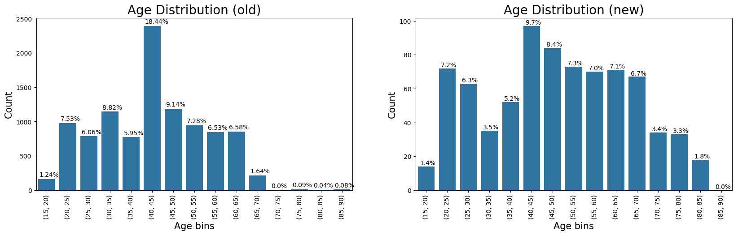
Note: The data and information in this document is reflective of a hypothetical situation and client. This document is to be used for KPMG Virtual Internship purposes only.
Data Exploration
Age distribution of customers
As we can observe from the relative frequencies plotted in the chart, the trend continues to be the same for the age group <25 years.
There is a decrease in the relative frequency of the age group (40-45) which is consequently seen as a slight increase in the percentage of customers belonging to the age group (50-85)
Therefore, customers falling in the age group (50-85) should be given more importance.

Slide 5
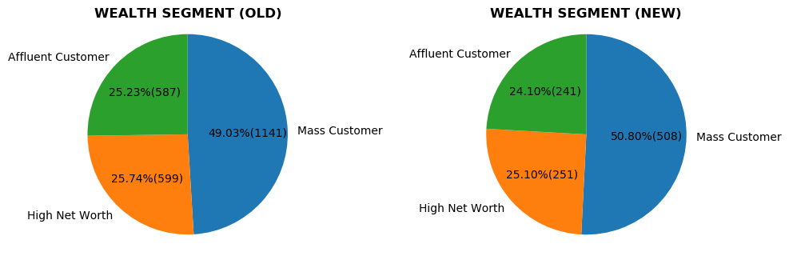
Note: The data and information in this document is reflective of a hypothetical situation and client. This document is to be used for KPMG Virtual Internship purposes only.
Data Exploration
Wealth segments distribution
There’s no major change that is observed here.
Mass customers must be given more attention, followed by high net worth customers and affluent customers

Slide 6
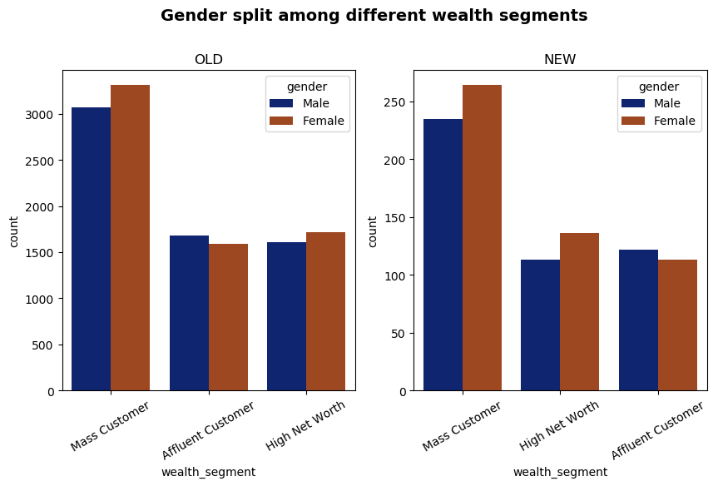
Note: The data and information in this document is reflective of a hypothetical situation and client. This document is to be used for KPMG Virtual Internship purposes only.
Data Exploration
There is an observable change in the gender split among high net worth customers and affluent customers in the new customers list.
Women must be targeted more than men in mass customer and high net worth customer segments whereas men should be targeted in from the affluent customers’ list.

Slide 7
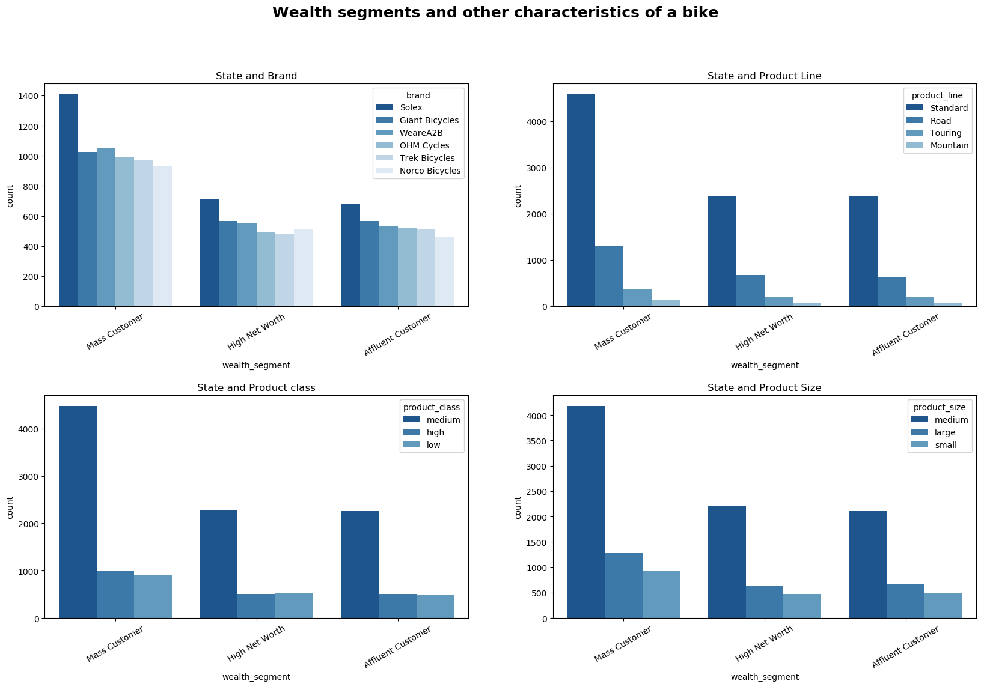
Note: The data and information in this document is reflective of a hypothetical situation and client. This document is to be used for KPMG Virtual Internship purposes only.
Data Exploration

Slide 8
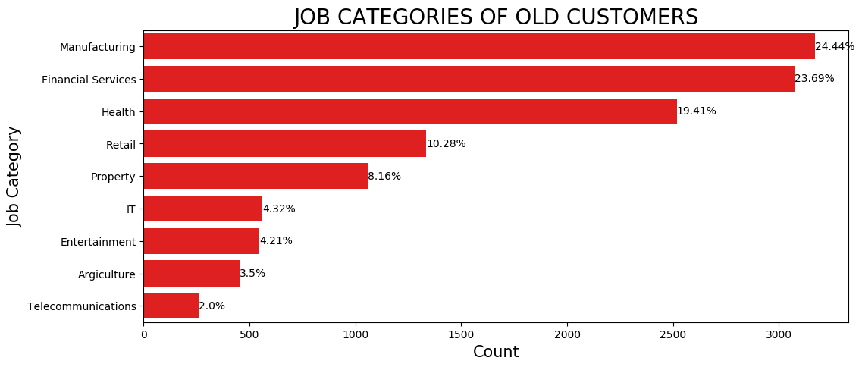
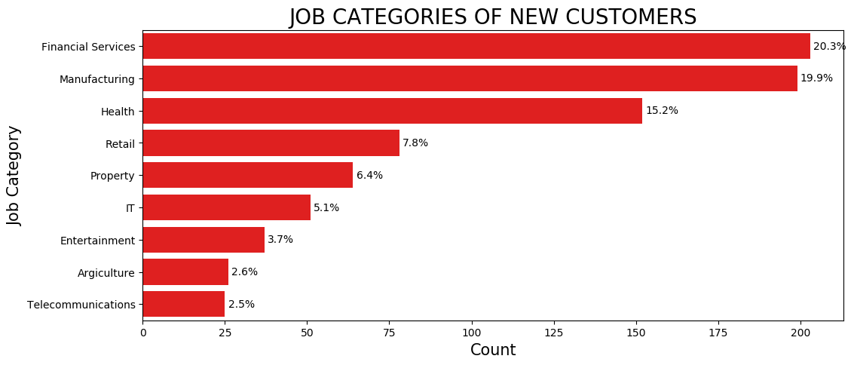
Note: The data and information in this document is reflective of a hypothetical situation and client. This document is to be used for KPMG Virtual Internship purposes only.
Data Exploration
Job industry category
The new customers list has more individuals from the financial services category (20.3%) closely followed by the manufacturing category (19.9%).
Since there is no major difference between their relative frequencies, both the categories must be given equal importance.
On the other hand, the other categories follow the same trend as that of the old customer list

Slide 9
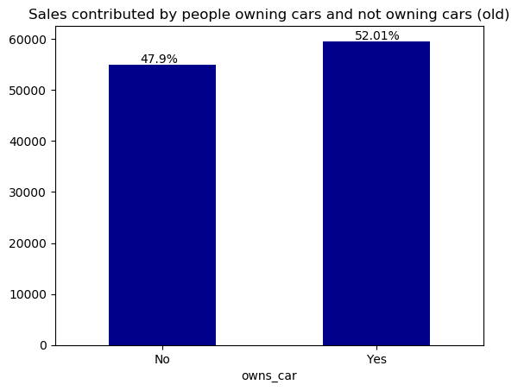
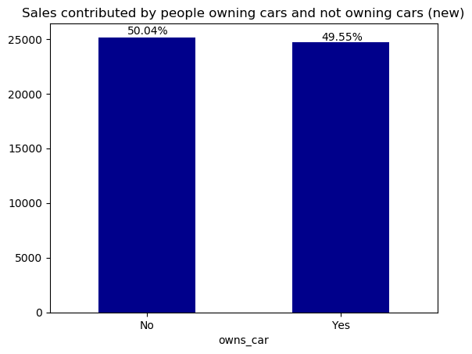
Note: The data and information in this document is reflective of a hypothetical situation and client. This document is to be used for KPMG Virtual Internship purposes only.
Model development
Sales contributed by customer who own and don’t own cars
Customers without a car have contributed more from the new customers’ list.

Slide 10
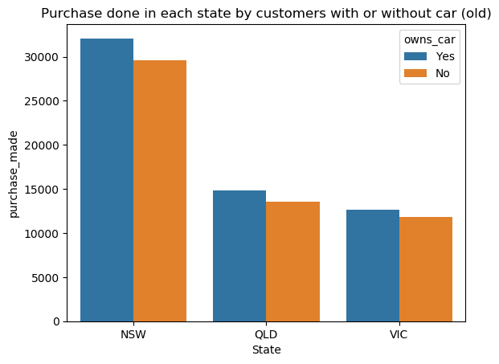
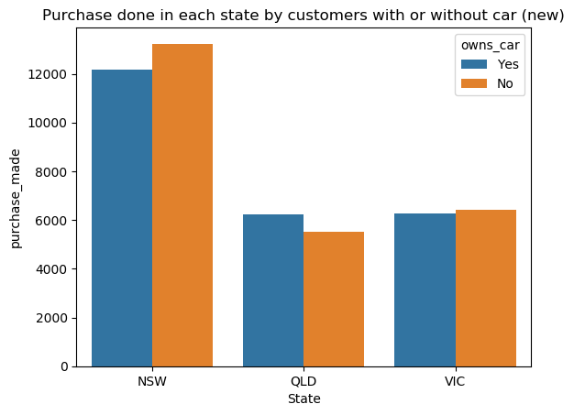
Note: The data and information in this document is reflective of a hypothetical situation and client. This document is to be used for KPMG Virtual Internship purposes only.
Interpretation
In the old customers’ list , we see that most purchases in the last 3 years were made by the customers who owned a car with a larger set of customers from New South Wales.
Although, that trend has seen a change in the new customers’ list where customers without a car have made more purchases than the other half in New South Wales and Victoria.
However, NSW continues to contain a larger set of the customers even in the new customers’ list. Therefore, some strategy should be used in the other two states in order to drive more sales.

Slide 11
Note: The data and information in this document is reflective of a hypothetical situation and client. This document is to be used for KPMG Virtual Internship purposes only.
Appendix

Slide 12
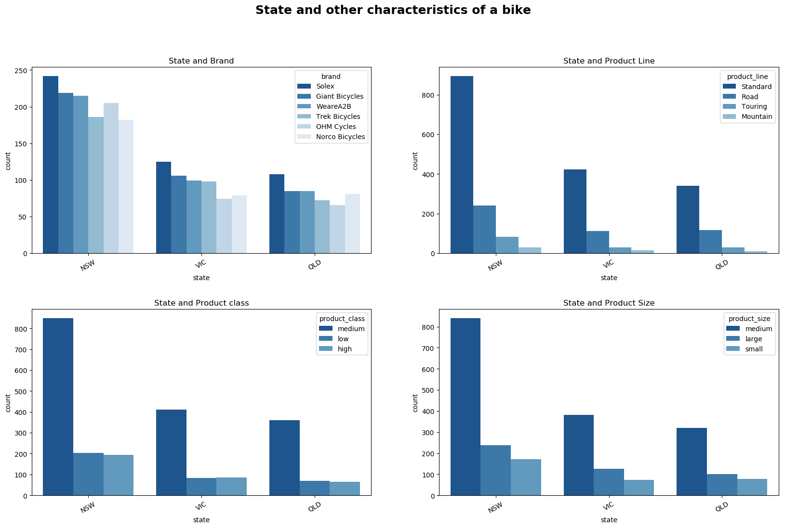
Note: The data and information in this document is reflective of a hypothetical situation and client. This document is to be used for KPMG Virtual Internship purposes only.
Appendix

