Slide 1
Sales and Revenue Data Visualization Analysis

Slide 2
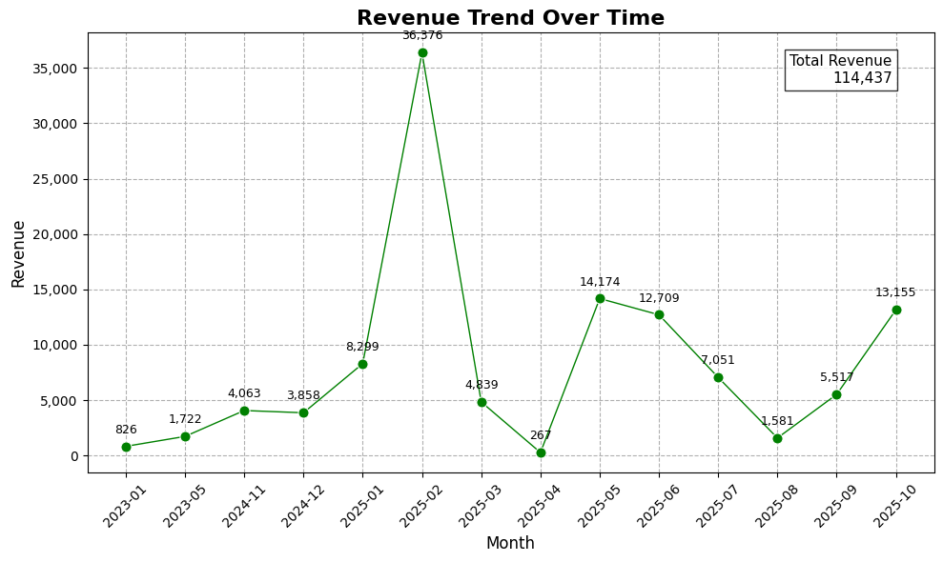
REVENUE TREND
Revenue fluctuated over time
February 2025 recorded peak revenue
Sharp decline followed after peak
Revenue recovered in later months

Slide 3
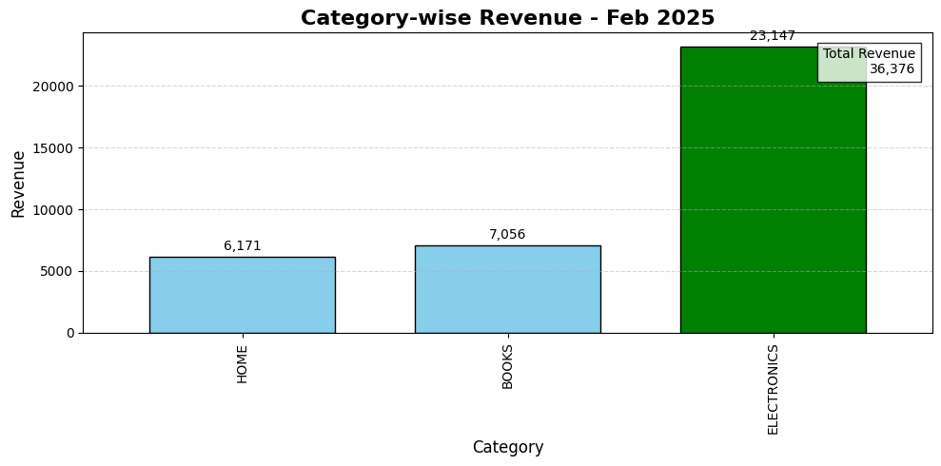
CATEGORY PERFORMANCE INSIGHTS – FEB 2025
Electronics generated highest revenue
Sales mainly concentrated in Electronics
Books and Home showed moderate performance

Slide 4
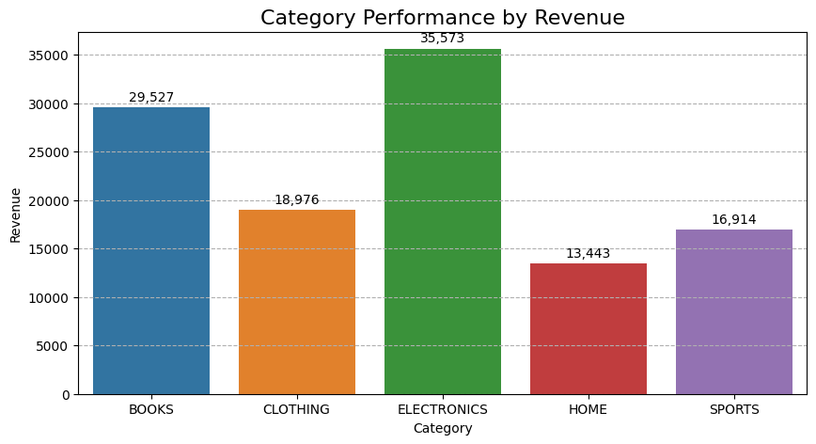
CATEGORY PERFORMANCE INSIGHTS
Electronics remained top category
Books performed strongly
Home generated lowest revenue
Revenue spread across categories

Slide 5
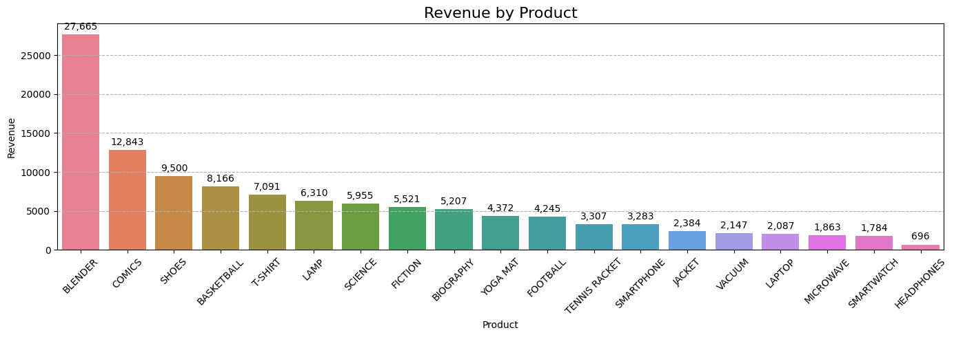
PRODUCT REVENUE INSIGHTS
Blender was the top-performing product
Top products contributed major revenue
Some products showed lower sales potential

Slide 6
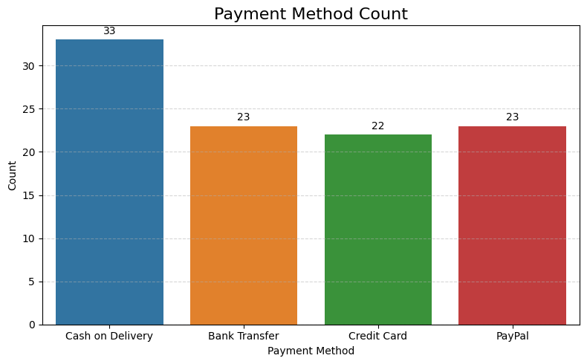
PAYMENT METHOD INSIGHTS
Cash on Delivery was most preferred
Digital payments showed balanced usage
Customers used multiple payment options

Slide 7
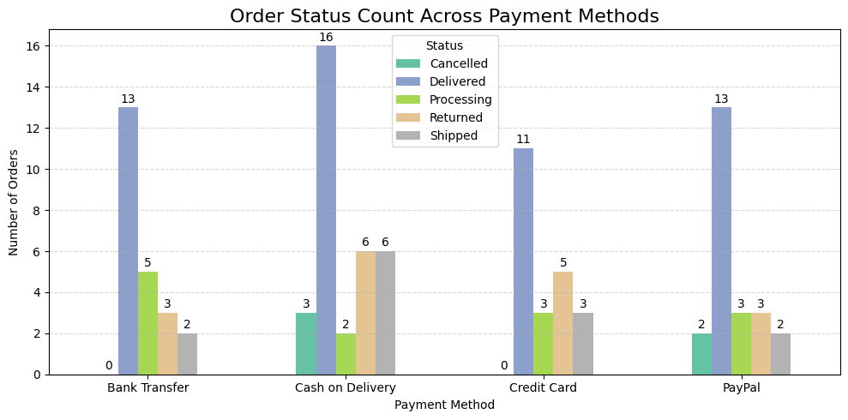
ORDER STATUS BY PAYMENT METHOD
Delivered orders were highest
Returns and processing orders were noticeable
Fulfillment improvement may reduce delays

Slide 8
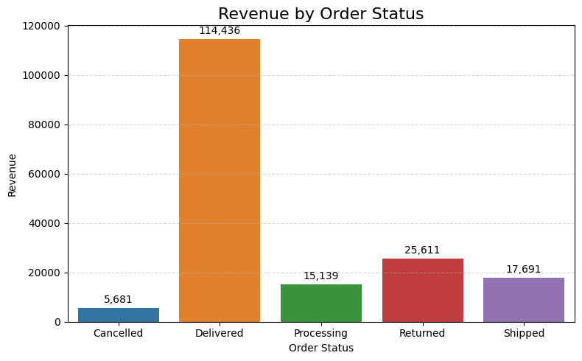
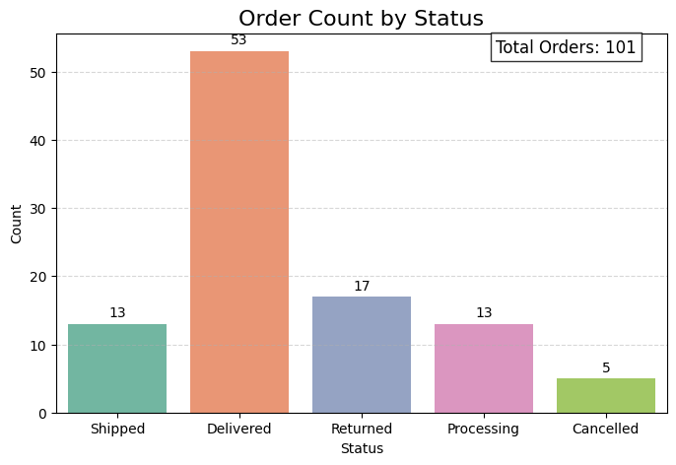
ORDER STATUS PERFORMANCE INSIGHTS
Delivered orders generated highest revenue
Returns affected business performance
Low cancellations reduced revenue loss
Better fulfillment can improve satisfaction

Slide 9
THANK YOU….

