Slide 1
Introducing SCRIPT: Smart Charging Infrastructure Planning Tool
September 21, 2018
Prepared by: Justin Luke
Notes:
New project at GISMo Group

Slide 2
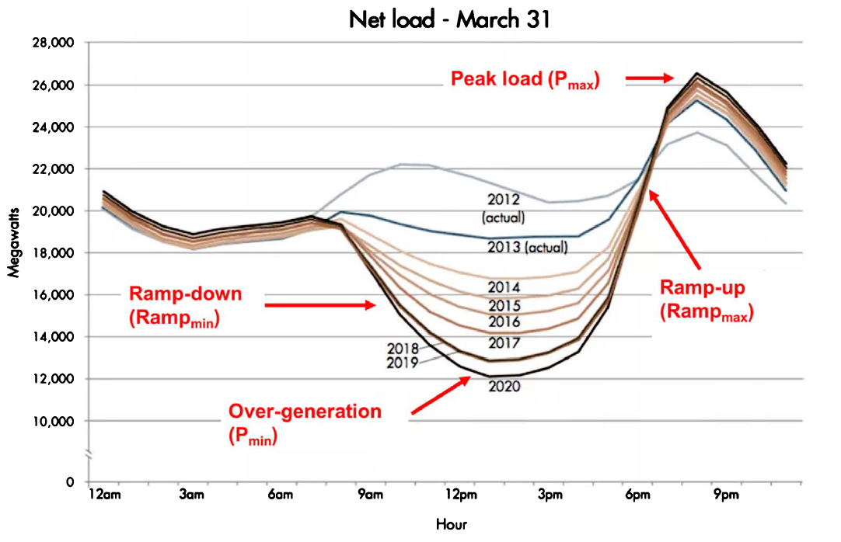
Motivation
Electric Vehicle (EV) Growth: charging demand adds stress to grid
CA: Executive Order for 5 million Zero-Emission Vehicles by 2030
Increased renewables penetration: how to integrate with legacy grid?
CA: Renewable Portfolio Standard (RPS) of 60% by 2030; 100% by 2045
Solar Overgeneration ➔ “Duck Curve”
CA: Energy Storage AB of 1.3 GW by 2020
Can aggregated EVs help flatten the curve?
Integrated EV charging infrastructure planning tool
Source: Jonathan Coignard et al 2018 Environ. Res. Lett. 13 054031
Notes:
As we push for increased growth in electric vehicles for a cleaner transportation sector, additional demand and grid stress, especially if same time/region
Decarbonize electricity grid; however, challenges in integrating intermittent renewables with the existing grid
Duck Curve; difficult and expensive to ramp up generation or have new generations just to meet peak demand. Storage can be used to mitigate; mandate. Unique opportunity for EVs?
Lack of integrated, collaborative tool for most effectively deploying our charging infrastructure

Slide 3
Source: Jonathan Coignard et al 2018 Environ. Res. Lett. 13 054031

Slide 4
Motivation
Electric Vehicle (EV) Growth: charging demand adds stress to grid
CA: Executive Order for 5 million Zero-Emission Vehicles by 2030
Increased renewables penetration: how to integrate with legacy grid?
CA: Renewable Portfolio Standard (RPS) of 60% by 2030; 100% by 2045
Solar Overgeneration ➔ “Duck Curve”
CA: Energy Storage AB of 1.3 GW by 2020
Can aggregated EVs help flatten the curve?
Integrated EV charging infrastructure planning tool
Source: Jonathan Coignard et al 2018 Environ. Res. Lett. 13 054031
Notes:
As we push for increased growth in electric vehicles for a cleaner transportation sector, additional demand and grid stress, especially if same time/region
Decarbonize electricity grid; however, challenges in integrating intermittent renewables with the existing grid
Duck Curve; difficult and expensive to ramp up generation or have new generations just to meet peak demand. Storage can be used to mitigate; mandate. Unique opportunity for EVs?
Lack of integrated, collaborative tool for most effectively deploying our charging infrastructure

Slide 5



Project Objectives
Develop methods for spatial-temporal forecasts of electric vehicle (EV) charging demand and flexibility
Develop daily smart charging algorithm which considers power network dynamics, solar generation outputs, customers’ travel needs, and costs
Develop tool and user interface for long-term planning of charging infrastructure deployment, considering grid needs, disadvantaged communities, solar generation, and economics
Notes:
Develop methods for forecasting EV charging demand and flexibility for any given day at a particular EV aggregation region. Methods from data-driven approach using charging data from San Francisco Bay Area
Thus, SCRIPT will develop a daily smart charging algorithm which jointly optimizes participation in grid market and absorbing local solar generation, while meeting customer travel needs
Develop a visual tool and interface for planning long-term large-scale goals for various stakeholders: (See above)
PG&E Integrated Capacity Analysis – Grid Needs Map
CEC Disadvantaged Communities – 25% of Electricity Program Investment Charge (EPIC) funds investment for disadvantaged communities identified under Senate Bill 350

Slide 6




Timeline
📜 TT1:
Design and Plan
🗲 TT4:
Smart Charging
$ TT5:
Cost-Benefit Analysis
💻 TT2:
Data Ingestion
📈 TT3:
Scenario-based Forecasting
👆 TT6:
Interface
Q1 2018
Q3 2018
Q1 2019
Q3 2019
Q4 2019
Q1 2020
Notes:
6 Phases
Target Completion Dates
Partners
Awaiting at phase 2
Following, will use data for forecast of charging demand and flexibility for phase 3
Go in detail at next slide

Slide 7
Data Pipeline
TT2: Data Ingestion
TT3: Scenario-based Forecasting
TT4: Smart Charging
TT5: Cost-Benefit Analysis for Different Stakeholders
Charging Session Data
OD data
Travel demand growth
State goals – EV growth, charging infrastructure deployment, storage mandates, RPS
For each scenario, forecast aggregated EV charging demand and flexibility
For each scenario, determine optimal solar capacity: solar purely absorbed by smart charging of EVs at each aggregation point
For each scenario and stakeholder, perform cost-benefit analysis: identifying the key factors/market drivers for smart charging algorithm
Notes:
Currently at TT2. While waiting for TT2 data, I am experimenting with TT3.

Slide 8
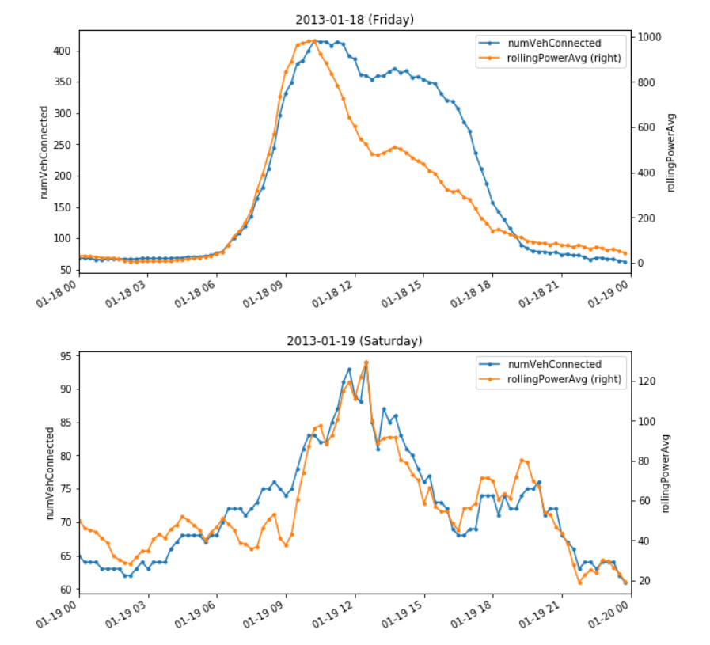
(kW)
Notes:
Peninsula, South Bay

Slide 9
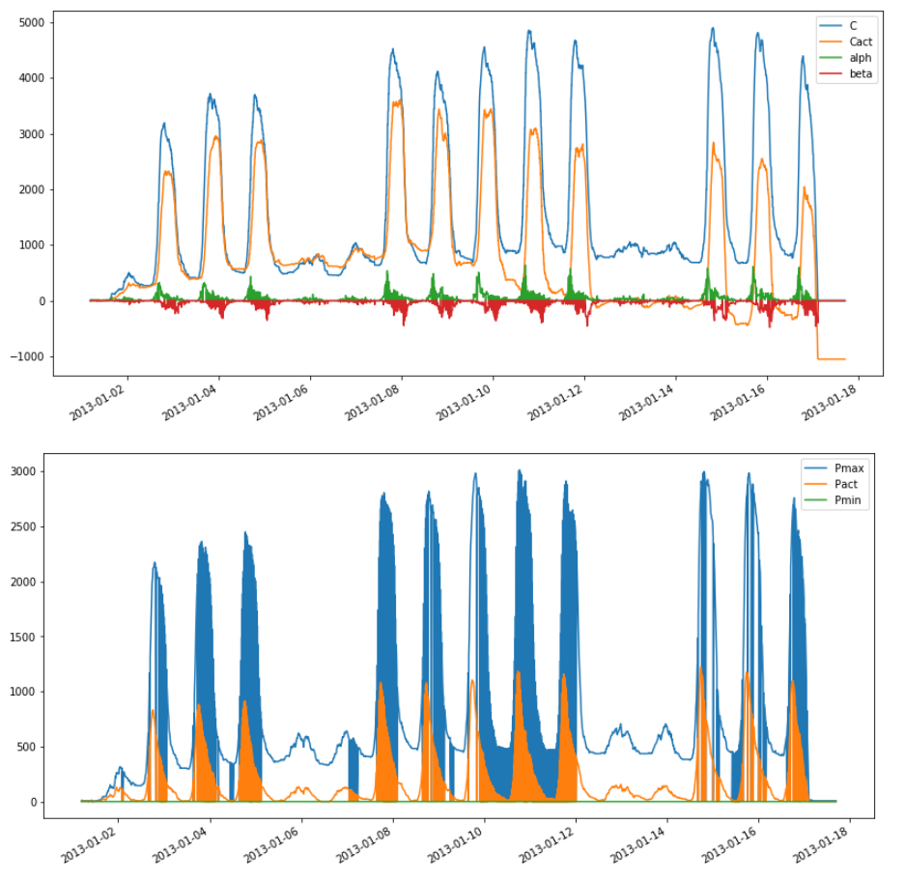
Energy (kWh)
Power (kW)
Notes:
Peninsula, South Bay, San Francisco

Slide 10
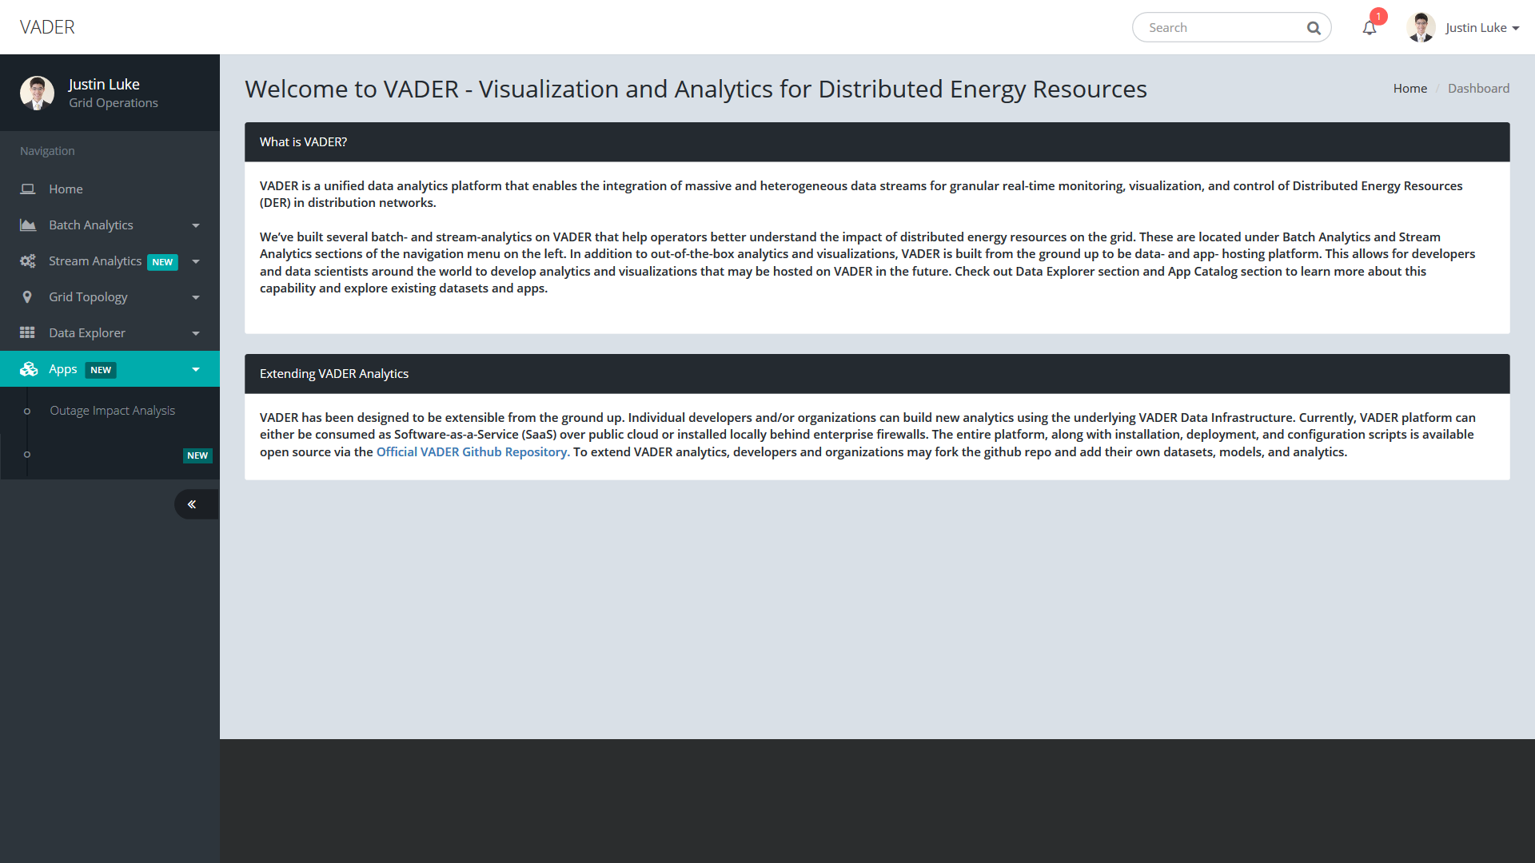
Smart Charging Infrastructure
Planning Tool (SCRIPT)

Slide 11
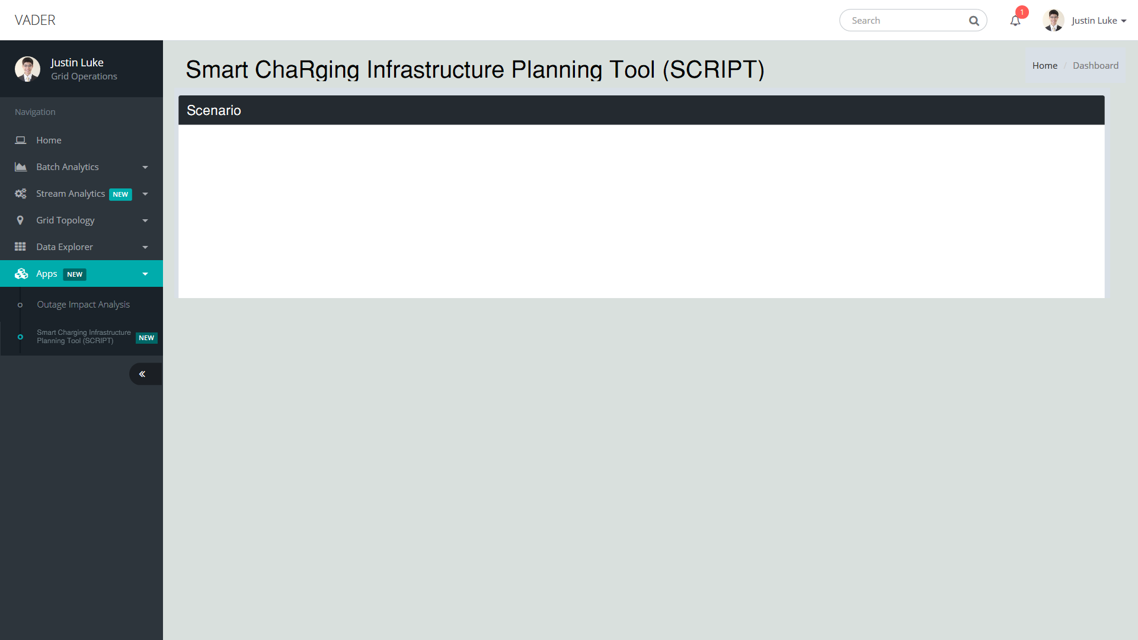

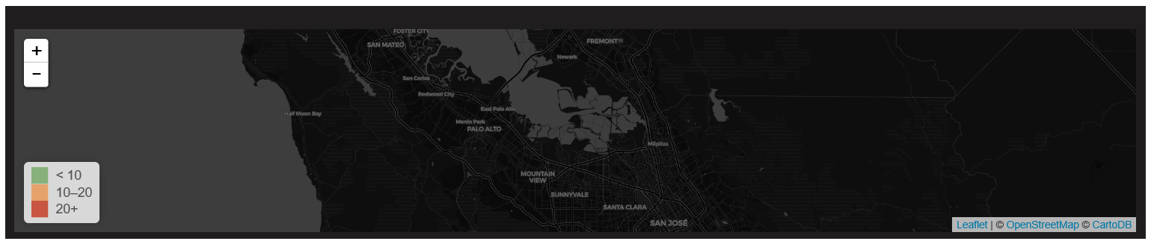
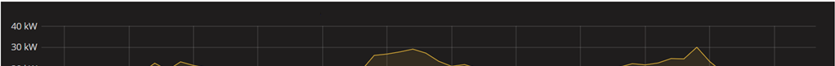
Zero-emission Vehicles Growth: 0.5 million in 2018 1.5 million by 2025 5.0 million by 2030
Charging Infrastructure Growth: 15,000 in 2018 250,000 by 2025 by
Charging Control:
20%
Autonomous Chargers: ☐ by:
Autonomous Vehicles: ☑ by: 2030
All uncontrolled
All smart controlled
Smart Charging Infrastructure
Planning Tool (SCRIPT)
Demand
Flexibility
Solar Resource
Cost Analysis
Year: 2030
Palo Alto|
Region: Palo Alto
2018
2030
2040

Slide 12


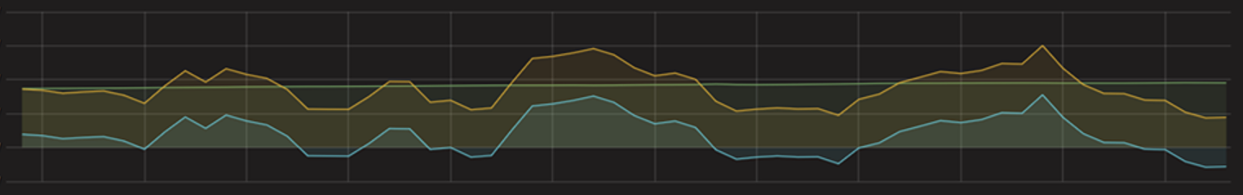
Demand
Flexibility
Solar Resource
Cost Analysis
Year: 2030
Palo Alto|
Region:
Palo Alto
900kW
600kW
300kW
0kW
-300kW
42kW
28kW
14kW
0kW
-14kW
2018
2030
2040
2018 2019 2020 2021 2022 2023 2024 2025 2026 2027 2028 2029 2030
2018 2019 2020 2021 2022 2023 2024 2025 2026 2027 2028 2029 2030
Notes:
Evolution

Slide 13

Demand
Flexibility
Solar Resource
Cost Analysis
Year:
2030
2038
Palo Alto|
Region:
Palo Alto
42kW
28kW
14kW
0kW
-14kW
42kW
28kW
14kW
0kW
-14kW
2018
2030
2038
2040
2018 2019 2020 2021 2022 2023 2024 2025 2026 2027 2028 2029 2030
2018 2020 2022 2024 2026 2028 2030 2032 2034 2036 2038

Slide 14
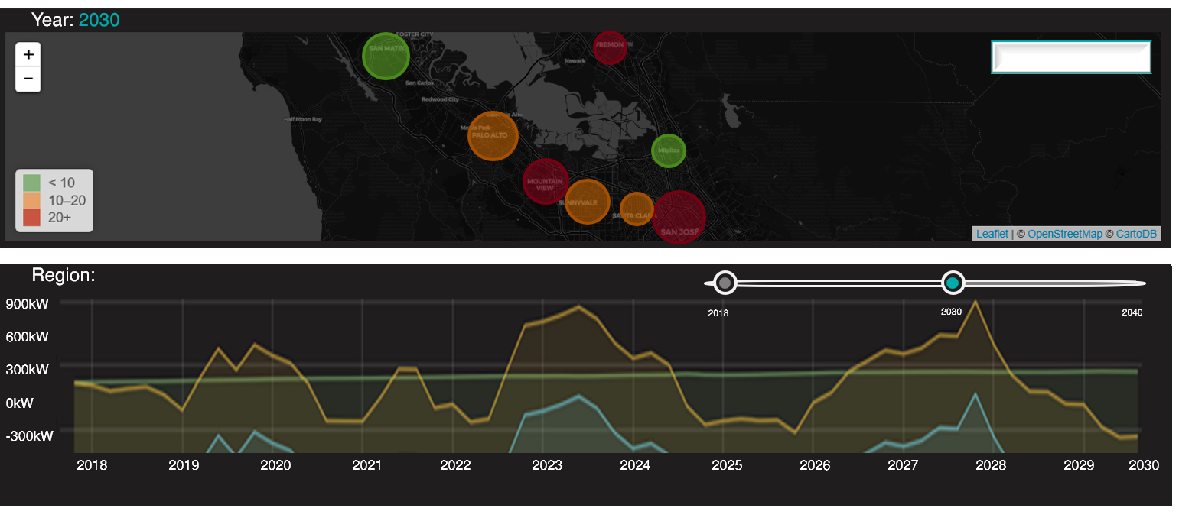
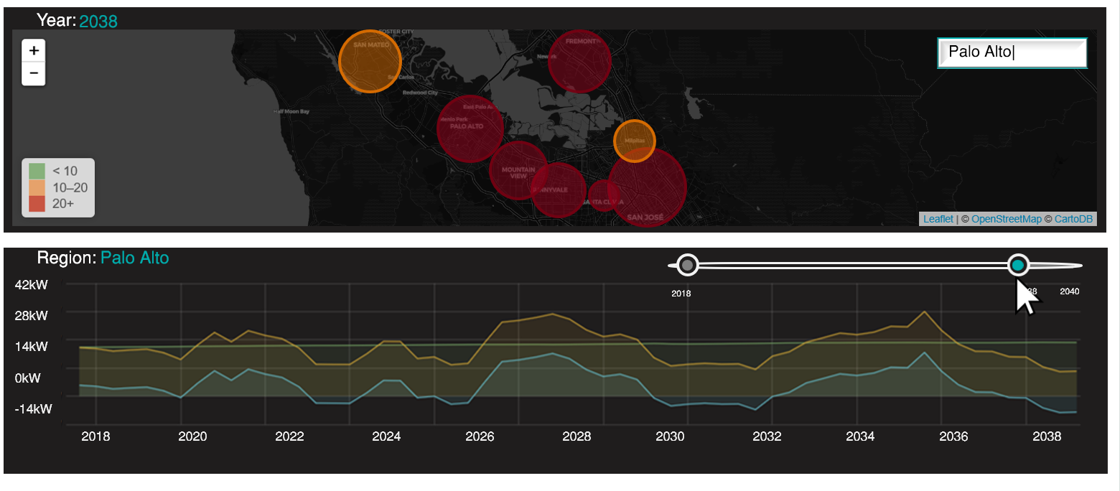
Load Scenario ↑
Scenario Editor ✎
Smart Charging Infrastructure
Planning Tool (SCRIPT)
Demand
Flexibility
Solar Resource
Cost Analysis
Region: Palo Alto
Notes:
Scenario Editor and Loader; Community
Defaults

Slide 15
Conclusion
Smart Charging Infrastructure Planning Tool (SCRIPT) is an early-stage CEC project led by SLAC GISMo
Produces data-driven forecasts of EV charging demand and flexibility
Smart charging algorithm will jointly optimize load-balancing and solar generation utilization
Open-source planning tool and interface can be used for collaboratively planning long-term goals
Notes:
Goals: deployment of charging infrastructure, meeting grid needs, serving disadvantaged communities

