Slide 1


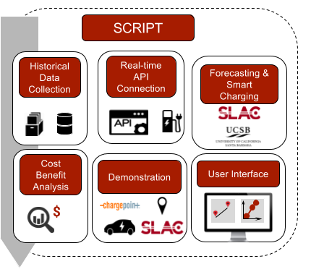




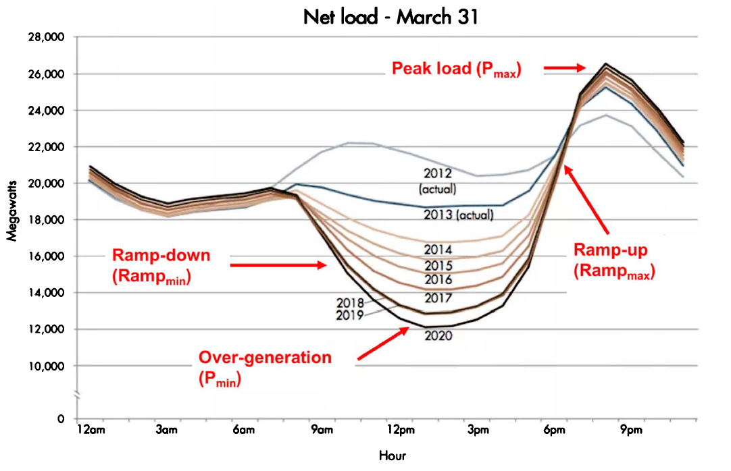
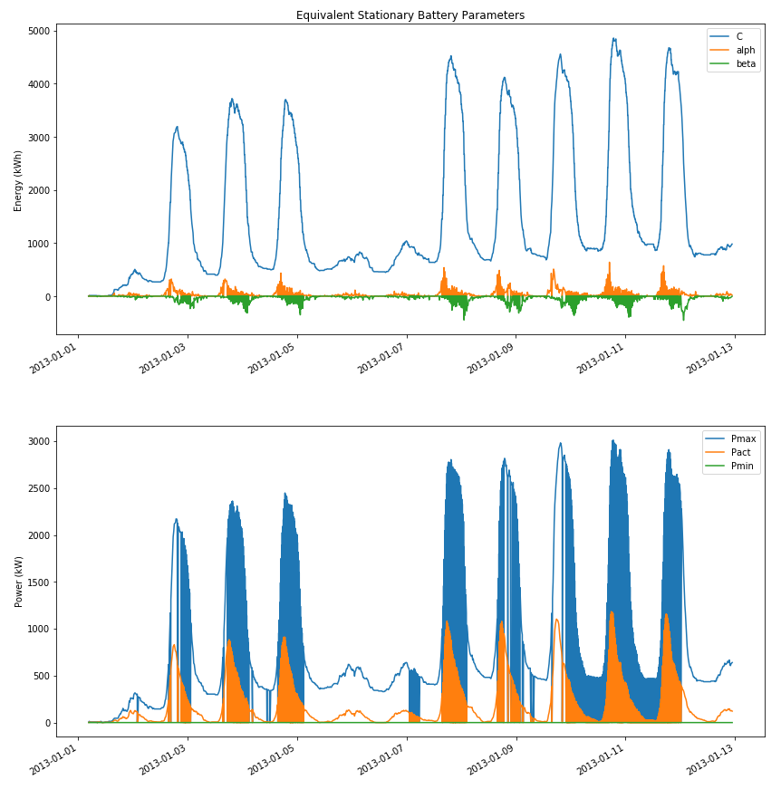

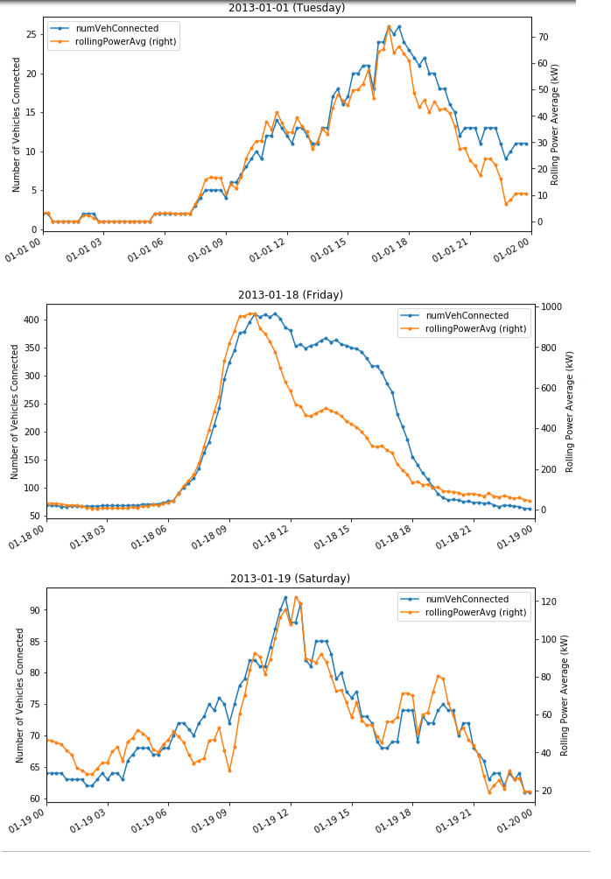
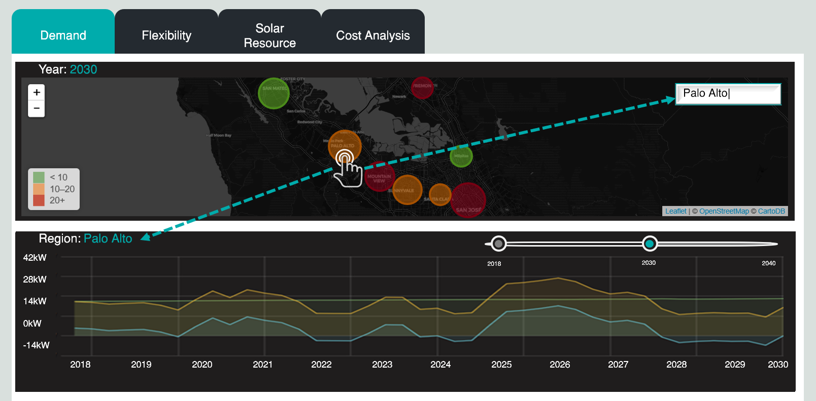
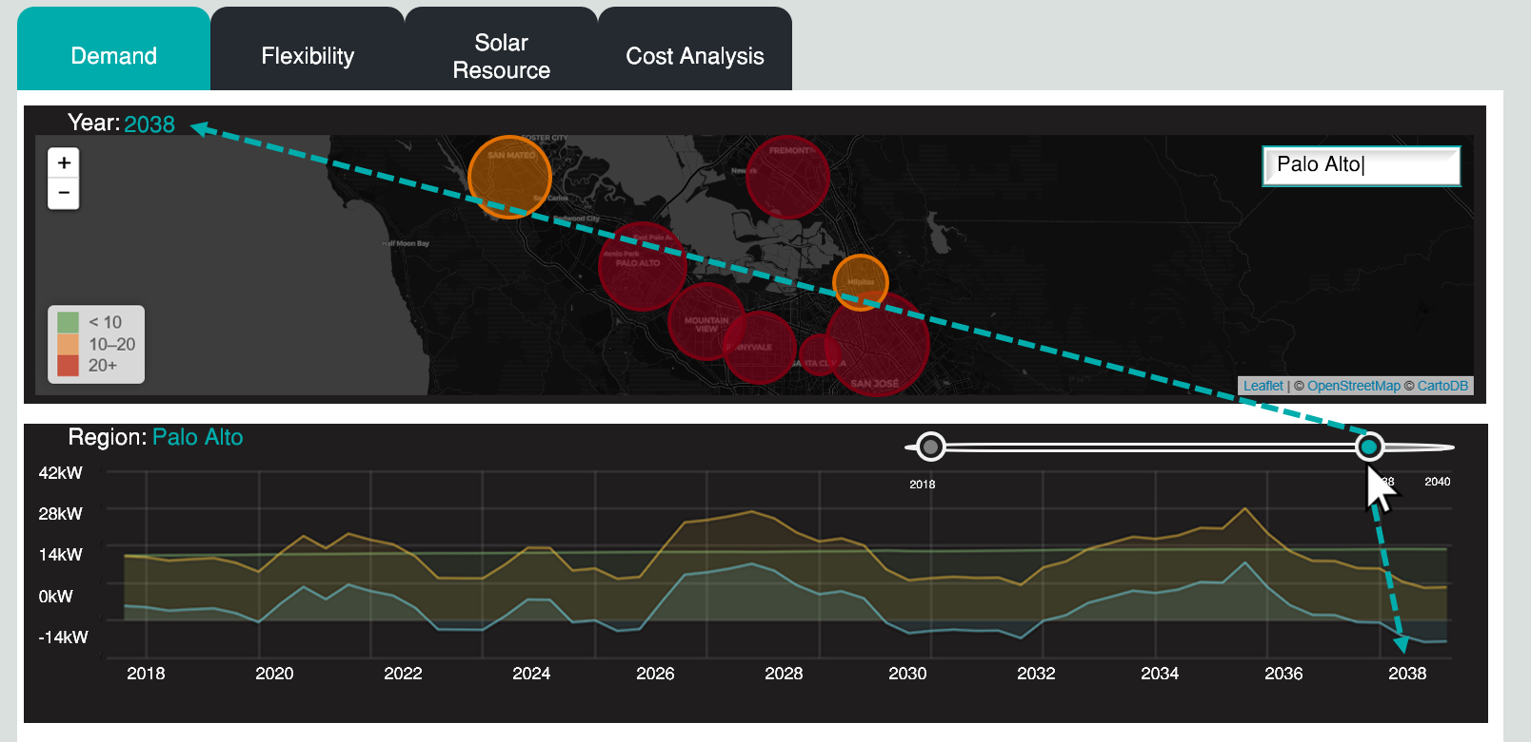

Smart Charging Infrastructure Planning Tool (SCRIPT)
Justin T. H. Luke, Emre C. Kara, Sila Kiliccote
Grid Integration, Systems & Mobility (GISMo), SLAC National Accelerator Laboratory
INTRODUCTION
FRAMEWORK
Electric Vehicle (EV) growth adds stress to the grid when charging demand is at similar space and time.
CA Executive Order for 5 million Zero-Emission Vehicles by 2030
Increased renewables penetration has presented integration challenges with the legacy grid. Solar overgeneration results in the “Duck Curve”
CA Renewable Portfolio Standard (RPS) of 60% by 2030; 100% by 2045
Using grid-scale storage to help flatten the curve
CA Energy Storage AB of 1.3 GW by 2020
Can aggregated EVs help flatten the curve?
Requires smart EV charging and a tool to evaluate the trade-off between new charging infrastructure investment and optimal management of existing infrastructure.
Data Ingestion
Scenario-based Forecasting
Smart Charging
Cost-Benefit Analysis for Different Stakeholders
Charging Session Data
Origin-destination data
Travel demand growth
State goals – EV growth, charging infrastructure deployment, storage mandates, RPS
For each scenario, forecast aggregated EV charging demand and flexibility
For each scenario, determine optimal solar capacity: solar purely absorbed by smart charging of EVs at each aggregation point
For each scenario and stakeholder, perform cost-benefit analysis: identifying the key factors/market drivers for smart charging algorithm
CURRENT WORK
Currently, SCRIPT is in the data ingestion phase. A ChargePoint dataset with commercial and residential charging session data from 2015-2018 in the San Francisco Bay Area will be integrated in the Visualization and Analytics of Distributed Energy Resources (VADER) platform which SCRIPT utilizes.
Following, time series analysis will be performed on the EV demand and flexibility data to produce forecasts. The forecasts are produced from a model which takes user input scenarios for varying EV growth, travel demand growth, and regional goals.
Given these forecasts, a smart charging algorithm will be developed to determine the optimal charging scheme for each aggregation of charging equipment, maximizing solar charging and minimizing costs (e.g. electricity, expansion) while meeting travel constraints.
Lastly, an open-source planning tool will be built for government organizations, utilities, and EV industry to create scenarios, plan charging infrastructure deployment and management, and compare results.
Source: Jonathan Coignard et al 2018 Environ. Res. Lett. 13 054031
OBJECTIVES
Develop methods for spatial-temporal forecasts of electric vehicle (EV) charging demand and flexibility
Develop daily smart charging algorithm which considers power network dynamics, solar generation, customers’ travel needs, and costs
Develop tool and user interface for informing decisions which will tap into EV value streams from smart charging and grid interactions. Plan long-term deployment of charging infrastructure, considering grid needs, disadvantaged communities, solar generation, and economics
Figure 1: Time series of equivalent stationary storage parameters using 2013 charging infrastructure data for San Francisco, Peninsula, and South Bay
Figure 2: Comparison of 2013 EV charging demand in South Bay and Peninsula aggregation regions: holiday, weekday, weekend (top to bottom)
ACKNOWLEDGMENTS
SCRIPT is funded by the California Energy Commission (CEC). The authors would like to acknowledge the support from Dr. Mark Hartney (SLAC CTO and Director of Applied Energy Division) and the project partners: ChargePoint, Gridmatic, UCSB (Professor Mahnoosh Alizadeh), and E3.
Figure 3: User Interface Wireframe – Touch map to adjust spatial scope
Figure 4: User Interface Wireframe – Use sliding bar to adjust temporal scope

