Slide 1
Uncertainty-Aware
Financial Forecasting
Transformer
Forecasting
Monte Carlo
Dropout
Regime
Detection
Lara Yıldırım • Belkıs Derin Yüksel
COM0415 Applied Deep Learning • Istanbul Kültür University

Slide 2
The Problem
Will BIST 100 go UP or DOWN tomorrow?
And how CONFIDENT should we be in that prediction?
✗ Traditional Models
✓ Our System
One answer.
No confidence measure.
Overconfident in volatile markets.
Prediction + uncertainty score.
Knows when it does not know.
Risk-aware by design.

Slide 3
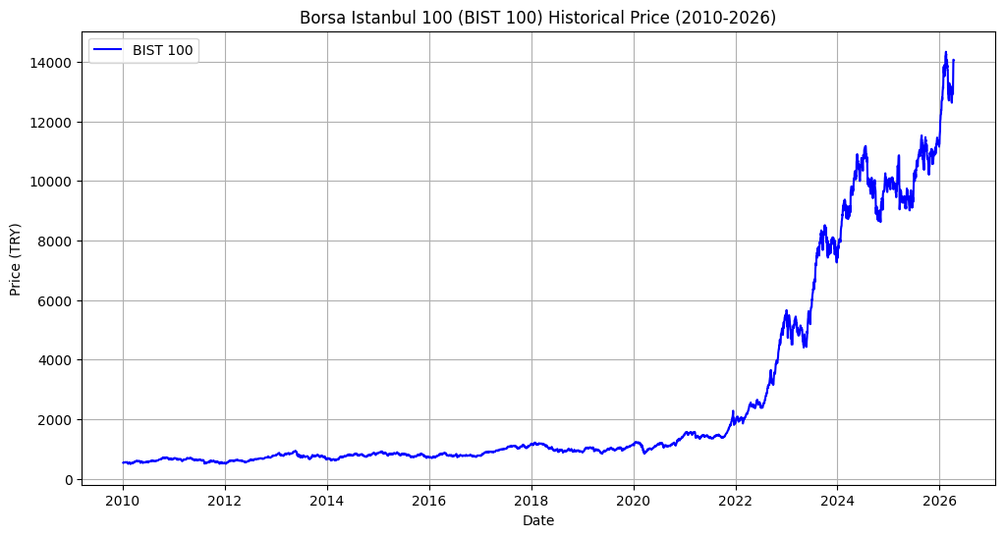
Data: 16 Years of Market History
4,231
Daily obs.
2010–2026
5
Features
Price + Macro
30d
Lookback
BIST 100 exponential surge post-2021: non-stationarity → log returns as target
per prediction

Slide 4
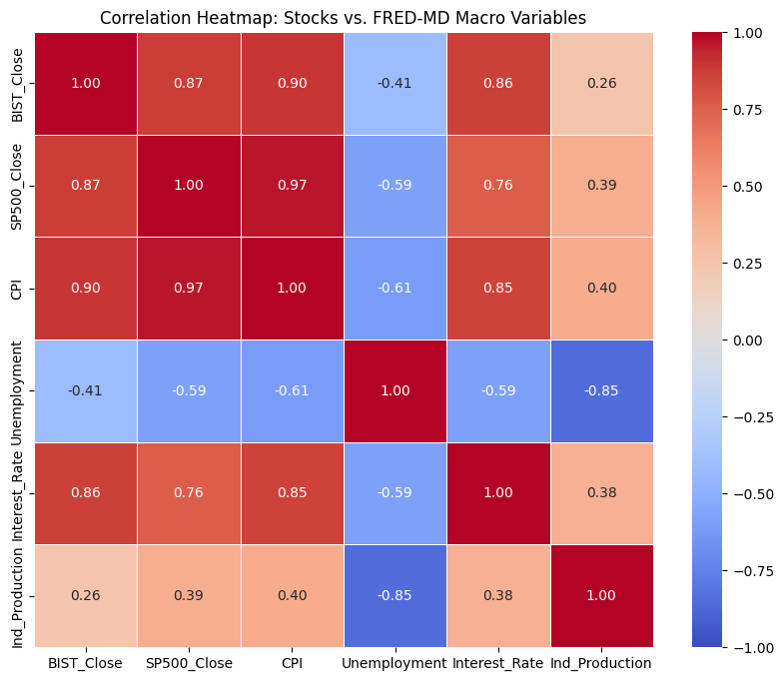
Feature Selection: What Drives BIST 100?
r = +0.90
BIST 100 & CPI
Inflation drives nominal prices
r = +0.87
BIST 100 & S&P 500
Global market linkage
r = −0.85
UNRATE & INDPRO
Redundant → UNRATE excluded
Final feature set: D = 5 (BIST100, SP500, CPI, FEDFUNDS, INDPRO)

Slide 5
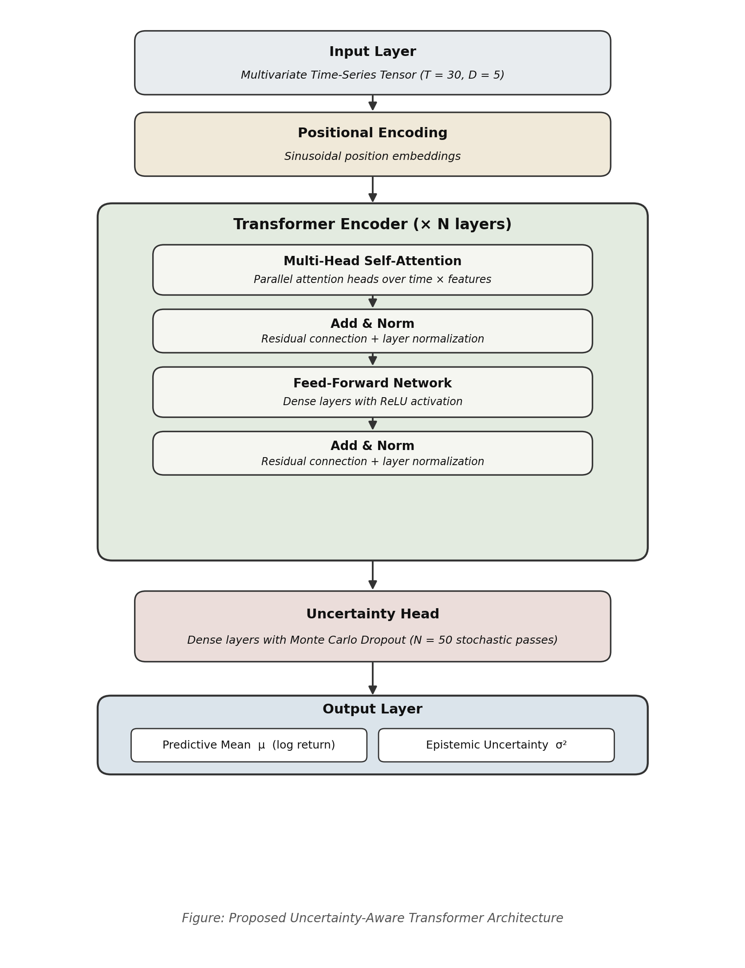
How Our System Works
1
2
3
4
30 days of data
enters the model
Transformer learns
which days matter
Model runs
50 times
Prediction +
Confidence Level
Transformer Architecture
Output: μ
• Input projection → Positional Encoding
Predicted return
• Multi-Head Self-Attention (4 heads)
Output: σ
• Feed-Forward Network + Add & Norm
Epistemic uncertainty
• MCDropout Uncertainty Head (N=50)

Slide 6
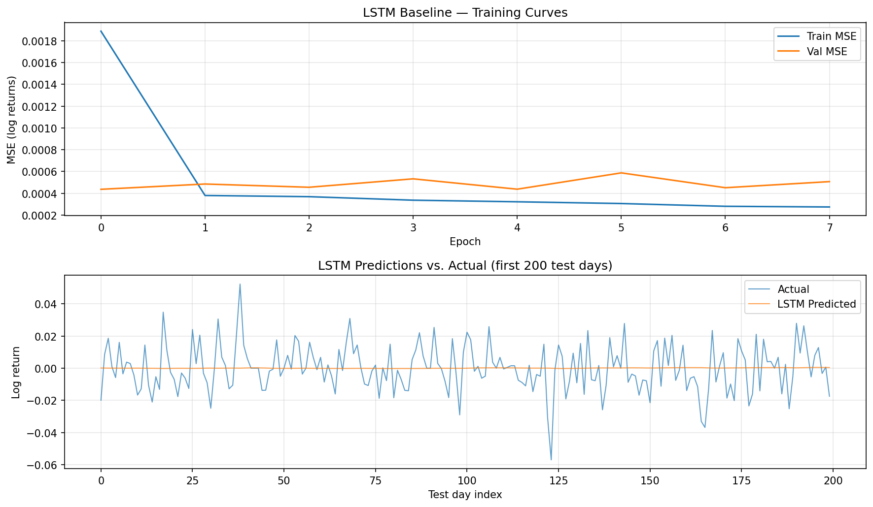
Baseline: LSTM Training Results
LSTM
Baseline
Architecture
2-layer LSTM
Hidden dim
64
Lookback
T = 30 days
Stopped at
Epoch 8
Dir. Acc.
49.8%
Predictions (orange) nearly flat near 0 -> model defaults to "no change" direction → serves as our challenge to beat

Slide 7
Results: How Well Did It Work?
Model
MAE
RMSE
Direction %
Naive (always predict: no change)
0.0108
0.0149
0%
LSTM Baseline
0.0104
0.0145
49.8%
Transformer + MCD (our model)
0.0113
0.0152
51.4%
The key metric: Direction Accuracy
51.4% suggests a weak directional signal above the 50% random threshold, though this should be interpreted cautiously given the test set size. The naive baseline scores 0% by construction, as predicting no change never commits to a direction.
Training: 17 epochs | Best val MSE: 0.000437
Mean uncertainty: σ = 0.0035 (range 0.0017–0.0059)

Slide 8
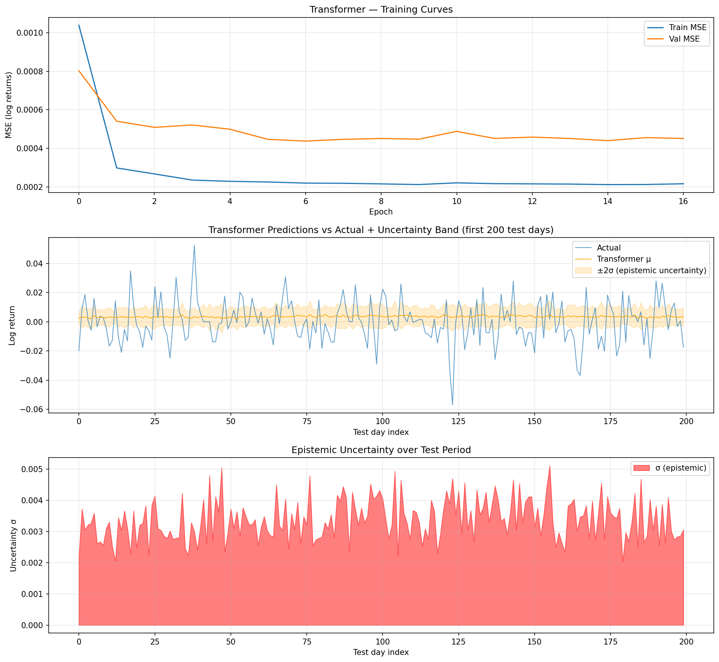
Transformer Predictions + Uncertainty Band
Top panel
Training converges in 17 epochs. Val MSE stabilises around 0.00044.
Middle panel
Orange band = ±2σ uncertainty. Wider when market is volatile.
Bottom panel
σ spikes during turbulent days — model correctly flags uncertainty.

Slide 9
What Does 'Uncertainty' Mean Here?
Like a weather forecast:
"70% chance of rain" is more useful than "it will rain" --> you know how confident the forecast is.
Low Uncertainty (σ ≈ 0.0017)
High Uncertainty (σ ≈ 0.0059)
Model has seen similar patterns
Market behaving normally
Trust the prediction more
Unusual market conditions
Model in unfamiliar territory
Reduce position size, be cautious
0.0035
0.0017
0.0059
N = 50
Mean σ
Min σ
Max σ
MC passes

Slide 10
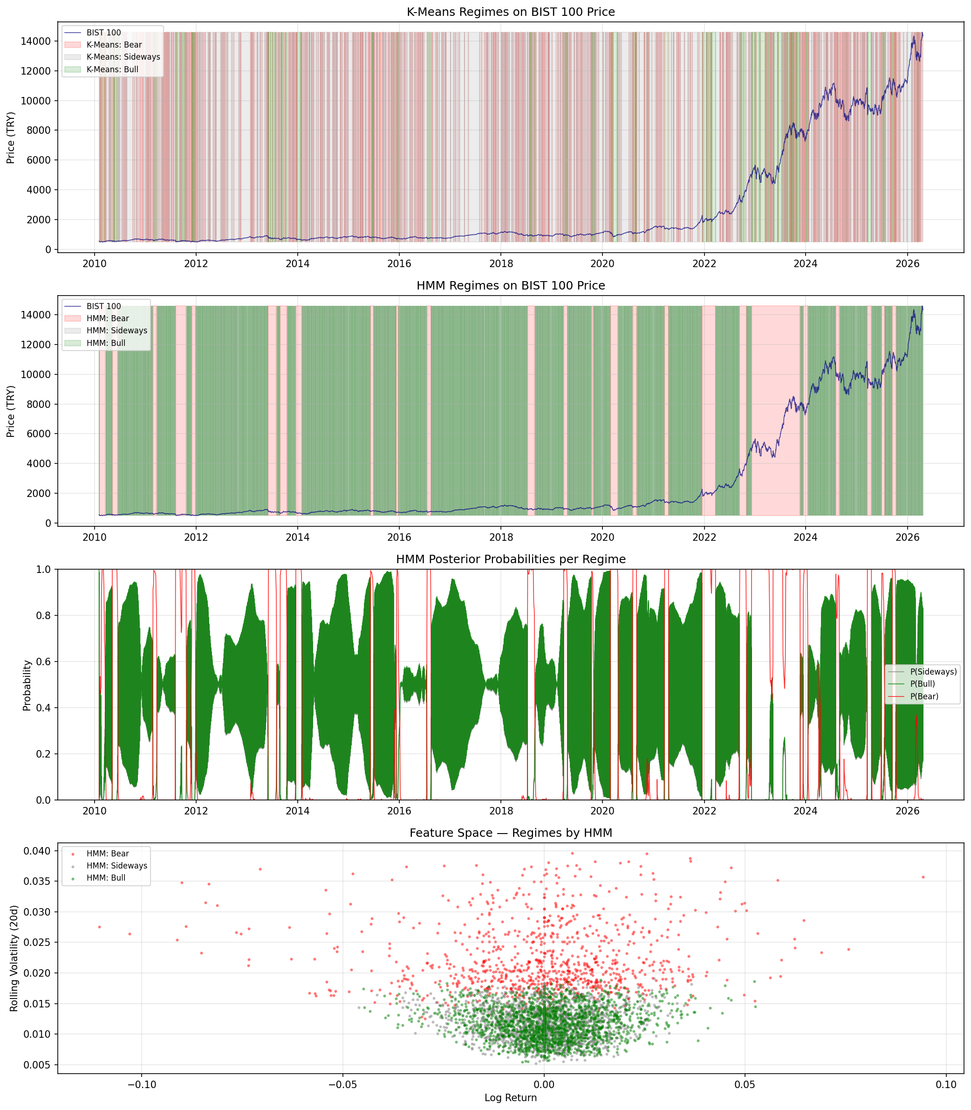
Market Regimes: K-Means + HMM
Bull
39%
1,648 days
Sideways
39%
1,642 days
Bear
22%
921 days
2023 = 243 Bear days
TL Crisis validated

Slide 11
What Did We Learn?
Predicting markets is hard, and that is actually expected (Efficient Market Hypothesis).
Public information is already priced in. Our contribution is the uncertainty signal and regime context, not raw accuracy.
✓
Directional accuracy 51.4% —> above 50% random threshold, model learns a signal
✓
Uncertainty signal rises during volatile periods —> model knows when it is unsure
✓
2023 Bear regime (243 days) correctly identified —> matches Turkey's currency crisis
~
MAE & RMSE close to naive —> expected, consistent with EMH literature, not a failure
✗
Regime labels not yet fed into Transformer —> connecting them is the next step

Slide 12
Conclusion
End-to-end forecasting pipeline
1
16 years of real BIST 100 data. Data collection → preprocessing → training → evaluation, fully reproducible.
Uncertainty-aware predictions
2
Monte Carlo Dropout (N=50) produces σ alongside every forecast. Grounded in Bayesian theory (Gal & Ghahramani, 2016).
Market regime detection
3
K-Means + HMM identifies Bull / Sideways / Bear. 2023 Bear regime (243 days) matches the real TL crisis.
Future: Condition Transformer on regime state • Uncertainty-aware training loss • Risk-adjusted trading evaluation

Slide 13
Live Demo
demo_live_forecast.ipynb, runs in 2 minutes on Google Colab
1
2
3
4
Upload data
Train model
Live forecast
Regime check
financial_data.csv → 4,231 days loaded
Transformer trains on 2010–2022 (~45 sec)
Last 30 days → 50 MC passes → μ + σ
HMM detects current market state
Forecast Output
Regime Output
Direction : UP ▲ / DOWN ▼
State : Bull / Sideways / Bear
μ (log return) • σ (uncertainty)
P(Bull) • P(Sideways) • P(Bear)
Confidence label: HIGH / MODERATE / LOW
Recommendation: trade or be cautious

Slide 14
Thank You
Questions?
4,231
51.4%
N=50
3
days of data
direction accuracy
MC passes
market regimes
Lara Yıldırım • Belkıs Derin Yüksel
github.com/derinyuksel/ADL-financial-forecasting

