Slide 1
FUNDAMENTALS OF BLOCKCHAIN · PROJECT
EtherQuest
Blockchain-Based Item Ownership for Fantasy RPGs
Your game items belong to you forever — not the game company
Derin Yüksel - 2200001724
EQ
Fundamentals of Blockchain · April 2026
Solidity · Remix IDE · Sepolia Testnet · MetaMask
EtherQuest Marketplace | Sepolia: 0xEd3B...0dDa
1 / 9

Slide 2



The Problem Definition
Why current game-item ownership is broken
01
02
03
Game Owns Everything
Account Bans = Total Loss
Trading Is Restricted or Taxed
When EtherQuest's servers go dark, the items still exist on-chain. A community fork, a sequel, or any compatible client can read them and honor the same stats. Even with no successor, the item remains tradeable on secondary markets — the value doesn't reset to zero overnight.
A banned account loses access to the game, but the wallet still holds the items. The player can sell them on the open market to active players and recover most of the spend. In the current system a ban zeros your inventory; on-chain, a ban becomes a forced sale, not a wipe.
Steam's Community Market takes 15% on every trade (5% Steam fee + 10% game fee on CS items) and bans cash withdrawals — your sale proceeds are locked to Steam Wallet credit. Most other games forbid peer-to-peer trades outright. On-chain, two wallets settle directly with only network gas in between.
The gap: Players spend real money on items they don't actually own. The game's database is a permission, not a deed.
EtherQuest Marketplace | Sepolia: 0xEd3B...0dDa
2 / 9

Slide 3
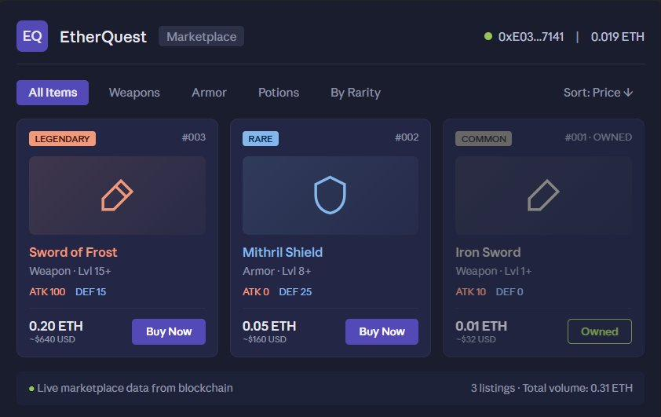


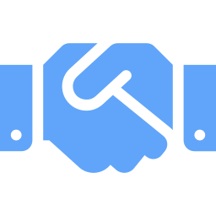
The Proposed Blockchain Solution
A smart contract that makes every item portable, permanent, and provably yours
True ownership
Item ownership lives in a public ledger keyed to the player's wallet — not a private database row.
Survives the studio
Even if EtherQuest's servers go offline tomorrow, items remain on-chain. Any future client can read them.
Provably unique items
Every item has an on-chain id, fixed stats (ATK, DEF, rarity), and a verifiable history of every owner who ever held it. A "Legendary Sword of Frost #003" is genuinely one-of-a-kind — not a database entry the studio could duplicate, nerf, or revoke.
EtherQuest in-game marketplace — every listing is a smart-contract call
Real precedent Axie Infinity's items have generated billions in secondary trade volume. Gods Unchained and Illuvium followed the same model. This is a proven design — not a thought experiment.
EtherQuest Marketplace | Sepolia: 0xEd3B...0dDa
3 / 9

Slide 4


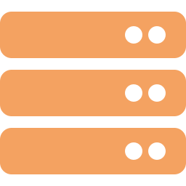
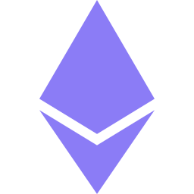

System Architecture & Actors
Where each responsibility lives — and why the split matters
Three actors, one ledger
Game Admin
Player Wallet
Smart Contract
The studio. Mints new items, sets initial prices. The only address allowed to call createItem.
Any Ethereum address. Buys, sells, gifts, and lists items. Signs every action via MetaMask.
The neutral ledger. Records who owns what, transfers ETH atomically with ownership changes.
Off-chain · On-chain split
OFF-CHAIN
ON-CHAIN
The game itself
This contract
Graphics, animation, combat resolution
Quest logic, story, NPC behaviour
Real-time multiplayer, matchmaking
Sound, art assets, the entire client
Item ownership records
Buy / sell / gift transactions
Marketplace listings and prices
Item stats — ATK, DEF, rarity
EtherQuest Marketplace | Sepolia: 0xEd3B...0dDa
4 / 9

Slide 5
Atomic – ETH and ownership move in the same transaction; no half-trades.
Permissioned mint — require(msg.sender == gameAdmin) blocks rogue minting.
Public state — anyone can verify item history via getItem() on Etherscan.
Smart Contract Logic
Three core functions handle the entire item lifecycle
EtherQuestMarketplace.sol
createItem()
Admin only
// Player buys an item — payable, atomic
function buyItem(uint256 _itemId) public payable {
require(items[_itemId].forSale, "Not for sale");
require(msg.value >= items[_itemId].price, "Insufficient ETH");
address previousOwner = items[_itemId].owner;
payable(previousOwner).transfer(msg.value);
items[_itemId].owner = msg.sender;
items[_itemId].forSale = false;
playerInventory[msg.sender].push(_itemId);
}
// Only the admin can mint — protects game balance
function createItem(
string memory _name, string memory _itemType,
string memory _rarity, uint256 _attackPower,
uint256 _defensePower, uint256 _price
) public {
require(msg.sender == gameAdmin, «Only admin»);
items[nextItemId] = Item({ … });
playerInventory[gameAdmin].push(nextItemId);
nextItemId++;
}
Mints a new item with name, type, rarity, ATK, DEF, and price. require(msg.sender == gameAdmin) blocks anyone else.
buyItem()
payable
Player sends ETH ≥ price. Contract transfers ETH to seller and ownership to buyer in the same transaction — no half-trades.
giftItem()
Owner only
Owner transfers an item to any address for free. Powers free-trade, gifting, and inheritance.
Course patterns reused: mappings, structs and require (EventRegistry), payable transfers (PiggyBank), access control via msg.sender (Identity).
EtherQuest Marketplace | Sepolia: 0xEd3B...0dDa
5 / 9

Slide 6
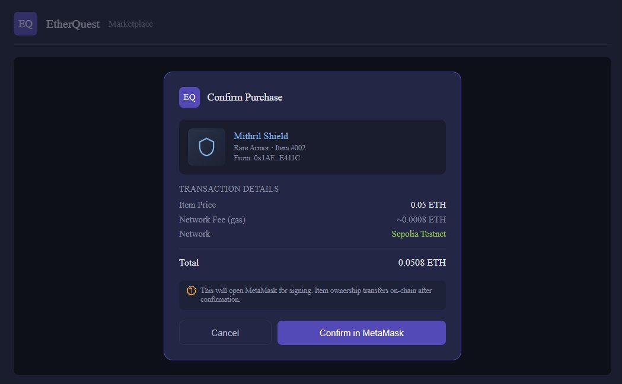
Wallet Integration
How a player's wallet becomes their in-game identity
MetaMask is the bridge
A browser-based wallet that holds the player's private keys locally and signs every transaction. The game client never sees the keys — only the resulting signed payload.
1
Player connects wallet
Game UI requests connection. Player approves once. Wallet address becomes the player's account ID — no email, no password.
2
Player clicks Buy
Game encodes a buyItem(itemId) call and sends it to MetaMask, with the item price as msg.value.
3
Wallet signs and broadcasts
Player approves in MetaMask. Transaction is mined on Sepolia. Ownership updates on-chain — game UI refreshes from the contract.
In-game purchase flow — every Buy click is a signed transaction
EtherQuest Marketplace | Sepolia: 0xEd3B...0dDa
6 / 9

Slide 7
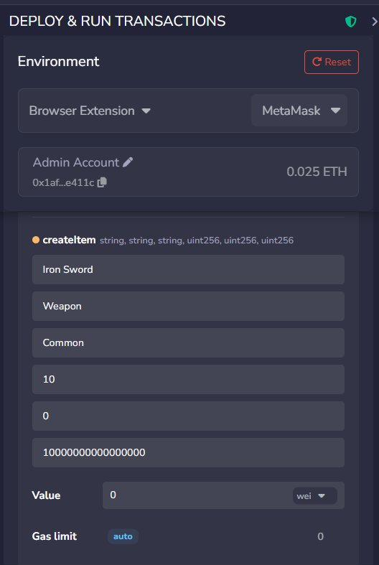
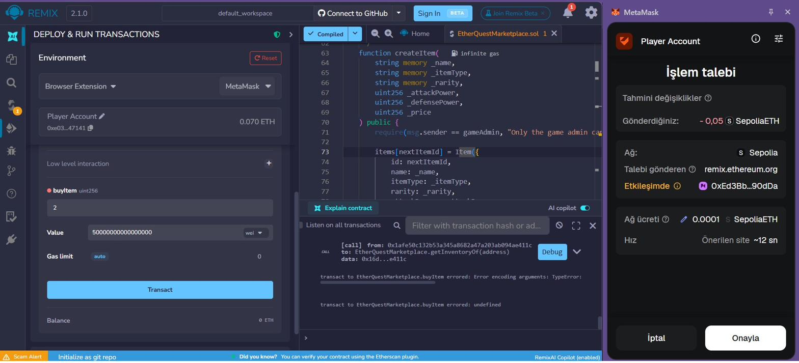
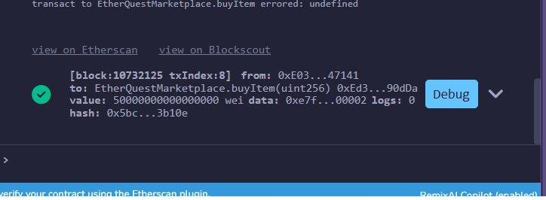
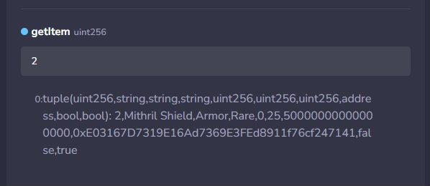
Live Demo
CONTRACT 0xEd3Bbe53...EB5586a93190dDa
Deployed on Sepolia testnet — verified via Etherscan
1. Admin creates Iron Sword
createItem() — Common, ATK 10
2. Player calls buyItem()
msg.value = 0.05 ETH, MetaMask signs
3. Transaction confirmed
4. Ownership transferred
Mined in ~12s on Sepolia
getItem() returns new owner address
EtherQuest Marketplace | Sepolia: 0xEd3B...0dDa
7 / 9

Slide 8

Limitations
Honest engineering trade-offs — what this design cannot solve
Gas costs scale with usage
Player minting
On Ethereum L1 a $1 trade can cost $0.50+ in gas. A real deployment would target a Layer 2 (Polygon, Arbitrum, Base) where fees fall to fractions of a cent.
Centralized minting is a deliberate trade-off. Pure player-driven minting is possible but requires economic safeguards (level gates, stat caps, bonding curves) outside this project's scope.
Throughput is bounded
Studio adoption is required
A million trades per day exceeds L1 capacity. Production designs use L2 rollups or app-specific chains for the trade volume.
Players cannot force a studio to inte grate the contract. The economic case has to be there — better player retention from real ownership is the lever.
The game itself is out of scope
Lost keys = lost items, permanently
This project demonstrates the on-chain layer. A full client (Unity, art, sound, server backend) is several engineering quarters of work beyond this course.
Self-custody is a feature and a risk. There is no “forgot password” flow. Production-grade games would offer optional social-recovery wallets.
EtherQuest Marketplace | Sepolia: 0xEd3B...0dDa
8 / 9

Slide 9
THANK YOU
Questions?
What I built
The takeaway Blockchain doesn't replace the game. It replaces the line in a private database that says this item belongs to you — with a public ledger that no studio, ban, or shutdown can erase.
A working Solidity contract on Sepolia that mints, sells, and transfers fantasy RPG items.
Three production-style game UI mockups (inventory, marketplace, purchase flow) showing how the contract feels in-game.
End-to-end demo: admin mints an item, a second account buys it with ETH, ownership and balances update on-chain.
Honest scoping: combat stays off-chain, only ownership lives on the ledger.
Repository: github.com/derinyuksel/etherquest-marketplace Contract (Sepolia): 0xEd3Bbe532A0cca3dfea5e9880EB5586a93190dDa
EtherQuest Marketplace | Sepolia: 0xEd3B...0dDa
9 / 9

