Slide 1
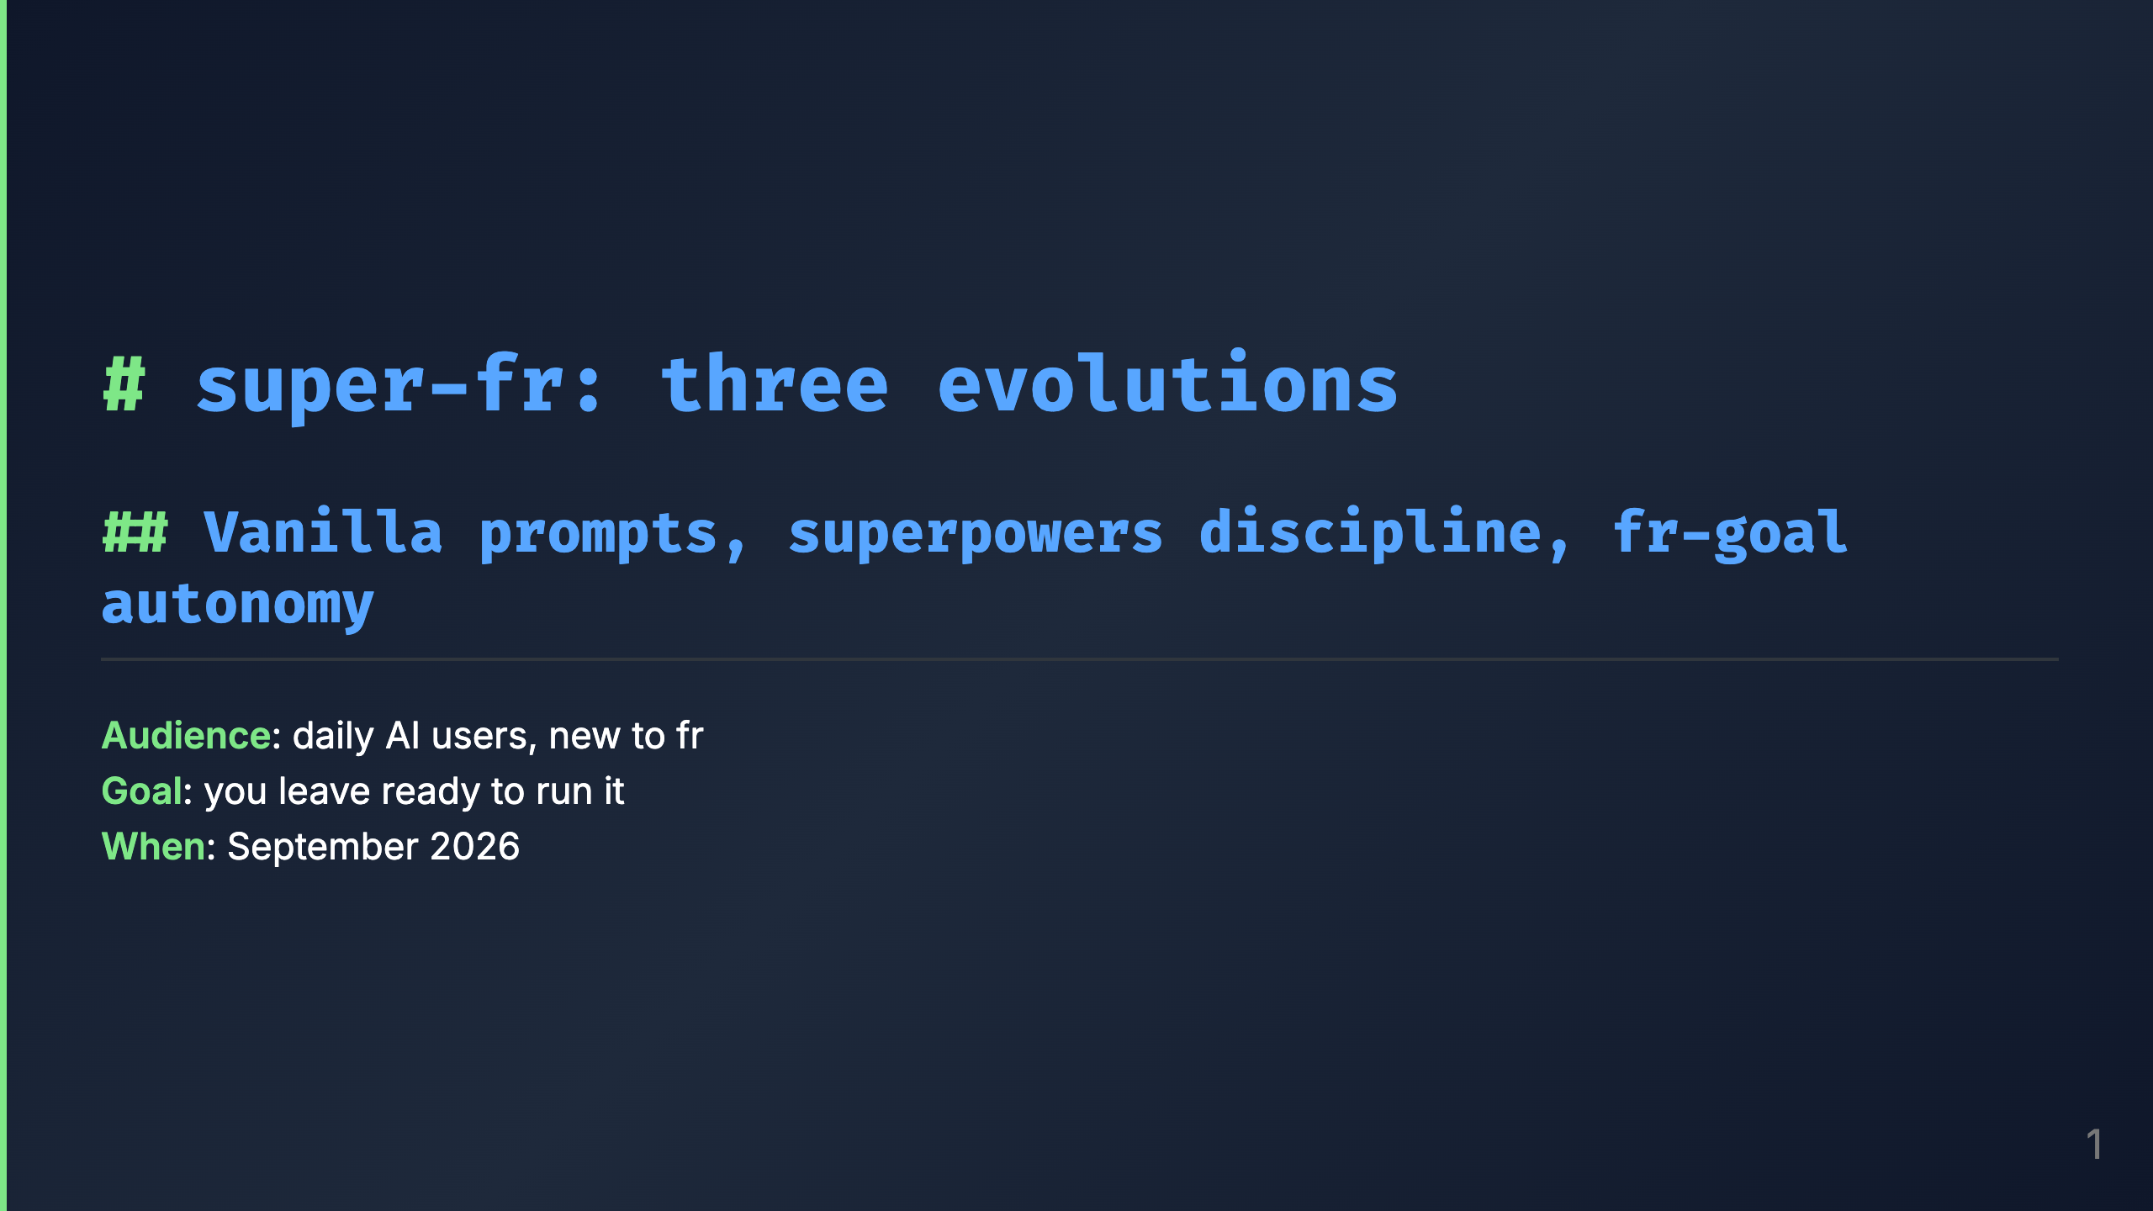
Notes:
Talk track: - Two halves today. Half 1 is yours to use on Monday: the mental model, why each piece exists, then the exact path to a first run. - Half 2, later: the same feature built twice, fr-goal versus vanilla, measured. I believe the ceremony pays. The numbers get a vote too. - No superpowers knowledge assumed. Everything is on these slides or one link away.

Slide 2
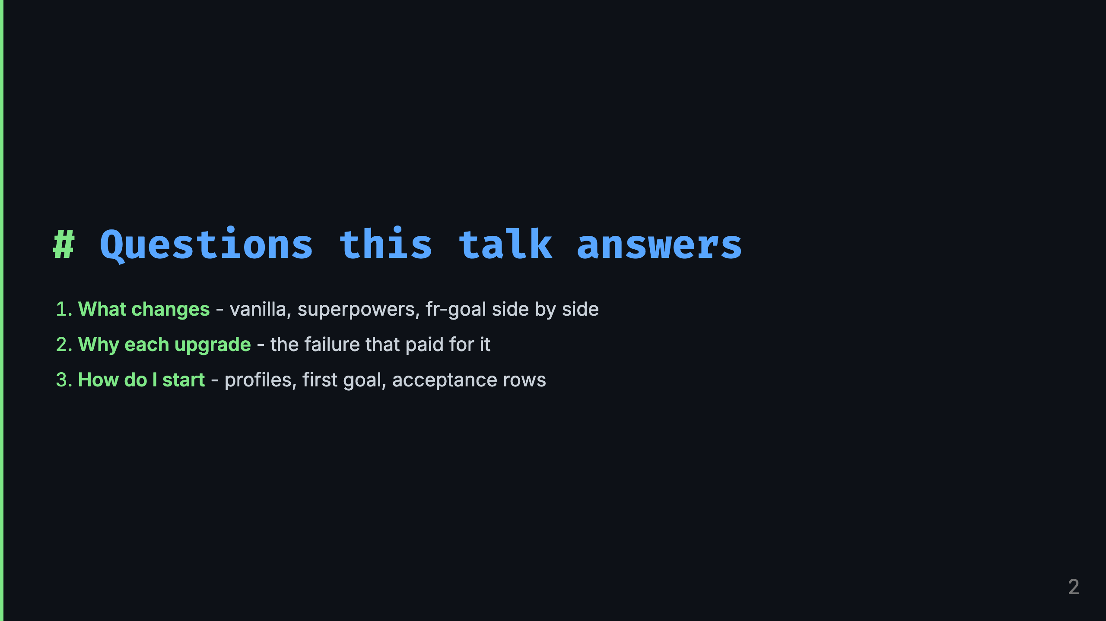
Notes:
Talk track: - Three promises. One: a mental model you can hold in your head, the shape and the cursor. - Two: honesty about cost. Every mechanism here slowed something down to prevent something worse. You get the failure stories, not just the features. - Three: runnable. Install, profile interview, first goal, acceptance rows. If the wifi holds there may be a live command or two.

Slide 3
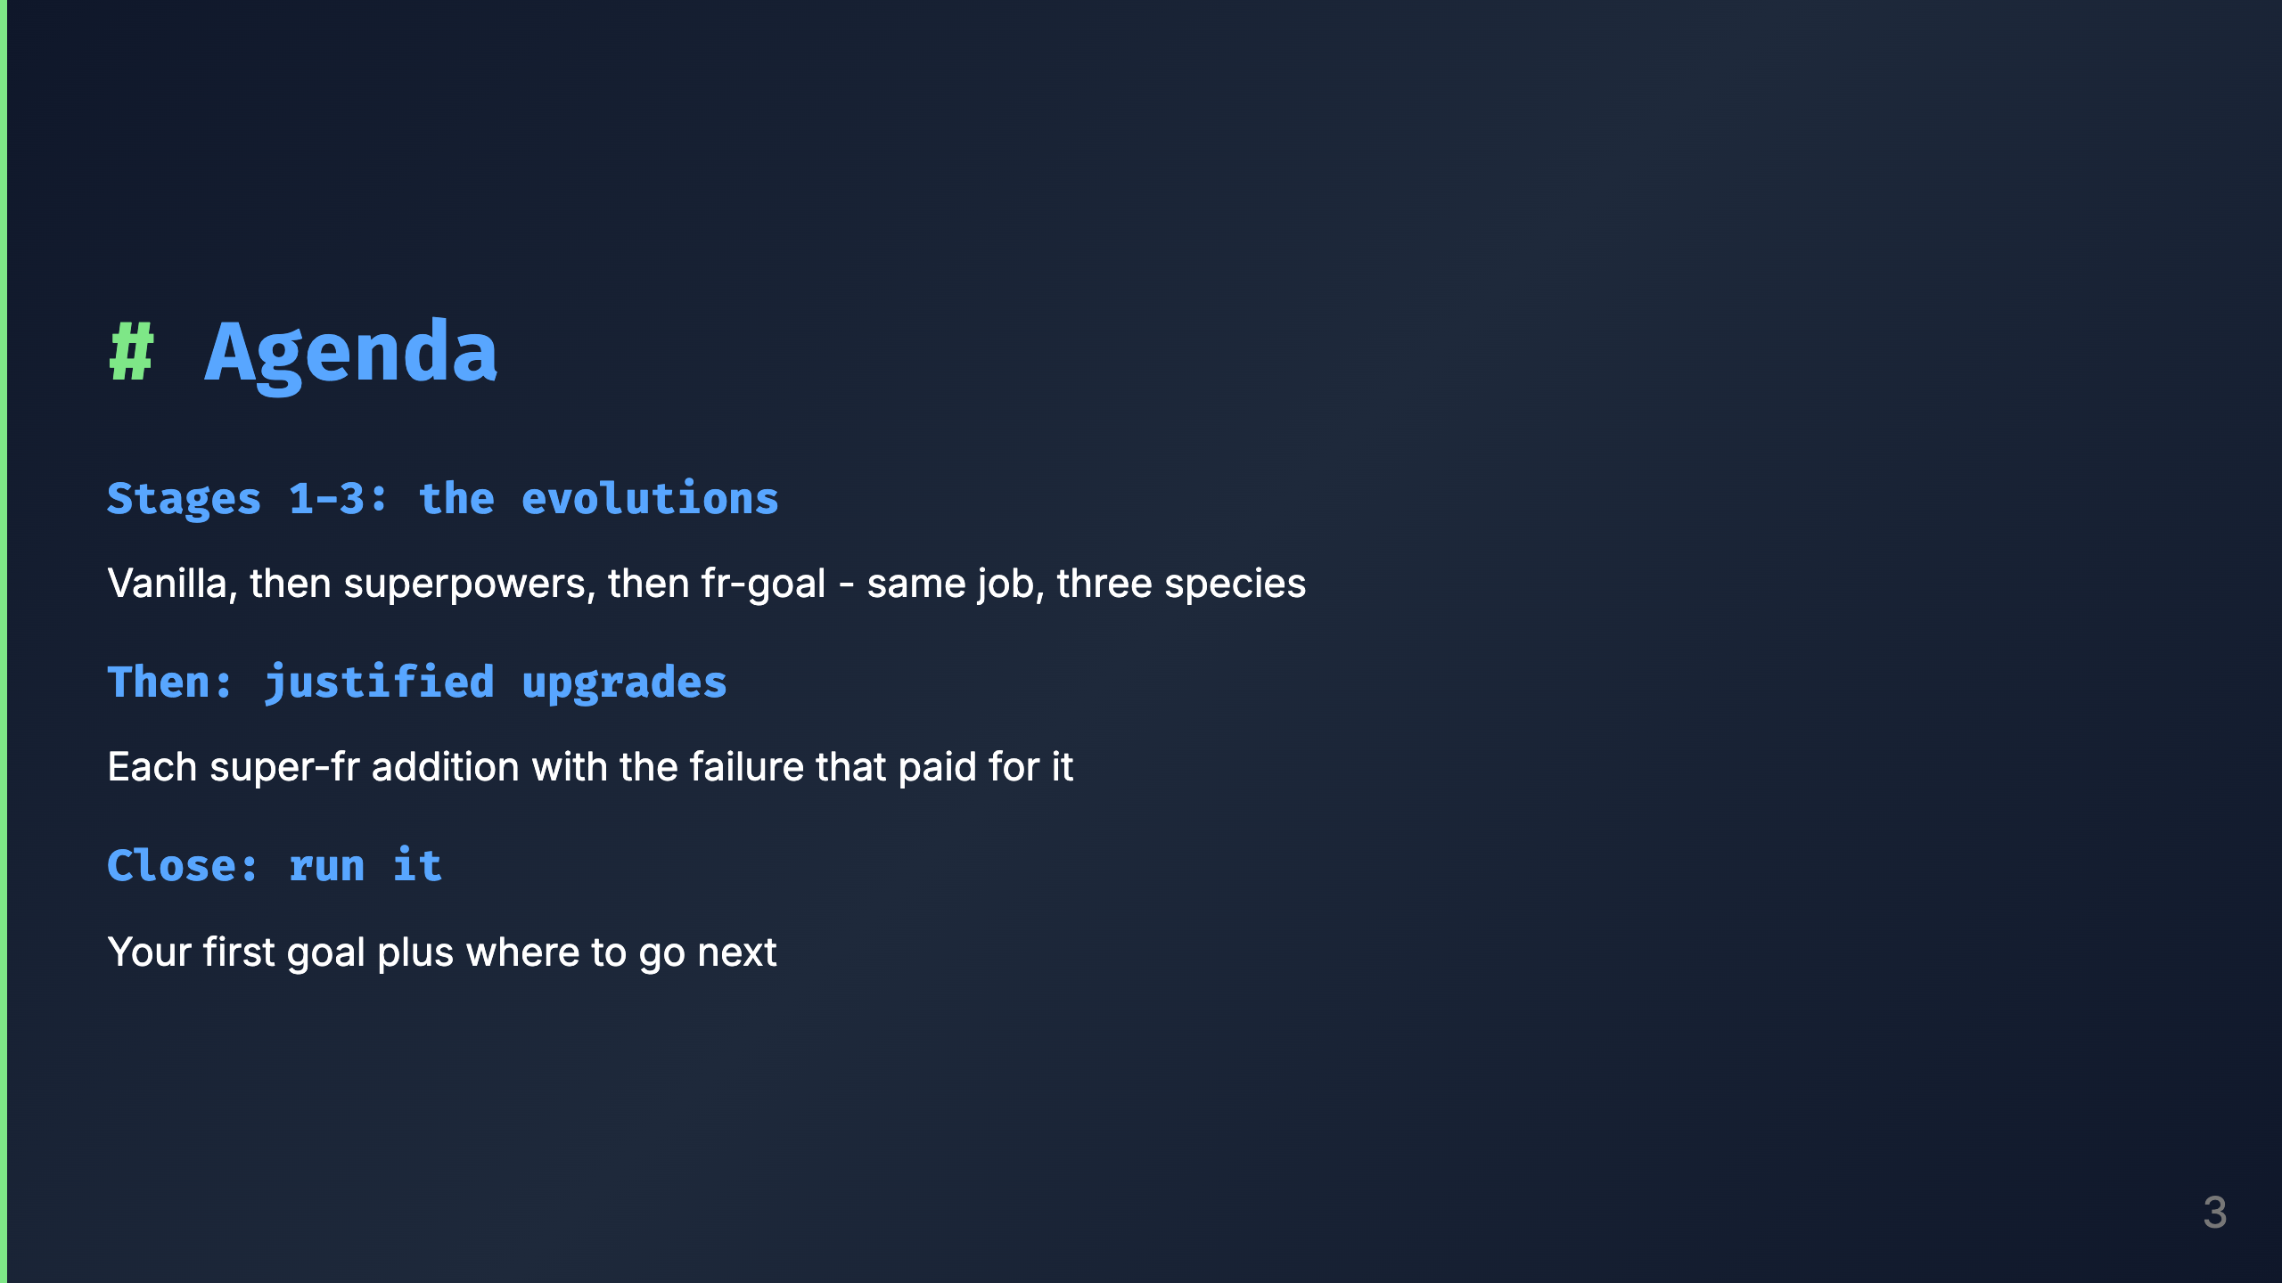
Notes:
Talk track: - Shapes first, scars second. The model gives scars somewhere to hang. Then we get practical. - Part 1 is the only abstract part. Survive it and the rest is stories plus commands.

Slide 4
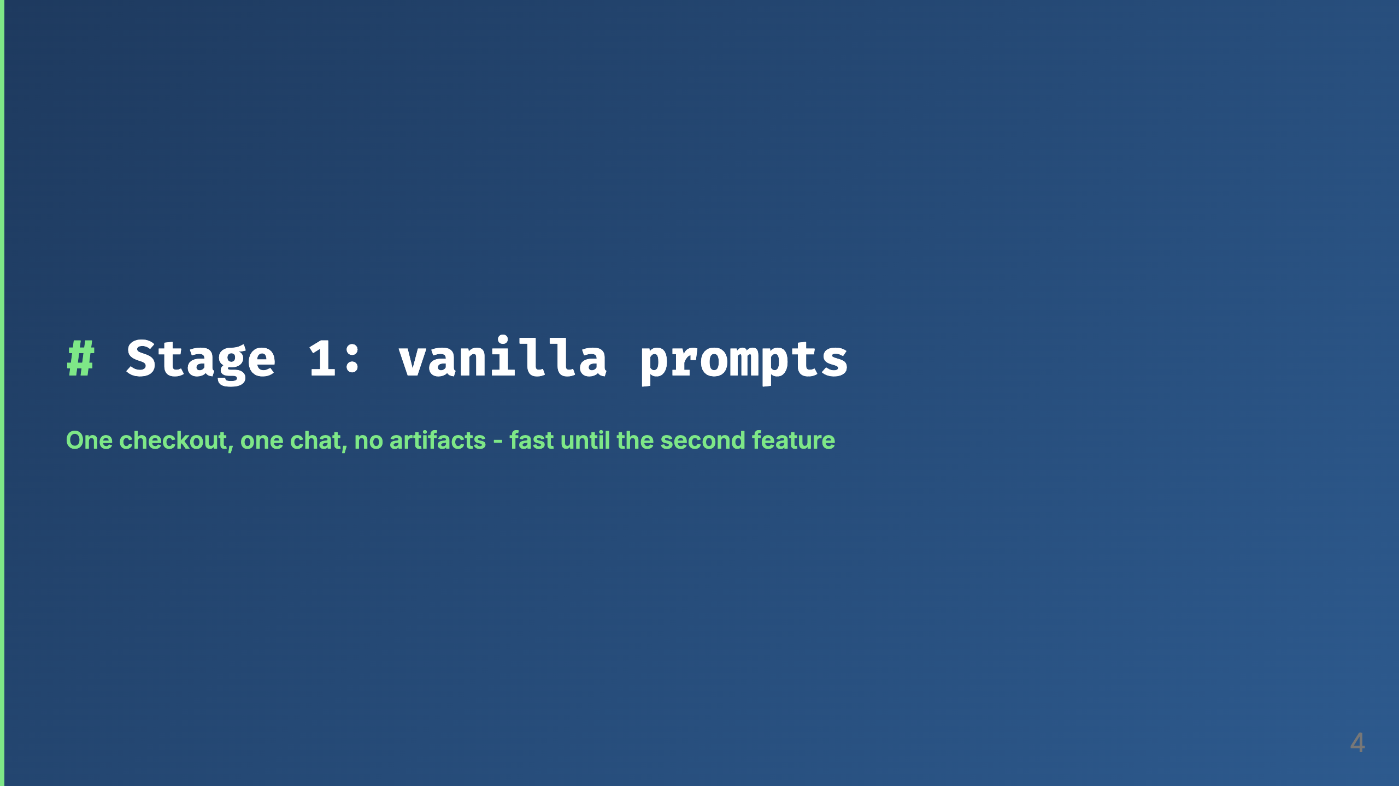
Notes:
Talk track: - Meet Charmander. You prompt, the model plans in chat, codes in your checkout, you eyeball it and push. - Nothing here is wrong at small scale. Everything here breaks at the second concurrent feature: the plan lives in chat history, the half-done state lives in your checkout, done means it looked right. - Keep this slide in mind. Every later stage is a response to something on it.

Slide 5
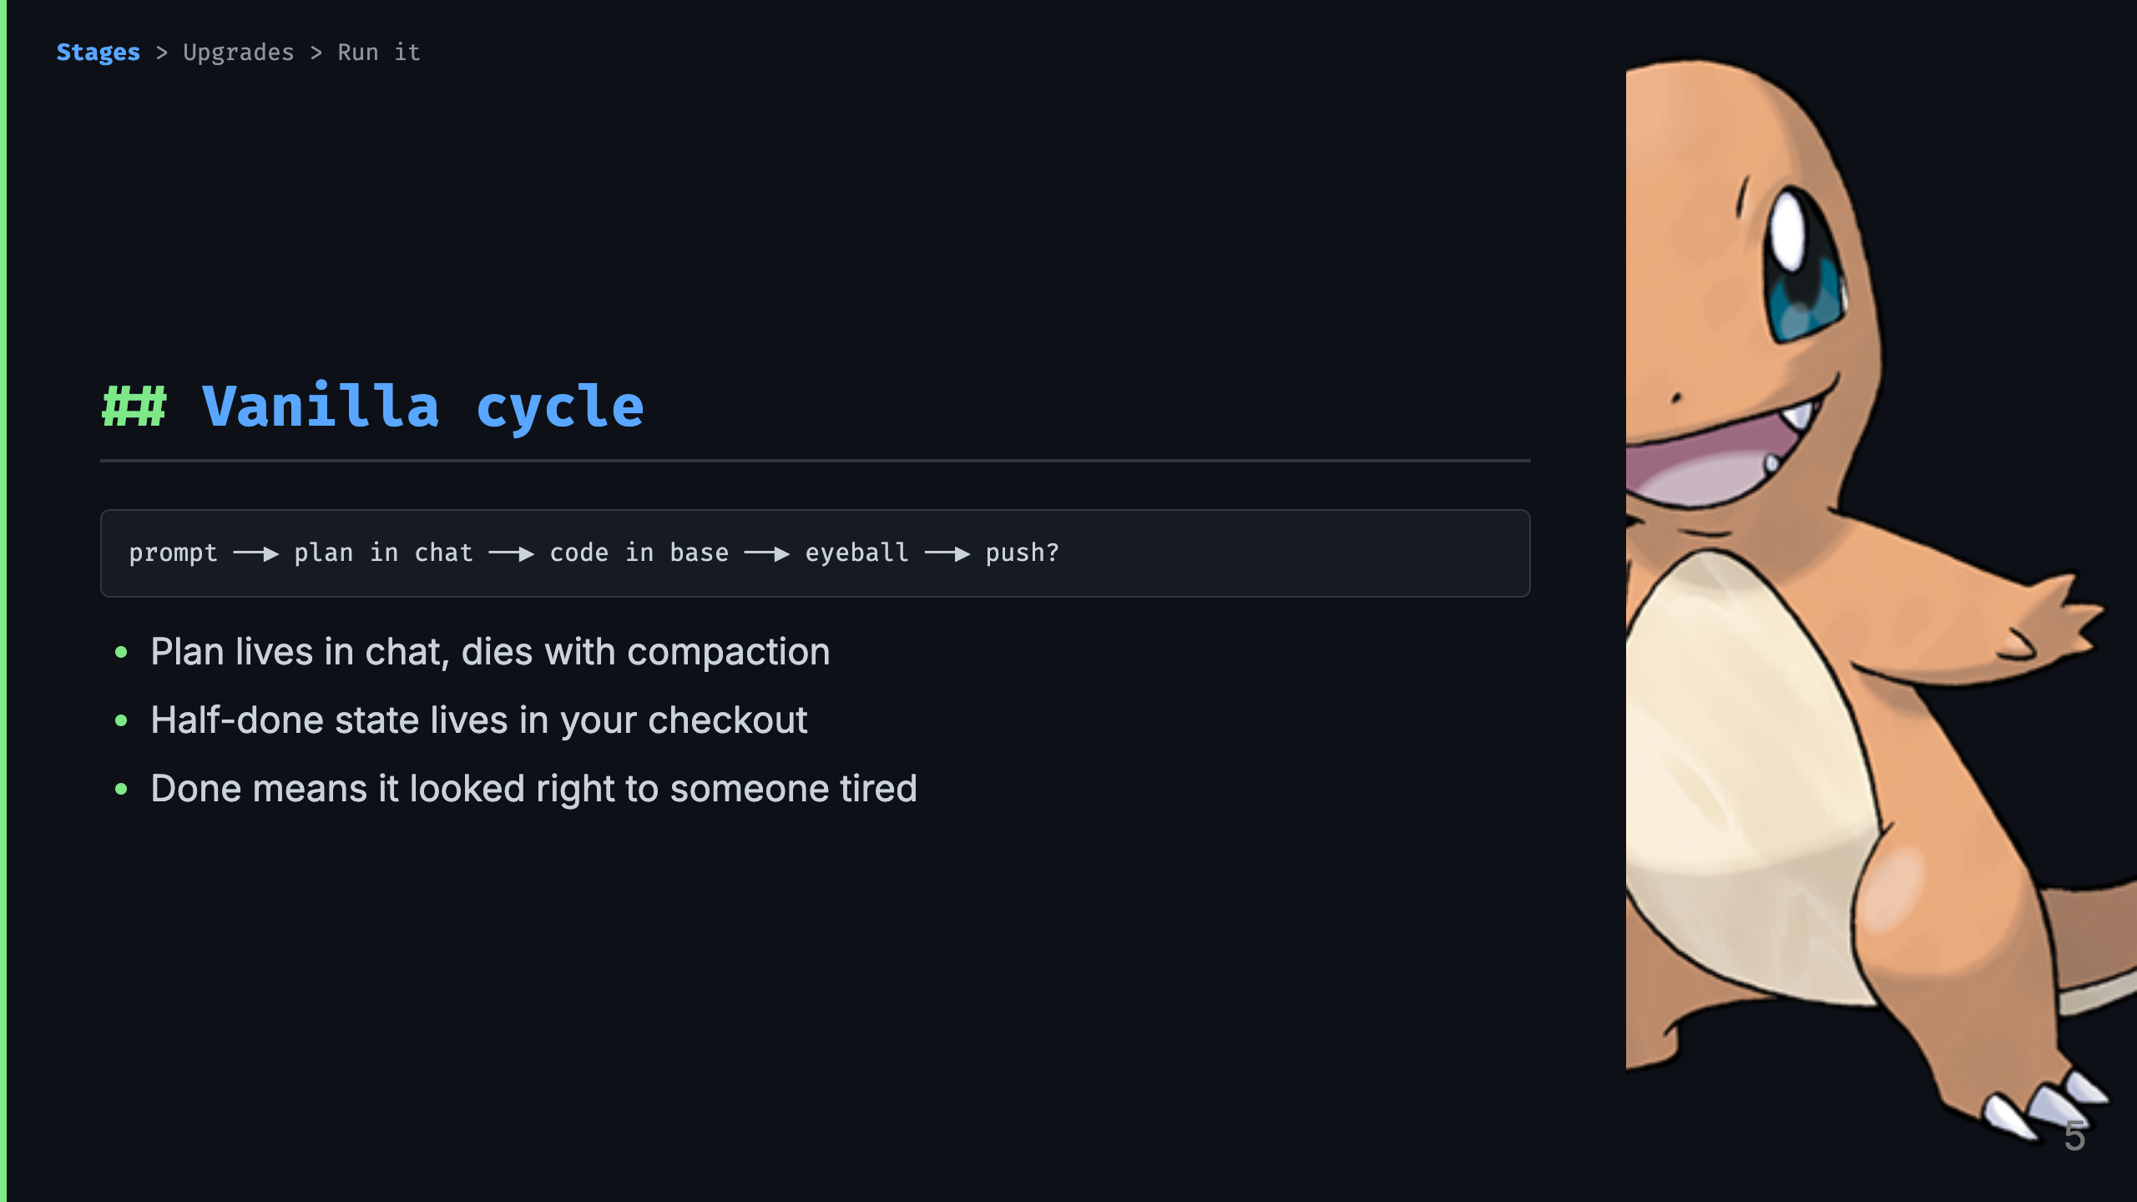
Notes:
Talk track: - Four boxes and a question mark. The plan is a rumor the chat tells itself. Your checkout holds finished work and half-thoughts side by side. - Verification is eyeballing. There is no gate that can say no. - This is the baseline the next two evolutions upgrade. Charmander is beloved and completely unequipped.

Slide 6
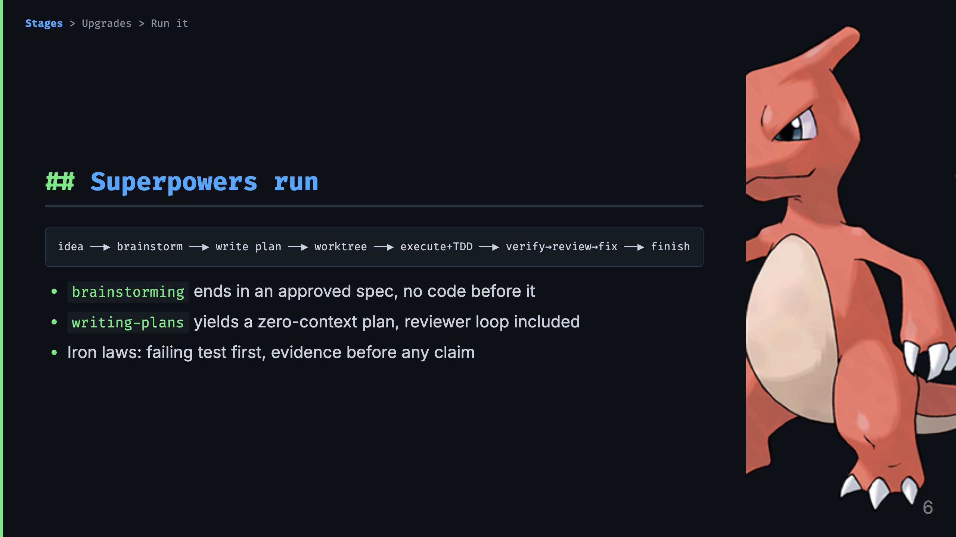
Notes:
Talk track: - Charmeleon. Same job, now with structure: brainstorming produces a spec markdown and refuses code until the design is approved. Writing-plans produces a plan markdown a fresh session could execute. - Execution picks subagent-driven or inline, test-driven-development runs the red-green-refactor loop inside, verification-before-completion forbids completion claims without a fresh full-command run. - Review is double-sided: requesting dispatches a SHA-scoped review, receiving bans performative agreement and demands verification. Finishing offers four options and cleans up the worktree. - Gaps remain, and they are the next slide deck: one markdown plan, session memory doing the carrying, worktree as a sidecar.

Slide 7
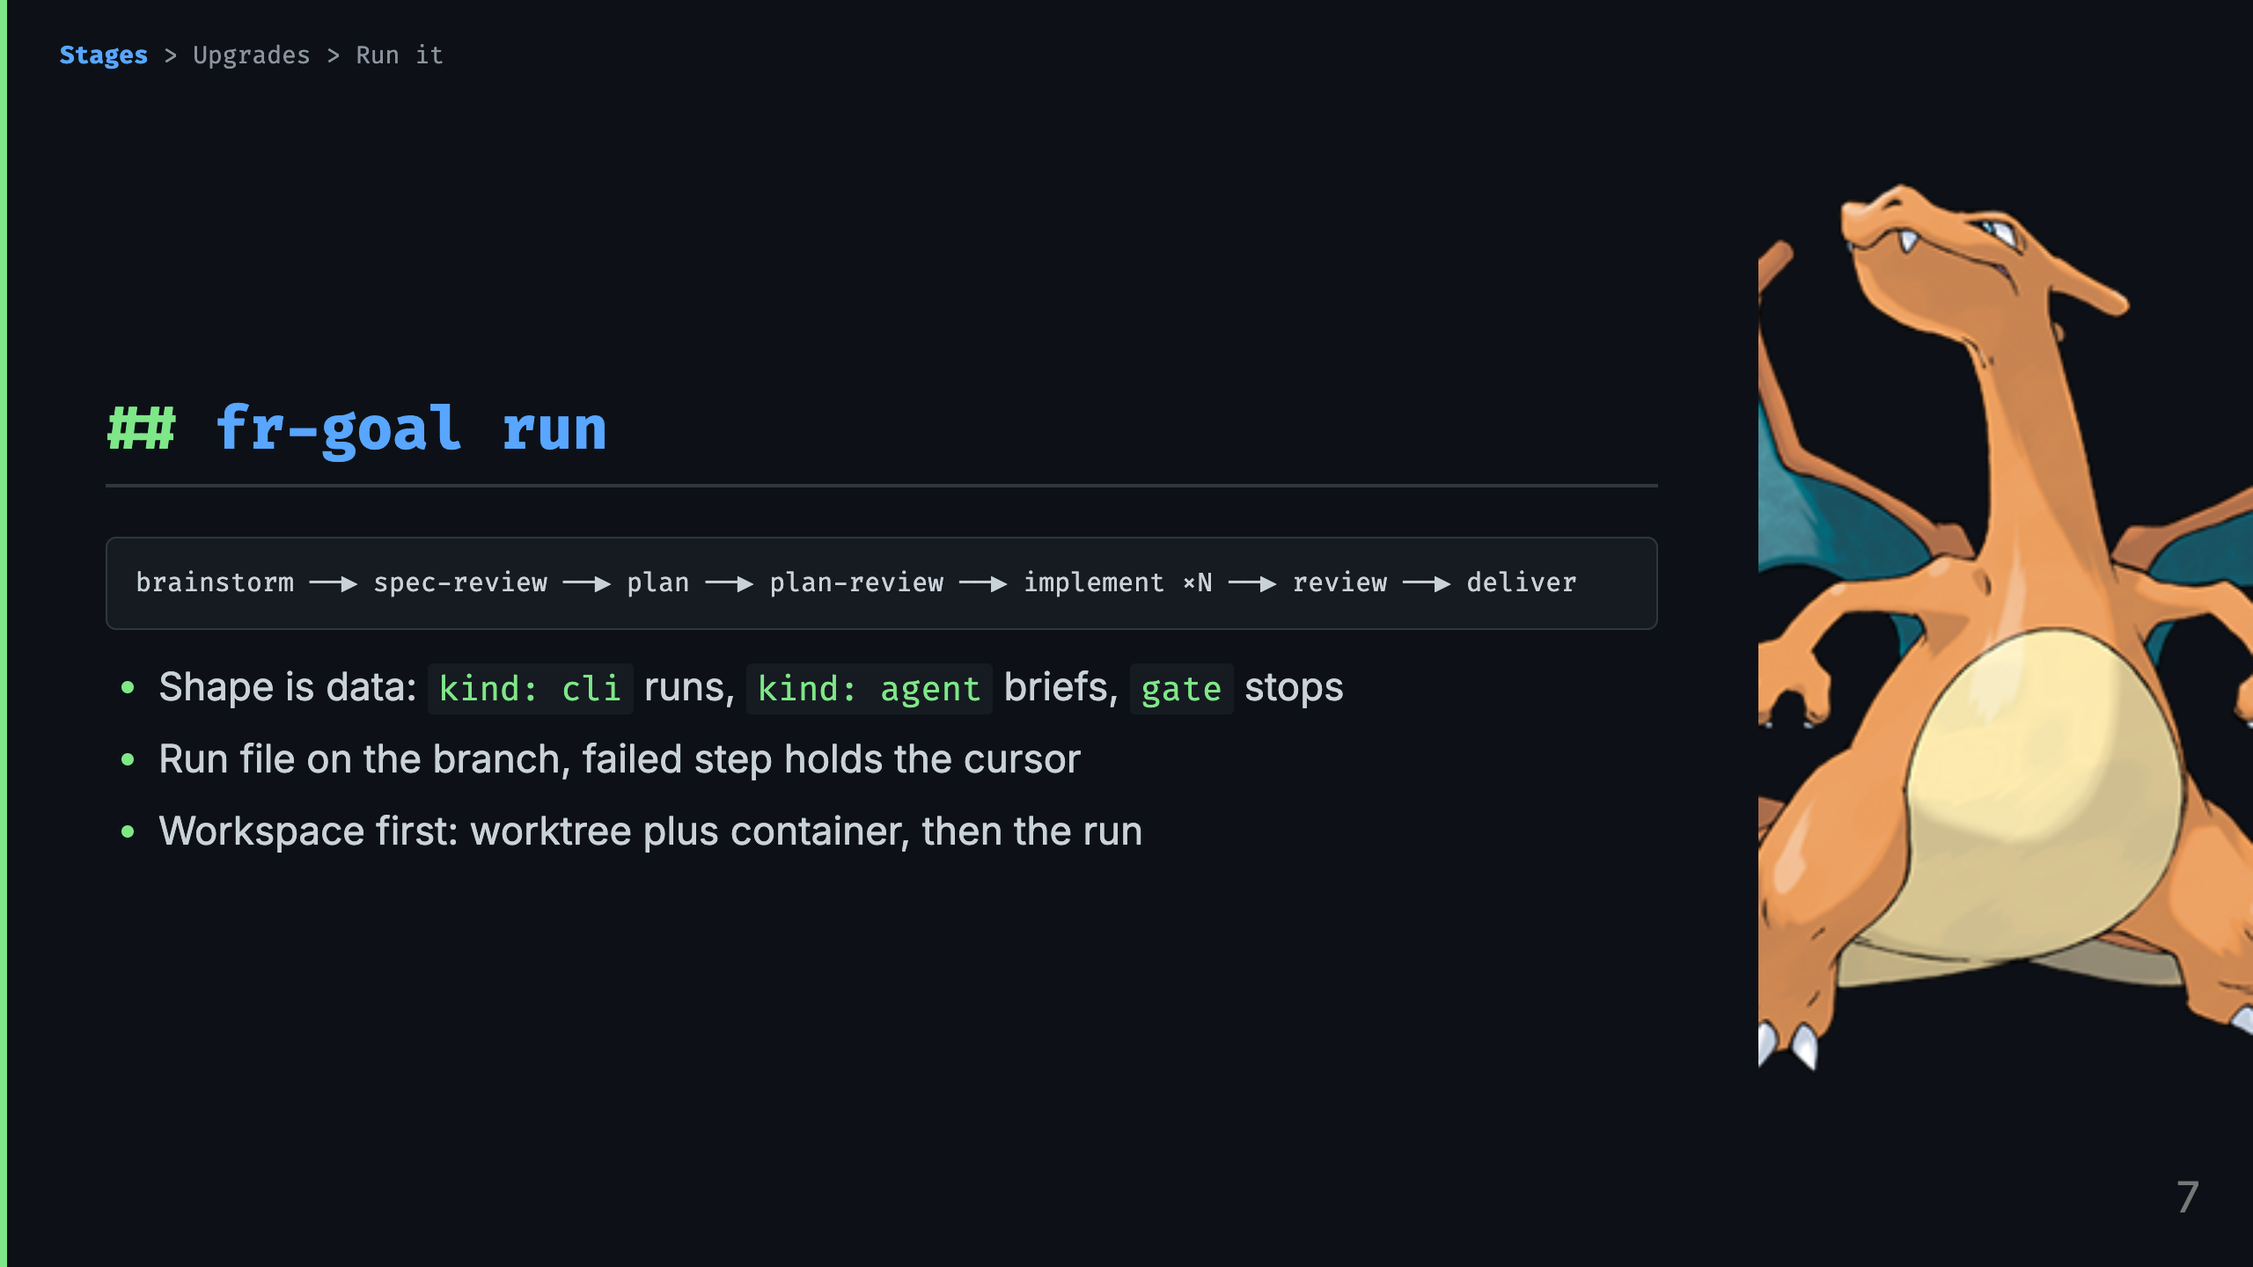
Notes:
Talk track: - Charizard. Same shape as Charmeleon, new species: the pipeline is a yaml manifest that validates, the cursor is a file on your branch that survives compaction, and isolation is mandatory worktree plus devcontainer, not a sidecar. - Cli steps execute with exit code as verdict. Agent steps print a brief, you work, you resolve. The single operator gate is the batched question round. - Everything after this slide is one super-fr addition presented as the upgrade it is: what superpowers lacked, what failure paid for it, what it costs.

Slide 8
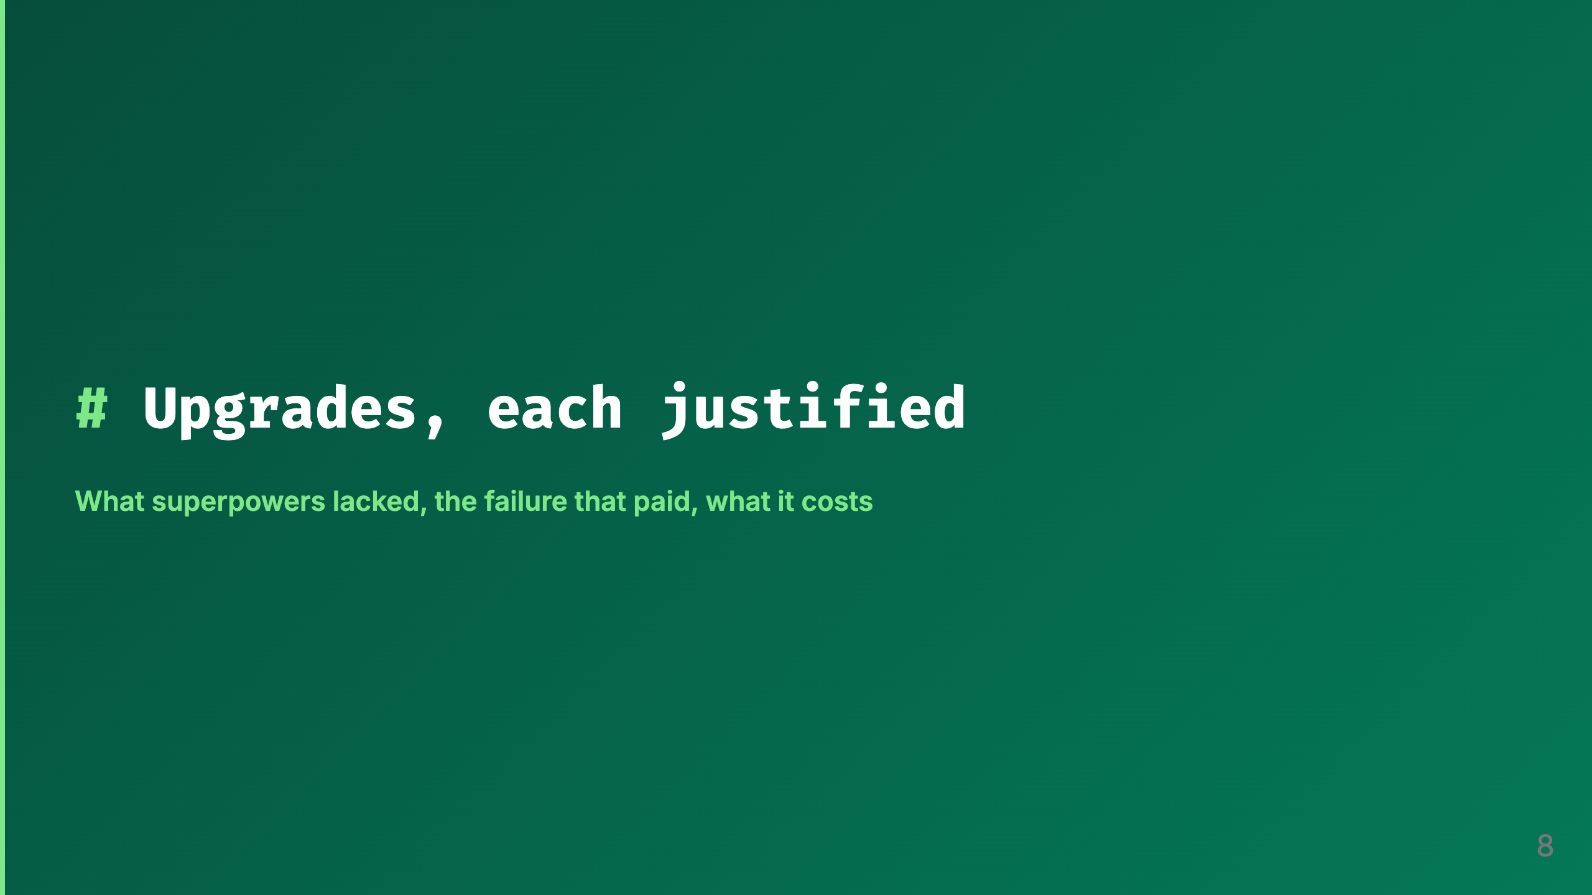
Notes:
Talk track: - The evolutions showed the what. These next slides show the why, one upgrade at a time. Each follows the same shape: what superpowers lacked, the failure that paid for the addition, what it costs you.

Slide 9
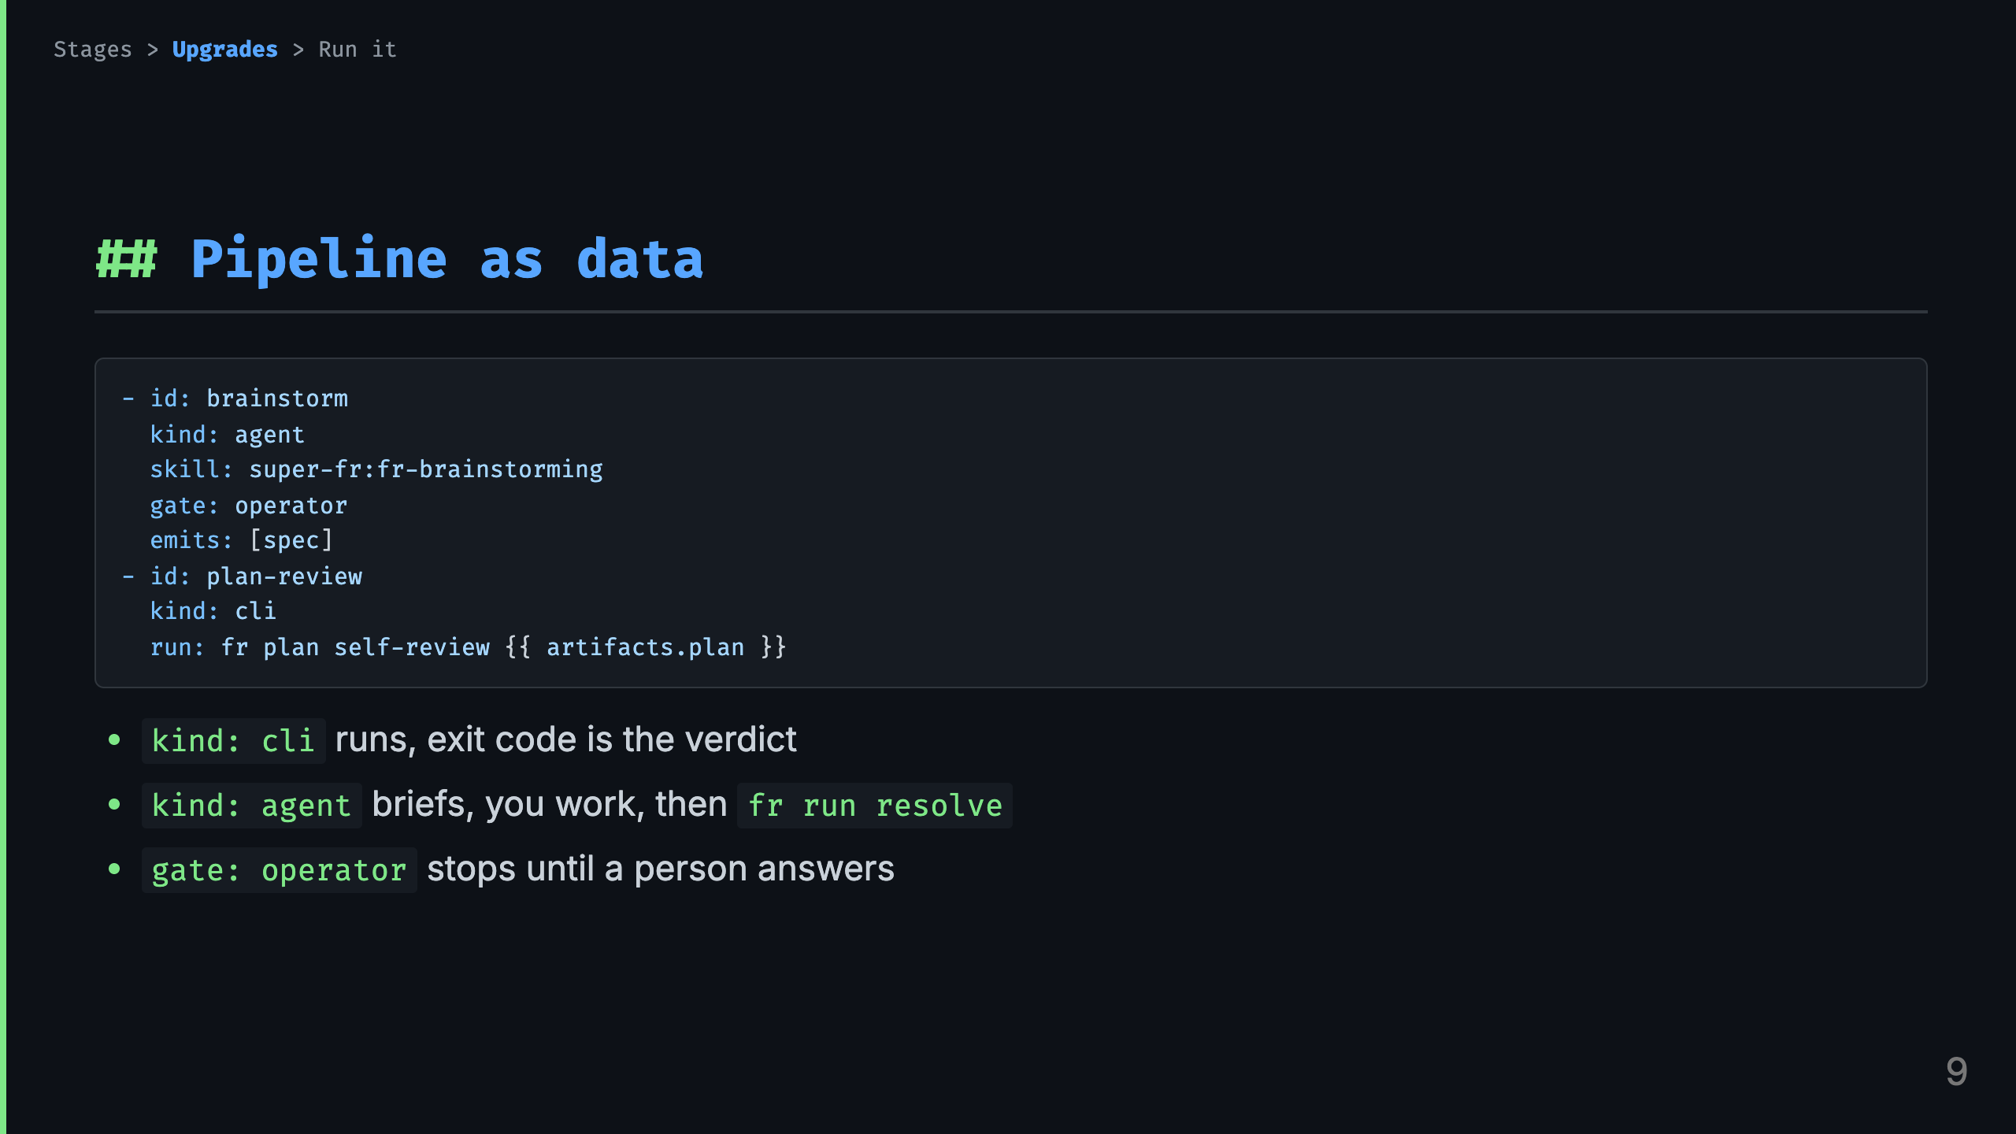
Notes:
Talk track: - This is a real fragment of fr-goal.yaml. A shape is an ordered list of steps plus what each step needs and emits. - Cli steps are deterministic, nobody interprets them. Agent steps never execute inside fr, it prints a brief, you do the work, you resolve. The gate is the one promised stop. - Consequence: the engine is a plain program with no path to a language model. Every judgment happens on the far side of a visible handoff. - Full file: plugins/super-fr/workflows/fr-goal.yaml, six steps plus two grouped children under implement.

Slide 10
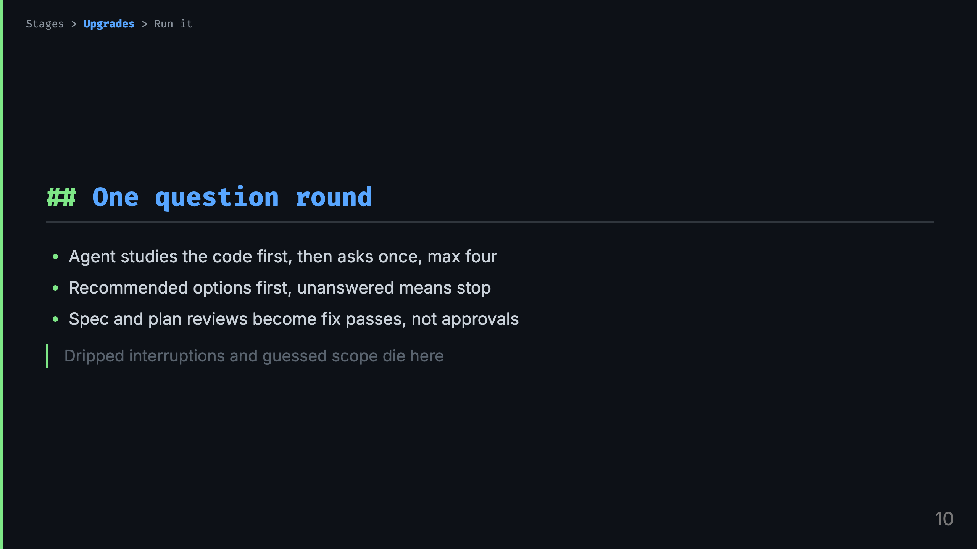
Notes:
Talk track: - Scar: decisions arrived one at a time across days, and anything unanswered got guessed. So exploration first, then a single batched round. Four questions max forces the agent to rank what is truly operator-owned. - Unanswered is a stop, never a default. After that the agent owes you no more approvals, it owes you fix passes. - Post-merge test plan and model-per-tier questions ride the same round when relevant.

Slide 11
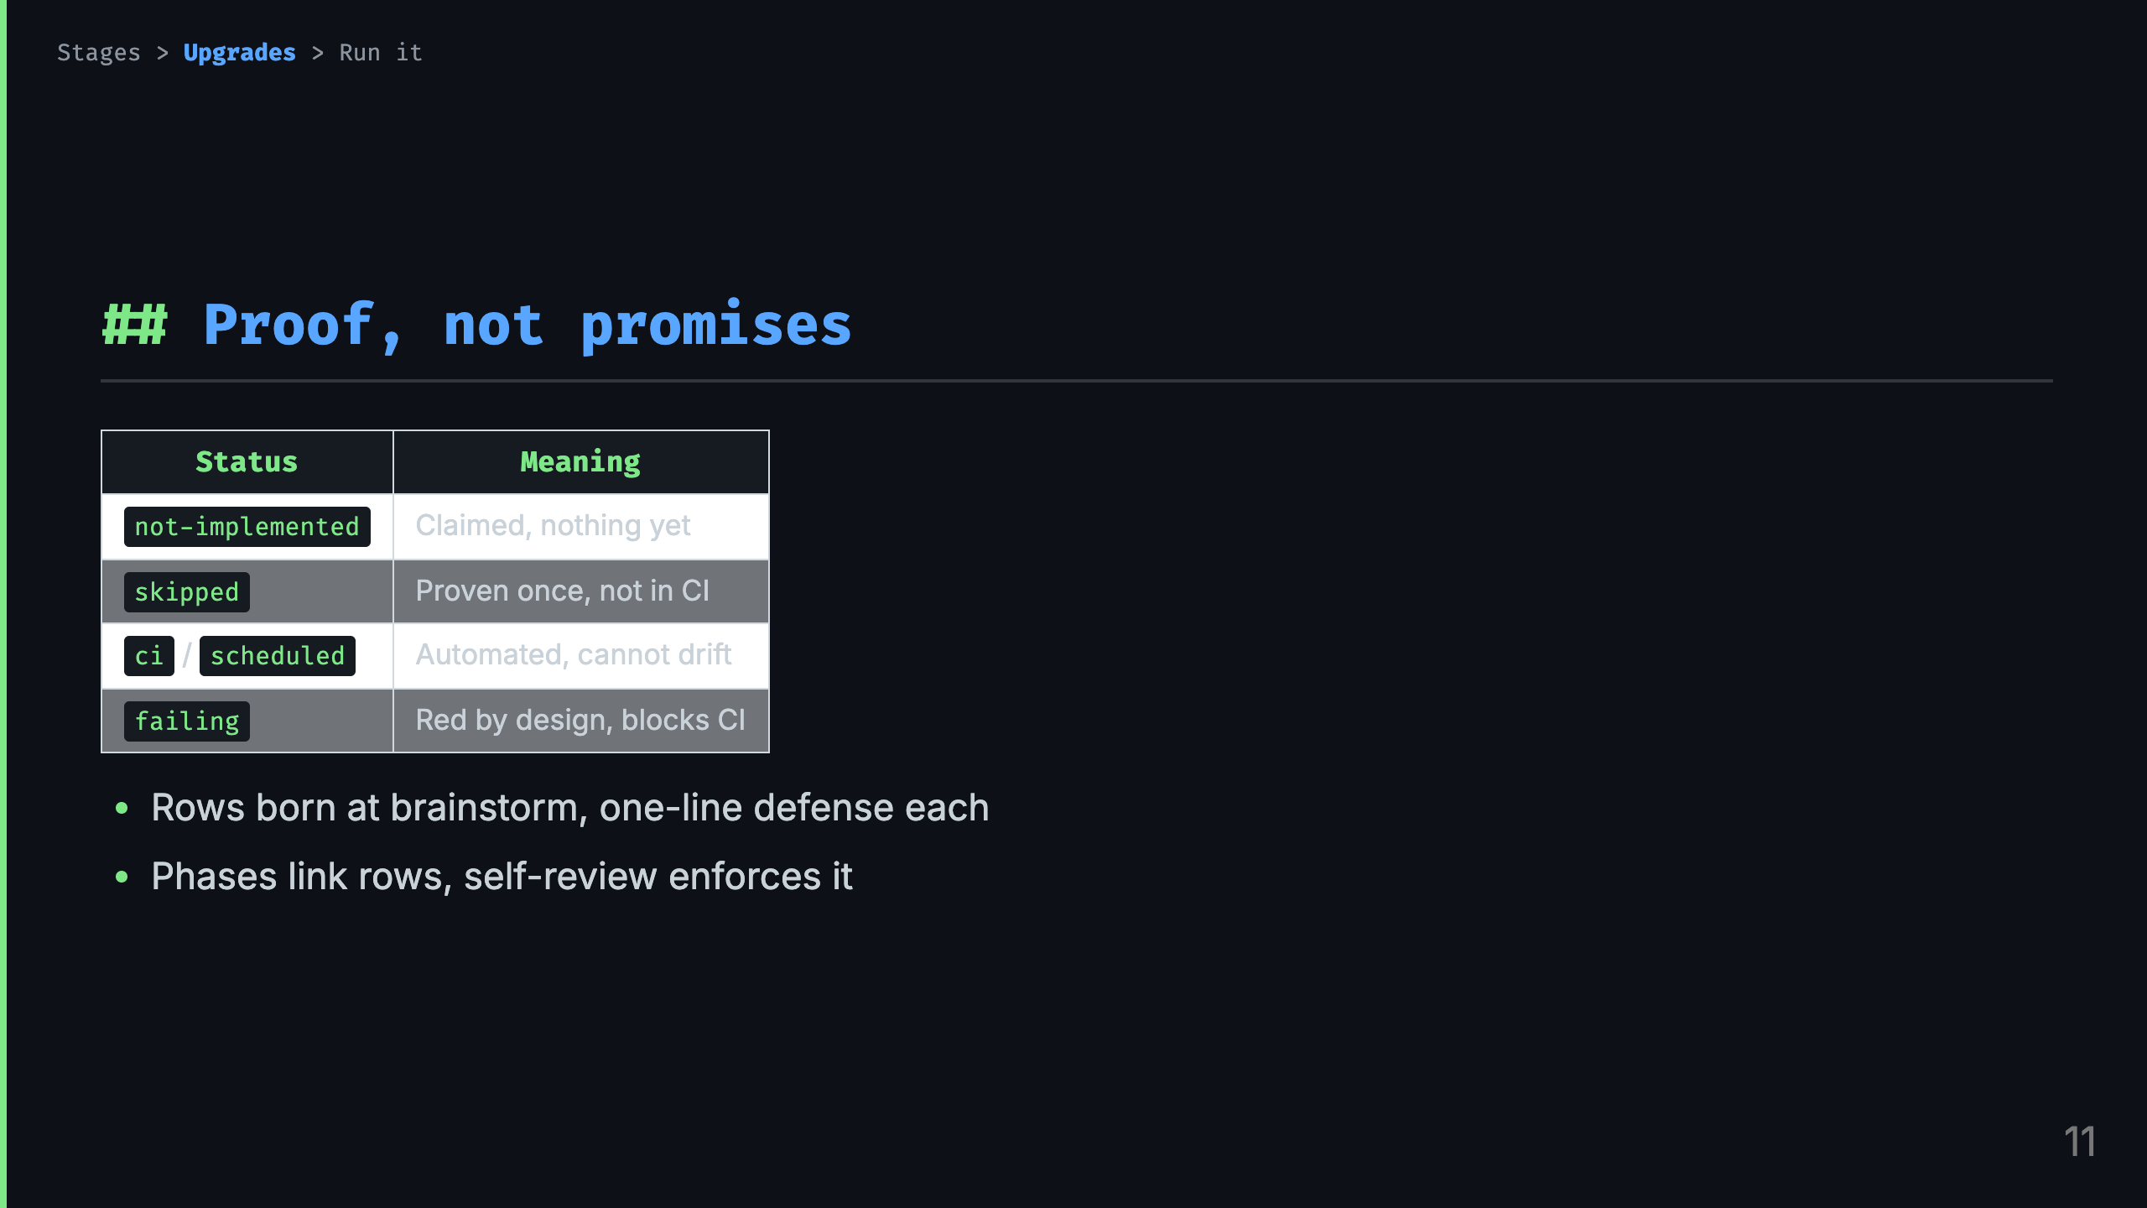
Notes:
Talk track: - Scar: suite green, feature not doing the thing. So acceptance rows in docs/acceptance/matrix.yaml, one operator-can-X per row, flipped up only with test evidence. - Rows are presented with defenses at brainstorm close. Silent creation is not agreement on scope. - The plan links phases to rows and the gate errors on unlinked test-plan specs. Debt stays visible in the pull request, embarrassing by design.

Slide 12
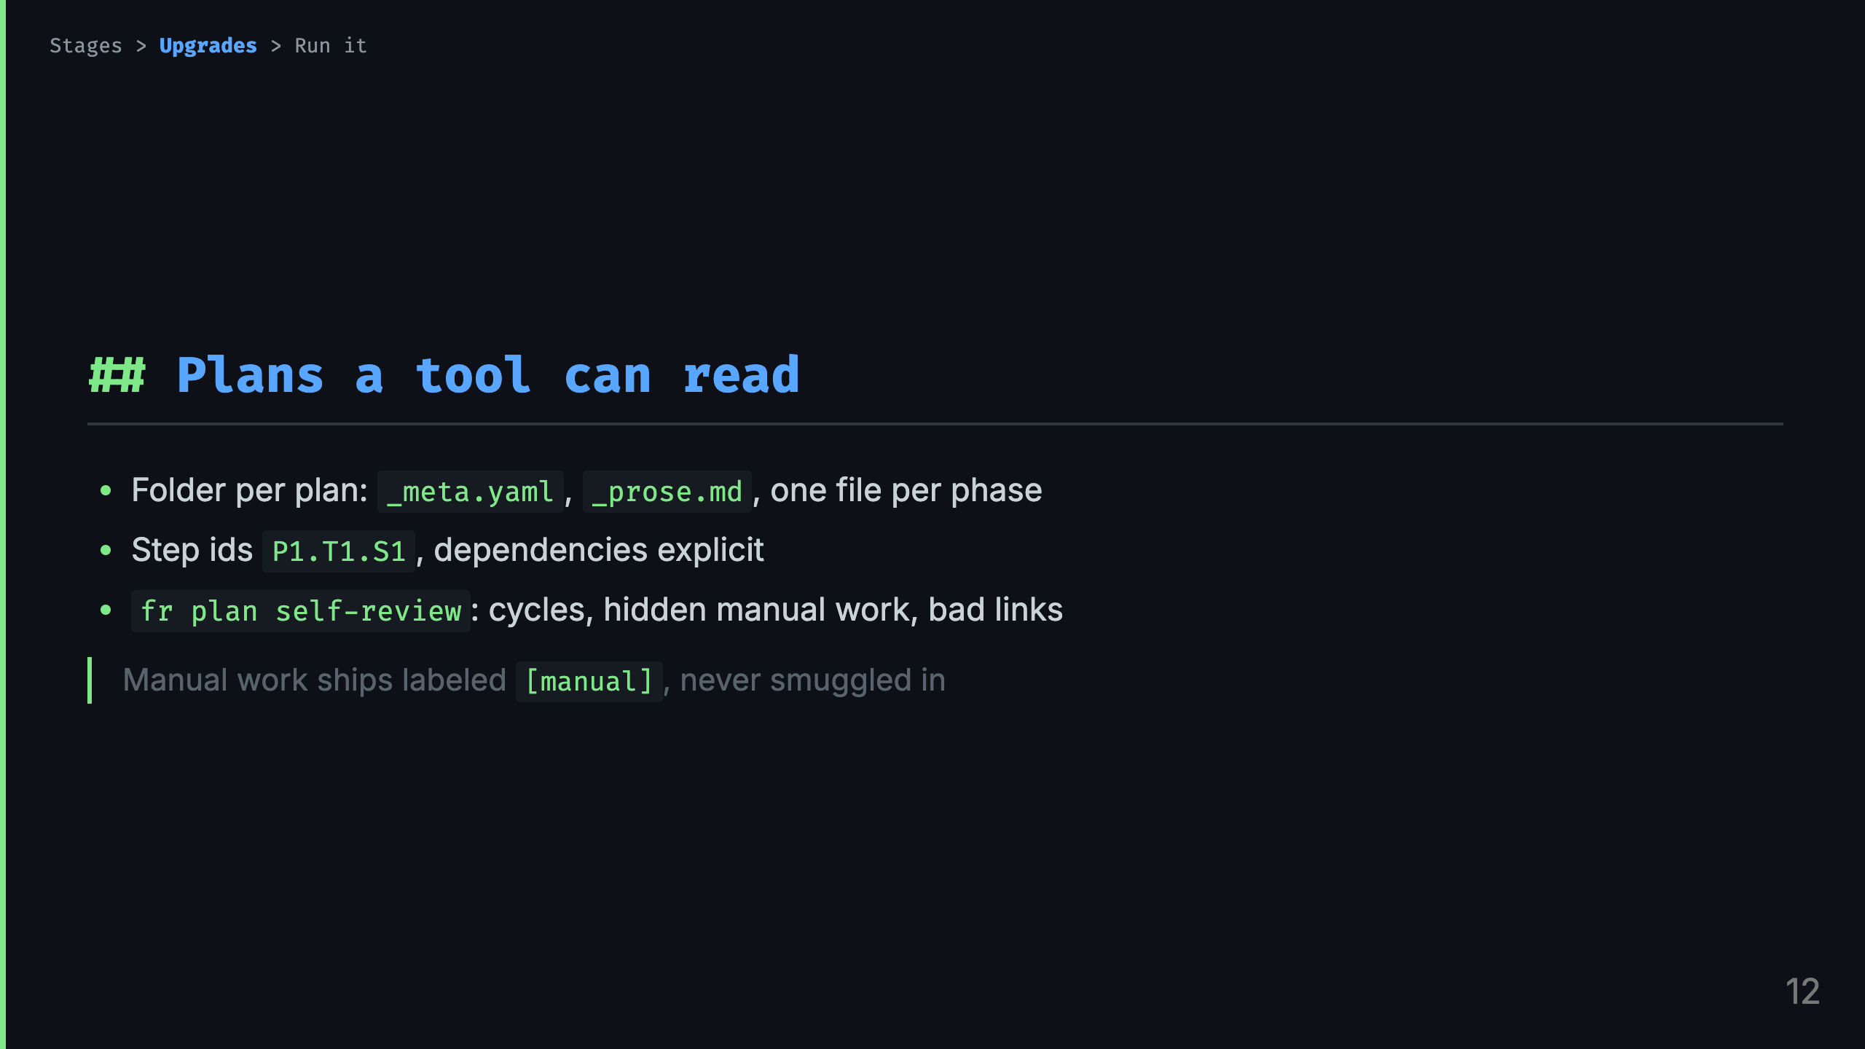
Notes:
Talk track: - Scar: the single markdown plan, unmergeable, position kept in the model's head. Per-phase files also kill merge conflicts. - Self-review runs before any token burns on implementation: dependency cycles, manual work hiding in agentic phases, unknown acceptance ids. - Manual phases back-load by default, the pull request ships them unimplemented and you push to the same branch. Front-load only when agentic work genuinely depends.

Slide 13
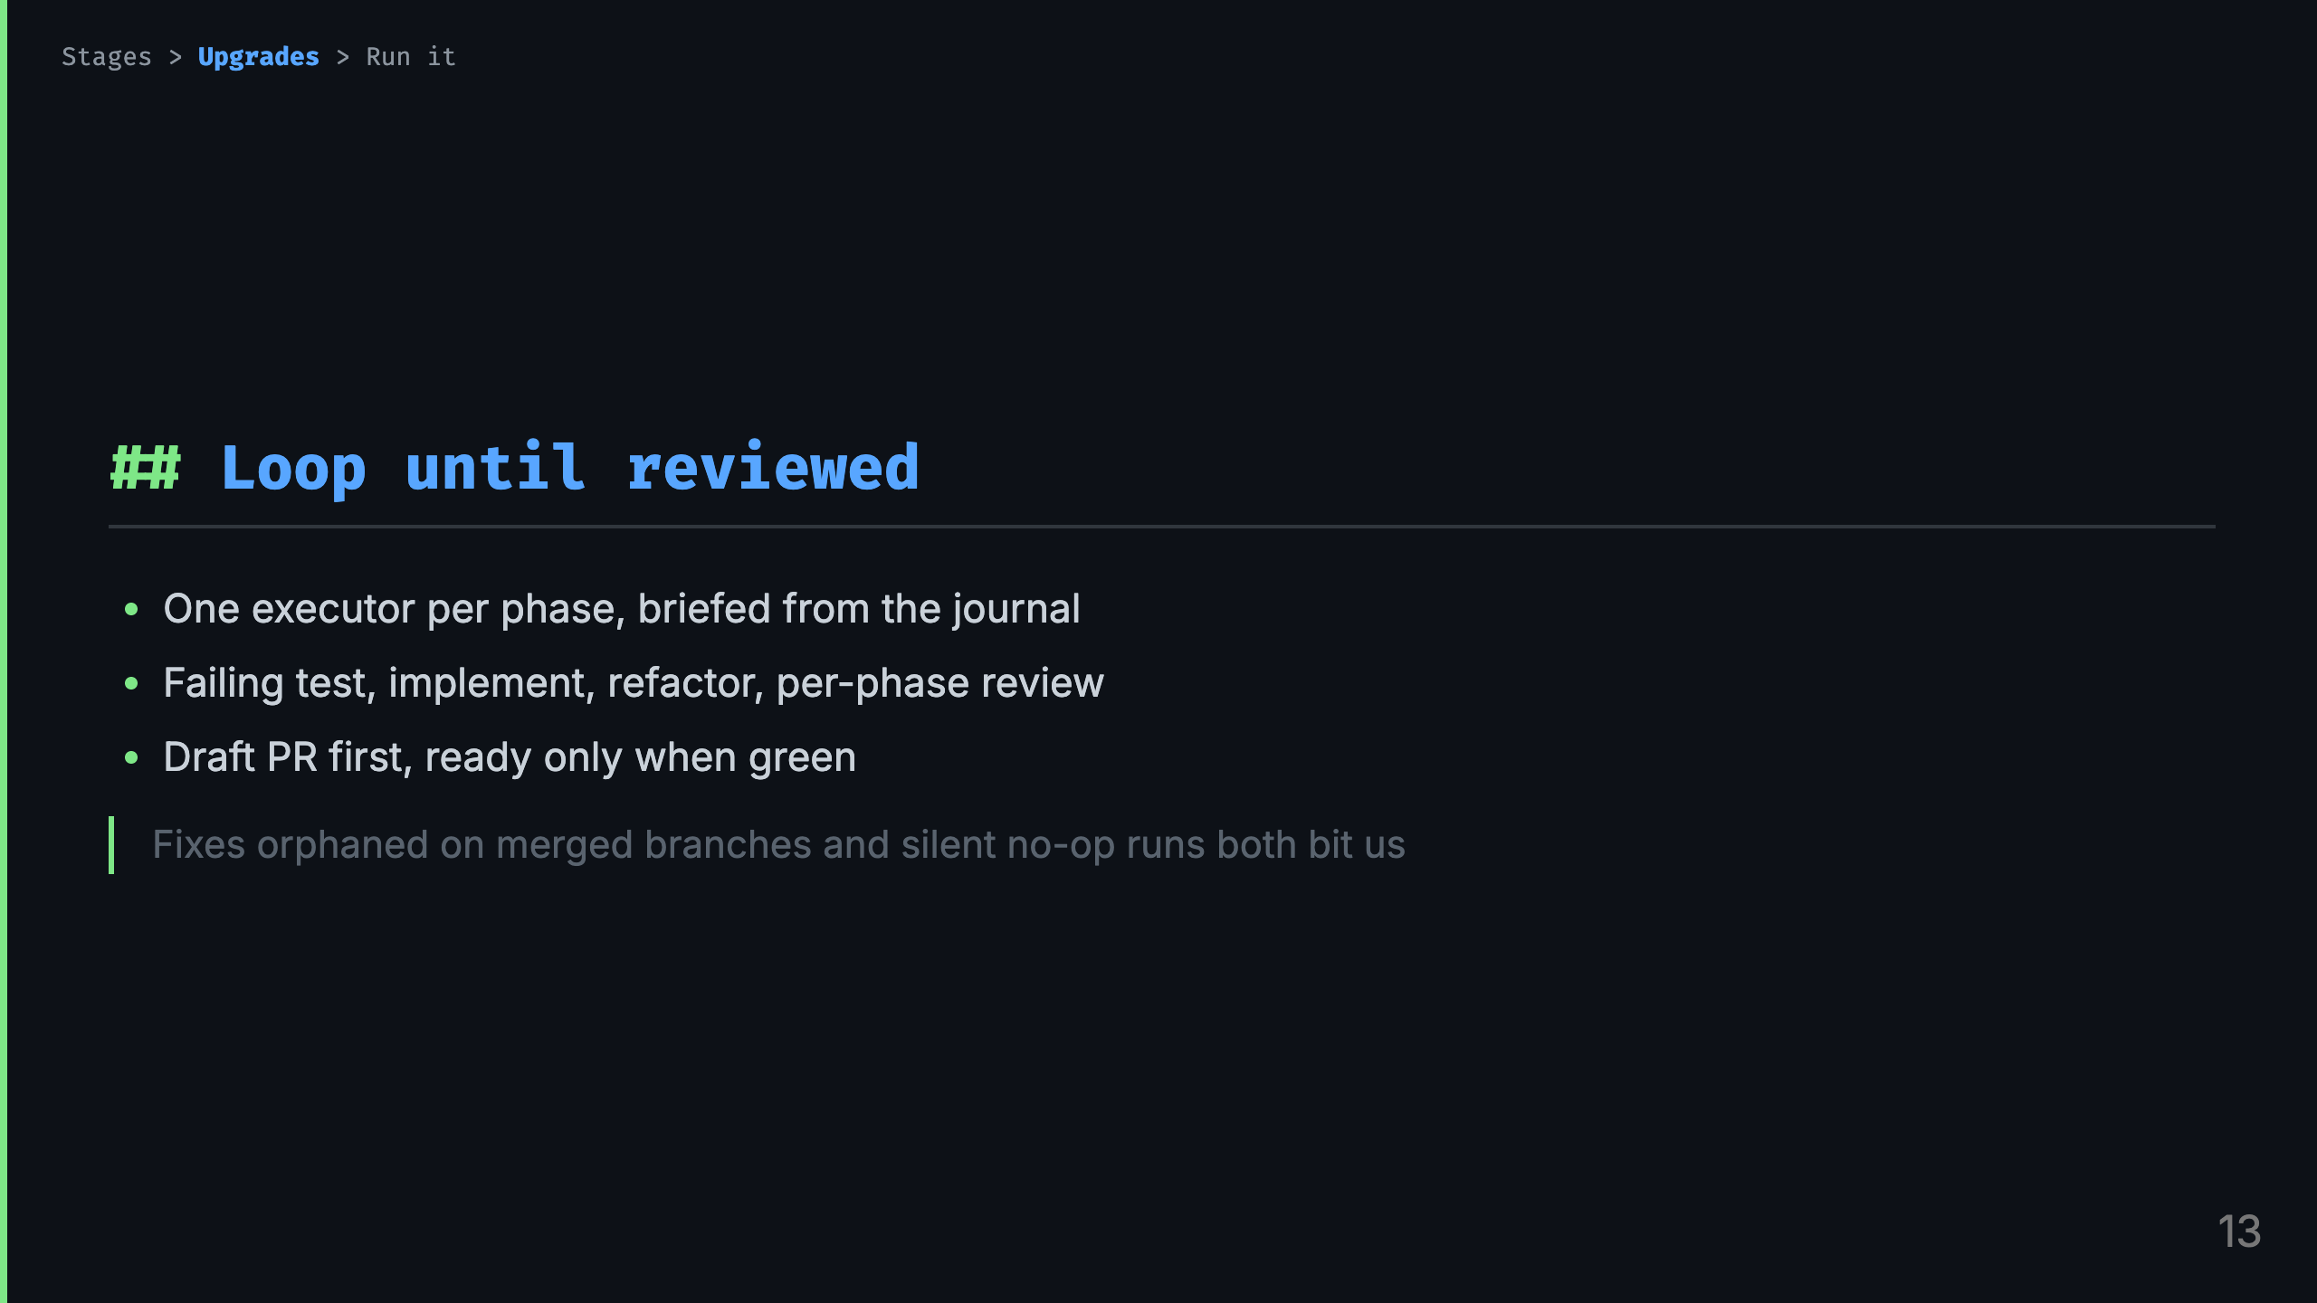
Notes:
Talk track: - Scar tissue, two of them. Fixes pushed after a premature merge landed on dead branches, so now draft first and the push guard refuses merged-branch pushes. - And the healthy-looking run that did nothing: a phase executor in a second worktree cut from main cannot see the spec, so the no-worktree carve-out is enforced by a hook, not by prose. - Review findings are fixed with tests or refuted with reasoning, recorded open, fixed, or refuted. The pull request body is rendered from that list.

Slide 14
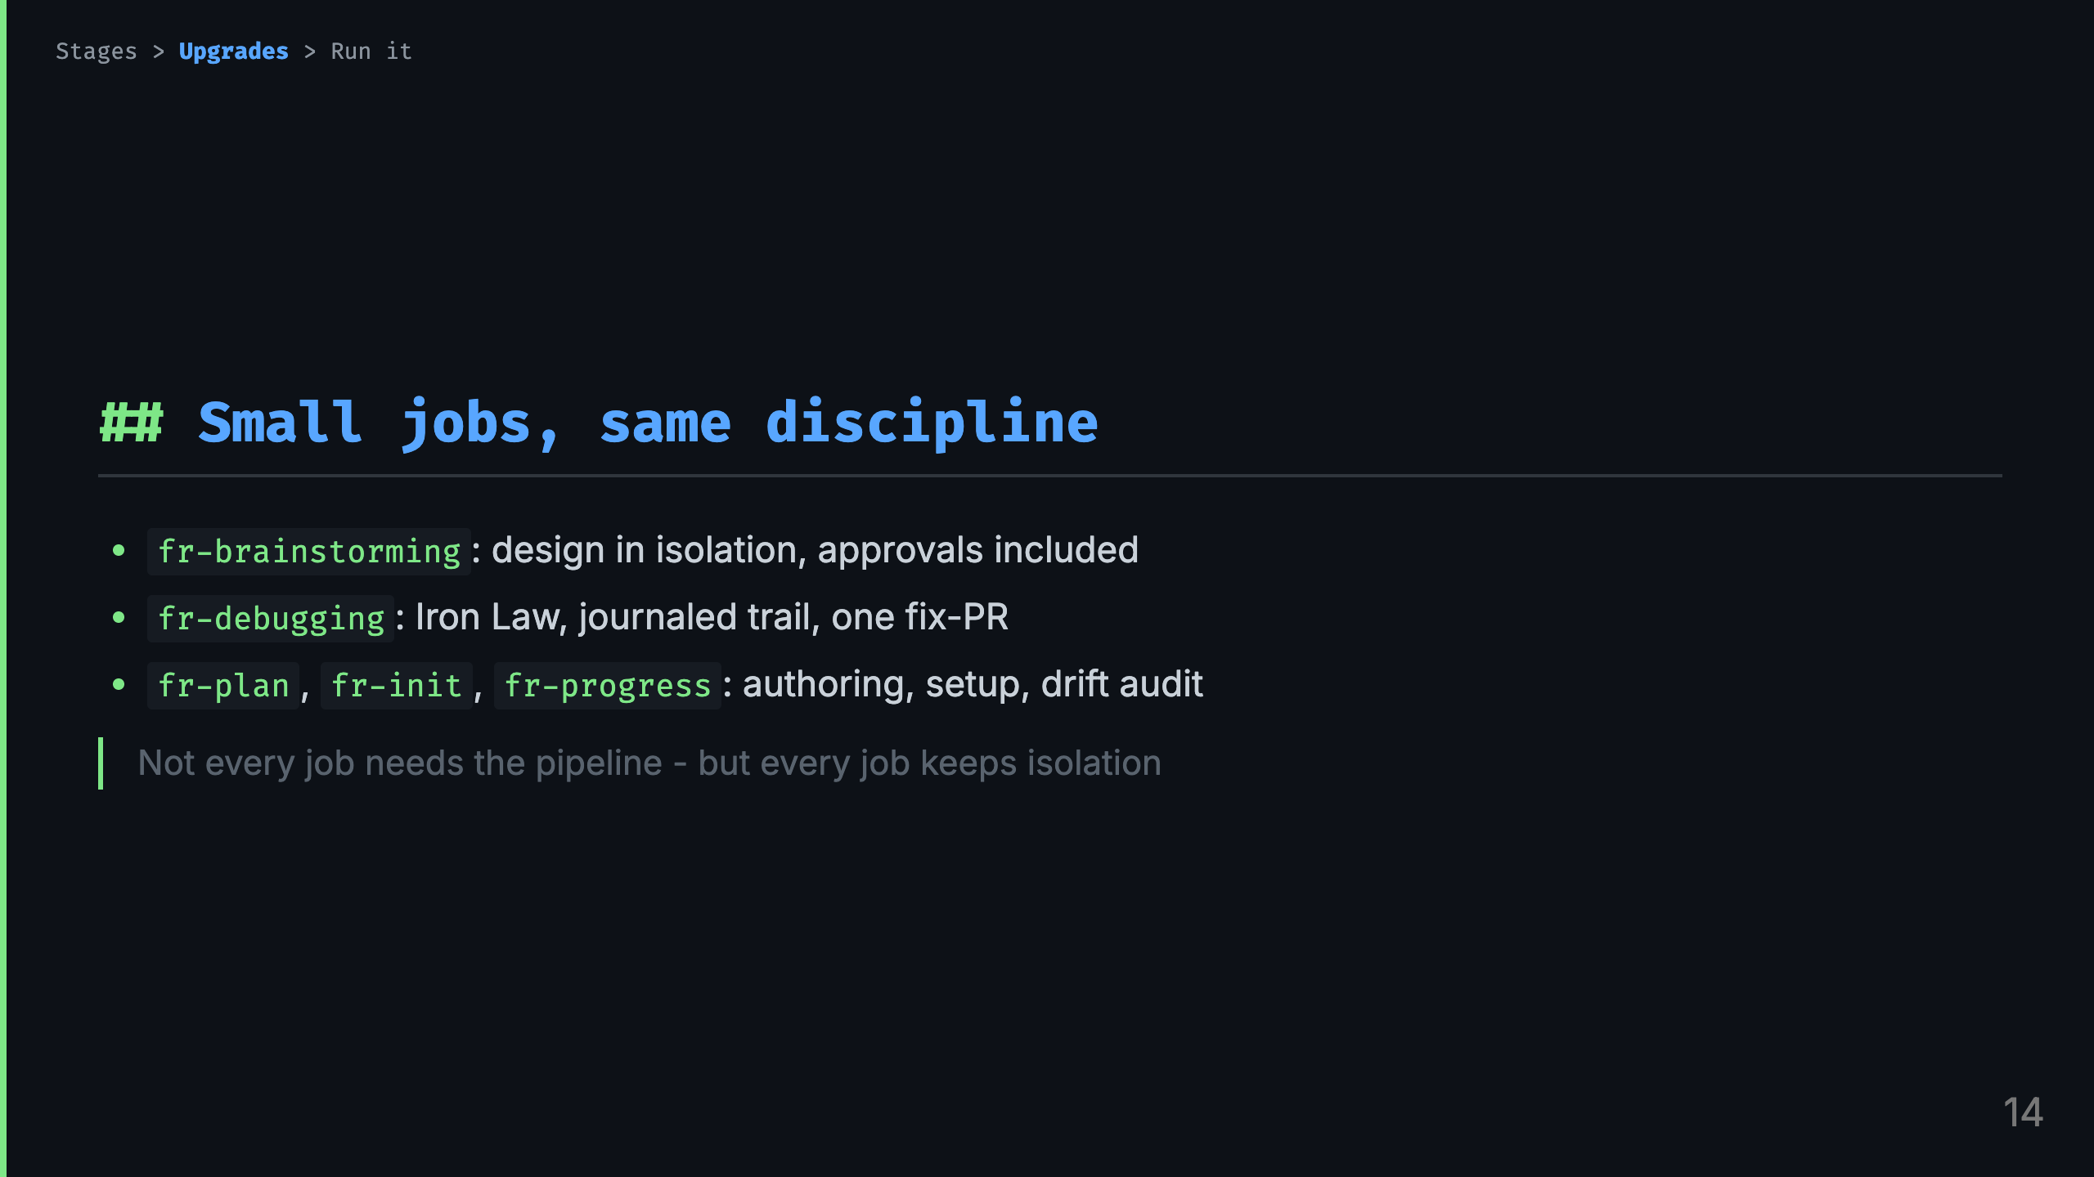
Notes:
Talk track: - Upgrade in miniature: the pipeline's steps usable alone. Brainstorming keeps section approvals when standalone, debugging reuses the feature workspace when the bug surfaces mid-goal. - The debugging journal is the idea I would steal for any workflow: rejected hypotheses written down before compaction eats them.

Slide 15
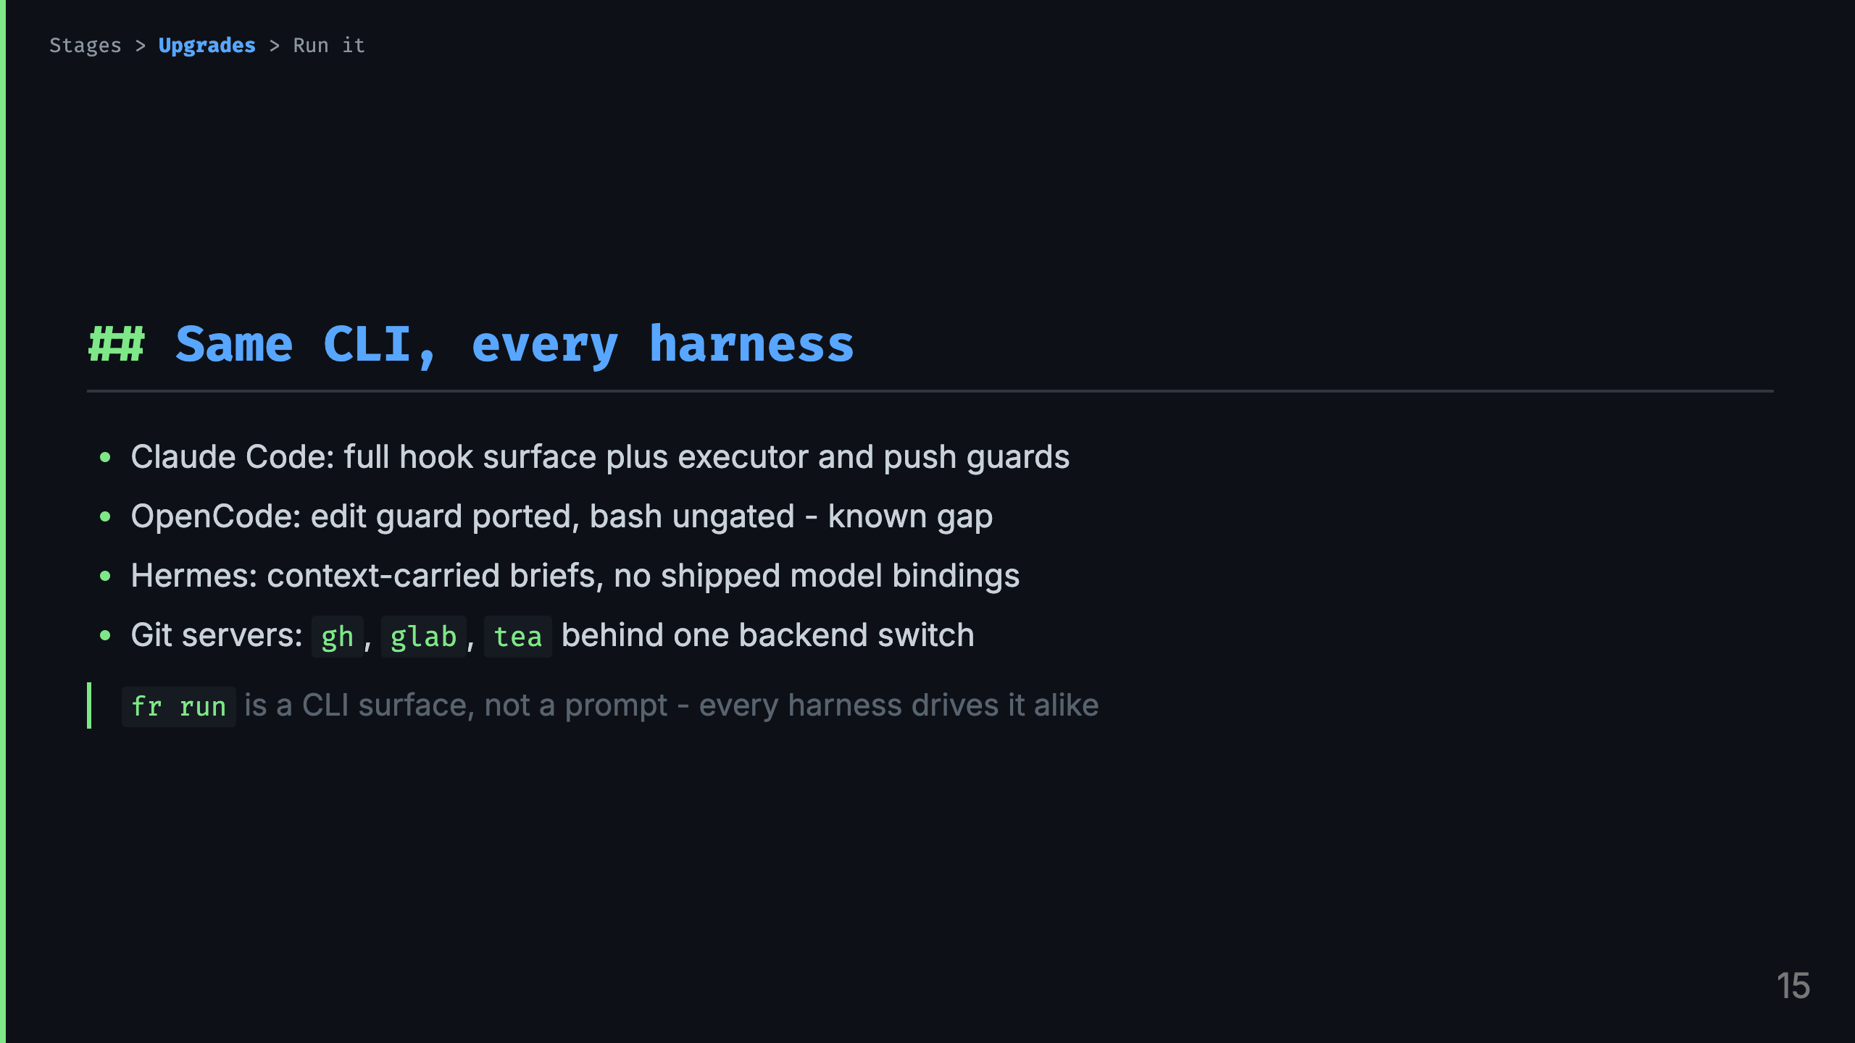
Notes:
Talk track: - If time dies, this slide dies first. One line each: Claude is the reference, OpenCode has a documented bash gap, Hermes dispatches through context, git hosts are detected backends. - The point for Monday: learn the CLI once, it follows you across harnesses.

Slide 16

Notes:
Talk track: - Theory over. This part is a checklist you can follow Monday. Four moves plus pointers.

Slide 17
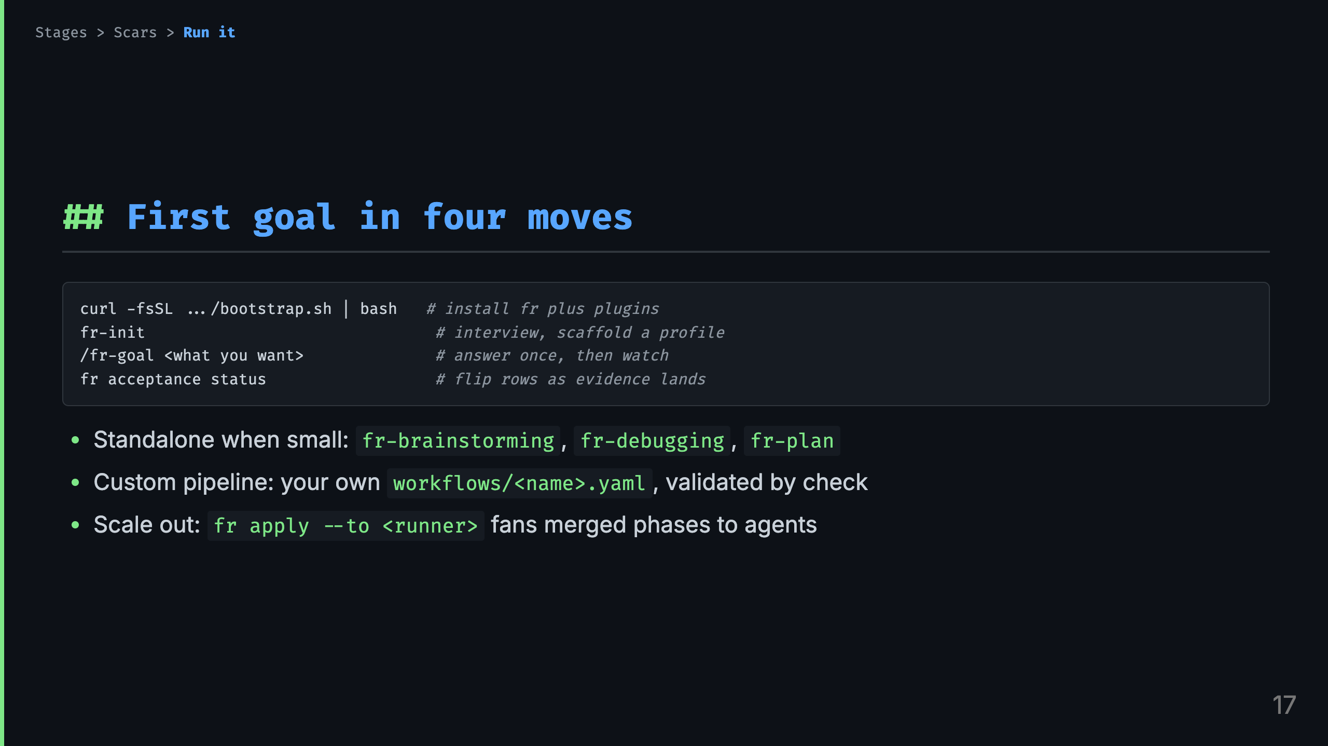
Notes:
Talk track: - Move one installs everything and wires the harness you have. Move two is the only interview in the system and it exists because isolation without a profile is a hard stop, not a degraded mode. - Move three is the whole talk in one command. Answer the round, then the shape drives. - Move four keeps you honest. Standalone skills cover the small jobs. A custom shape is a yaml file plus check. Dispatch is for merged plans with per-phase pull requests. - Repos resolve runners and git hosts the same way everywhere, one CLI surface per harness.

Slide 18
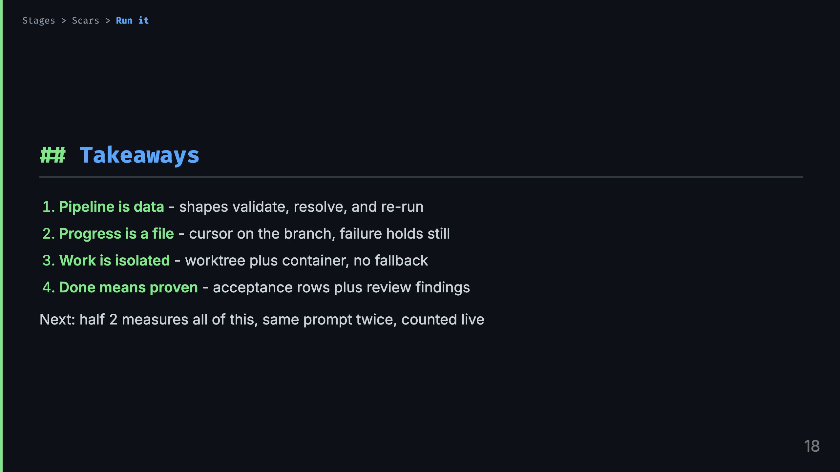
Notes:
Talk track: - Four sentences to carry out. If you remember nothing else: data, file, isolation, proof. - My position, stated plainly: the ceremony earns its keep. Each row of ceremony exists because the un-ceremonied version failed on a real feature. - Half 2 is the audit. Same seed prompt, same pinned model, every nudge logged, side-by-side recording. The table gets to disagree with me. - Thank you. Questions, then your first goal whenever you are ready.

