Slide 1


IMPLEMENTATION STUDY OF FOOD SAFETY IN MSMES AND STREET FOOD BUSINESSES IN THE APEC REGION Deri Siswara
Materials: derisiswara.art/apec-2025
SCSC_102_2024T

Slide 2



INTRODUCTION
Why Food Safety Matters for MSMEs in APEC Region?
Food safety is critical for public health, especially as urban populations increasingly rely on ready-to-eat foods, restaurants, and street vendors. Poor food handling practices, contaminated ingredients, cross-contamination, excessive preparation times, and improper storage create risks of foodborne illnesses and nutrient loss.
This study evaluates food safety implementation among MSMEs and street food businesses in the APEC region, identifying appropriate methods based on international standards (ISO, HACCP, and GMP) to ensure safe food practices across the supply chain.
Source: bakingworld.id
98% of APEC businesses are MSMEs, with approximately half operating in the food sector (Hredzak, 2020).
Culinary tourism significance: Food businesses serve as cultural ambassadors, showcasing unique local varieties and traditions that attract tourists.
Quality and cleanliness concerns: Many food MSMEs face challenges in maintaining proper hygiene standards and food safety protocols due to resource constraints.
SCSC_102_2024T

Slide 3

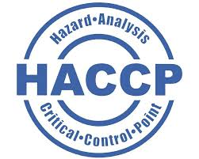



RESEARCH DESIGN
Background
We conducted a survey using criteria from the ISO Food Safety Management System, HACCP, and GMP. The elements included in the questionnaire are relevant and have the potential to guarantee food safety based on the literature study conducted. The questionnaire aims to capture the experiences, obstacles, and challenges faced by MSME and street food business operators in order to increase knowledge and understanding of food safety based on international standards.
Respondents
This study surveyed 59 participants across the APEC region: approximately 50 MSME and street food business actors, and 9 government regulators. Business respondents included food processors, restaurants, street vendors, and catering services of various scales and experience levels, representing diverse APEC economies from local to export-oriented operations.
Regulatory respondents comprised food safety inspectors, policy makers, and standards officers from health departments, food safety authorities, and trade ministries across different jurisdictional levels. This balanced composition ensures comprehensive insights from both implementation challenges (business perspective) and regulatory expectations (government perspective) across diverse APEC regulatory environments.
Actors
Regulators
SCSC_102_2024T

Slide 4
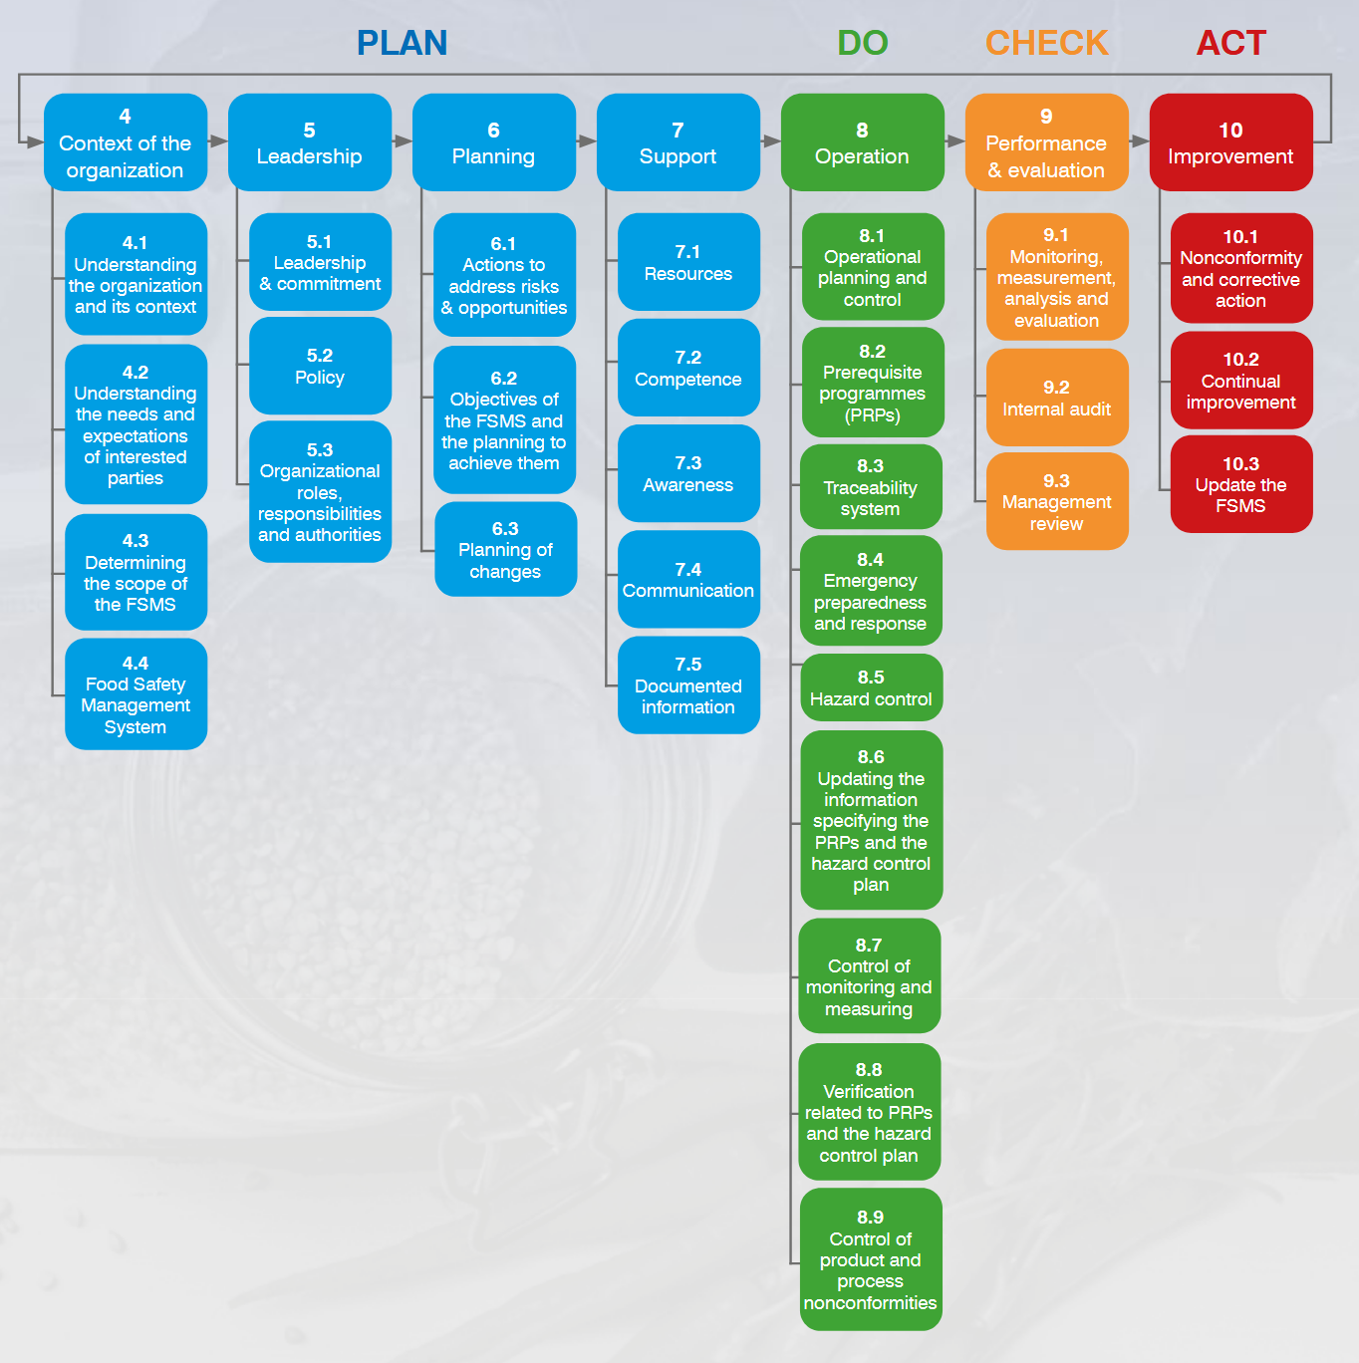
ISO22000:2018
ISO 22000:2018 establishes a systematic approach to food safety through the Plan-Do-Check-Act (PDCA) cycle, fully incorporating HACCP principles while integrating Good Manufacturing Practices within its framework.
For our study of food safety in MSMEs and street food businesses across the APEC region, this standard provides an ideal structure to evaluate existing practices and implement improvements. The PDCA methodology allows us to assess current conditions, apply adapted protocols suitable for small operations, measure compliance through appropriate metrics, and continuously refine our approach based on regional findings.
SCSC_102_2024T

Slide 5
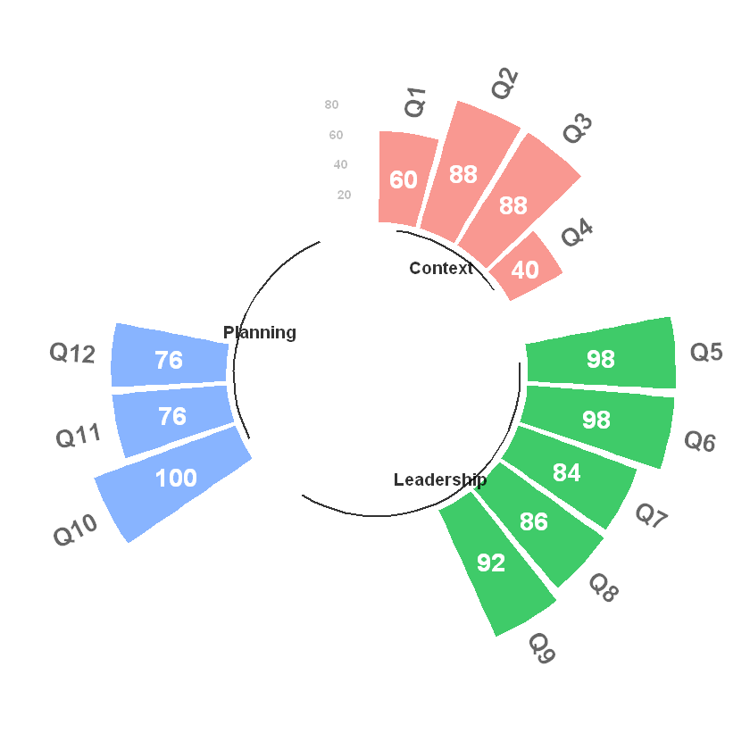
FINDINGS
Clause 4,5, and 6
Clauses 4, 5, and 6 constitute the essential PLAN segment of the PDCA cycle in ISO 22000:2018. Our assessment indicates that most vendors successfully meet the general criteria requirements within these clauses. However, a significant compliance gap exists as less than 50% of vendors possess proper product distribution permits.
Question | Definition
Q1 | Status in business [Owner]
Q2 | Venture type [Own Capital]
Q3 | Business license/legality
Q4 | Product distribution permit
Q5 | Person in charge of business operation
Q6 | Responsible for food quality and safety
Q7 | Responsible for raw material suppliers
Q8 | Quality guidelines and procedures
Q9 | Provisions for unsuitable raw materials/products
Q10 | Attention to food cleanliness
Q11 | Follow up on customer feedback
Q12 | Conduct annual/periodic evaluations
SCSC_102_2024T

Slide 6

FINDINGS
Product Distribution Permit
Most micro and street-food businesses across the APEC region—such as roadside carts, mobile stalls, and home-kitchen operators—are generally exempt from formal distribution-permit requirements. Regulators waive these permits when vendors prepare ready-to-eat items with shelf lives under seven days, package food directly in front of customers, work at a very small scale, and use only basic processing steps like washing, cutting, and mixing.
However, exemption from permits does not cancel the responsibility to keep food safe. Applying the core principles of ISO 22000:2018—good hygiene practices, simple hazard checks, brief daily records, basic staff training, and prompt corrective action—gives these small operators a practical way to protect consumers without the cost of full certification.
Type of Shops
SCSC_102_2024T
Notes:
For example, in Indonesia, the National Agency of Drug and Food Control (BPOM)

Slide 7
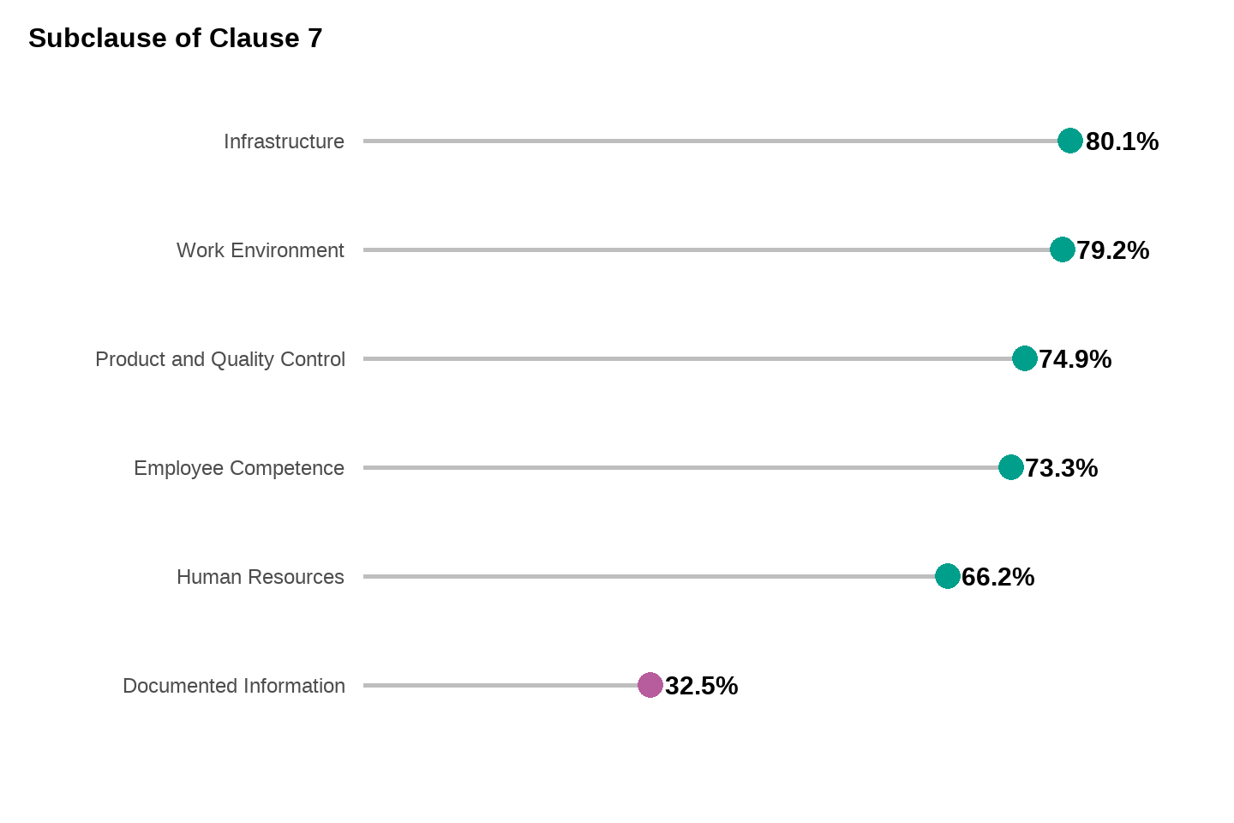
FINDINGS
Clause 7
Last, the essential PLAN segment of the PDCA cycle in ISO 22000:2018 is Clause 7. This looks at the resources, competence, awareness, communication, and documentation of a FSMS. Overall good except documented information.
SCSC_102_2024T

Slide 8
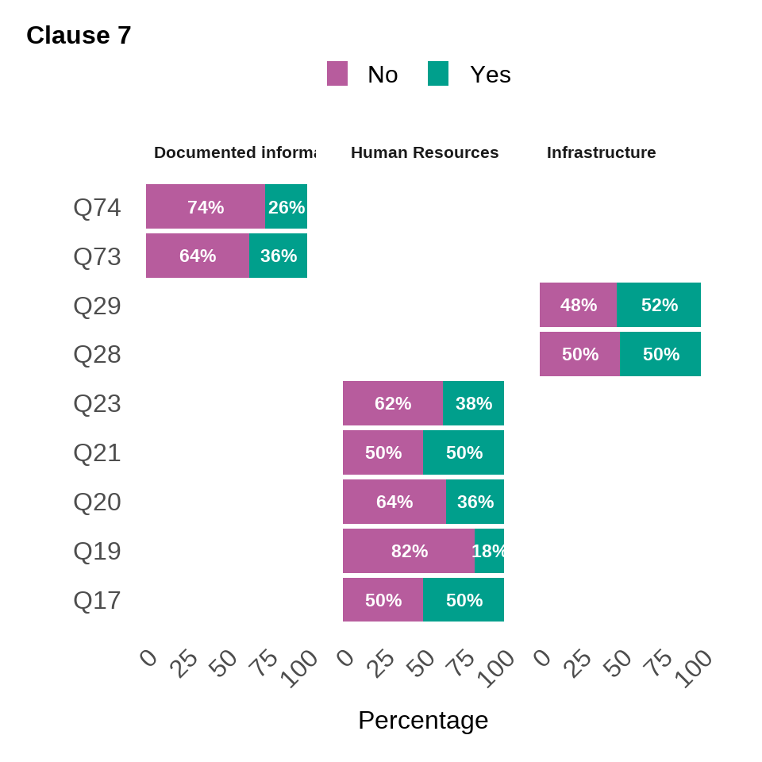
FINDINGS
Clause 7
Clause 7 of ISO 22000:2018 highlights key compliance gaps in SMEs and street food vendors, particularly in human resources, infrastructure, and documentation. Many vendors lack proper worker health checks, food safety training, and hygiene practices, increasing contamination risks. Issues like inadequate pest control and poor cleanliness also persist. Additionally, a failure to document raw materials, processes, and employee health makes compliance difficult to prove. Addressing these gaps through training, health monitoring, improved infrastructure, and proper documentation is essential to ensure food safety and compliance.
Question | Definition | Subcluase
Q17 | Workers change clothes/wear special attire | Human Resources
Q19 | Periodic health checks for workers | Human Resources
Q20 | Employees as cashiers | Human Resources
Q21 | Cashier allowed to process food | Human Resources
Q23 | Prohibition on jewelry/watches | Human Resources
Q28 | Food pests seen at business location | Infrastructure
Q29 | Personal items in processing areas | Infrastructure
Q73 | Records on raw materials/operations | Documented information
Q74 | Records on worker health/training | Documented information
SCSC_102_2024T

Slide 9
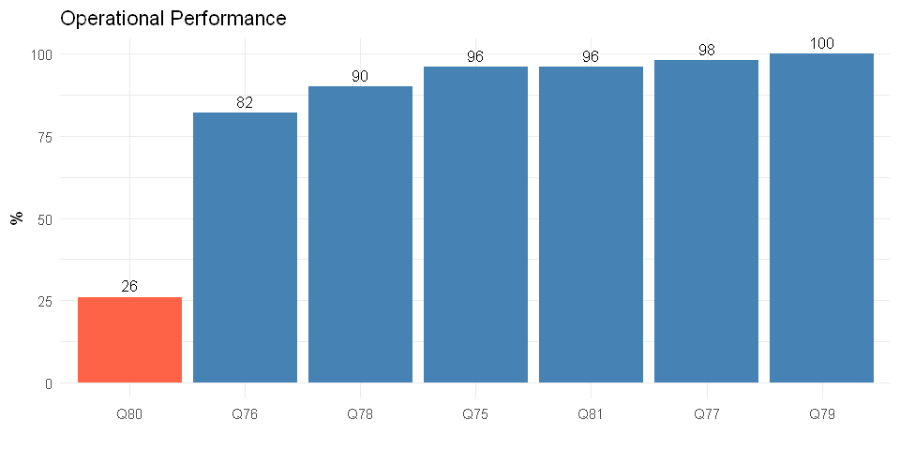
FINDINGS
Clause 8
Question | Definition
Q75 | Materials and products stored in good conditions to avoid quality decrease
Q76 | Storage marked with dates and using First In First Out system
Q77 | Ingredients that absorb water stored in a dry place
Q78 | Hazardous materials stored separately to avoid contamination
Q79 | Cleaned machines/equipment stored properly to avoid contamination
Q80 | Food packaging clearly labeled for consumer ease
Q81 | Person in charge overseeing production process for quality control
This is the core of a Food Safety Management System (FSMS), where the integration of most HACCP principles takes place, and execution becomes crucial after the system has been planned. Evaluation shows that many businesses fail to clearly label food packaging for consumer ease. This is likely due to many ready-to-eat products lacking proper packaging.
SCSC_102_2024T

Slide 10
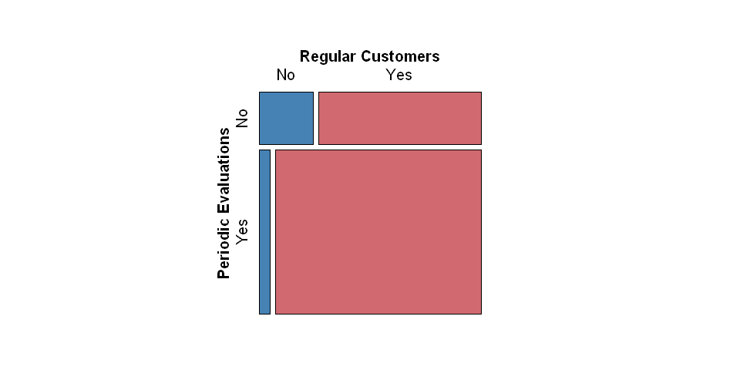
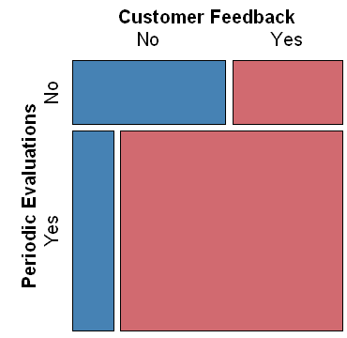
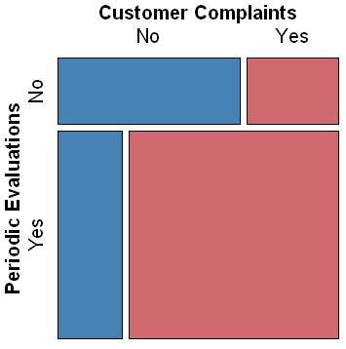
FINDINGS
Clause 9 and 10
FSMS performance is evaluated through process monitoring, internal audits, and management review to ensure product objectives, meet customer expectations, prevent undesired effects, and drive continual improvement. Some businesses (24%) do not conduct periodic evaluations. These businesses also do not ask for customer feedback, and interestingly, most of them do not receive customer complaints. Their business processes tend to remain the same each day, without regular evaluation or feedback-driven adjustments.
Pearson's Chi-squared test, p = 0.1513
Pearson's Chi-squared test, p = 0.01072*
Pearson's Chi-squared test, p = 0.01682*
Note: *, significant, p < 0.05
SCSC_102_2024T

Slide 11
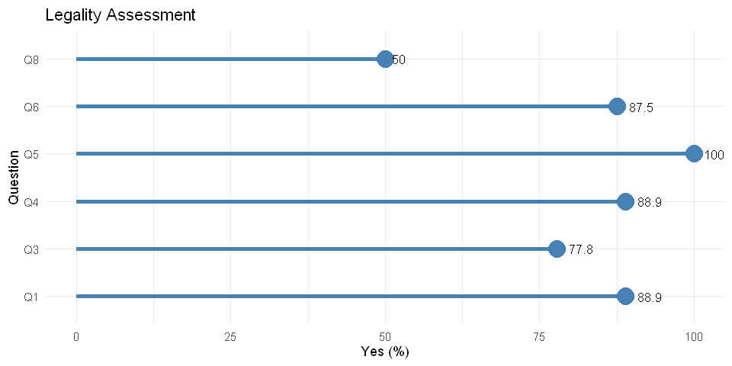
FINDINGS
Regulators Assessment
Question | Definition
Q1 | Existence of local regulations for MSME/street food supervision
Q3 | Permit or registration requirement for MSMEs/street food
Q4 | Availability of business registration permit service
Q5 | Systems/procedures for granting permits
Q6 | Complaint service for business registration certificates
Q8 | Cost to register a business license
On Clause 4.2 and 4.3 regarding legality and regulatory requirements, most regulators in the APEC region have established regulations that require business licensing, registration, and reporting mechanisms for street food and MSME businesses.
However, one notable difference is the cost structure: about half of the regions impose a fee for obtaining a business license, while the other half provide the licensing service free of charge.
SCSC_102_2024T

Slide 12
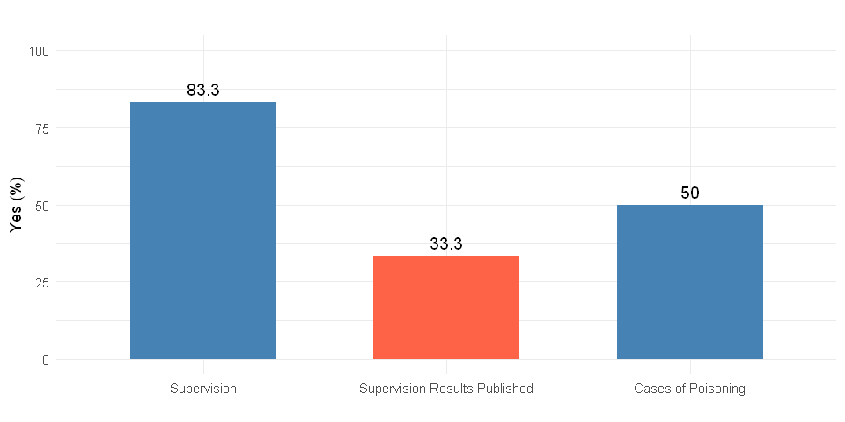

FINDINGS
Regulators Assessment
Regulatory control and supervision are critical points in ISO 22000:2018 (notably clauses 8.4, 8.8, 9, and 10), with regulators having established supervision plans, conducting at least annual inspections, and performing contaminant testing. However, supervision results are generally not published, limiting transparency for businesses and the public. Despite these efforts, food poisoning cases remain common in the street food sector, mainly due to persistent issues with cleanliness and hygiene among vendors.
SCSC_102_2024T

Slide 13
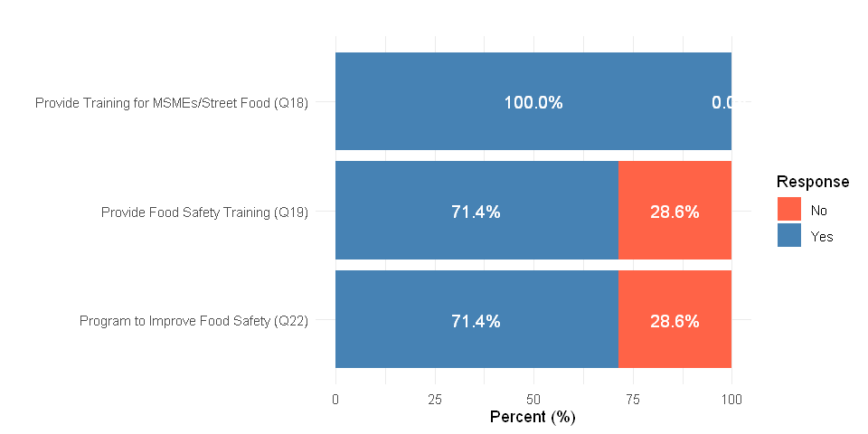
FINDINGS
Regulators Assessment
Foster of street vendors is covered under Clause 7: Support (especially 7.1, 7.2, and 7.4) of ISO 22000:2018. Most institutions/agencies provide general training for MSMEs and street food businesses; however, fewer offer specific food safety training. Not all institutions/agencies have dedicated programs to improve food safety, suggesting there is room for more proactive initiatives.
SCSC_102_2024T

Slide 14
CONCLUSION AND RECOMMENDATION
Most street food vendors and MSMEs meet the general PLAN requirements (Clauses 4, 5, 6, and 7) of ISO 22000:2018, but often lack proper product distribution permits and documented information—both of which are commonly exempted in street food regulations. Many vendors also lack proper worker health checks, food safety training, and hygiene practices, increasing the risk of contamination. Issues such as inadequate pest control and poor cleanliness persist, and the failure to document raw materials, processes, and employee health makes compliance difficult to demonstrate.
Operationally (Clause 8), many businesses fail to clearly label food packaging for consumer ease, likely because many ready-to-eat products are sold without proper packaging.
In terms of performance and improvement (Clauses 9 and 10), some businesses do not conduct periodic evaluations. Their business processes tend to remain unchanged, without regular evaluation or feedback-driven adjustments—reflecting the typical character of street food businesses that do not aim to expand.
Most institutions have adequate legal frameworks, though mechanisms vary. Cleanliness remains a critical issue among street vendors. Not all regulators have dedicated food safety programs, indicating there is room for more proactive initiatives.
BBased on literature review in other countries/regions, across varied low- and middle-income settings, research typically shows the same pattern: street-food vendors know basic food-safety principles and are knowledgeable enough, but still lack hygiene practices due to lack of resources, highlighting the need for training and stronger regulation.
SCSC_102_2024T

