Slide 1
precession
(the celestial pole is “wobbling” around on this path)
N
S

Slide 2
N
S

Slide 3
Celestial north pole
Your zenith
Suppose you are here
N
Earth’s equator
S
Celestial equator
Your horizon

Slide 4
Celestial north pole
23.5°
N
Earth’s equator
S
Ecliptic
Celestial equator

Slide 5
N
S

Slide 6
zenith
horizon

Slide 7
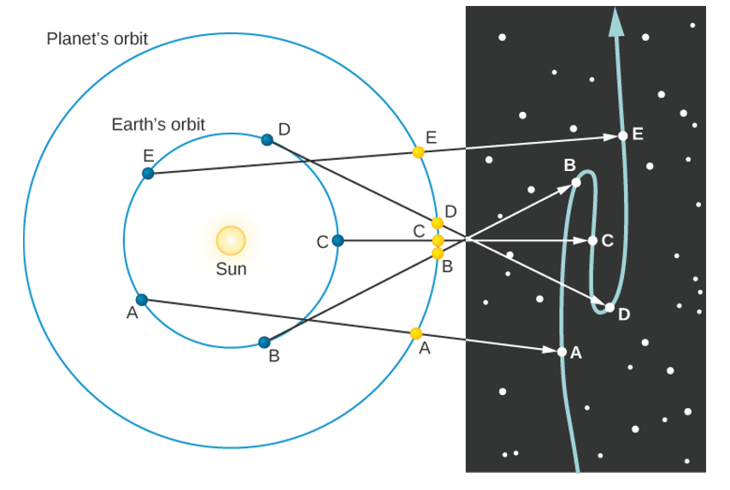
Planet’s orbit
Earth’s orbit
Sun

Slide 8
epicycle
Centre of epicycle
deferent
planet
X
Earth

Slide 9
epicycle
planet
X
Earth

