Slide 1
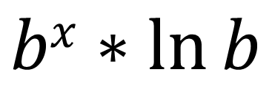
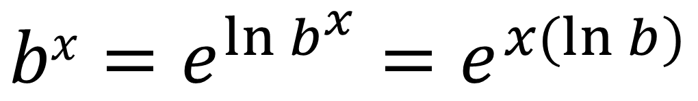
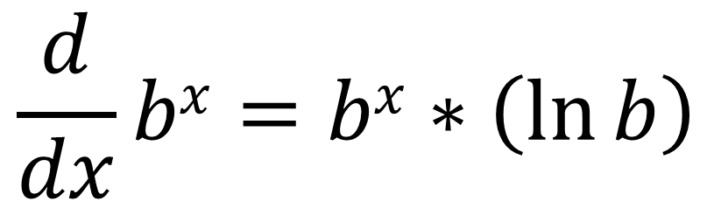
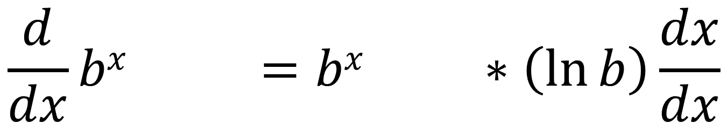
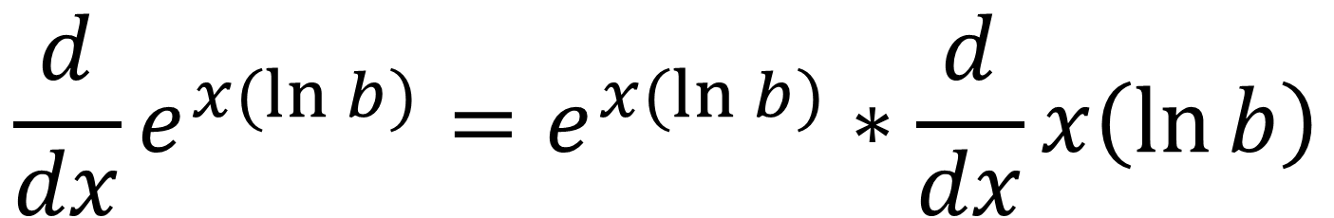
$$bx=e^{\ln{b^{x}}}=e^{x(\ln{b})}$$
$$bx∗\ln{b}$$
$$\frac{d}{dx}e^{x(\ln{b})}=e^{x(\ln{b})}∗\frac{d}{dx}x\left(\ln{b}\right)$$
$$\frac{d}{dx}bx =bx ∗\left(\ln{b}\right)\frac{dx}{dx}$$
$$\frac{d}{dx}bx=bx∗\left(\ln{b}\right)$$

Slide 2
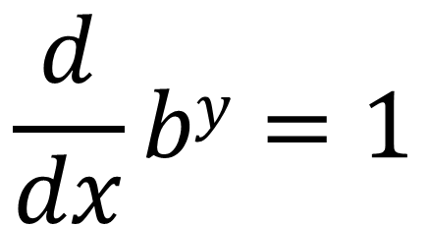
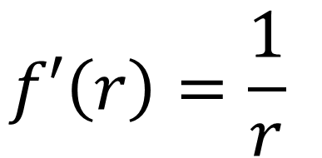
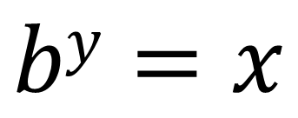
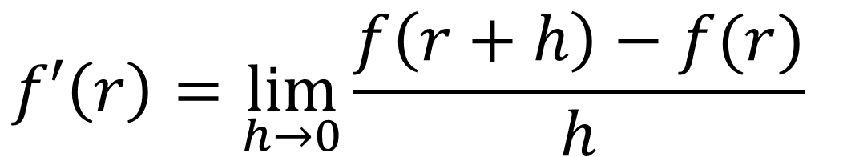
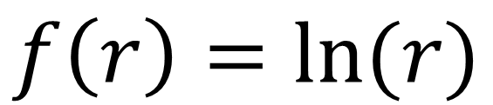
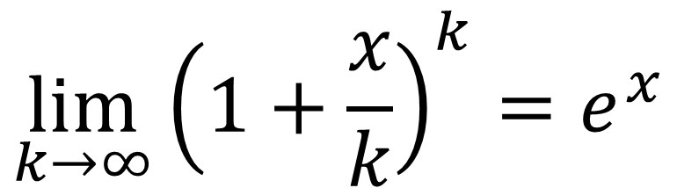
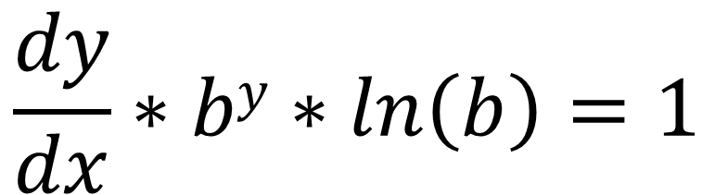
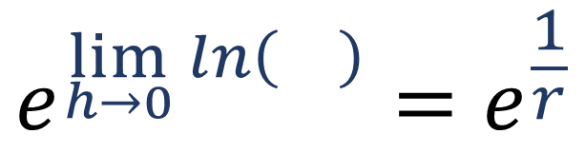
$$f′\left(r\right)=\frac{1}{r}⁡$$
$$\frac{d}{dx}by=1$$
$$f′\left(r\right)=\lim_{h→0}{\frac{f\left(r+h\right)−f(r)}{h}}⁡$$
$$by=x$$
$$e^{\lim_{h→0}{ln\left(\right)}}=e^{\frac{1}{r}}$$
$$f\left(r\right)=ln⁡(r)$$
$$\lim_{k→∞}{{\left(1+\frac{x}{k}\right)}^{k}}=e^{x}$$
$$\frac{dy}{dx}∗by∗ln\left(b\right)=1$$

Slide 3
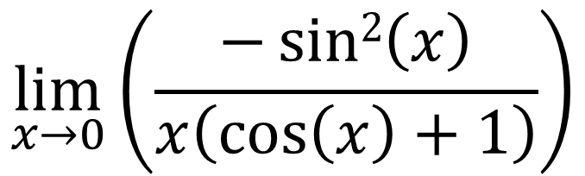
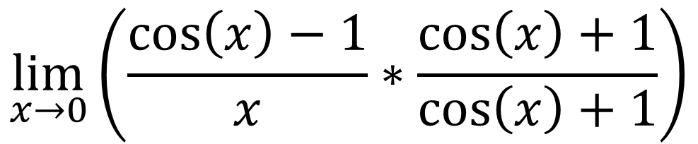
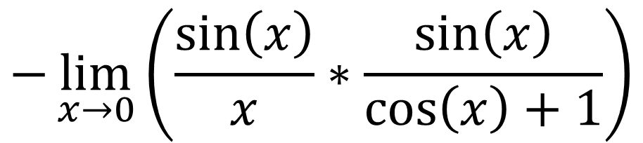
$$\lim_{x→0}\left(\frac{\cos\left(x\right)−1}{x}∗\frac{\cos\left(x\right)+1}{\cos\left(x\right)+1}\right)$$
$$\lim_{x→0}\left(\frac{−sin2\left(x\right)}{x\left(\cos\left(x\right)+1\right)}\right)$$
$$−\lim_{x→0}\left(\frac{\sin\left(x\right)}{x}∗\frac{\sin\left(x\right)}{\cos\left(x\right)+1}\right)$$

Slide 4
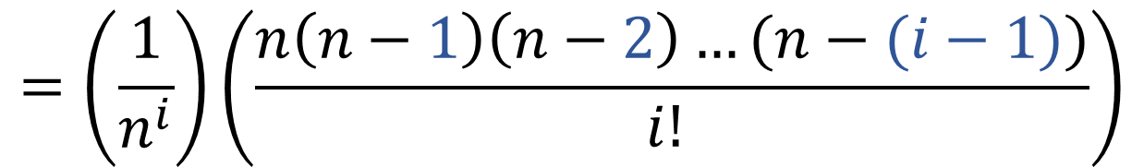
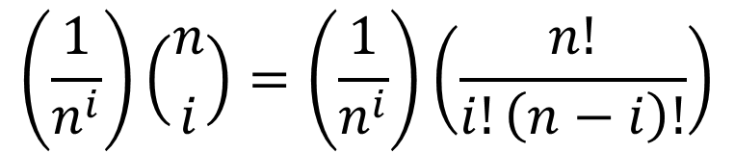
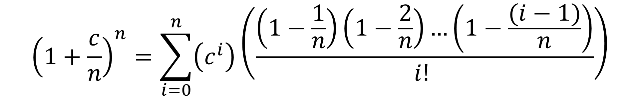
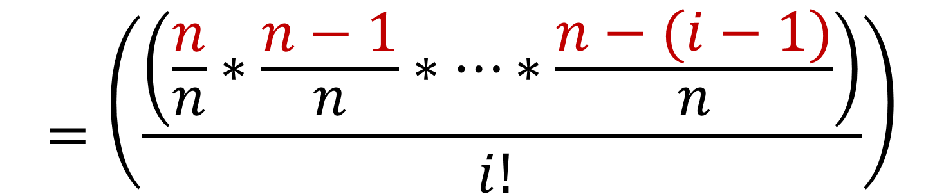
$$=\left(\frac{1}{n^{i}}\right)\left(\frac{n\left(n−1\right)\left(n−2\right)…(n−(i−1))}{i! }\right)$$
$$\left(\frac{1}{n^{i}}\right)\left({n \atop i}\right)=\left(\frac{1}{n^{i}}\right)\left(\frac{n!}{i!\left(n−i\right)!}\right)$$
$$=\left(\frac{\left(\frac{n}{n}∗\frac{n−1}{n}∗…∗\frac{n−(i−1)}{n}\right)}{i! }\right)$$
$${\left(1+\frac{c}{n}\right)}^{n}=\sum_{i=0}^{n}{\left(c^{i}\right)\left(\frac{\left(1−\frac{1}{n}\right)\left(1−\frac{2}{n}\right)…\left(1−\frac{(i−1)}{n}\right)}{i! }\right)}$$

Slide 5
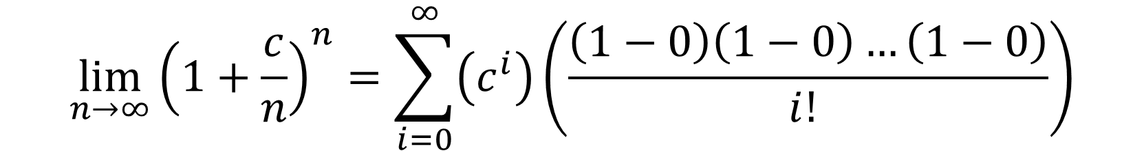
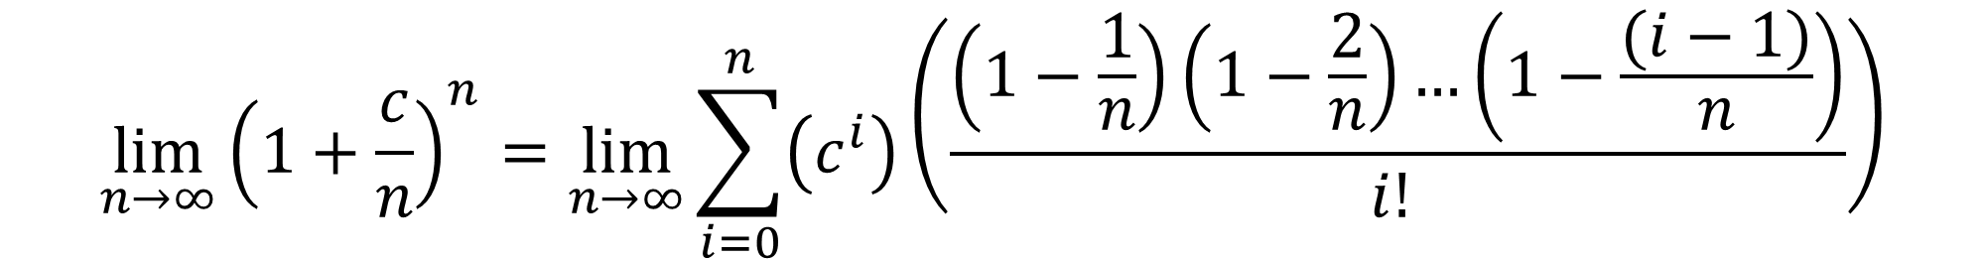
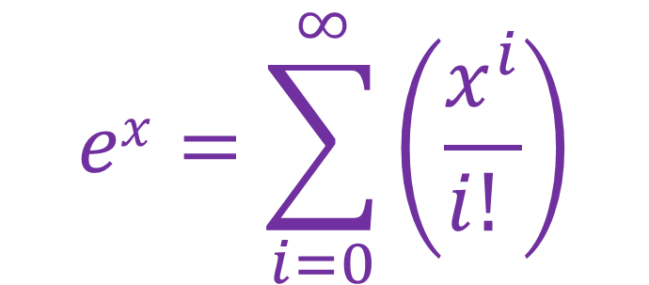
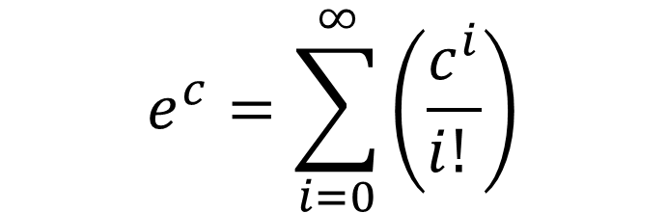
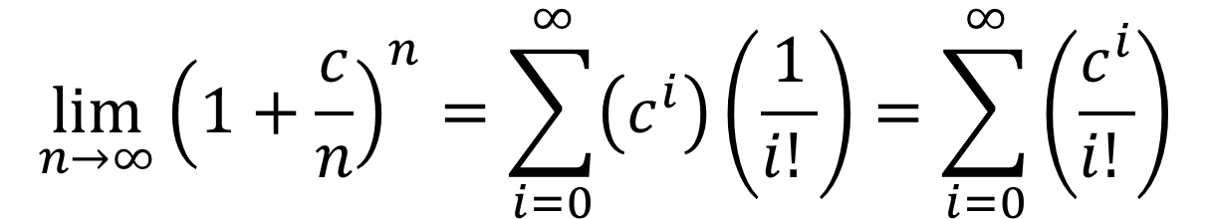
$$\lim_{n→∞}{{\left(1+\frac{c}{n}\right)}^{n}}=\lim_{n→∞}{\sum_{i=0}^{n}{\left(c^{i}\right)\left(\frac{\left(1−\frac{1}{n}\right)\left(1−\frac{2}{n}\right)…\left(1−\frac{(i−1)}{n}\right)}{i! }\right)}}$$
$$\lim_{n→∞}{{\left(1+\frac{c}{n}\right)}^{n}}=\sum_{i=0}^{∞}{\left(c^{i}\right)\left(\frac{\left(1−0\right)\left(1−0\right)…\left(1−0\right)}{i! }\right)}$$
$$\lim_{n→∞}{{\left(1+\frac{c}{n}\right)}^{n}}=\sum_{i=0}^{∞}{\left(c^{i}\right)\left(\frac{1}{i! }\right)}=\sum_{i=0}^{∞}{\left(\frac{c^{i}}{i! }\right)}$$
$$ex=\sum_{i=0}^{∞}{\left(\frac{x^{i}}{i! }\right)}$$
$$e^{c}=\sum_{i=0}^{∞}{\left(\frac{c^{i}}{i! }\right)}$$

