Slide 1
h
b

Slide 2
C
D
A
B
E

Slide 3
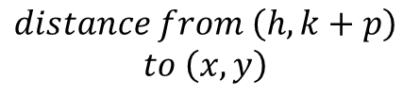
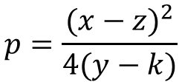

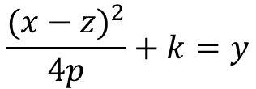
$$p=\frac{{(x−z)}^{2}}{4(y−k)}$$
$$distance from \left(x,y\right)$$
$$to the directrix$$
α + (α + β) + β = 180
$$\frac{{(x−z)}^{2}}{4p}+k=y$$
2*(α + β) = 180
α + β = 90
$$distance from \left(h, k+p\right)$$
$$to \left(x, y\right)$$

Slide 4



F
We can prove the reflective property if we show that α and θ are equal
$$θ$$
$$α$$
R
$$θ$$
V
E
M
D

Slide 5
F
V
Rays perpendicular to the directrix are reflected towards the focus

Slide 6
F
(0, p)
(a,b)
V

Slide 7
F
(0, p)
R
(a,b)
V

Slide 8
D
α
β
α
β
A
B
C

Slide 9
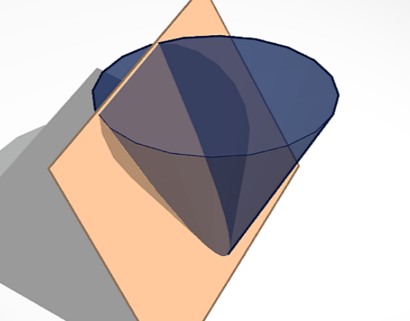

Slide 10
- The axis of the cone
α
α
A

Slide 11


Slide 13
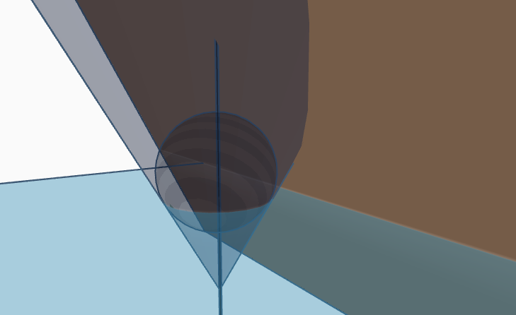

Slide 14
