Slide 2


$$z$$
$$sin⁡(x)$$
x

Slide 3

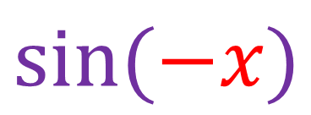
-x
$$sin⁡(−x)$$
$$−z$$

Slide 4

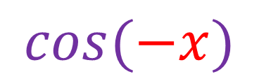
-x
$$a$$
$$cos⁡(−x)$$

Slide 5

$$sin⁡(90 −x)$$
90 - x

Slide 6

$$sin(z)$$
90 - x
x
z
90 - z

Slide 7

$$cos⁡(x)$$
x
$$a$$

Slide 9
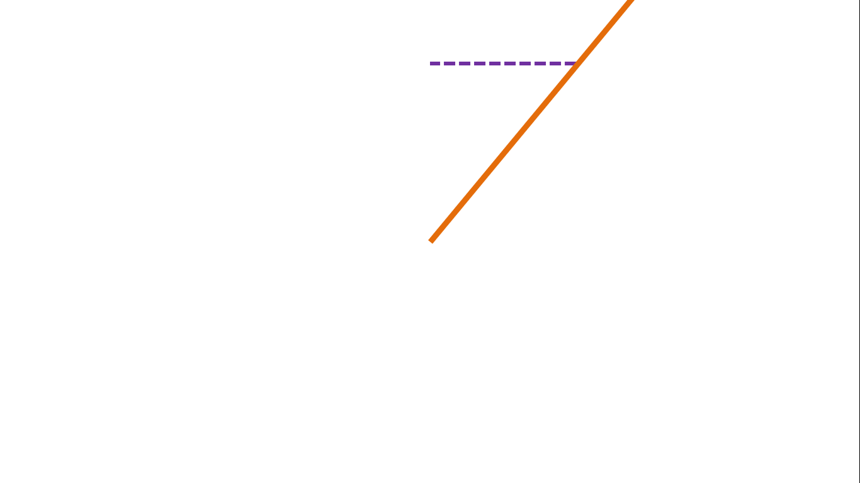

Slide 21


$$a$$
$$sin⁡(x+90)$$
x+90

Slide 22
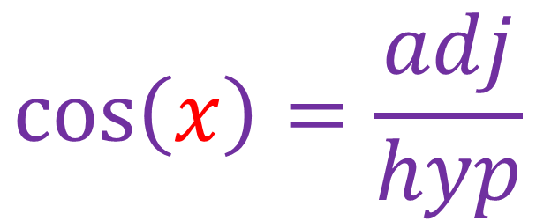
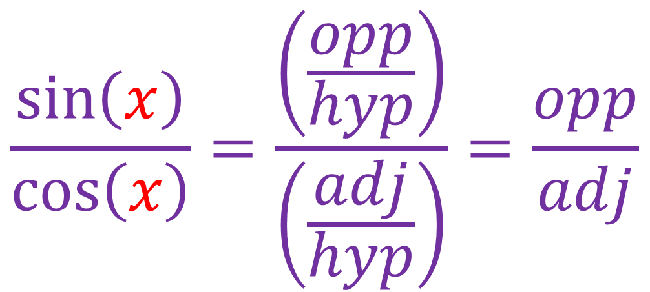
$$\frac{\sin\left(x\right)}{\cos\left(x\right)}=\frac{\left(\frac{opp}{hyp}\right)}{\left(\frac{adj}{hyp}\right)}=\frac{opp}{adj}$$
$$\cos\left(x\right)=\frac{adj}{hyp}$$

Slide 23
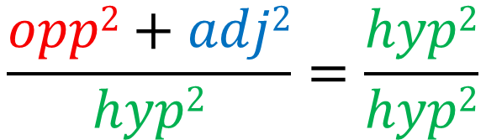


$$a2+b2=c2$$
c
a
$$\frac{opp2+adj2}{hyp2}=\frac{hyp2}{hyp2}$$
b
$$\sin\left(x\right)2+\cos\left(x\right)2=1$$

