Slide 2
algebra

Slide 3
geometry

Slide 4
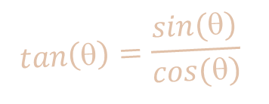

$$tan\left(θ\right)=\frac{sin⁡(θ)}{cos⁡(θ)}$$
trigonometry
$$\sin\left(θ\right)+\cos\left(θ\right)=1$$

Slide 5

sequence
$$\sum_{x=0}^{x=n}{(2x)}$$
1, 3, 5 …

Slide 6
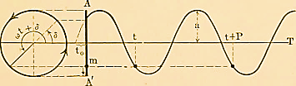

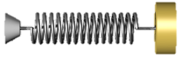

mechanics

Slide 7

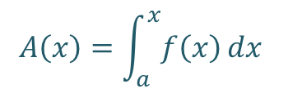
$$\frac{d}{dx}y=g(x)$$
$$A\left(x\right)=\int_{a}^{x}{f\left(x\right)}dx$$
calculus

Slide 8





Electricity
&
Magnetism

Slide 9



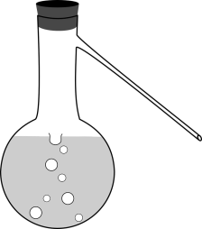
chemistry

Slide 10
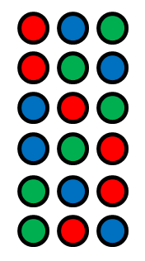
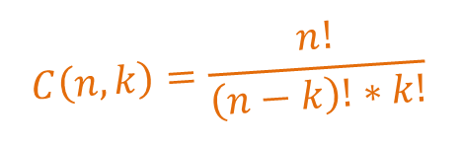
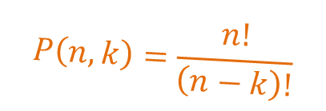
$$C\left(n,k\right)=\frac{n!}{\left(n−k\right)!∗k!}$$
Discrete
Mathematics
$$P\left(n,k\right)=\frac{n!}{\left(n−k\right)!}$$

Slide 11
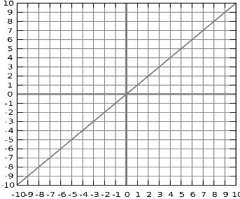
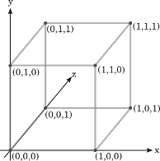
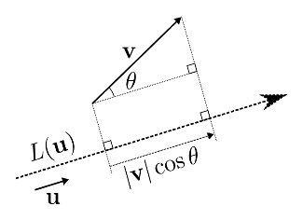


Linear Algebra
$$\left[\begin{matrix}2 & 3 \\ 4 & 5\end{matrix}\right]$$
$$\left[\begin{matrix}0 & 1 \\ 1 & 0\end{matrix}\right]=\left[\begin{matrix}3 & 2 \\ 5 & 4\end{matrix}\right]$$

Slide 12
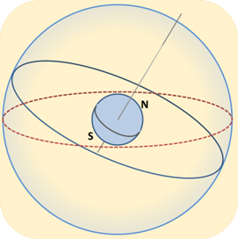
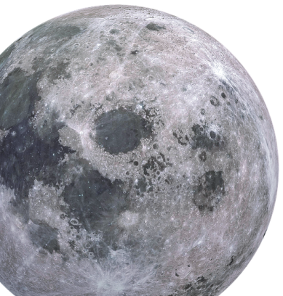

astronomy

Slide 13

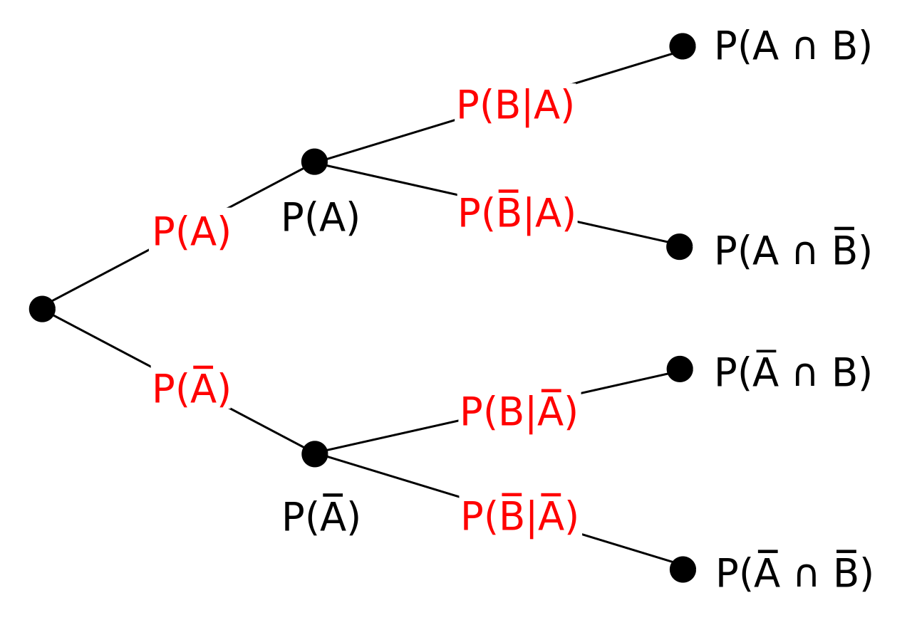
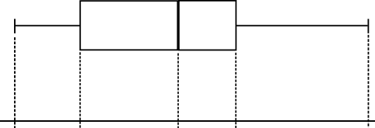
Probability
&
Statistics

Slide 14
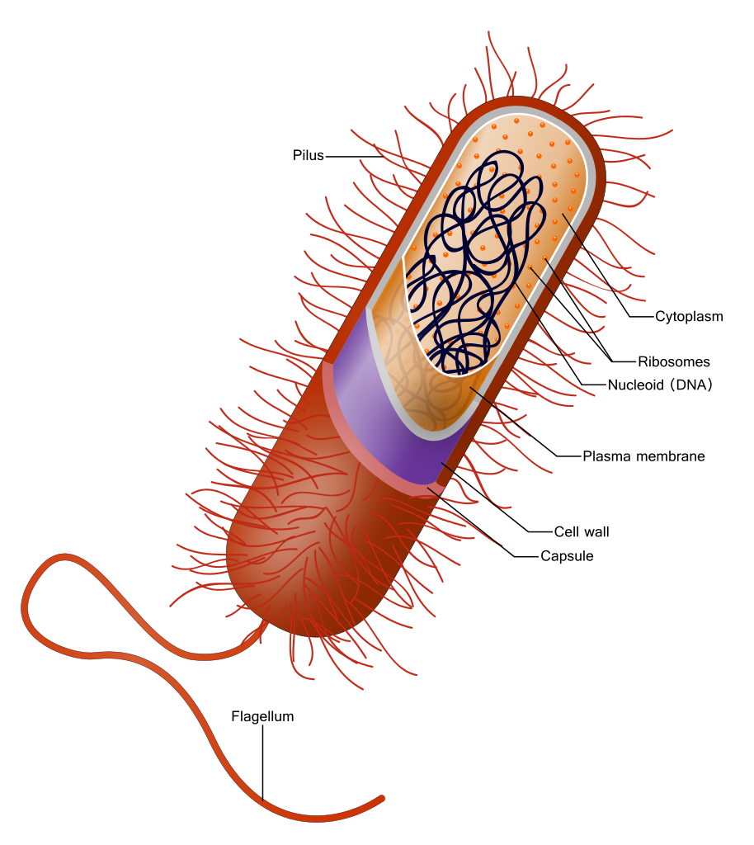

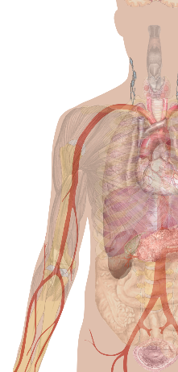
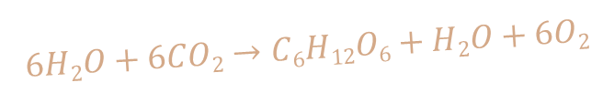
Biology
$$6H2O+6CO2→C6H12O6+H2O+6O2$$

Slide 15

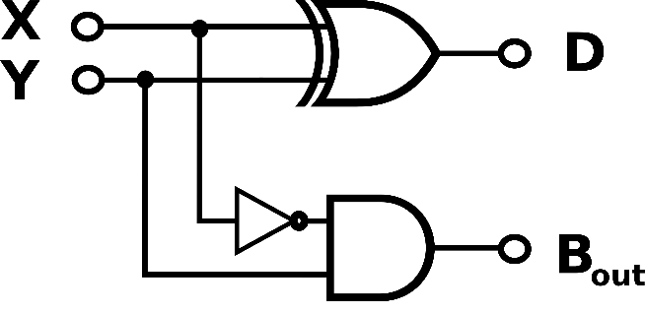
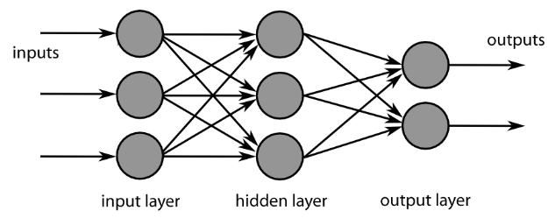
Computer Science

Slide 16
Under
Construction!

Slide 17
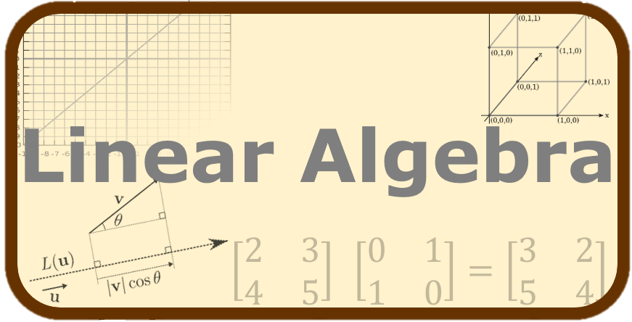

Slide 19


