Slide 1
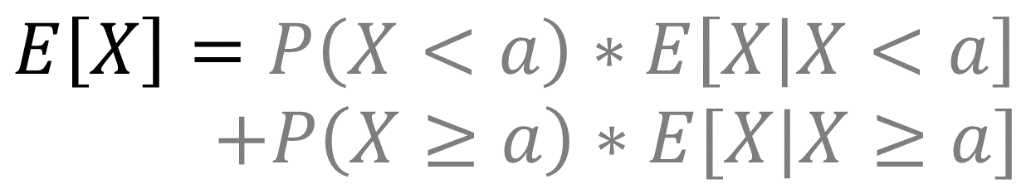
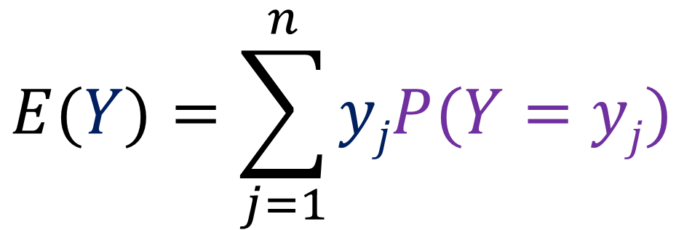
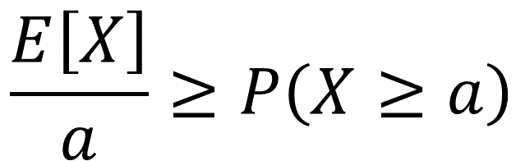
$$E(Y)=\sum_{j=1}^{n}{yjP(Y=yj)}$$
$$\frac{E\left[X\right]}{a}≥P\left(X≥a\right)$$
$$E\left[X\right]=P\left(X<a\right)∗E\left[X | X<a\right]$$
$$+P\left(X≥a\right)∗E[X|X≥a]$$
$$E\left[X\right]≥P\left(X≥a\right)∗E\left[X | X≥a\right]$$

Slide 3
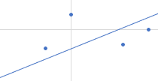






Slide 4
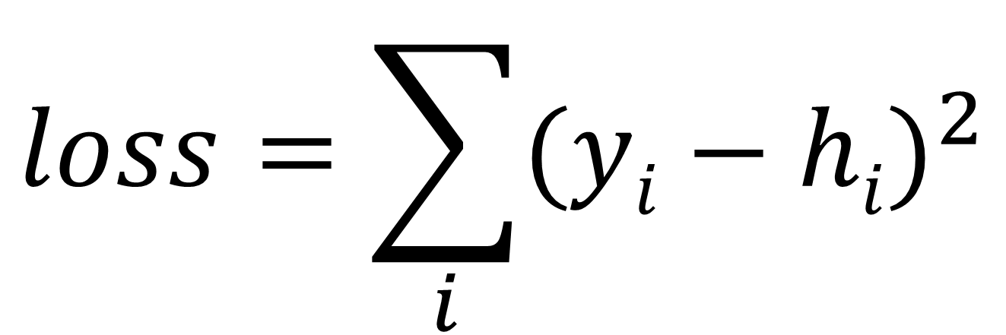
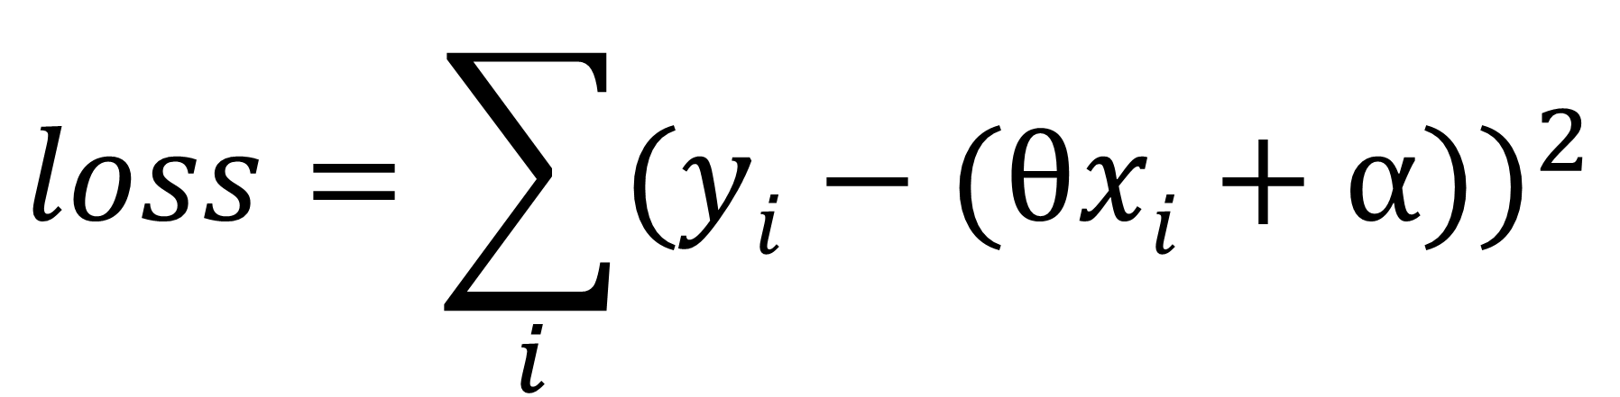
$$loss=\sum_{i}{{(yi−hi)}^{2}}$$
$$loss=\sum_{i}{{(yi−(θxi+α))}^{2}}$$

Slide 5
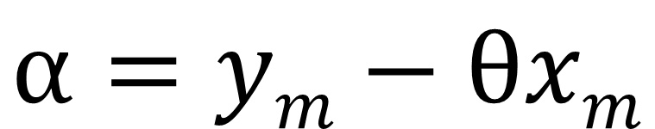
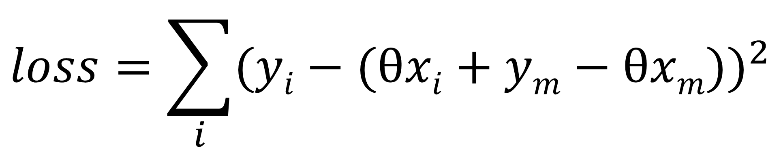
$$α=ym−θxm$$
$$loss=\sum_{i}{{(yi−(θxi+ym−θxm))}^{2}}$$

Slide 6
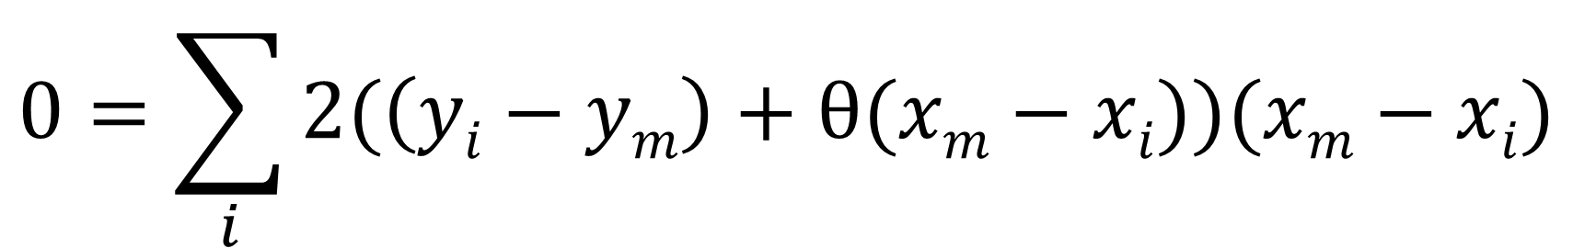
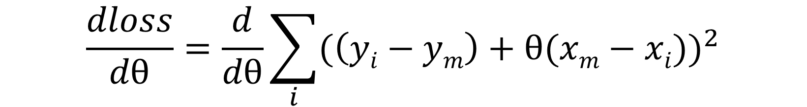
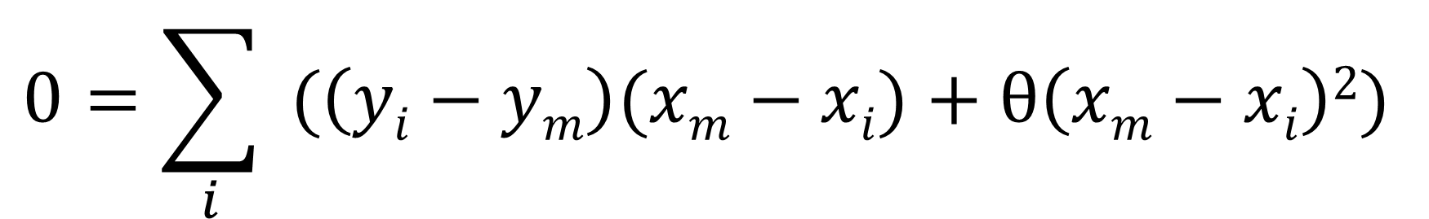
$$\frac{dloss}{dθ}=\frac{d}{dθ}\sum_{i}{{(\left(yi−ym\right)+θ(xm−xi))}^{2}}$$
$$0=\sum_{i}{2(\left(yi−ym\right)+θ(xm−xi))(xm−xi)}$$
$$0=\sum_{i}{ (\left(yi−ym\right)(xm−xi)+θ\left(xm−xi\right)2) }$$

Slide 7
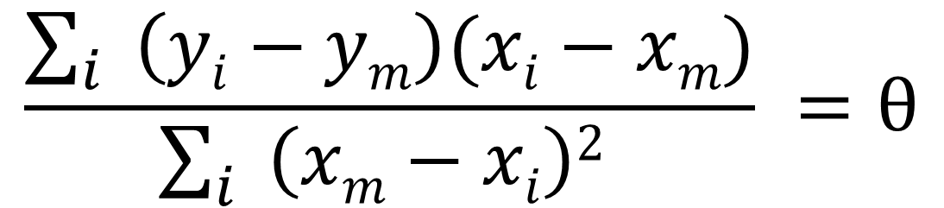
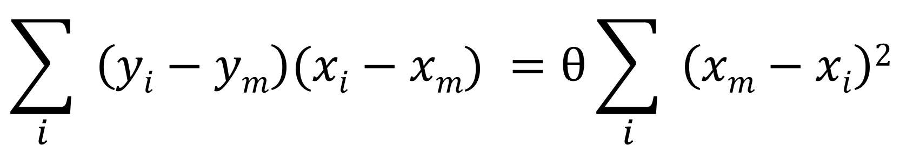
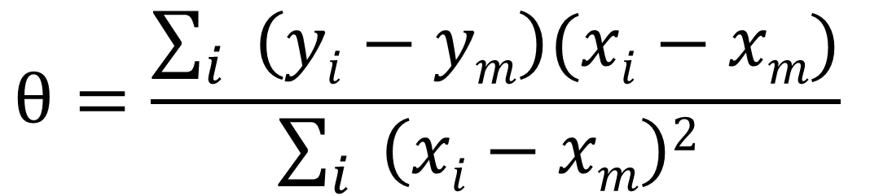
$$\sum_{i}{ \left(yi−ym\right)(xi−xm)} =θ\sum_{i}{ \left(xm−xi\right)2 }$$
$$\frac{\sum_{i}{ \left(yi−ym\right)(xi−xm)}}{\sum_{i}{ \left(xm−xi\right)2 }} =θ$$
$$θ=\frac{\sum_{i}{ \left(yi−ym\right)(xi−xm)}}{\sum_{i}{ \left(xi−xm\right)2 }}$$

