Slide 1
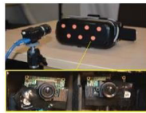
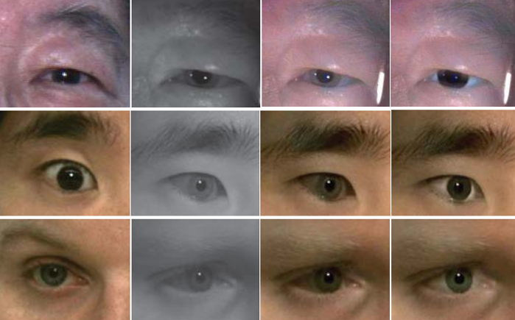
Main Idea：
1:
Develop a setup that consists of two near-infrared (NIR) cameras inside the HMD for eye capturing and one external RGB camera for recording visible face regions.
2:
A dedicated algorithm is proposed to colorize the NIR eye images and further rectify the color distortion caused by the non-linear mapping of IR light sensitivity.
Notes:
30s

Slide 2
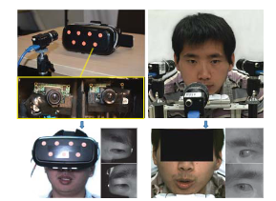
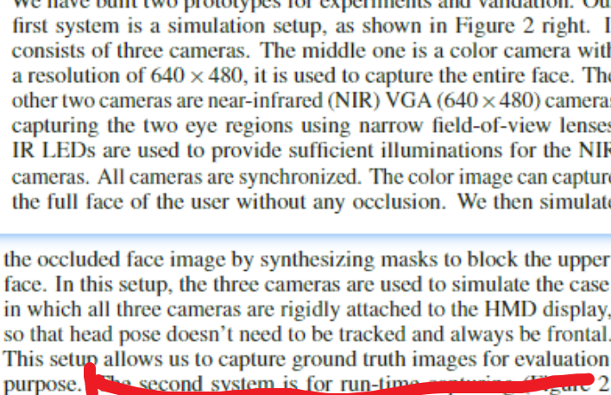
Hardware Setup：
our
GT
Notes:
右边用来获得gt，具体就是配置和论文配置一样，rgb得到真的图像，然后后期再加上一块黑的

Slide 3
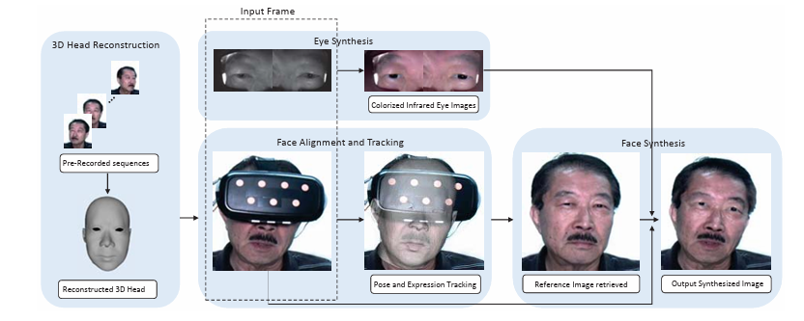
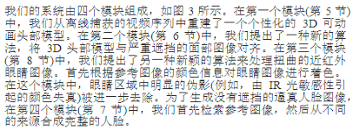
SYSTEM OVERVIEW:
Notes:
这里结束 总计2 min
We reconstruct a personalized 3D animatable head model from a video sequence captured offline in the first module
In the second module we propose a novel algorithm to align 3D head model to the face image with severe occlusion.
In the third module we propose another novel algorithm to process the warped near-infrared eye images
In the fourth module we first retrieve for the reference image and then compose the complete face from different sources.

Slide 4
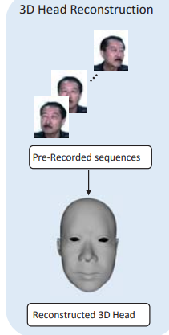
First Module：
3d head reconstruction
Step 1、Record a video sequence of a novel user with neutral expression under various head poses
Step 2、We first apply the approach in ref [14] to estimate a sparse point cloud. A bi-linear face morphable model is then used to reconstruct a dense 3D model.
Notes:
一： 30s

Slide 5
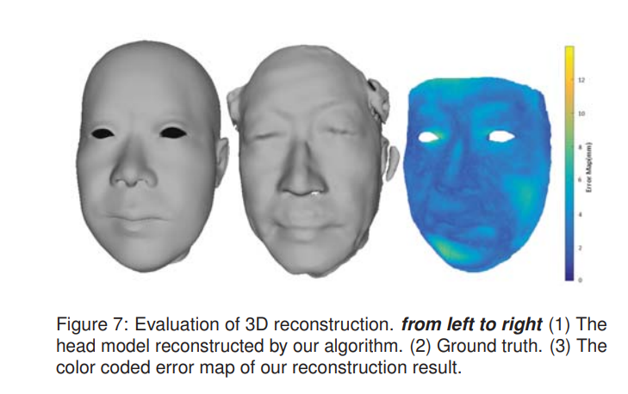
result：
Notes:
至此 2.5min

Slide 6



Second Module：
alignment and tracking
Step1、Extract the facial landmarks from both the color and IR images
Step2、Initial Alignment:
Estimate the transformation (represented as rotation R∗ and translation T∗) between the 3D head model and the HMD .
How: The user is instructed to change head pose with a neutral expression each time they put on the HMD.
How exactly: The alignment is formulated as a non-linear minimization problem
Notes:
第二部分
1.5 min
Step2中
第一条what 第二条how
第三条具体怎么算：
The first term Ef is the projection error
It measures the Euclidean distance between visible facial features in the 2D image and the corresponding 3D points of the head model projected into the camera view.
The second term Ee is the eye movement error term
It measures the error between eye features in the 2D image from the Near-Infrared (NIR) eye-tracking camera and the corresponding 3D points of the head model transformed through the eye camera's transformation matrices.

Slide 7



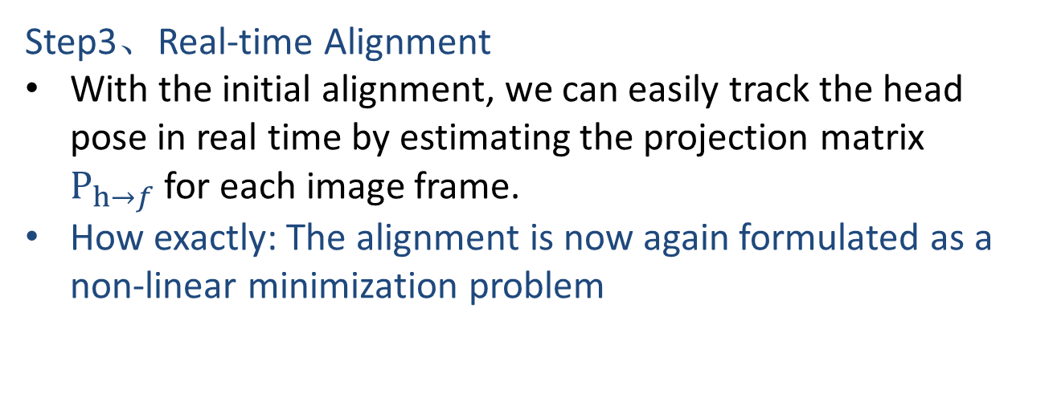
Step3、Real-time Alignment
With the initial alignment, we can easily track the head pose in real time by estimating the projection matrix $P_{h→f}$for each image frame.
How exactly: The alignment is now again formulated as a non-linear minimization problem
step2
Notes:
Et:
This term is defined as the constraint term. It represents the temporal continuity of expression weights between consecutive frames.
Et​ ensures that the changes in facial expressions from one frame to the next are smooth and not abrupt.
Es:
This term is the regularization term that forces the expression weights to be close to the statistical center.
It adds a penalty for expression weights that are far from a precomputed statistical norm, thereby avoiding unlikely facial expressions that do not conform to the learned model of expressions.

Slide 8
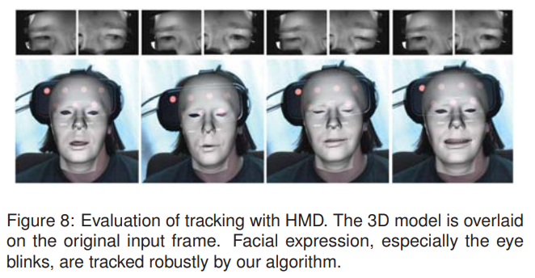
Result：

Slide 9
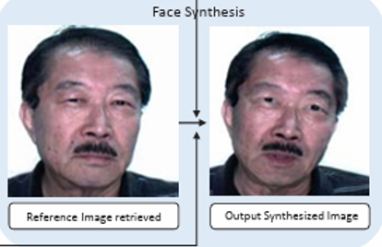
Fourth Module：
Face Synthesis
Step 1、Through the current head pos, we first search for a reference image from the data set we have captured off-line.
Step 2、Then we apply a two-step warping to warp both the template image and the NIR eye images.
Notes:
1.5 min
Step2 .【这里好像只是区分出被遮挡的mask和没遮挡的mask？】

Slide 10
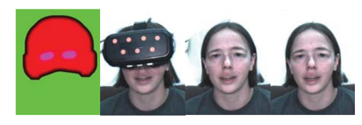

Step1：
Retrieval of Reference Image
The similarity between ith image in the data set and the query image is measured based on three distances
Step2:
Face and Eye image wraping
How: As the 3D head model have been estimated and aligned with both the reference image and the query image separately, we use 3D model as a bridge to warp reference image to align with query image.
Notes:
1.5 min
Step1:
The first term is the distance between head poses of the query image and the reference image candidate
The second term is the distance between 2D facial landmarks of the selected reference image in previous time frame (Lr−1) and current reference image candidate (Li r).
This term removes large 2D translation between two consecutive image frames even they have similar poses.
The third term is defined so that current image candidate and previous reference image have close time stamps., ensures continuous.
Step2:
公式解释：
Ed​: data term ensuring that the pixel values are not distorted beyond the effects of the bilinear interpolation.
Es​: similarity transformation term that ensure that the warped image preserves the geometric features of the face.
Eb​: This term is used to reduce the transformation outside the face region.
Eh​: This term is introduced to constrain the silhouette of the face in the image 即ensuring a smooth transition and avoiding artifacts along the silhouette of the face.
图的解释；
1) The mask used to blend images from different sources. The green region represents the background we would like to keep in the final result. The red region represent the head region that is extracted from the warped reference image. The purple region is the region corresponding to the NIR eye images
2) The query image with the face occluded by the HMD.
3) The blending result of the query image, warped reference image, and colorized eye images.
4) The final blending result after background replacement

Slide 11
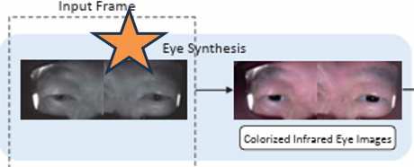
Third Module：
eye synthesis
(colorize the warped NIR eye images)
Step1、we colorize the eye images based on the color information from the reference image.
Step2、we further refine the eye regions by removing obvious artifacts (e.g., IR color distortion) during the colorization

Slide 12
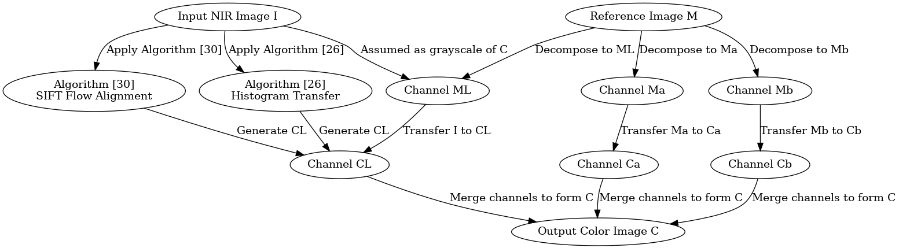
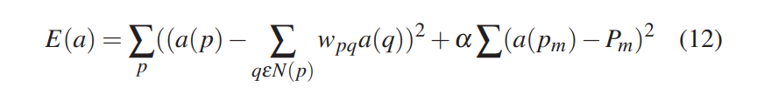

Step1、colourization
[L*a*b* color space]
Step1：get L channel
Step2: get a & b channel
Minimizing the following equation using ref[20]:
Notes:
1.5min
第一步中：
L:luminance a:green b: blue
We denote the input NIR image as I, the reference image as M, and output color image as C.
The first algorithm [26] is a straightforward histogram transfer based on the standard deviations and mean values of I and ML. In the second algorithm [30], the images I and M are aligned based on the landmarks and the SIFT flow [22]. Then two images are decomposed into multiscale Laplacian stacks. These stacks are updated by the gain maps and are aggregated to generate CL.
The second one performs better but is time-consuming
第二步中：
第一个Equation 的目的是：
This equation minimizes the difference between the color at pixel p and its weighted averages of the neighboring pixels. The weight wpq is computed based on CL and statistics of the local patch around p. 种子Pm are the pre-defined seed pixels
第二个是因为只用第一个会产生obvious artifacts，所以通过它remove
use a voting scheme to remove the unreliable seed pixels. We first run adaptive k-means clustering to segment the image M at gray scale level. Then we only select seed pixels with high confidence that is measured by
where Ip is the intensity value of pth pixel in I and Ic is the intensity value of the center of each segment. We only select the seed colors with error < 0.06.

Slide 13
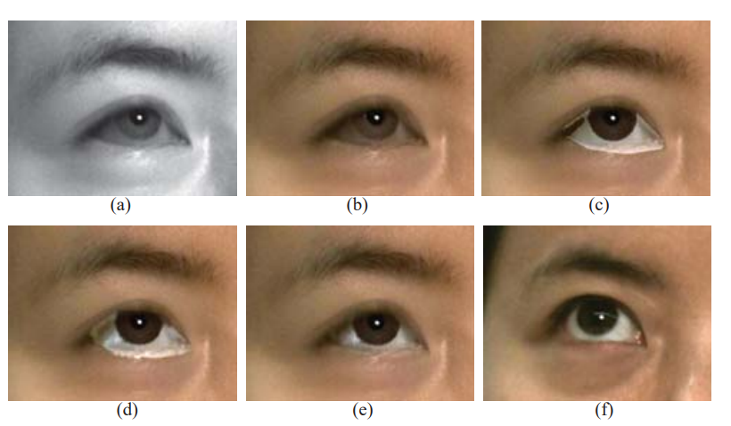
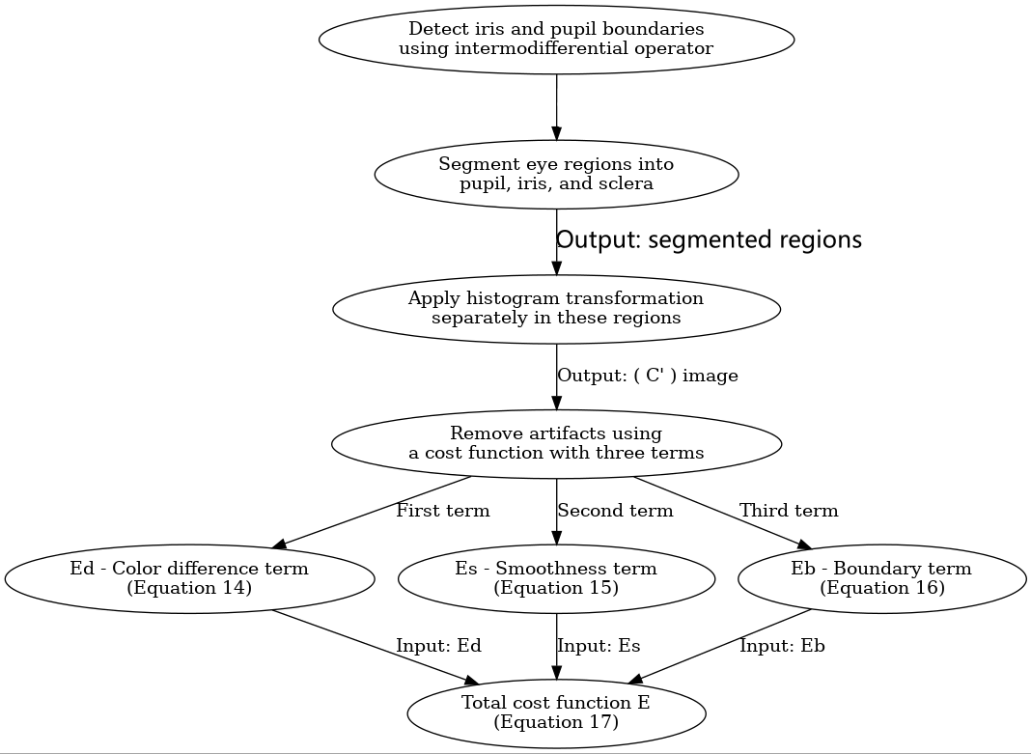
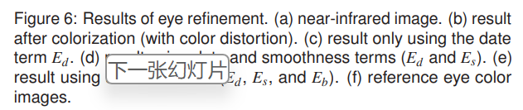
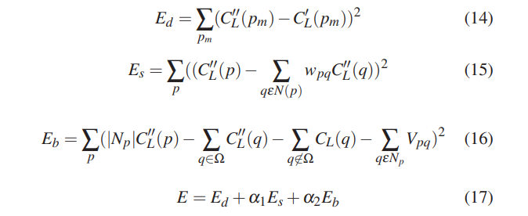
Step2、Refinement of
eye regions
Notes:
1.5 min
意义：解决上一页Step1 得到图b（contains very strong artifacts：IR color distortion effects)
第一个框：分区域在histogram transform
First & Second:
detect iris and pupil !boundaries! in both nir images and color. Combining with the eye landmarks, we segment the eye regions into three categories, pupil, iris, and sclera.
Third:
Then apply histogram transformation separately in the regions of these categories.
This result partially removes color distortion effects. However, it introduces strong artifacts around boundaries of these categories and makes the result unnatural.
第二个框 FOURTH: In order to remove the artifacts, we formulate a minimization based on a cost function with three terms。
The first term Ed is the data term that color an unknown pixel same as the seed pixel in the input image.
Es is the smoothness term
and the last term Eb is the Poisson equation with Dirichlet boundary conditions inspired by the gradient image editing

Slide 14
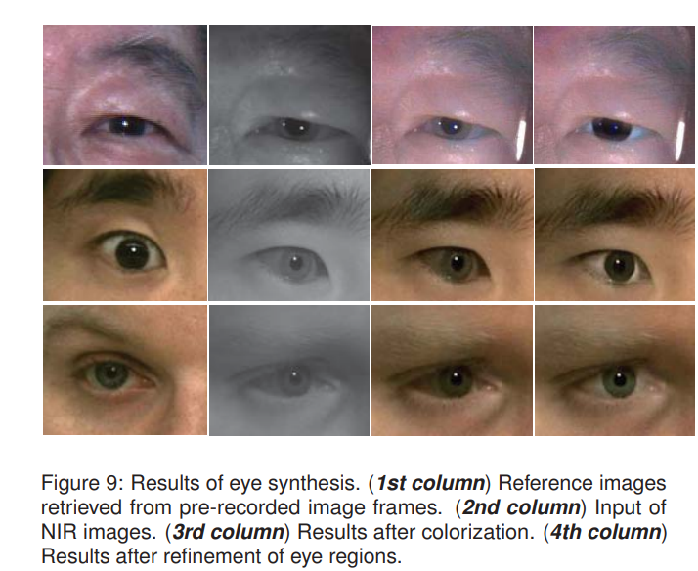
Result：

Slide 15
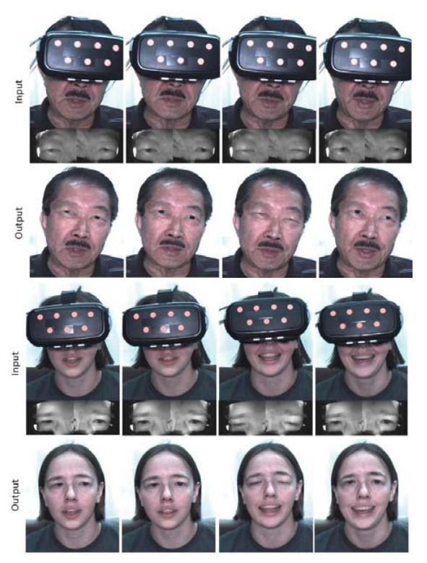
Result of the Real System:

