Slide 1
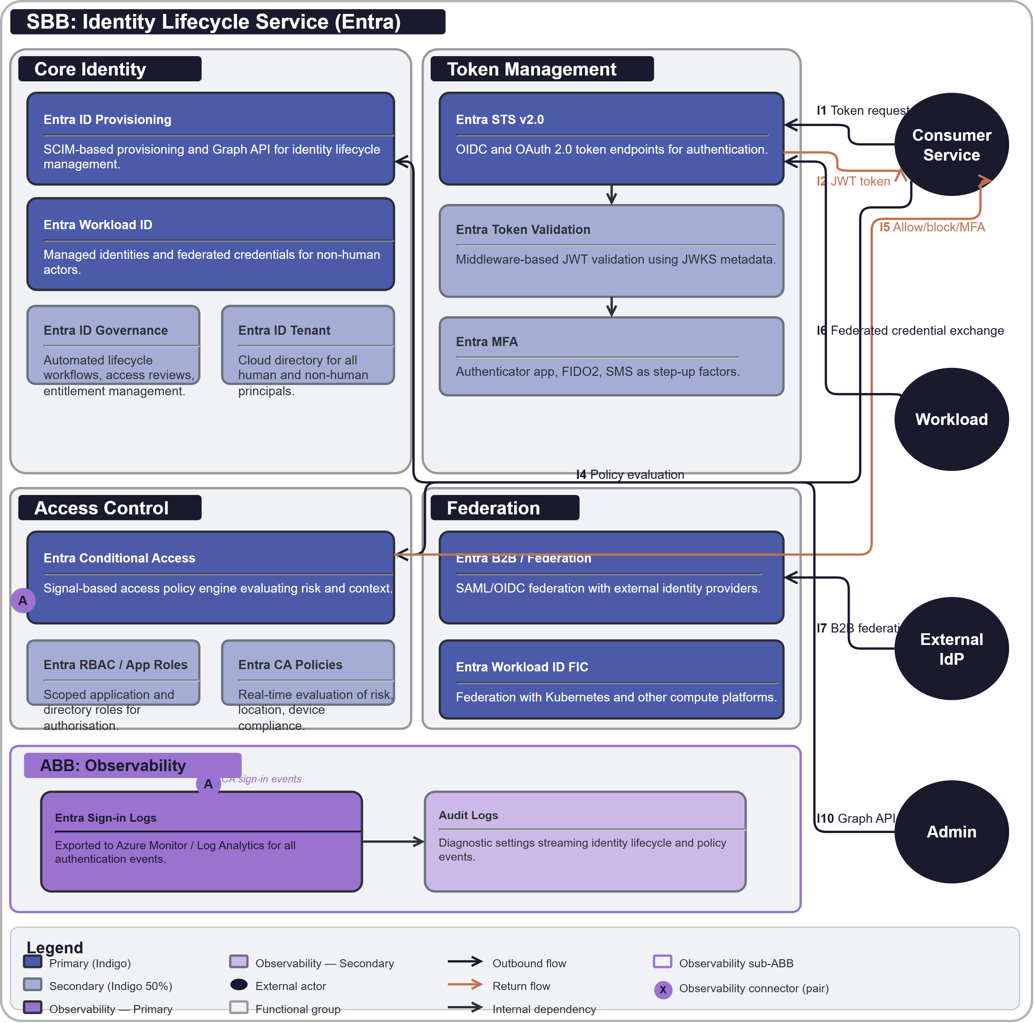
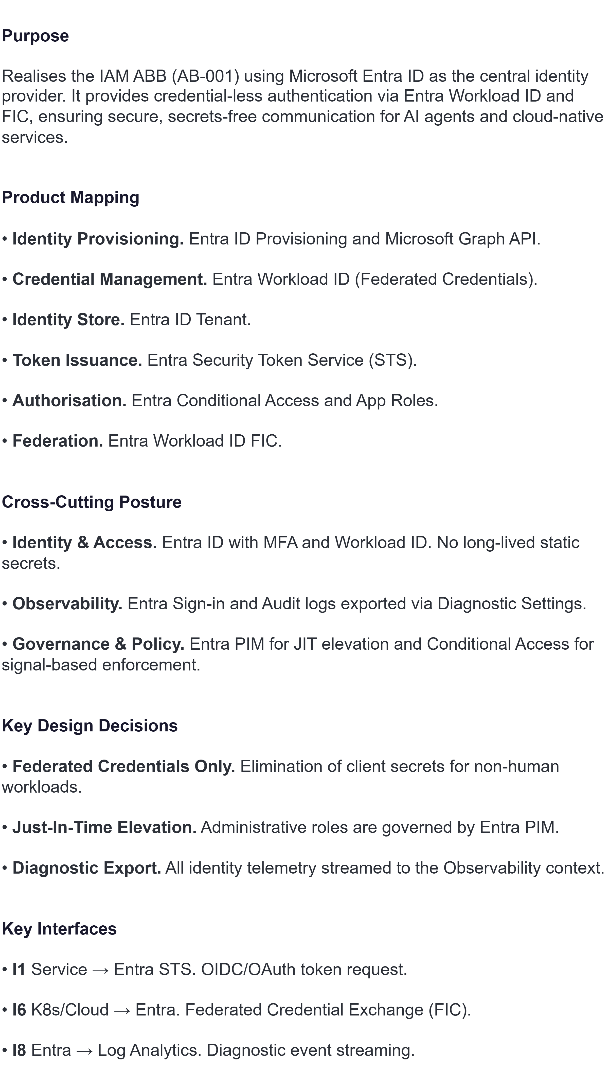
SBB: SB-001 Identity Lifecycle Service (Entra)

