Slide 1
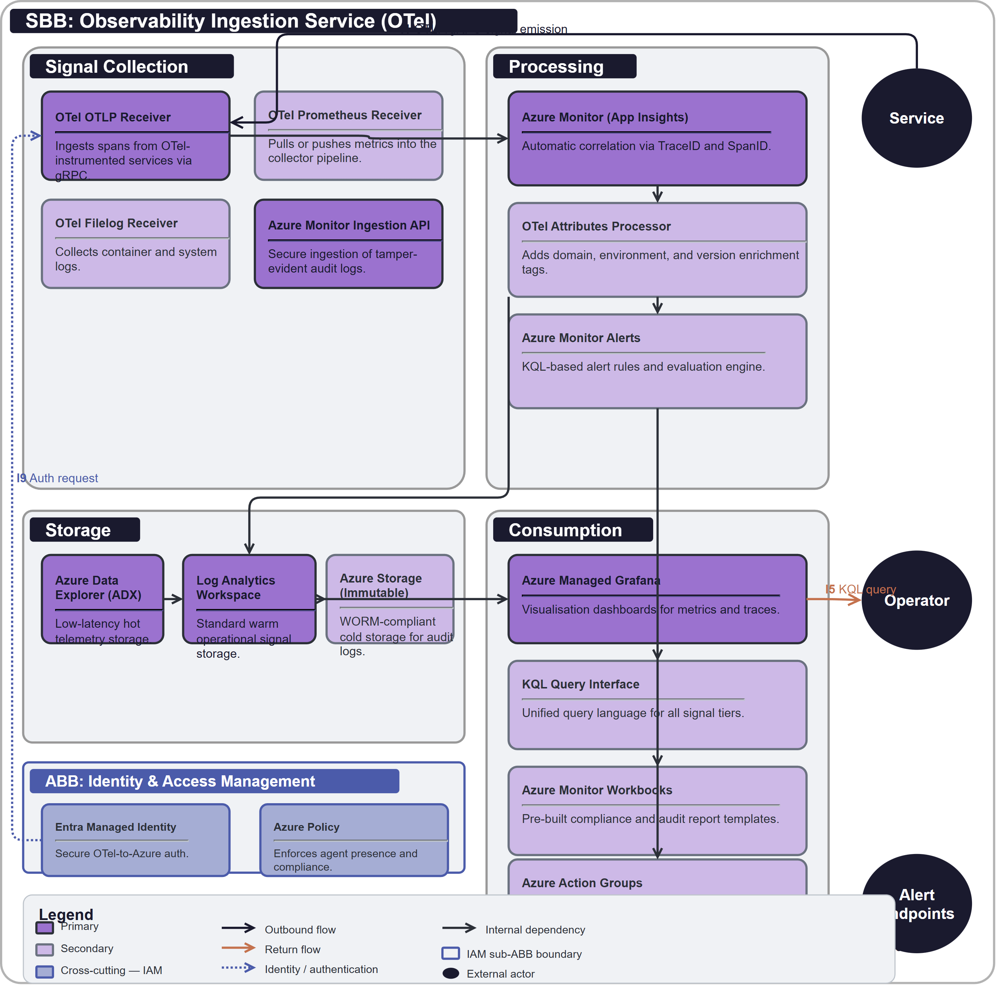
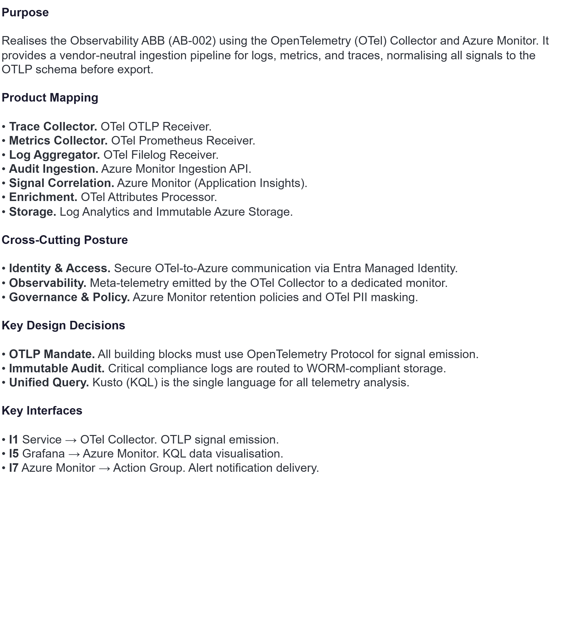
SBB: SB-002 Observability Ingestion Service (OTel)

