Slide 1
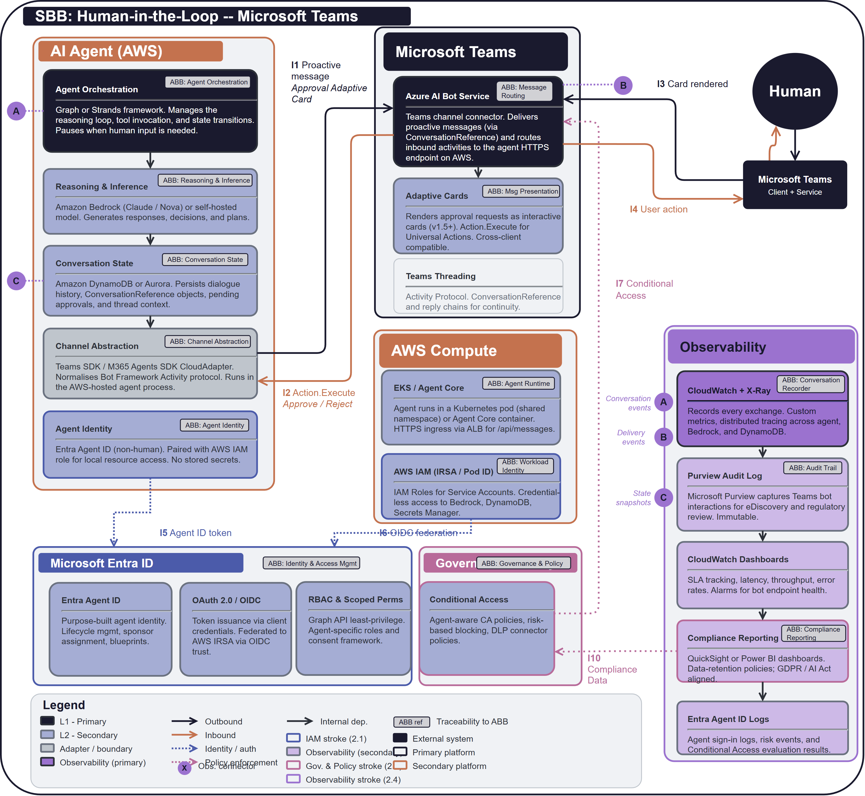
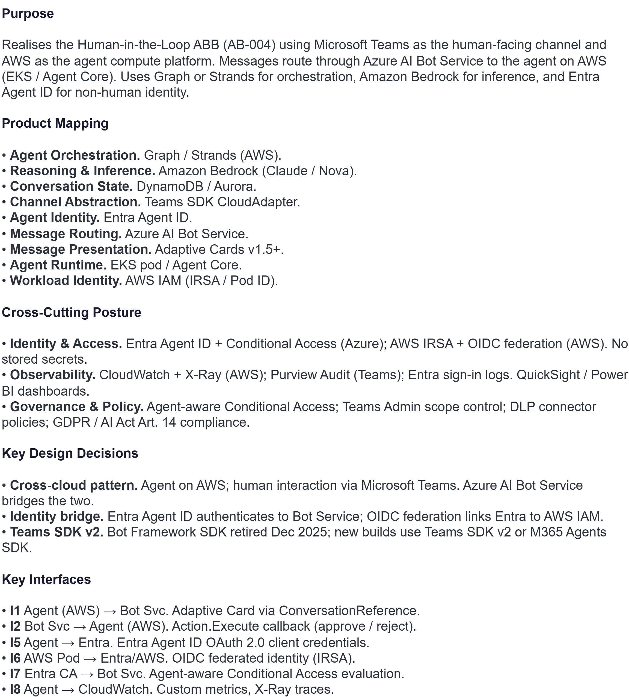
SBB: SB-004 Human-in-the-Loop via Microsoft Teams

