Slide 1
Global HIV Trends & Treatment Effectiveness Analysis Power BI Dashboard By: Aderonke

Slide 2
Project Overview
This project analyzes global HIV trends, treatment coverage (ART), and mortality using Power BI to provide insights for public health decision-making.

Slide 3
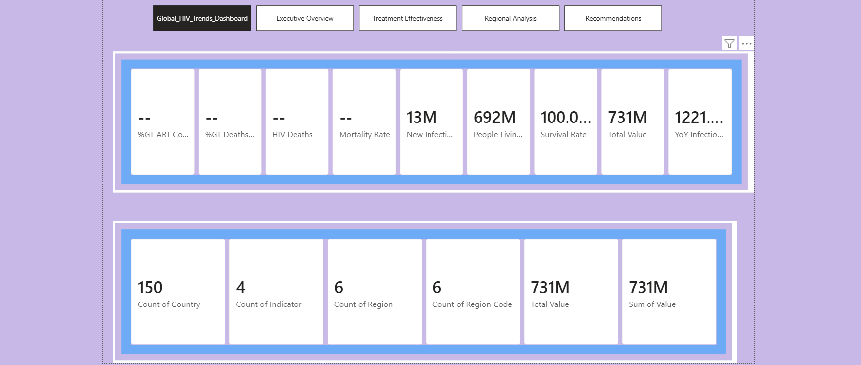

Slide 4
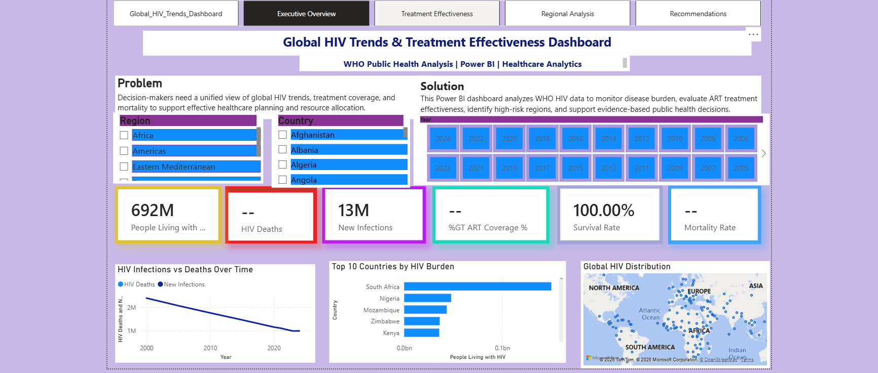

Slide 5
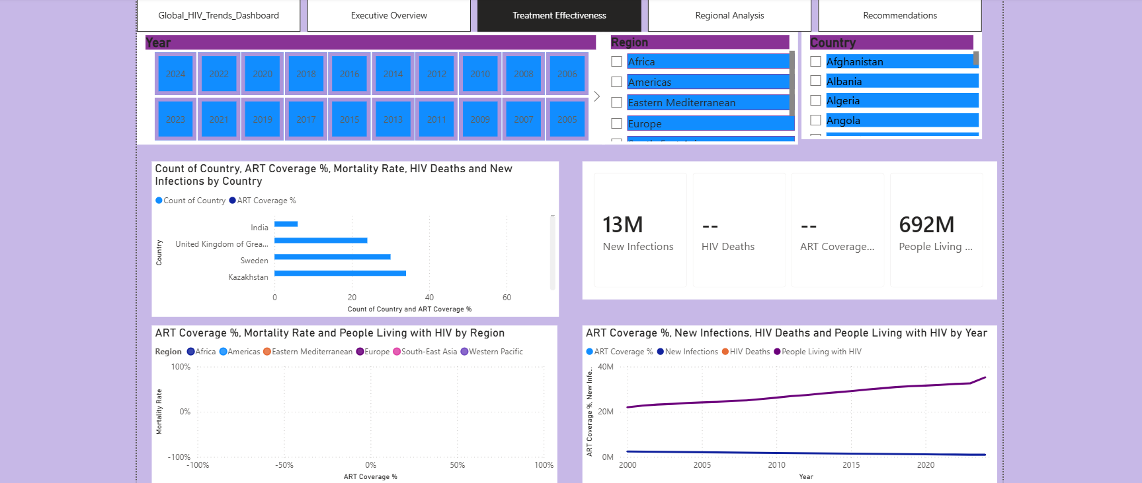

Slide 6
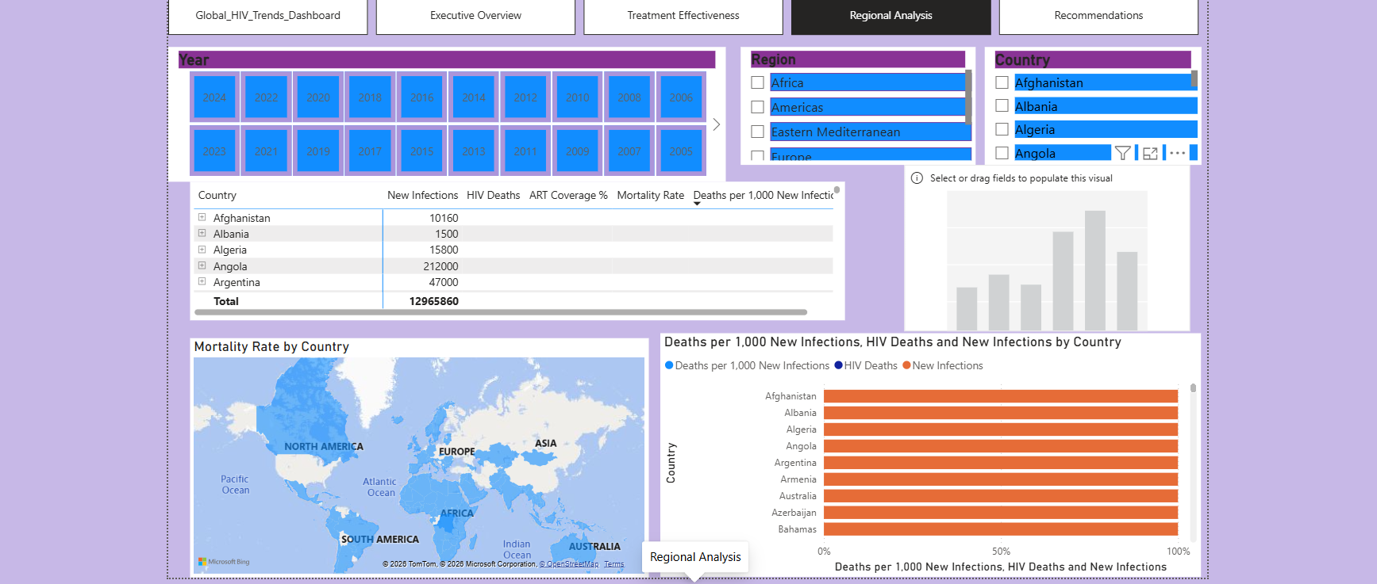

Slide 7
