Slide 1
ELECTRICITY SUPPLIER BUSINESS PLAN
AIML_ST1511 CA2 (Timeseries)
YOUR COMPANY
Name: Lee Hong Yi (2223010)
Class: DAAA/FT/2A/05

Slide 2
CONTENTS OF THIS TEMPLATE
Introduction to Task
Objective:
To use the given dataset to train timeseries models, and forecast the consumption of Gas, Electricity, and Water into the future.
Background Information:
Water, gas, and electricity are essential resources that are used for a variety of purposes. The global consumption of these resources is increasing, and it is projected to continue to increase in the coming years. By being able to be ahead of the curve and predict how the consumption of such resources will change over the years, the government and related utility companies can see how to create more buffer to give us resource security.
Output Variable:
Future consumption of water, gas and electricity.

Slide 3
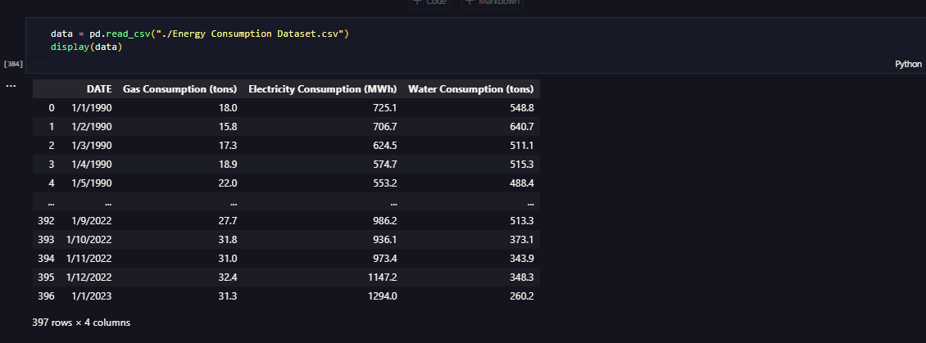
TABLE OF CONTENTS
Preparing Data + EDA
Since the data has already been collected, we can move straight onto preparing it, as well as EDA.
From the initial EDA, there is not much we can tell about the dataset. However, there are some potential outliers that are present. We use the IQR method to identify them, then use backfilling to remove them.
Using a corrplot, we can also see that there is some mild correlation between the features.
Lastly, we use STL seasonal decomposition to break down the timeseries into it’s component parts, allowing us to understand the underlying patterns in the data.
We also perform test on stationarity and can see that the “Electricity Consumption” feature is not stationary.

Slide 4
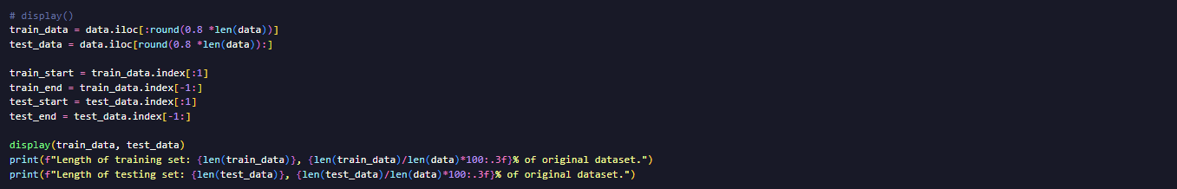
TABLE OF CONTENTS
Modelling
We shall also split our data into a training and testing set, so that we can actually see how the model performs on unseen data. We shall allocate ~80% of the data to training, and ~20% to testing.
Once we have split the data, we can move onto modelling.
There are a few models that we can use to make forecasts on the dataset, such as
Holt-Winters Exponential Smoothing,
ARIMA (Auto Regressive Integrated Moving Average),
SARIMA (Seasonal Auto Regressive Integrated Moving Average), and
VARMAX (Vector Autoregressive Moving Average with eXogenous regressors)
These models all have values which we need to find. I will elaborate on them later.

Slide 5
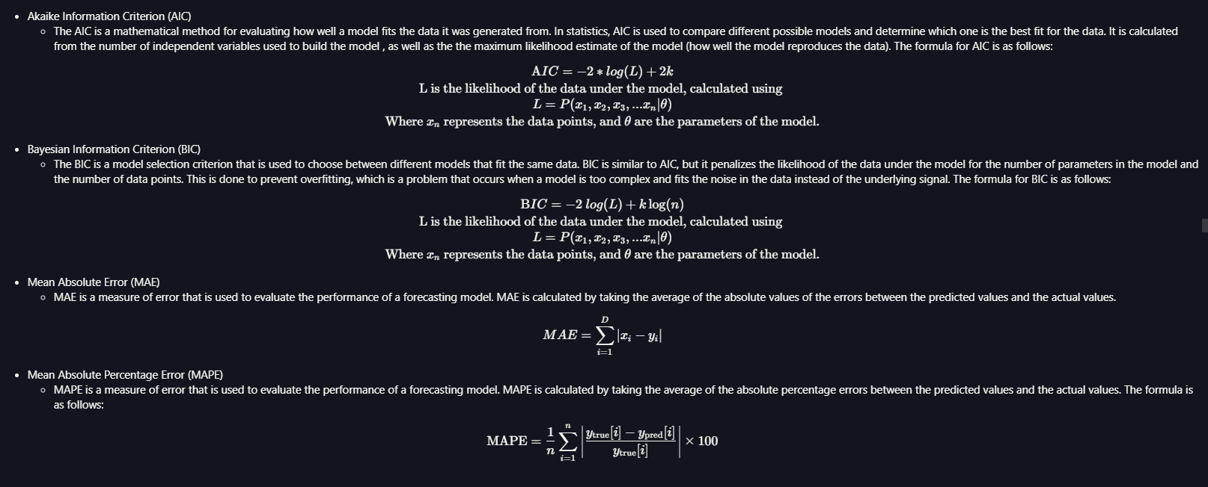
TABLE OF CONTENTS
Modelling
As I mentioned earlier, ARIMA and SARIMA are time series forecasting models that use past data to predict future values. ARIMA is a general-purpose model, while SARIMA is specifically designed for time series with seasonality. Both models have the same AR, I, and MA components, but SARIMA also has a seasonal component to model repeating patterns.
To help us in our modelling, we shall use the AIC, BIC, MSE and MAPE metrics.

Slide 6
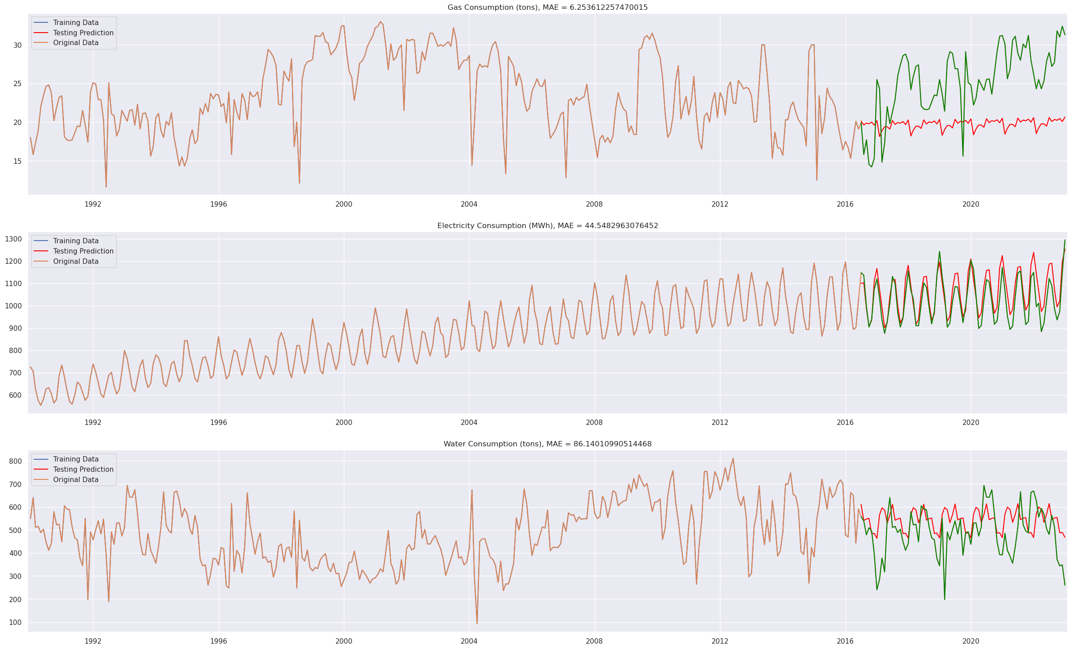
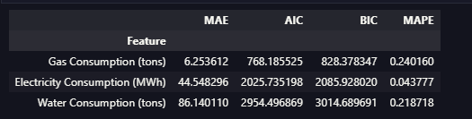
TABLE OF CONTENTS
Modelling
We shall start by using Holt-Winters Exponential Smoothing, as well as establish it as a baseline model.
From the graph generated from the training data, as well as the predictions from the model, we can see that the model struggles to predict the trend for “Gas Consumption” effectively but seems to be able to fit the trend for “Electricity Consumption” and “Water Consumption” decently well.

Slide 7
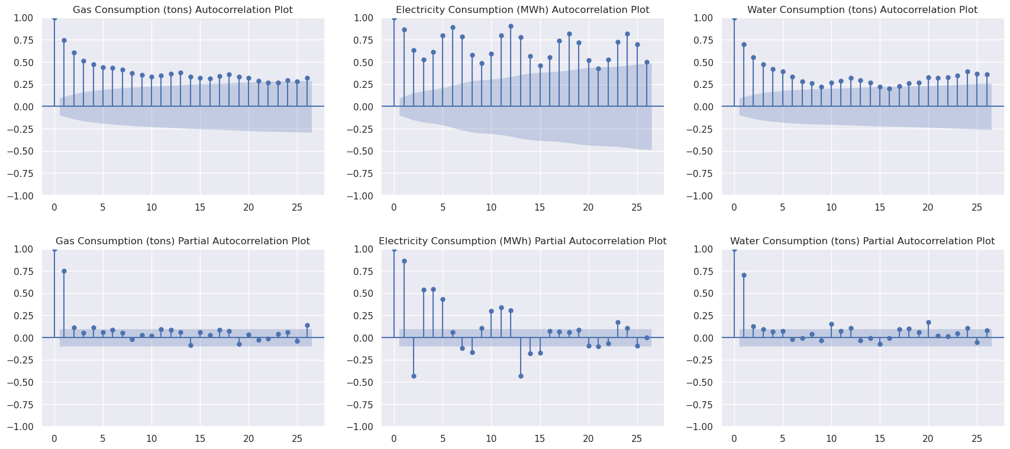
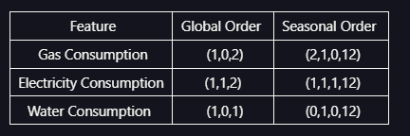
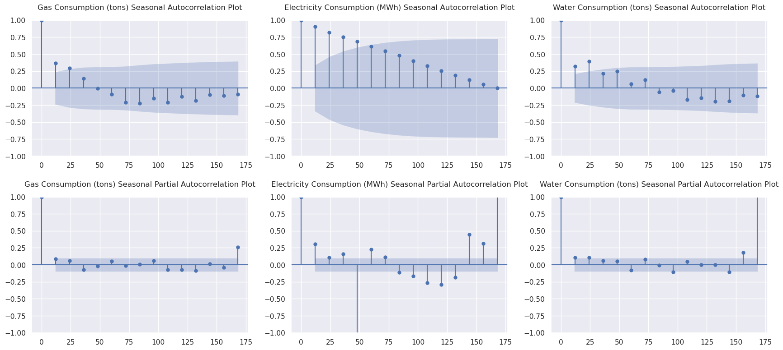
TABLE OF CONTENTS
Modelling
Before we move onto more complicated ARMA models, we shall first carry out a ACF and PACF test to identify some of the values which we need to fill in. We also plot SACF and SPACF plots to help us identify the values fo r the seasonal order which we need to find.
From the plots, we have figured out the p (AR) and q (MA) values for both the global and seasonal orders. For some of the other values, we shall use insights that we made earlier. We have identified the d values from the stationarity test we did earlier (0 for gas and water, 1 for electricity.
We have also filled the S value as 12 for all features, given that the data seems to have yearly seasonality.

Slide 8
TABLE OF CONTENTS
Modelling
Summary of the results, and quality of fit of the initial plotting of the ARMA models (ARIMA, VARIMA, SARIMAX).
Feature/Model | ARIMA | VARIMA | SARIMAX
Gas Consumption | Follows mean. Acceptable. | Marginal. | Poor.
Water Consumption | Follows mean. Acceptable. | Good. | Poor.
Electricity Consumption | Follows mean. Acceptable. | Acceptable. | Poor.
Using the metrics which I mentioned earlier, both ARIMA and VARIMA models had a acceptable score, hence, we shall move onto hypertuning them. However, SARIMAX scored exceptionally poorly on all metrics, hence, we shall not hypertune it.

Slide 9
TABLE OF CONTENTS
Model Improvement.
Now, we shall attempt to find the optimal order for ARIMA and SARIMA models using a function which attempts to be similar to sklearn’s GridSearchCV. We shall use Expanding Window cross-validation, as we are training a timeseries model.
The method we are using is similar to K-Fold, but the training set is expanded with the test set each fold.
Once we have run the code to improve the model, we obtained the following orders as the best for their respective models and features.
Feature/Model | ARIMA (p,d,q) | SARIMA (p,d,q) x (P,D,Q,S)
Gas Consumption | (7, 0, 9) | (7, 0, 9) x (1, 0, 3, 12)
Water Consumption | (9, 1, 6) | (7, 0, 9) x (2, 1, 4, 12)
Electricity Consumption | (7, 0, 2) | (7, 0, 9) x (0, 0, 4, 12)

Slide 10
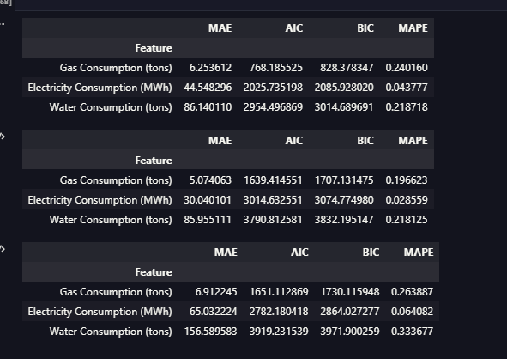
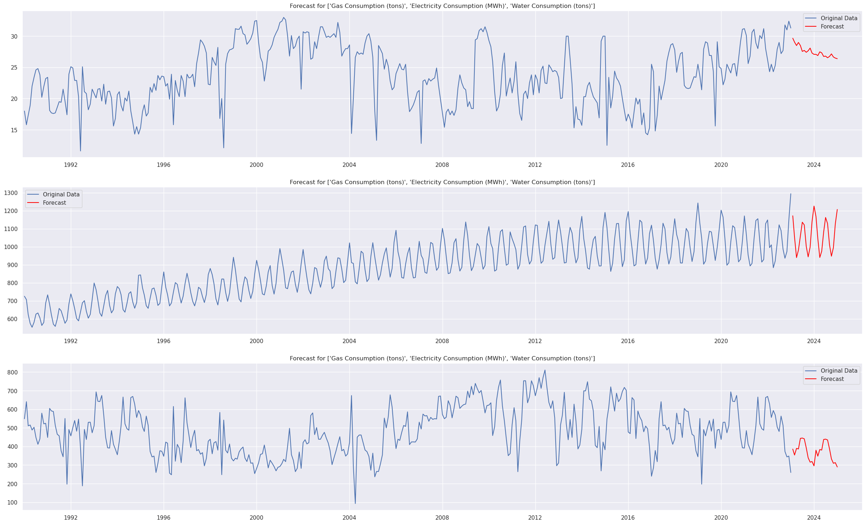
TABLE OF CONTENTS
Forecasting
After comparing all the models, and their final models to each other, we have finalized on the 3 models we shall use to forecast the consumption. We shall forecast 24 steps, or 2 years into the future. We picked the models based off their performance.
The three final models are
Gas Consumption - ARIMA(7, 0, 9)
Electricity Consumption - ARIMA(9, 1, 6)
Water Consumption - Holt-Winters Exponential Smoothing
From the forecast, we can see that the models predict the amount of gas consumed to slowly drop, the amount of electricity consumed to maintain on it’s current trend, and for water consumption to increase slightly, but follow it’s pre-existing seasonal trend.

Slide 11
TABLE OF CONTENTS
CONCLUSION.
We have created three models to forecast utility usage. These models are able to predict usage with reasonable accuracy. However, there are some limitations to our models. For example, our gas consumption predictions are not very accurate. Additionally, our models are not able to predict sudden spikes in consumption or shifts in consumption that could be caused by external factors. This is because our models do not take into account other exogenous features. Finally, our models are not able to predict very far into the future without new data, or losing accuracy. This means that their usefulness will decrease over time.
Overall, our models are a good starting point. However, we can improve them by providing them with better data that includes exogenous variables and more data with higher fidelity (i.e daily records). We can also improve our predictions by using more advanced models such as neural networks.

