Slide 1
PDAS_ST1510
CA1 Presentation
How has interest in courses shifted over the years?
Lee Hong Yi (2223010)

Slide 2
Storyline regarding analysis.
Xiao Ming has been asked by Singapore Polytechnic to analyse how the interest of courses in Singapore has changed over the years, and advise on how Singapore Polytechnic can adjust its focus to better cater to it’s current and future students, as well as where support is needed.

Slide 3
What is analysed.
Xiao Ming then decides to analyse the following datasets.:
Number of Secondary School Graduates
Enrolment and Intake for Pre-University Students
Enrolment and Intake for Polytechnic Students
Enrolment and Intake for ITE Students
From here, he would like to find out:
How has interest in the types of courses changed?
Which type of course should SP offer more support to?
How can Singapore Polytechnic improve it’s advertising?

Slide 4
Nature of datasets.
Dataset 1 - enrolment-secondary-by-level-and-course.csv | year - Year of Data
 | level - Level of Education (Secondary 1/2/3/4/5)
 | course - Name of course (Express/Normal (Acad)/etc)
 | sex - Gender (F/MF)
 | enrolment_secondary - Number of people enrolled in the course
Dataset 2 - polytechnics-intake-enrolment-and-graduates-by-course.csv | year - Year of Data
 | sex - Gender (F/MF)
 | course - Name of course
 | intake - Number of people as intake for the academic year. (includes direct entry to second year)
 | enrolment - number of people who attempted to join course
 | graduates - number of people who graduated course.

Slide 5
Nature of datasets.
Dataset 3 - enrolment-pre-university-by-level-and-course.csv | year - Year of Data
 | level - Level of Education (Junior College/Pre-University/1/2/3)
 | course - Name of course (Science/Arts/Commerce)
 | sex - Gender (F/MF)
 | enrolment_preu- Number of people enrolled in the course
Dataset 4 - ite-intake-enrolment-and-graduates-by-course.csv | year - Year of Data
 | sex - Gender (F/MF)
 | course - Name of course (classified by school)
 | intake - Number of people as intake for the academic year. (includes Nitec/Higher-Nitec, but excl. apprentices)
 | enrolment - number of people who attempted to join course
 | graduates - number of people who graduated course.

Slide 6
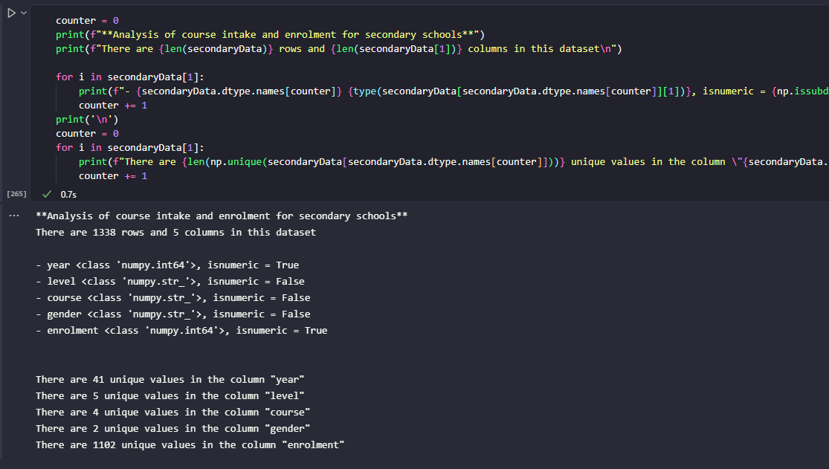
Analysis of Data.
Analysis of the data was done with the block of code to the right, with each cell slightly modified to suit the dataset which was being analysed.
Using the block of code, information regarding the dataset was obtained, namely the type of data obtained, along with the number of unique values.

Slide 7
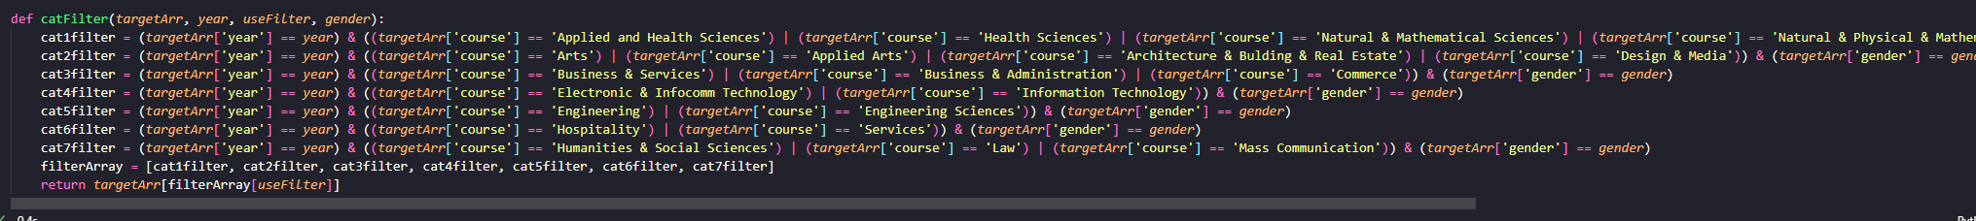
Data Cleaning.
As the datasets had different start dates, as well as different names for the courses, cleaning had to be done to split the courses into their respective categories. In addition, the “gender” column in the datasets was of special concern, as interpreting them wrongly would result in the double counting of data.
The function below was used to set the parameters for each category of course, along with the year and gender which was to be used.
The function returns a filter which can be used for boolean indexing, which allows for the target data to be easily sorted and filtered from the originally generated list . The categories which the courses were placed in can be seen in the following slides.
Errors were manually cleaned using Microsoft Excel.

Slide 8
Classifying Courses. (1/3)
Courses from ITE
Course | Category (number)
Applied and Health Sciences | Science (1)
Business & Services | Business (3)
Design & Media | Arts (2)
Electronics & Infocomm Technology | Infocomm (4)
Engineering | Engineering (5)
Hospitality | Service (6)

Slide 9
Classifying Courses. (2/3)
Courses from Polytechnics
Course | Category
Applied Arts | Arts (2)
Architecture, Building & Real Estate | Arts (2)
Business & Administration | Business (3)
Education | Service (6)
Engineering Sciences | Engineering (5)
Health Sciences | Science (1)
Humanities & Social Sciences | Social (7)
Course | Category
Information Technology | Infocomm (4)
Law | Social (7)
Mass Communication | Social (7)
Natural & Mathematical Sciences | Science (1)
Natural, Physical & Mathematical Sciences | Science (1)
Services | Service (6)

Slide 10
Classifying Courses. (3/3)
Courses from JC/Pre-U/MI
Course | Category (number)
Arts | Arts (2)
Commerce | Business (3)
Science | Science (1)

Slide 11
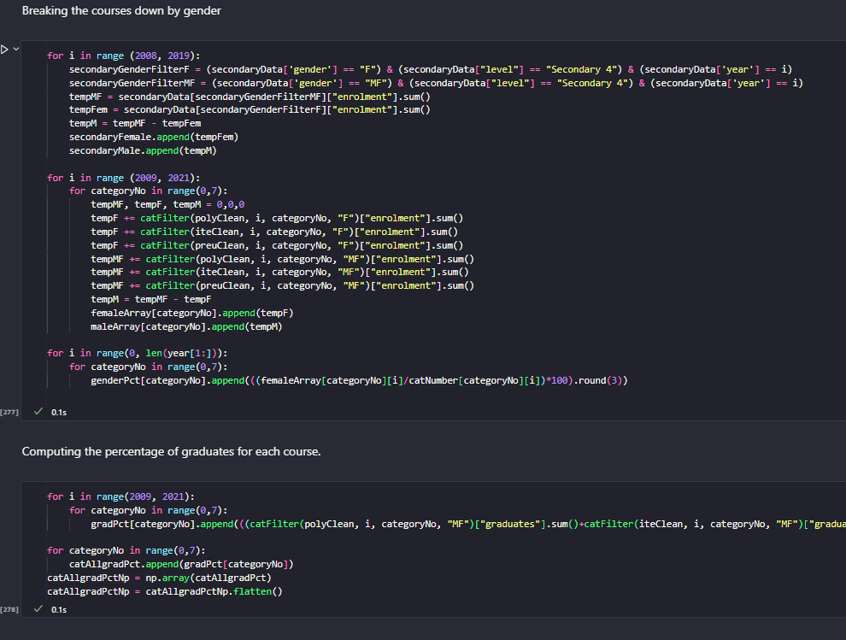
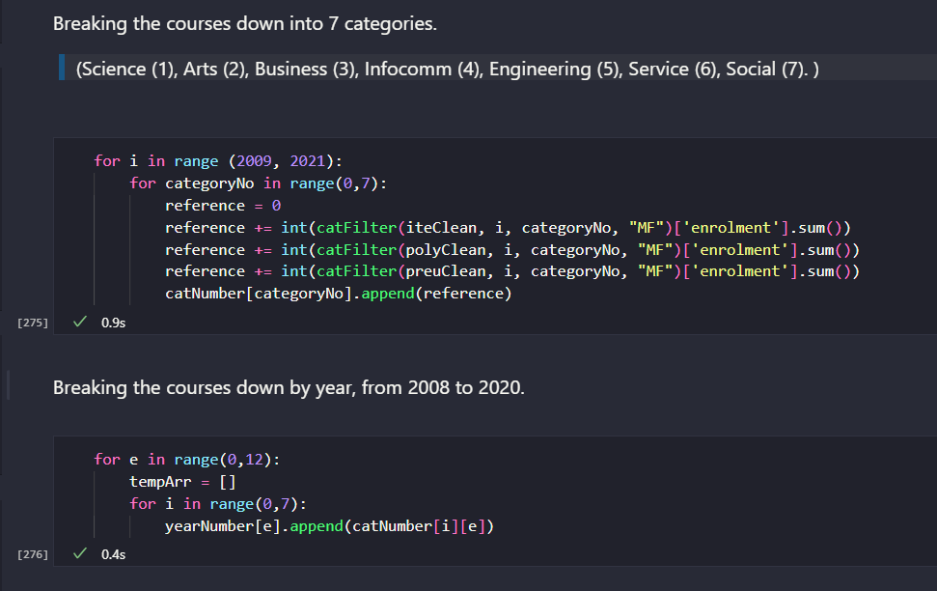
Data Categorization.
The categorization of data was done in two stages. Firstly, the data was split by year and category to obtain the general trend. Then, the data was split by gender and the graduation rate was computed. The second stage was done to obtain more specific insights that can then be used by Xiao Ming in his analysis.

Slide 12
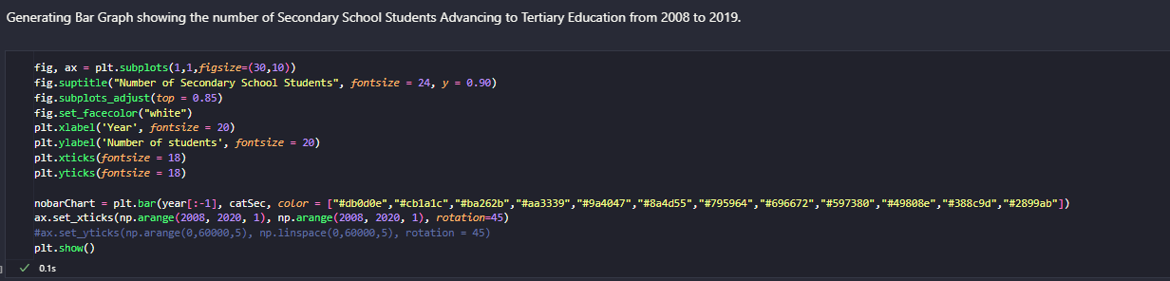
Graph 1 - Number of Secondary School Students
The cell of code below was used to generate the Graph 1 (bar chart). The graph was generated using the data categorized earlier, thus not much list manipulation was required.

Slide 13
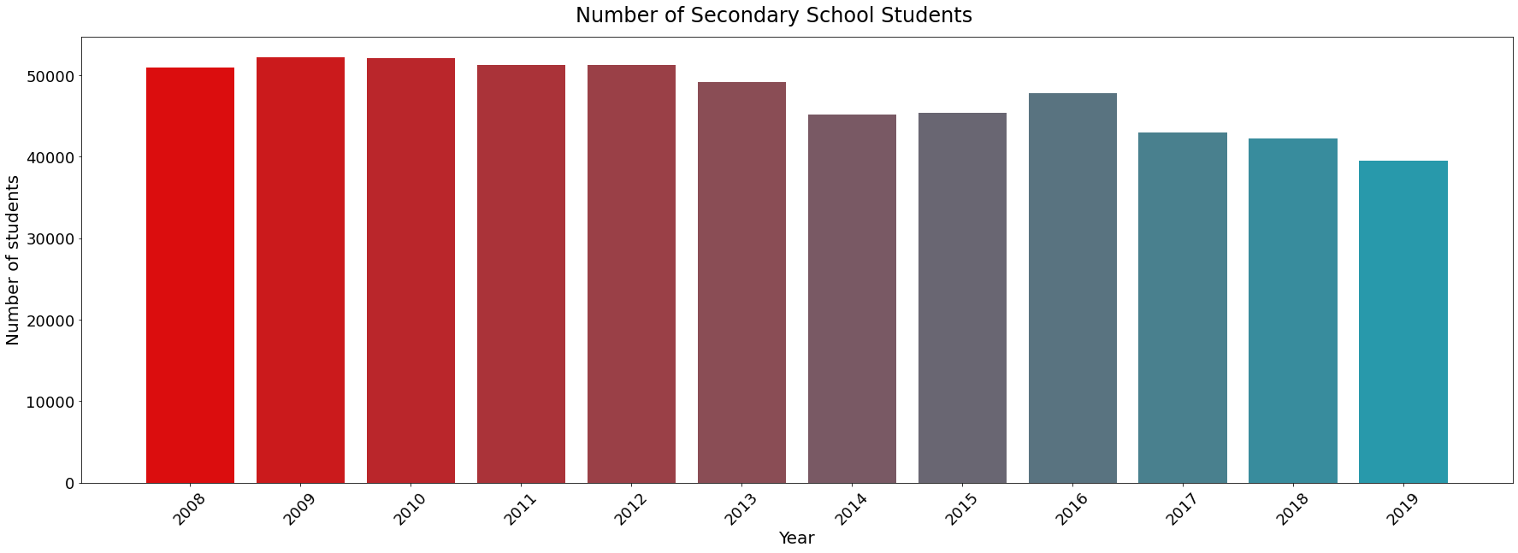
Graph 1 - Number of Secondary School Students
This graph shows the number of Secondary 4 Students across all courses from 2008 to 2019.
This graph shows a decreasing number of secondary school students, which means there is a decreasing amount of people who then progress onto tertiary education.

Slide 14
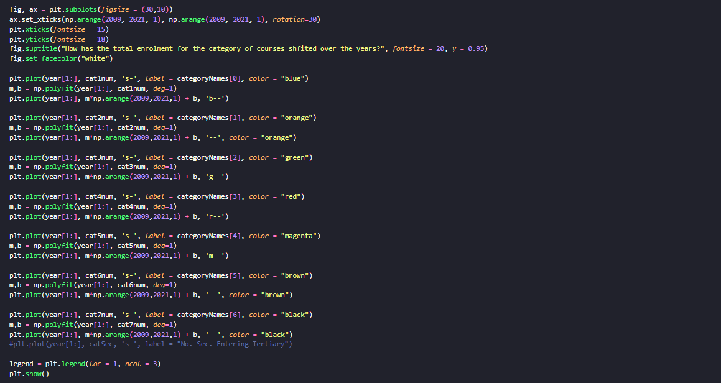
Graph 2 - Change in total enrolment per category.
The cell of code below was used to generate Graph 2 (line chart.)
Similar to Graph 1, most of the data was already categorized earlier, thus little list manipulation was used here.
Using matplotlib, a line graph was generated with the number of people who were taken in for each category of courses.
In addition, the np.polyfit function was used to generate a trend line which allows for the general trend to be visualised with ease.

Slide 15
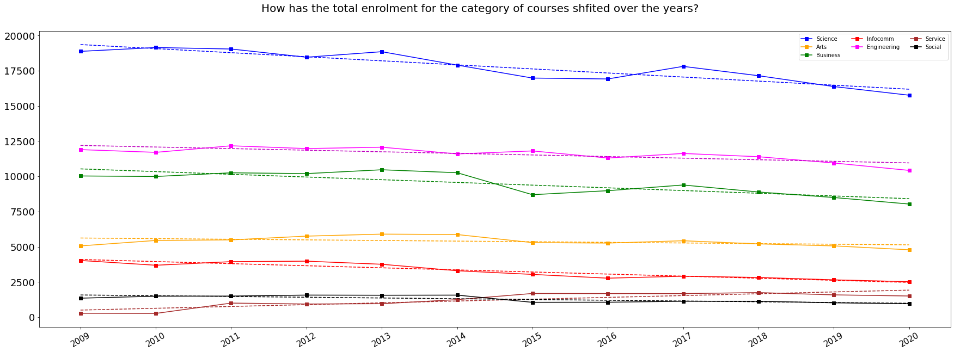
Graph 2 - Change in total enrolment per category.
Graph 2 shows the general trend as to how the total number of people taken into each category of course has changed from 2009 to 2021.
As we can see, the overall trend is decreasing, with the only exception being the Service category of courses, which has experienced a increase. This can be partially blamed upon the decreasing amount of secondary school students entering tertiary education.
However, Science type courses are still the most popular in Singapore.

Slide 16
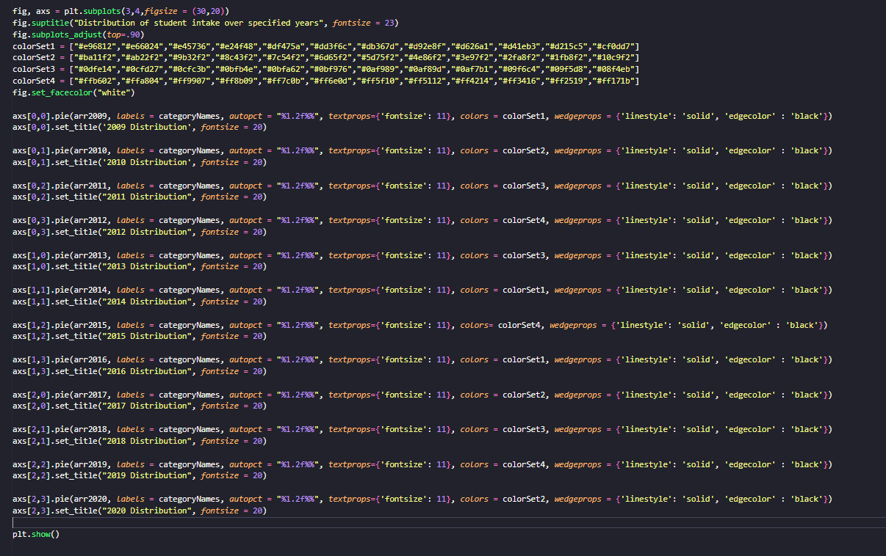
Graph 3 - Overall distribution of intake over the years.
The cell of code to the right was used to generate the pie chart which displays the overall proportion of courses per year.
The pie chart generated gives further insight into how the popularity of courses has changed over the years, as it highlights which course is the most popular, as well as which has gained the most popularity over the years.

Slide 17
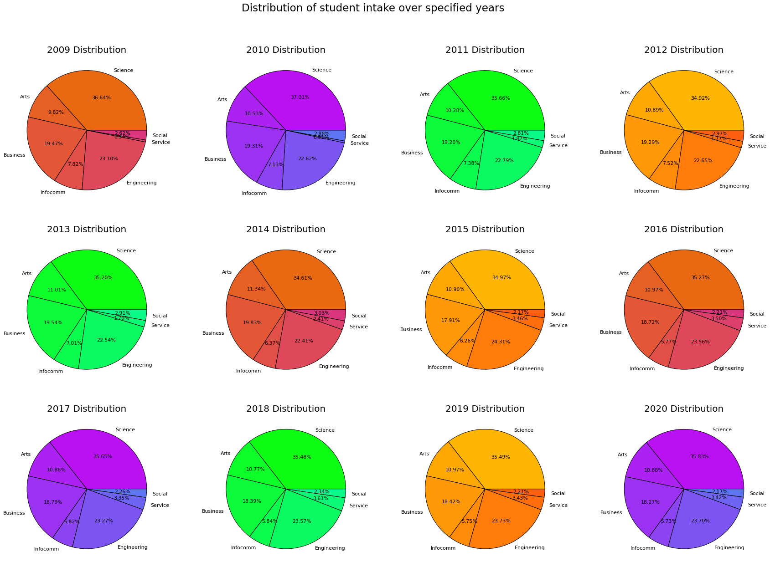
Graph 3 - Overall distribution of intake over the years.
From the graph on the right, we can see how the Science course has constantly remained the most popular over the years, with the largest percentage of students enrolling in such courses, maintaining between 34.61% to 35.83% share over the years, with Business coming second, with 18-19% share.
One big improver would be the Service category, which improved over 600% from 0.54% in 2009 to 3.42% in 2020.

Slide 18
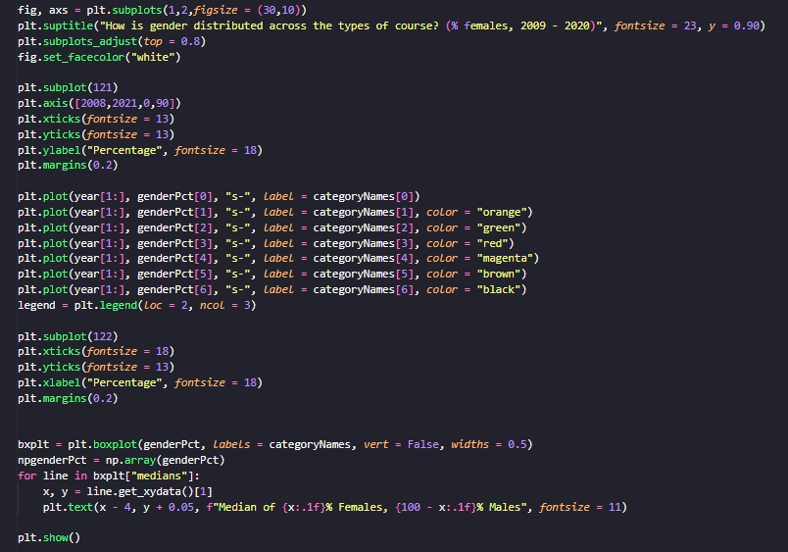
Graph 4/5 - Distribution of Gender per Year & per Course
The cell of code on the left was used to generate a line graph as well as a box plot, both of which were used to show the distribution of gender.
The line graph generated shows the gender trend per category of course, while the boxplot shows the distribution of gender, and compares the categories of courses to each other.
Furthermore, the boxplot also shows the numeric distribution gender between the different courses.

Slide 19
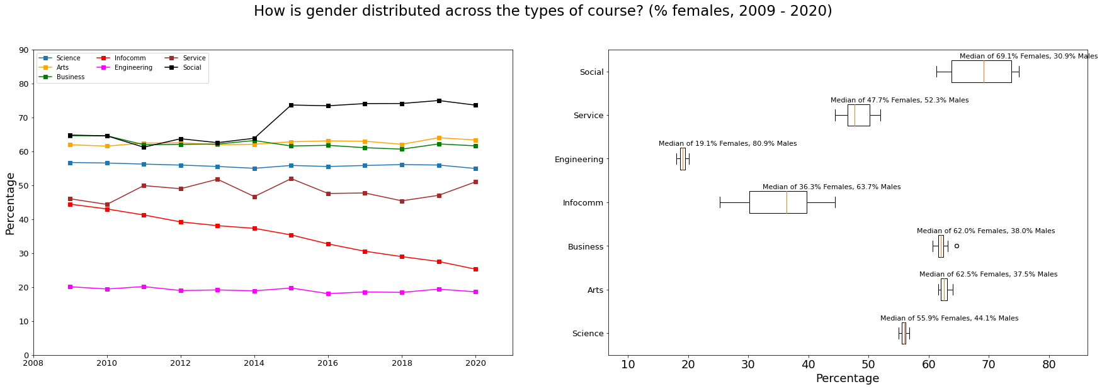
Graph 4/5 - Distribution of Gender per Year & per Course
From the graphs below, we can see that while most distributions of gender have remained stable over the years, with the exception of 2 courses.
One example is the Infocomm sector, which has had a decreasing amount of females over the years.
In addition, the Social sector had a sharp increase in female students from 2014 to 2015.
From the boxplot, we can also see that Engineering has had the lowest proportion of female students on average, with a median of 19.1% female and 80.9% females. In addition, we can also see that both the Infocomm and Social categories have had the largest Interquartile Ranges, signalling that they have had the largest changes in distribution over the years.

Slide 20
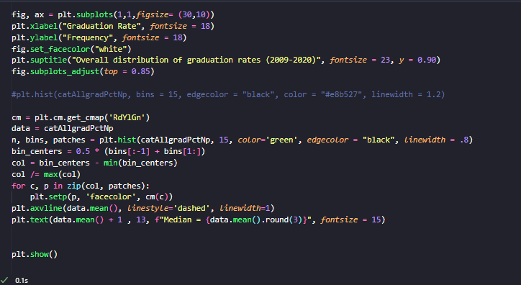
Graph 6 - Overall histogram of graduation rates.
The cell of code on the left is used to generate a histogram which shows the distribution of graduates for all categories of courses.
A numpy array was used to obtain the overall mean of the values, as well as to generate a dotted line which was used to show where the median of all values were.

Slide 21
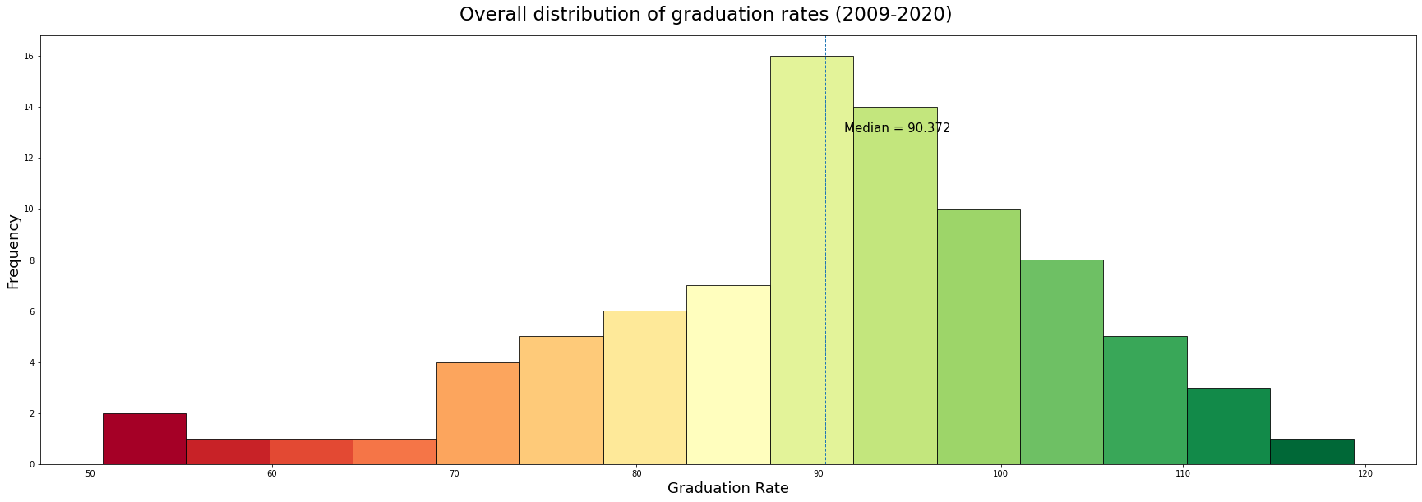
Graph 6 - Overall histogram of graduation rates.
From the graph below, we can see that the median graduate rate for all courses across all categories is 90.372%. In addition, we can also see that there are courses with a graduation rate >100%, which is caused by people joining the courses in the 2nd/3rd years of education.
Furthermore, we can also see that there are some courses with a graduation rate below <70%, which is drastically low.

Slide 22
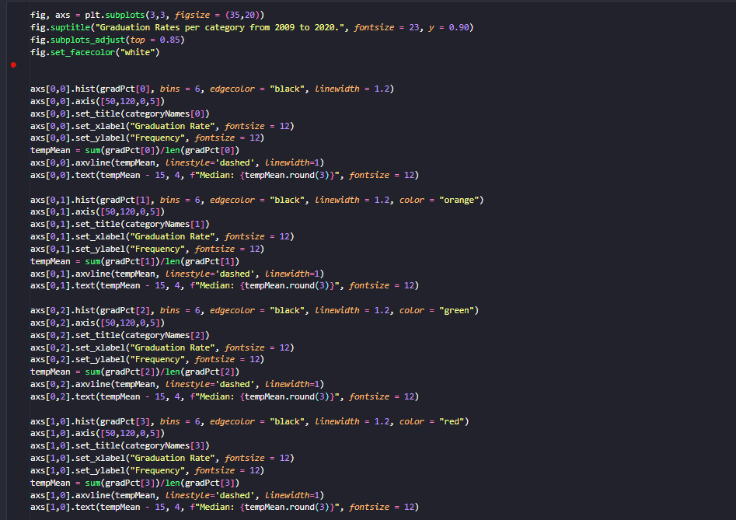
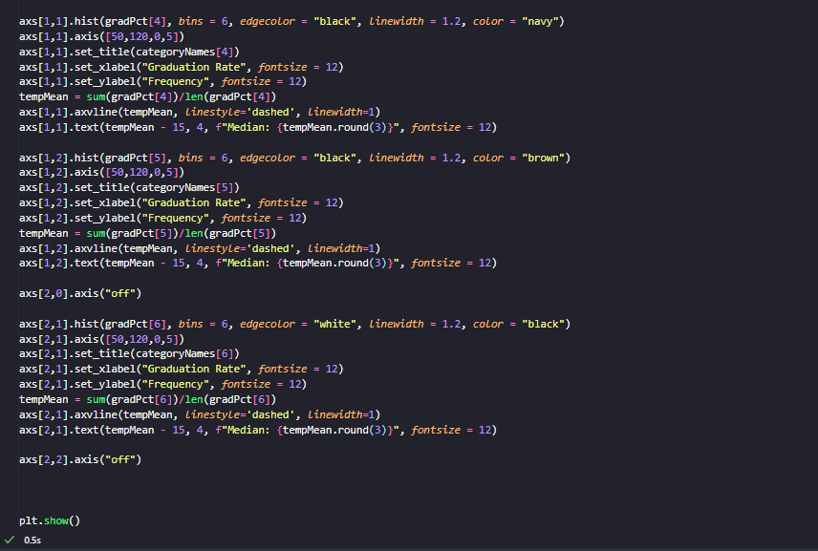
Graph 7 - Histogram of graduation rates distributed by course.
The code above generates histograms showing the graduation percentage per course.

Slide 23
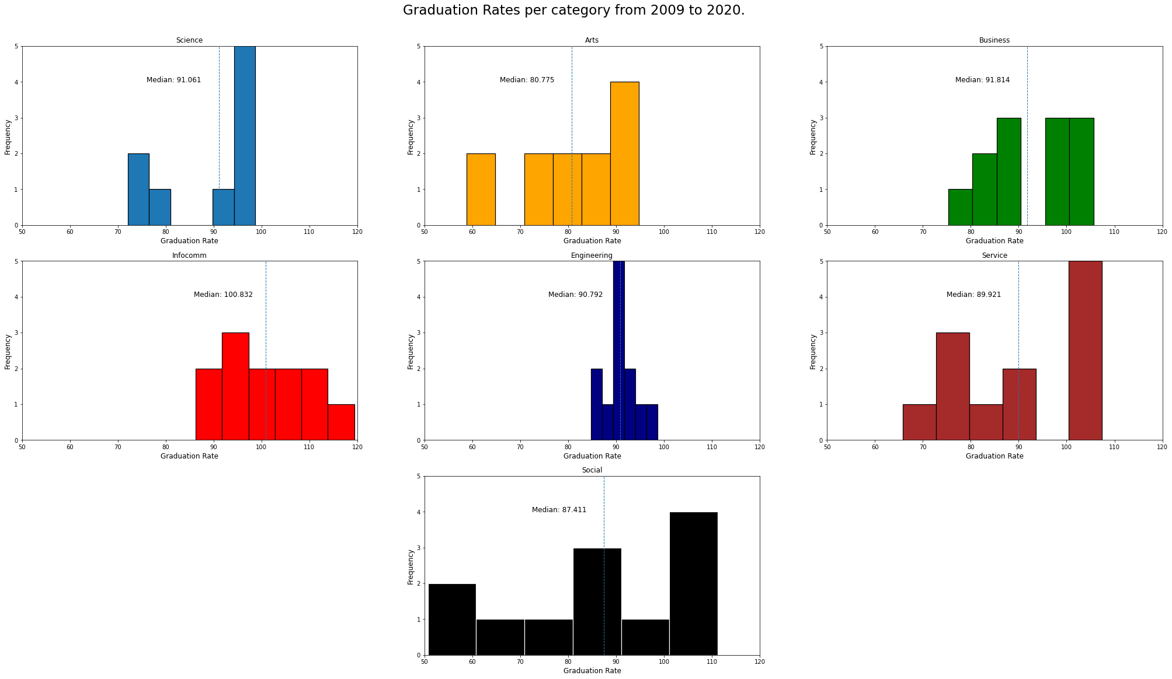
From the charts above, we can see that some the Infocomm category of courses has a median graduation rate of 100.832%, showing that there is a large amount of people who transfer into the course in the later years of the programme.
In addition, we can also see that there are some courses with a much lower graduation rate than the median, in particular the Arts category, with a 80.775% graduation rate.

Slide 24
Final Conclusions.
From the data, Xiao Ming can conclude that the interest in courses has generally remained stable, however, the Services category of courses should receive increased interest from SP. Examples of such courses would be the Diploma in Facilities Management (DPM).
In addition, Xiao Ming can also conclude that SP can offer more support to the Arts category of courses, namely courses within MAD, as they are the most likely to drop out, or switch to other courses. Xiao Ming can also tell SP that courses in SOC are doing very well, and can receive less focus from the Polytechnic.
Lastly, Xiao Ming can also tell SP that as the demographic of it’s students are becoming more male-dominated, it’s advertising can also shift in that direction.

Slide 25
References.
Data.gov.sg. (2022). Polytechnics - Intake, Enrolment and Graduates by Course-Data.gov.sg. [online] Available at: https://data.gov.sg/dataset/polytechnics-intake-enrolment-and-graduates-by-course [Accessed 1 Dec. 2022].
‌Data.gov.sg. (2021). Enrolment - Pre-University, By Level and Course-Data.gov.sg. [online] Available at: https://data.gov.sg/dataset/enrolment-pre-university-by-level?view_id=16d236b8-688c-463d-a664-ce67a8d4b3e4&resource_id=8b436e71-ef7d-4a92-86e5-dfdebdc25d8c [Accessed 1 Dec. 2022].
‌Data.gov.sg. (2021). Enrolment - Secondary, By Level and Course-Data.gov.sg. [online] Available at: https://data.gov.sg/dataset/enrolment-secondary-by-level [Accessed 1 Dec. 2022].
Data.gov.sg. (2021). ITE - Intake, Enrolment and Graduates by Course-Data.gov.sg. [online] Available at: https://data.gov.sg/dataset/ite-intake-enrolment-and-graduates-by-course [Accessed 1 Dec. 2022].
Sp.edu.sg. (2022). SP. [online] Available at: https://www.sp.edu.sg/ [Accessed 8 Dec. 2022].
‌
‌

