Slide 1
Predicting Miles Per Gallon With a Given Car
Derek Albosta
Nov. 30 2018

Slide 2
Variables
Variables in this study are
[, 1] | mpg | Miles/(US) gallon
[, 2] | cyl | Number of cylinders
[, 3] | disp | Displacement (cu.in.)
[, 4] | hp | Gross horsepower
[, 5] | drat | Rear axle ratio
[, 6] | wt | Weight (1000 lbs)
[, 7] | qsec | 1/4 mile time
[, 8] | vs | Engine (0 = V-shaped, 1 = straight)
[, 9] | am | Transmission (0 = automatic, 1 = manual)
[,10] | gear | Number of forward gears
[,11] | carb | Number of carburetors

Slide 3
Data
Data extracted from the 1974 Motor Trend US magazine
Collected data comprises of fuel consumption and 10 aspects of automobile design and performance
Contains data from 32 automobiles (1973–74 models).

Slide 4
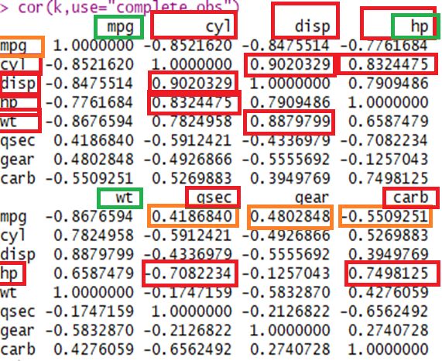
Correlation Matrix
NOTE:
Cylinder, displacement, and weight have very strong correlations so we only use weight since it has the best correlation with MPG
Hp, qsec, and carb have fairly strong correlations so we use hp since it has the best correlation with MPG
Gear has a weaker correlation with mpg so I left it out
Total of 5 Explanatory variables: 2 categorical (vs, am) | 2 numerical (hp, wt)

Slide 5
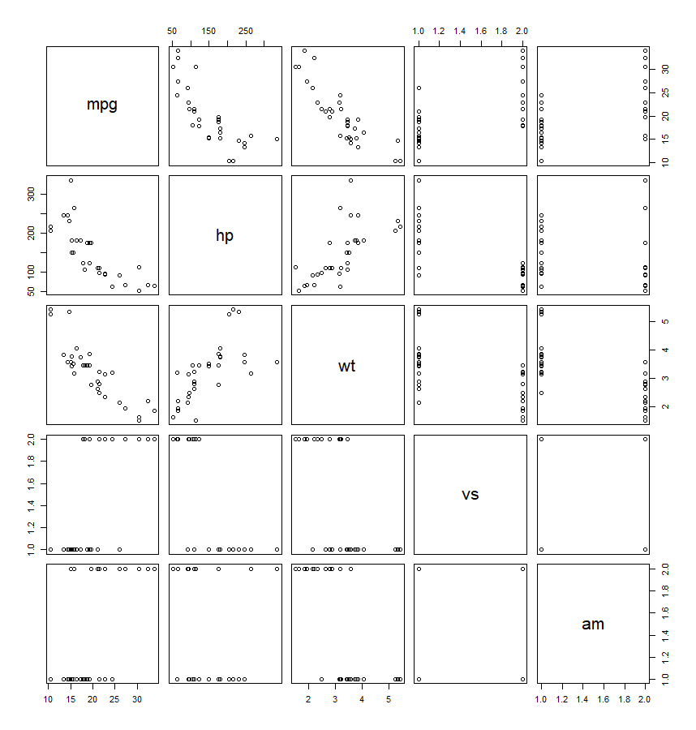
Scatter plot matrix

Slide 6
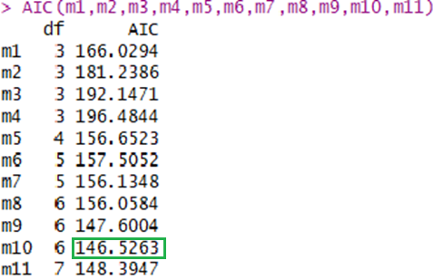
AIC testing
Model name | Model
M1 | mpg~weight
M2 | mpg~hp
M3 | mpg~vs
M4 | mpg~am
M5 | mpg~wt+hp
M6 | mpg~vs+wt+hp
M7 | mpg~am+wt+hp
M8 | mpg~am+vs+wt+hp
M9 | mpg~am+wt*hp
M10 | mpg~vs+wt*hp
M11 | mpg~vs+am+wt*hp
Final model does not use am variable (transmission type)

Slide 7
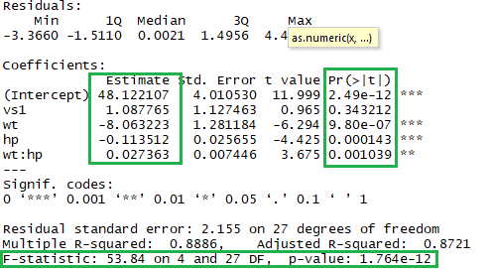
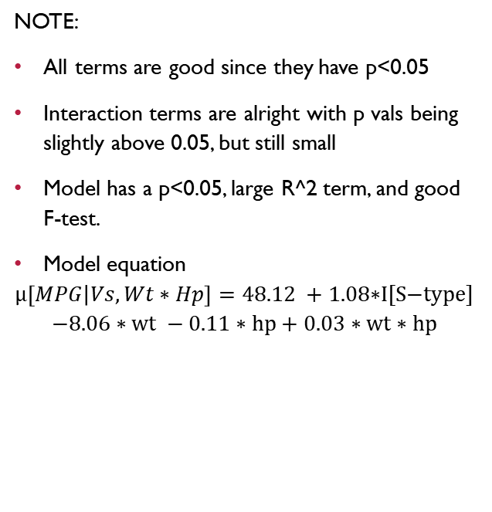
Model summary
NOTE:
All terms are good since they have p<0.05
Interaction terms are alright with p vals being slightly above 0.05, but still small
Model has a p<0.05, large R^2 term, and good F-test.
Model equation
$$μ\left[MPG | Vs,Wt∗Hp\right]=\text{48.12 +} \text{1.08∗}\text{I}\text{[}\text{S}\text{−}\text{type}\text{] }$$
$$−8.06∗wt −0.11∗hp+0.03∗wt∗hp$$

Slide 8
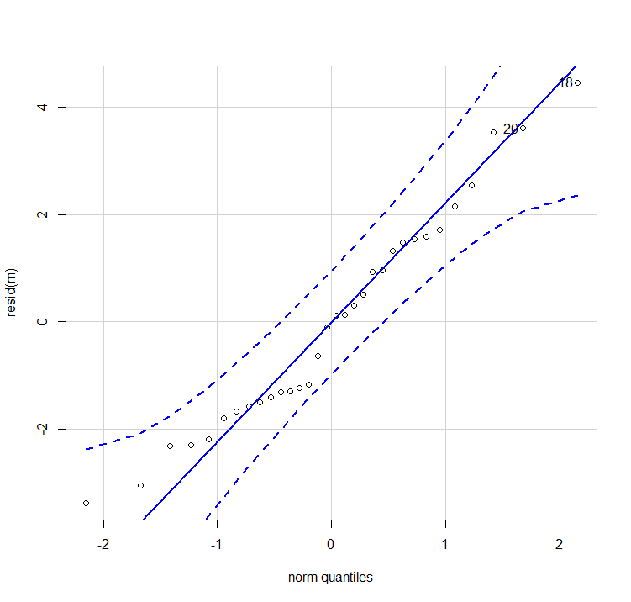
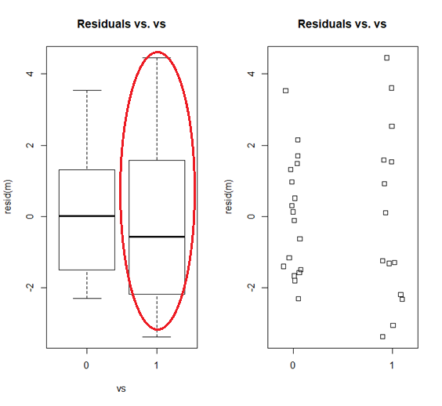
SVA’s

Slide 9
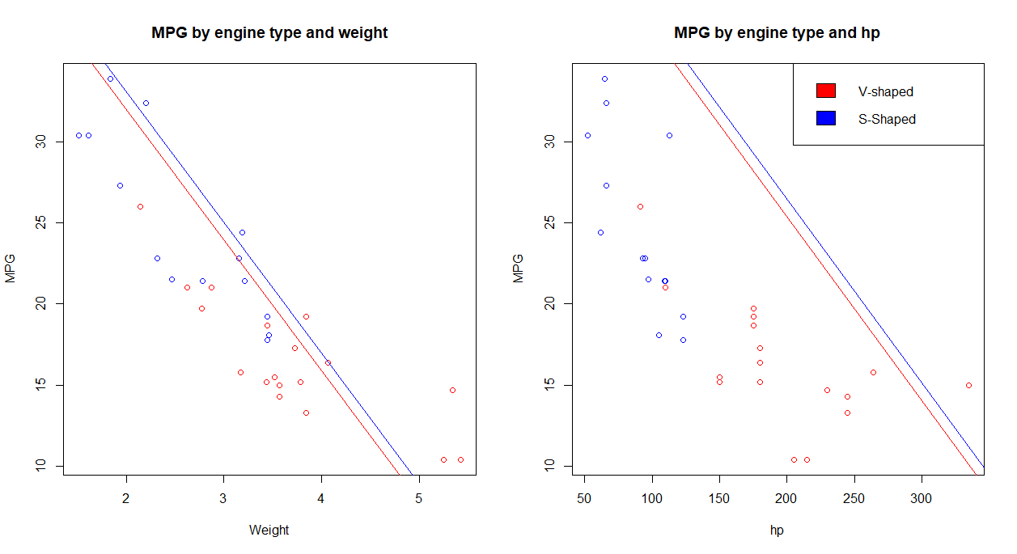

Slide 10
Prediction testing
Test | hp | wt | vs | actual | prediction
1 | 110 | 2.62 | 0 | 21 | 22.39
2 | 245 | 3.57 | 0 | 14.3 | 15.45
3 | 93 | 2.32 | 1 | 22.8 | 25.84
4 | 66 | 2.2 | 1 | 32.4 | 27.95
NOTE:
S-Type engines tend to be less accurate (probably from skew in our residual boxplot)

Slide 11
Questions?

