Slide 1
Anime and its Consumers
Based on MyAnimeList
A presentation by KV Le

Slide 2
Why Analyze Anime?
Anime is rapidly growing, often taking the world by storm with mega hits
Large companies like Netflix have started backing anime, funding or producing their own shows
With information like favorite genres and studios, licensors and producers can use their money more efficiently and produce “better” anime overall

Slide 3
Research Questions
What is an average watcher like?
What are the “best” genres for anime?
What varies between different animation studios?
Can we predict the score and popularity of an anime on MyAnimeList?

Slide 4
Methodology
Phase 1: Data Retrieval and Cleaning
Scraping Data and filtering large Datasets
Phase 2: Data Analysis
Each Research Question had their own subset of instructions using Pandas, Seaborn, and SciKit

Slide 5
7000 Animes
100,000 Profiles
Combining the Kaggle dataset that had information up to 2018 and my scraped information that had 2019 anime data, there were almost 7000 anime entries to analyze
There were over 100,000 MyAnimeList profiles to analyze, each user having their own anime list that accompanied it

Slide 6
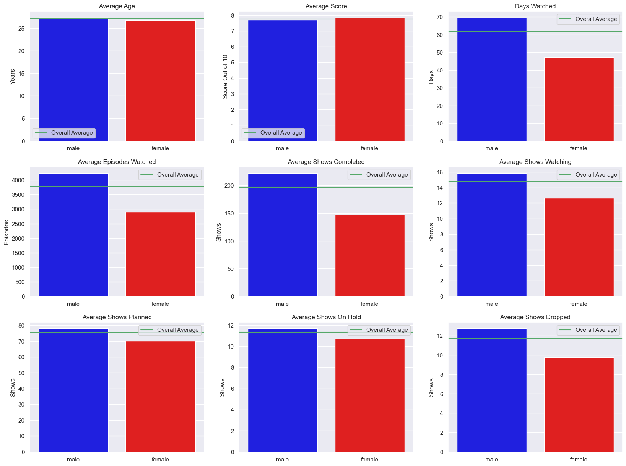
Over 1440 Hours
Out of all My Anime List users, the average time watched is a bit over 60 days of anime. That’s over 1440 hours!
However, when dividing between genders, we can see there are some significant differences

Slide 7
The Difference Between Genders
Overall, Males have higher averages for almost every category, but score is the exception.

Slide 8
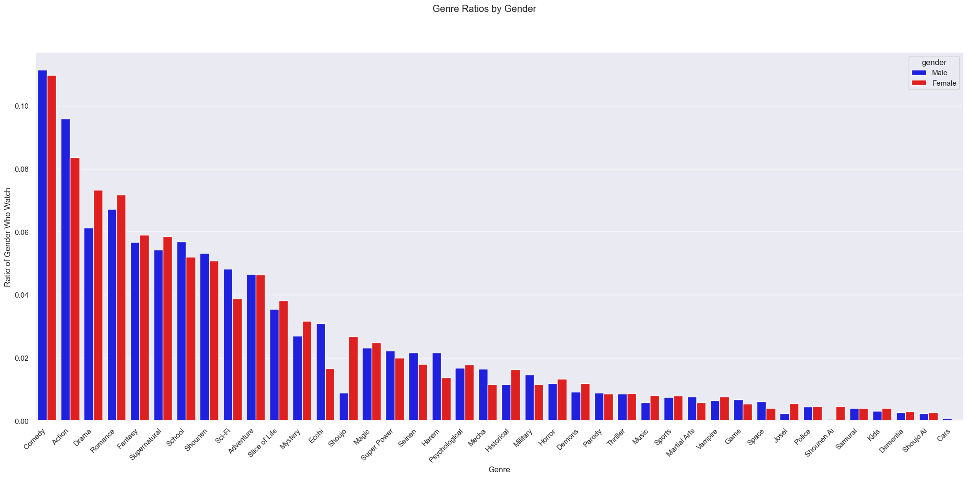
This chart shows the ratio of genders that watch a certain show

Slide 9
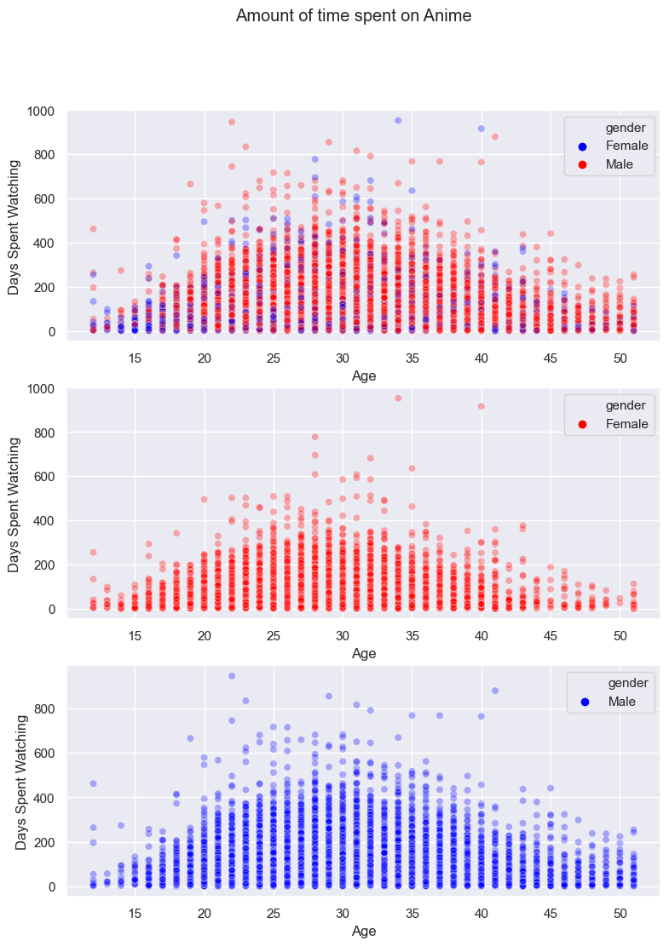
Age and Watch Time
The most active age age group seems to be between 25 and 35
For Females, the distribution seems a bit younger, lower, and more spread out than Males

Slide 10
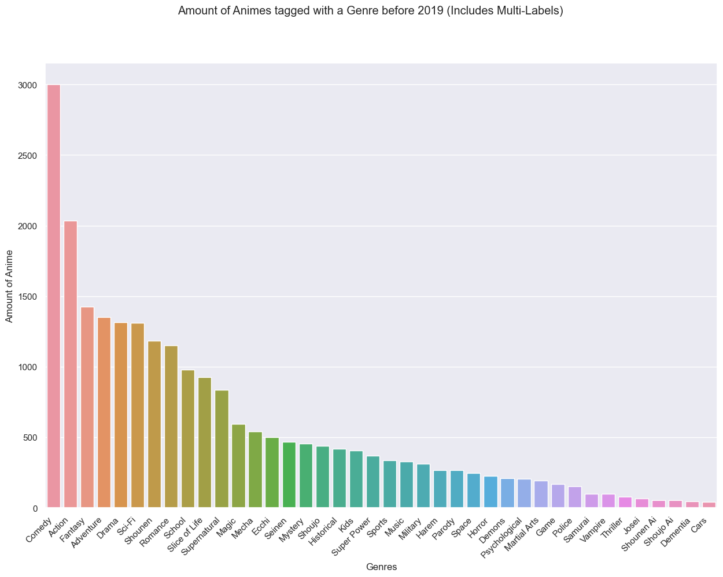
3000 Comedies
With 3000 animes with a comedy tag, it is one of the most prevalent genres in anime.
The runner up is lagging significantly with just over 2000 tags.

Slide 11
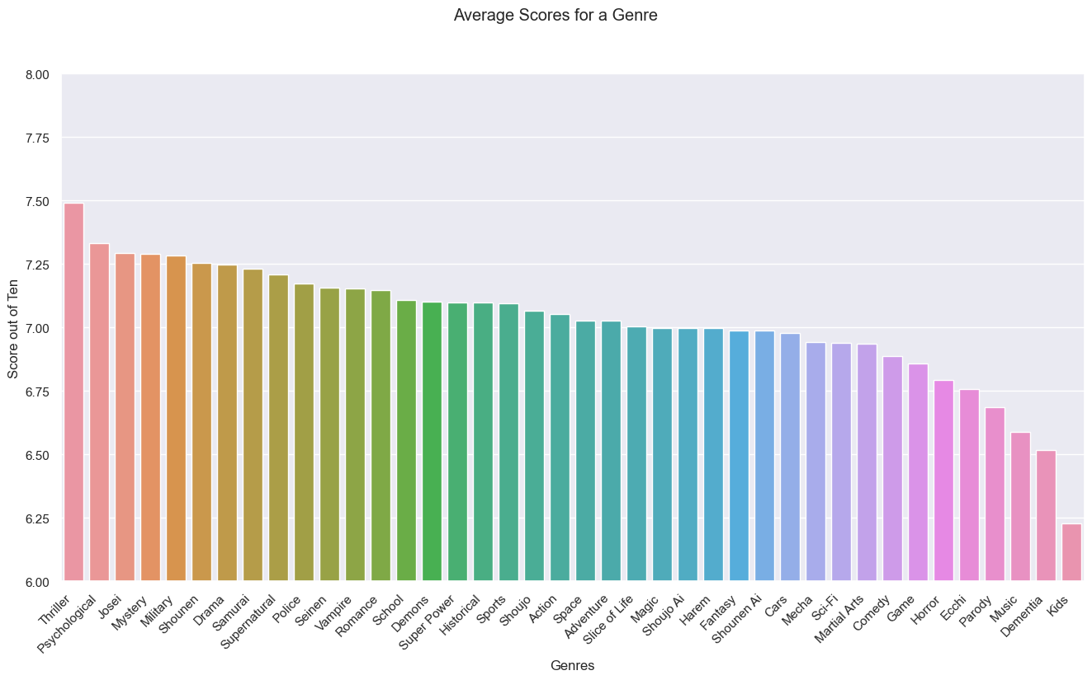
However, When it comes to scores, Thriller leads by a good margin.

Slide 12
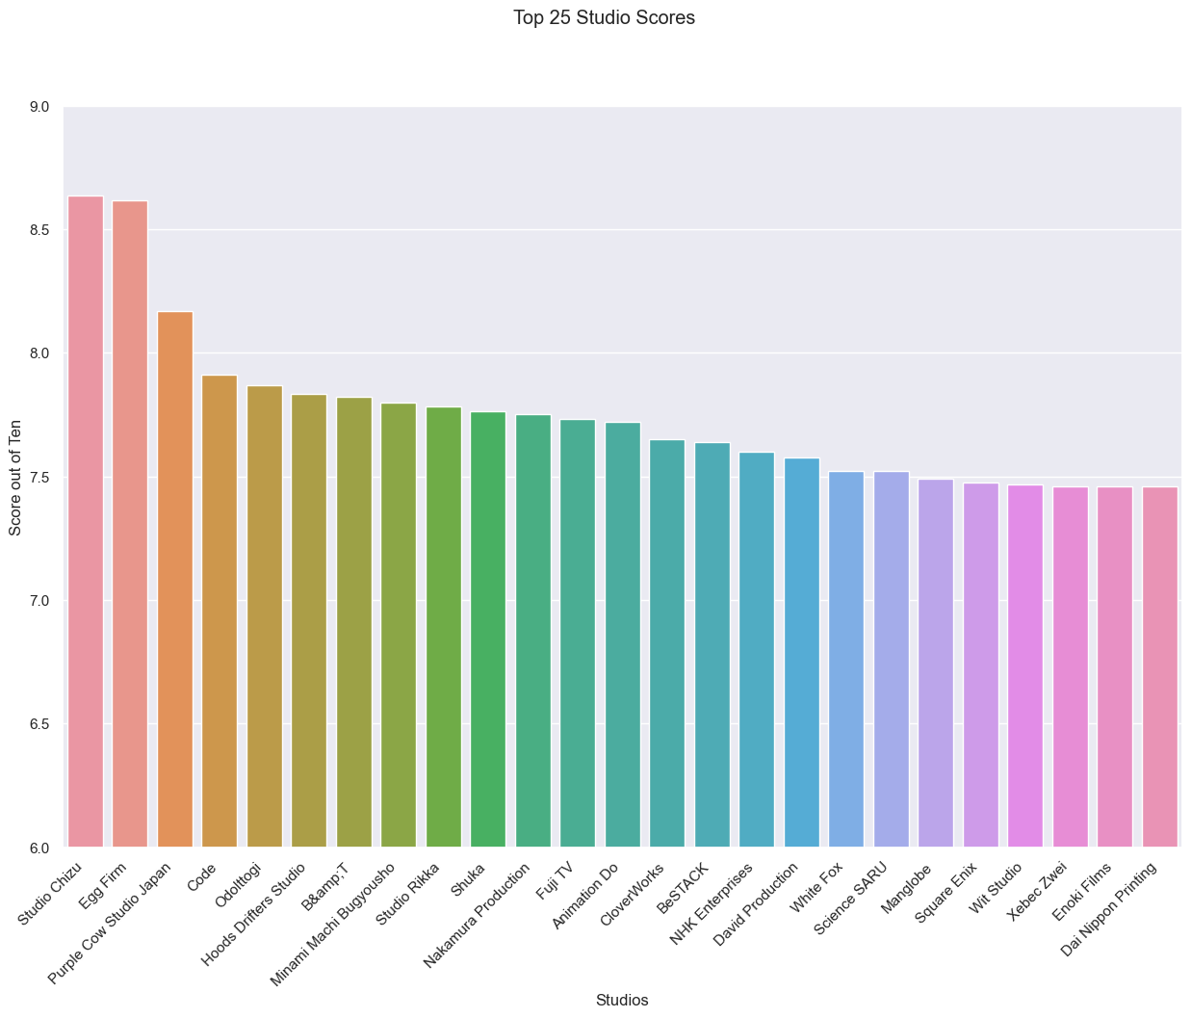
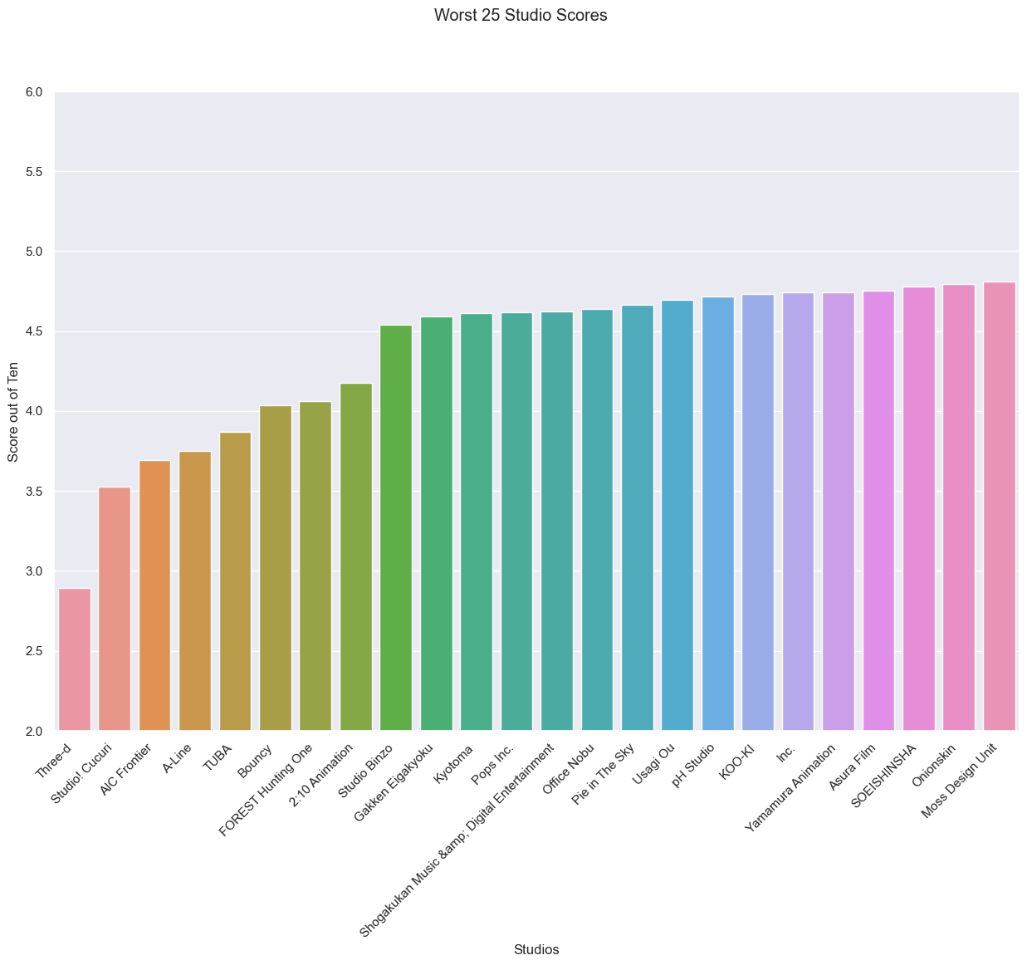
Studios

Slide 13
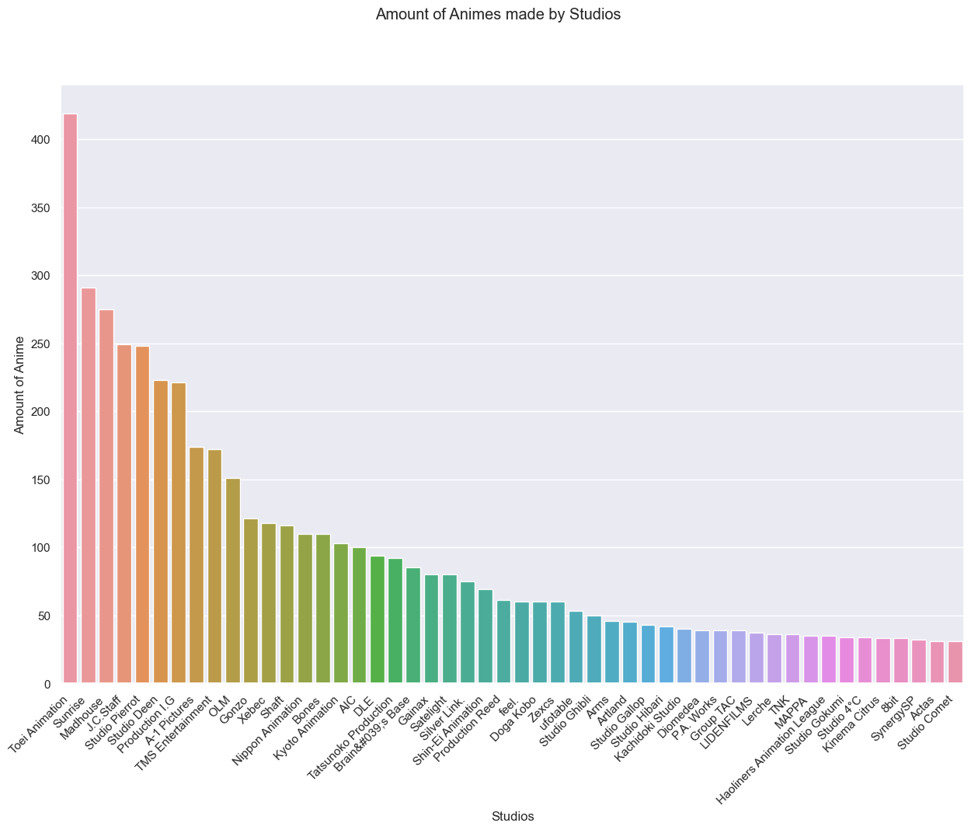
Toei has a significant lead in terms of the anime they produce

Slide 14
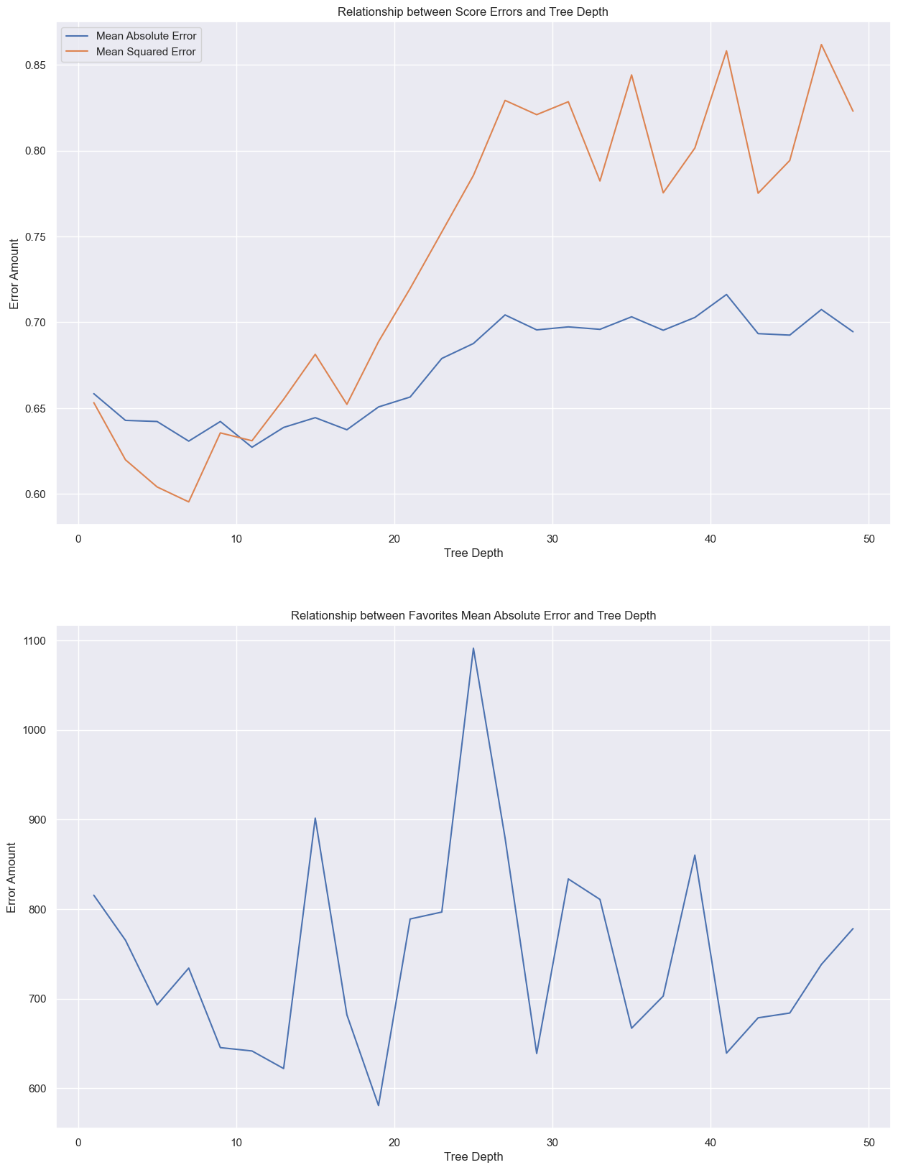
Predicting Scores and Popularity
The model for scores seemed fairly accurate with its peak accuracy being around .64 points off.
With the popularity model, the error change graph indicates the model is unstable and isn’t as trustworthy.

Slide 15
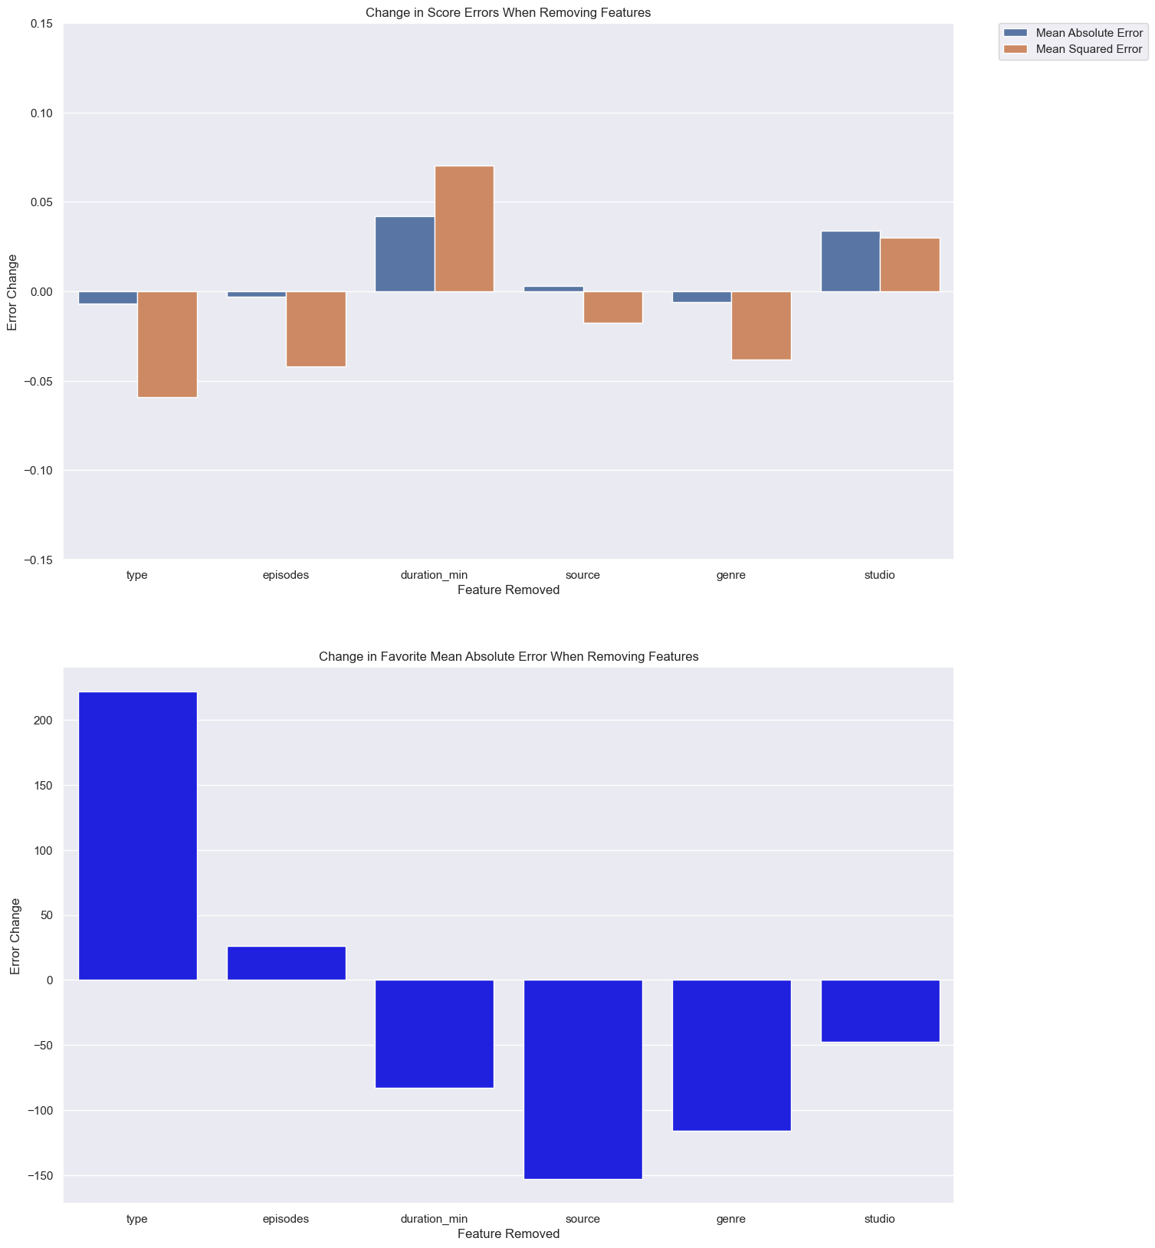
Important Factors
For score, the most important factors seemed to be the duration of the episode or show and the studio it was made by.
For popularity, It seemed the type of anime it was (a TV show, Movie, Special, etc) was the greatest factor in making the shows popularity.

Slide 16
Where to go on from here?
Making more advanced prediction models that take into account things like anime airing/released alongside it or contemporary/cultural context
Studying Licensors and Producers and how they impact an anime
Analyzing the impact of global companies trying to distribute anime (Crunchyroll, Netflix, etc)
Investigate whether an anime’s time period impacts its rating. (Observe nostalgia bias)

Slide 17
Thanks for Listening

