Slide 1
Repetition: Control Structures
While, Do While, and For loops

Slide 2
Control Structures
Sequence
Repetition
Selection

Slide 3
Uses of Repetition Structures
Repetition(loops) structures is a programming construct that allows you to repeat a certain set of instructions multiple times. This is extremely useful in situations where you need to perform a task repeatedly, but don't want to copy and paste the same code over and over again.
Some real world examples:
1. Having your music to replay the song unless you stop it.
2. Traffic lights. Green then Yellow then Red and starts over.
3.Setting and alarm clock but forgetting to disable it.

Slide 4
While Loops and Do While Loops
There are 2 types of while loops in java. They have the following syntax : while (condition) {
// code to be executed
}<= end of the loop structure
Do {
// code to be executed
} while (condition) ; <= end of the loop structure

Slide 5

Things To Avoid. Infinite LOOPS!
Do not create an Infinite Loop!
An infinite loop occurs when a loop does not have a proper “loop exit condition”.
This causes the loop to run for ever and this can cause your program to become unresponsive or crash entirely.
A common solution is using incrementation. example: I ++

Slide 6
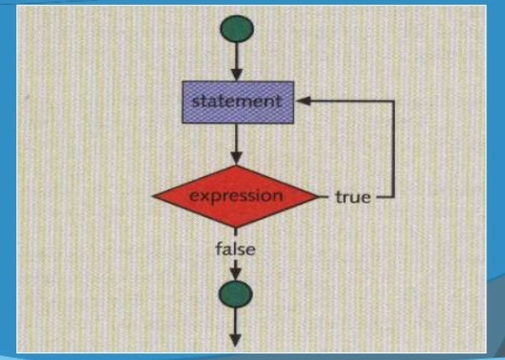
Visualization of Repetition Structure

Slide 7
Examples of While Loops
Printing from 1 to 10.
int i = 1;
while (i <= 10) {
System.out.println( i );
i++; <= incrementing( avoids infinite loops)
} <= ends loop structure

Slide 8
Examples of While Loops (Cont.)
2. Calculating the sum of integers from 1 to 100
int i = 1;
int sum = 0;
while (i <= 100) {
sum += i;
i++;
}
System.out.println("The sum of numbers from 1 to 100 is: " + sum);

Slide 9
For Loops
The syntax for For Loops in Java goes as follows: for (initialization; condition; update/incrementing) {
// code to be executed
} <= end of the loop structure

Slide 10
Examples of a For Loop(Cont.)
Printing from 1 to 10
For( int i = 0 ; i < 10 ; i ++){
System.out.println(i);
} <= end of the loop structure

Slide 11
Examples of a For Loop(Cont.)
Printing even numbers only from 1 to 10
For( int i = 0 ; i < 10 ; i += 2){
System.out.println( i );
} <= end of the loop structure

