Slide 1
Selection: Control Structures
If, if-else, switch statements

Slide 2
Control Structures
Sequence
Repetition
Selection

Slide 3
Uses of Selection Structures
Selection structures are used to alter the flow of a program’s execution by making a selection or choice.
A real world example:
1. If car is running then drive.
2. If rain is ralling stay indoors else go outside
3. If age is above 16 then allowed to drive else not allowed to drive

Slide 4
Uses of Selection Structures (Cont.)
If statements in Java follows the following syntax:
if (condition) {
statement;
}
else {
statement;
}

Slide 5
Examples of Selection Structures
Representation of the previous examples in Java code:
1.
boolean running = true;
if (running) {
System.out.println(“Drive”);
}
//The following code prints “Drive” to the screen if running is True

Slide 6
Examples of Selection Structures (Cont.)
Representation of the previous examples in Java code:
2.
boolean rainFalling = true;
if (rainFalling) {
System.out.println(“Stay indoors”);
}
else {
System.out.println(“Go outdoors”);
}

Slide 7
Examples of Selection Structures (Cont.)
Representation of the previous examples in Java code:
3.
Int age = 13;
if (age > 16 ) {
System.out.println(“Allowed to drive”);
}
else {
System.out.println(“Not allowed to drive”);
}
// The above code displays “Not allowed to drive” as the age is not greater than 16

Slide 8
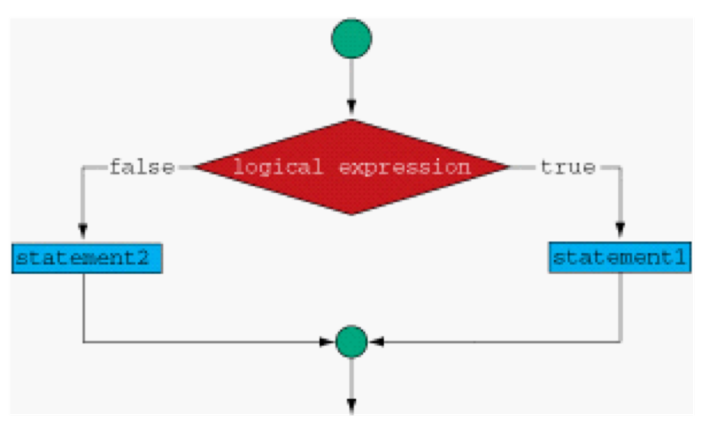
Visualization of Selection Structure

Slide 9
Switch Statement
Java offers an easy way to check expressions without the use of numerous if-else statements through the use of a switch statement.
Switch Statement Syntax:
switch (expression) {
case x:
//code
break;
case y:
//code
break;
default:
//code
}

Slide 10
Examples of Switch Statement
num = 2;
switch (num) {
case 1:
System.out.println(“Number is 1”);
break;
case 2:
System.out.println(“Number is 2”);
break;
default:
System.out.println(”No Case”);
}

