Slide 1
Java Basics
Output, input, Variables

Slide 2
Output
To output data to the console on java you can use any of these print statements:
Print
Println

Slide 3
Print
A print statement in java is written System.out.print(); all the text you want to print is placed inside double quotes “” inside of the brackets ().

Slide 4
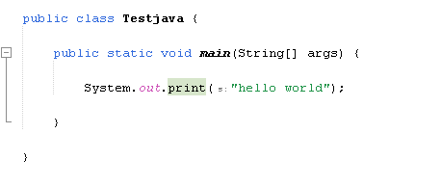
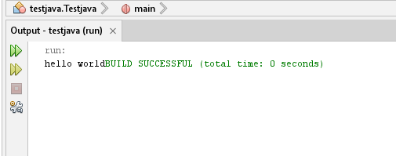
Code
output

Slide 5
Println
The Println statement also known as the Print line statement in java is written System.out.println(); and just like the print statement the text is placed inside quotes “” inside of the brackets ().
The only difference however is after the line is printed the system will automatically move the curser down to the next line.

Slide 6
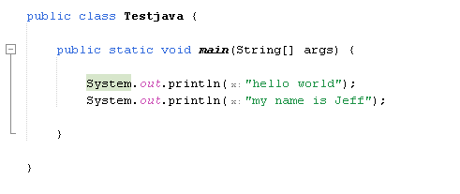
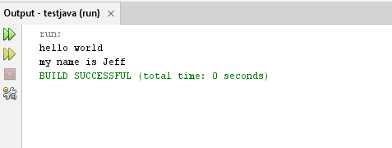
code
output

Slide 7
Variables
A variable in java is a placeholder for a value that behaves as the value it contains. A variable can be either a primitive type variable or a reference type variable.
A primitive type variable has a limited size and no methods.
A reference data type does not have a limited size and has methods associated with it.

Slide 8
All data types in java
Data type | Size | Primitive / Reference | Value
Boolean | 1 bit | Primitive | True / False
Byte | 1 byte | Primitive | -128 to 127
short | 2 bytes | Primitive | -32,768 to 32,767
Int | 4 bytes | Primitive | - 2 billion to 2 billion
long | 4 bytes | Primitive | -9 quintillion to 9 quintillion
float | 4 bytes | Primitive | Fractional number with 6-7 decimal places. Has to be Witten with a f at the end EX 8.837644f
double | 2 bytes | Primitive | Fraction number with 15 decimal places
char | 2 bytes | Primitive | Single character
String | varies | reference | A series if characters

Slide 9
Creating variables
When a variable is create it can either be declared or initialized. When a variable is declared it only is created when it is initialized it is created and a value is placed in it.
To declare a variable you write:<data type> <name>;
Ex: int X;
To initialize a variable you write:<data type> <name> < = > <value>
Ex: int X = 18;

Slide 10
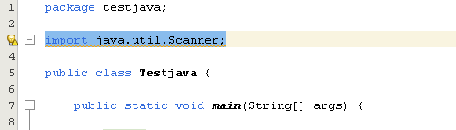
Reading
in java user data can be accepted in many ways however the way we will use at this stage is the Scanner.
Before a scanner is used it must be imported to import a scanner type: “import java.util.Scanner;” below the package and above the class.

Slide 11
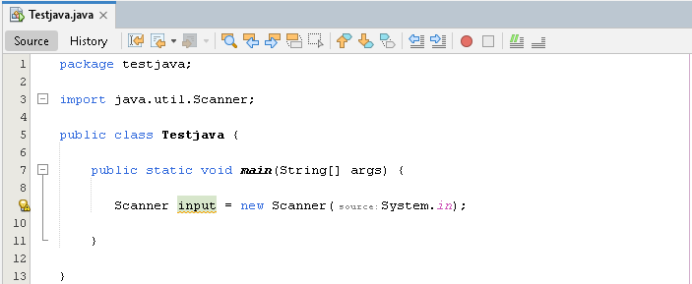
Scanner
Before using the scanner the scanner object must be created in the main. The syntax to do so is written: “Scanner scannerName = new Scanner(System.in);”
note: scannerName can be anything you want

Slide 12
Scanner
To use the Scanner you have created you first need a variable to store the input in. After you have that type: <variable name> < = > <Scanner name> < . > after the dot you need to write the method you will like to use(most IDE’s will suggest methods).

Slide 13
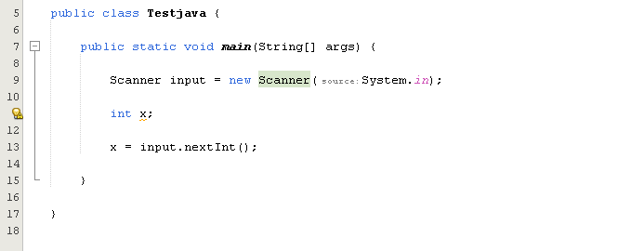
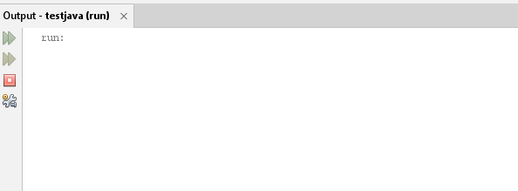
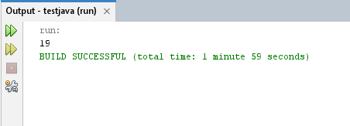
Code Output
waiting for input
data entered
note the nextint() method as our variable is a type int;

