Slide 1
FIELD AUDIT · WISFMA.COM · 26 SEPT 2026
What Is Working,
and what isn't.
A hands-on UX review of the WISFMA / Flow's CRM agency platform — every section used live, workflows exercised end-to-end, benchmarked against what full-service OF management agencies pay for. The engine is impressive. The cockpit needs work.
15
6
14
9
SECTIONS TESTED LIVE
CRITICAL ISSUES
FRICTION POINTS
STANDOUT STRENGTHS

Slide 2
EXECUTIVE SUMMARY
A power tool that hides its power.
KEEP — GENUINELY DIFFERENTIATED
FIX — BLOCKS DAILY FLOW
+
Shadowban alerts with evidence
“1.1k views vs 5.4k normally” — no competitor shows this
!
Revenue is invisible
the #1 agency number never reaches the dashboard
+
AI niche strategy + insights
full per-creator playbooks with next moves for the team
!
Instagram has no section
65% of views, 52 accounts — no nav entry
+
White-label client reports
branded PDF per client — a retention weapon
!
Employees page is hidden
team accountability buried inside a Pulse tab
+
Trials + hook library
mining proven reels to re-post, done well
!
Same client, four pickers
every section restarts client selection
+
Pulse
“is the work getting done” per account & employee
!
Expenses = a different app
money-out lives on another domain

Slide 3
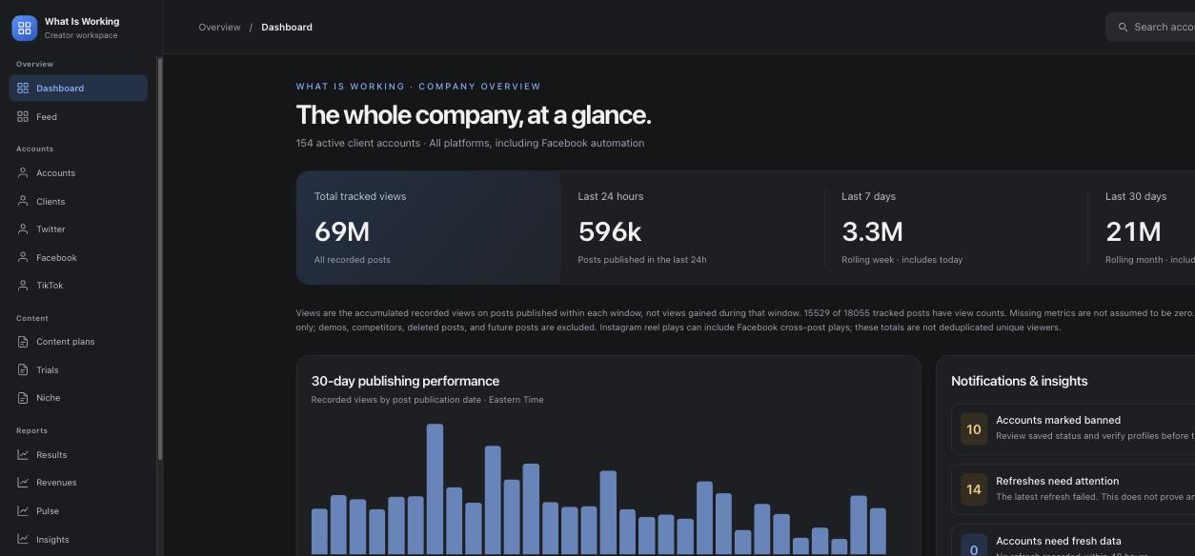
CRITICAL 01
DASHBOARD
“At a glance” — with zero dollars on it
The company dashboard is 100% views: 69M tracked, platform splits, publishing chart. But agencies run on revenue — and the platform already has it: $101,853/30d sits on the Revenues page, and every client card shows OnlyFans earnings.
Views are the input. Money is the output. The glance page only shows the input.
SUGGESTED CHANGE
Add a revenue strip to the dashboard hero (24h / 7d / 30d, top-3 earners, biggest mover). The data already exists — it's a layout change, not a feature.

Slide 4
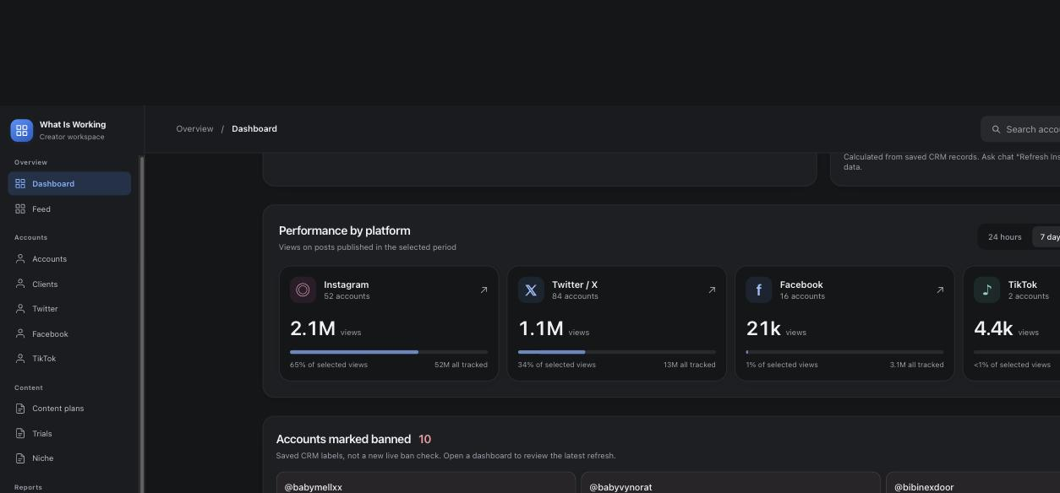
CRITICAL 02
NAVIGATION
Instagram is the business — and has no home
Sidebar: Twitter ✓ Facebook ✓ TikTok ✓ … Instagram ✗. Yet Instagram is 52 accounts and 65% of all selected views, and the entire Content Studio is built around Instagram filming plans.
The three platform pages that do exist use three different layouts — an operator learns three UIs to do one job.
SUGGESTED CHANGE
One shared platform-page template (health → creators → accounts → top content), instantiated for all four platforms. Instagram gets a first-class sidebar entry.

Slide 5
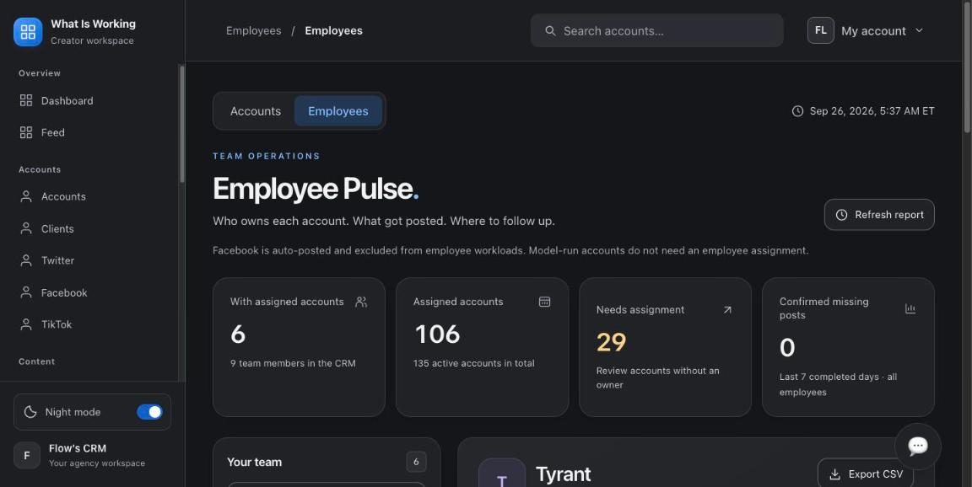
CRITICAL 03
TEAM OPS
The team page is a secret
A full Employee Pulse exists — who owns each account, what got posted, 29 accounts needing assignment, per-employee CSV export. It is not in the sidebar; the only way in is a small tab inside Pulse.
Meanwhile the dashboard flags “29 accounts need an employee” every day — and the workflow to fix it is hidden two levels deep.
SUGGESTED CHANGE
Promote Employees to the sidebar under a “Team” group; dashboard card links straight into an assignment view with bulk assign.

Slide 6
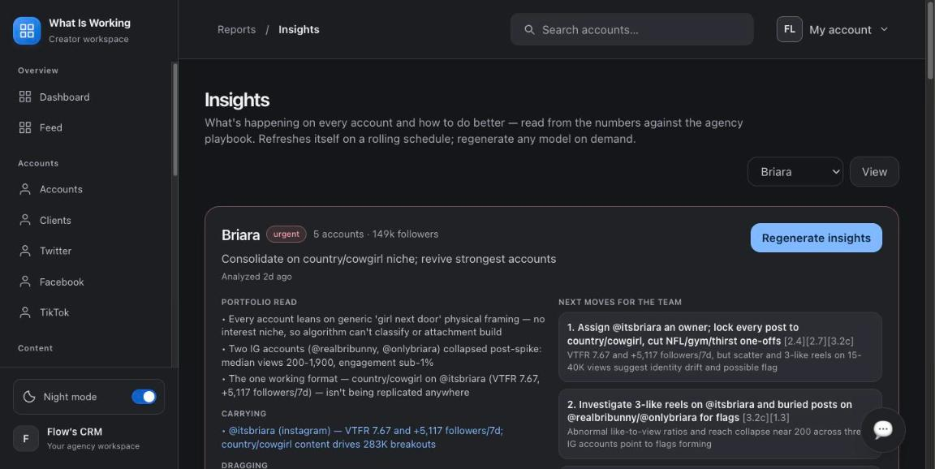
CRITICAL 04
REPETITIVENESS
Four sections, four client pickers
Working one model: Niche → dropdown + View. Insights → another dropdown + View. Results → dropdown + Apply. Content plans → find her card in a grid. The app never remembers which client you're working on.
Client-page tabs jump to global pages and the breadcrumb switches section — “back to my client” is never one click. (Recorded as a GIF in the full report.)
SUGGESTED CHANGE
Make the client the unit of navigation: persistent client switcher in the top bar; stable client sub-pages for plans / niche / results.

Slide 7
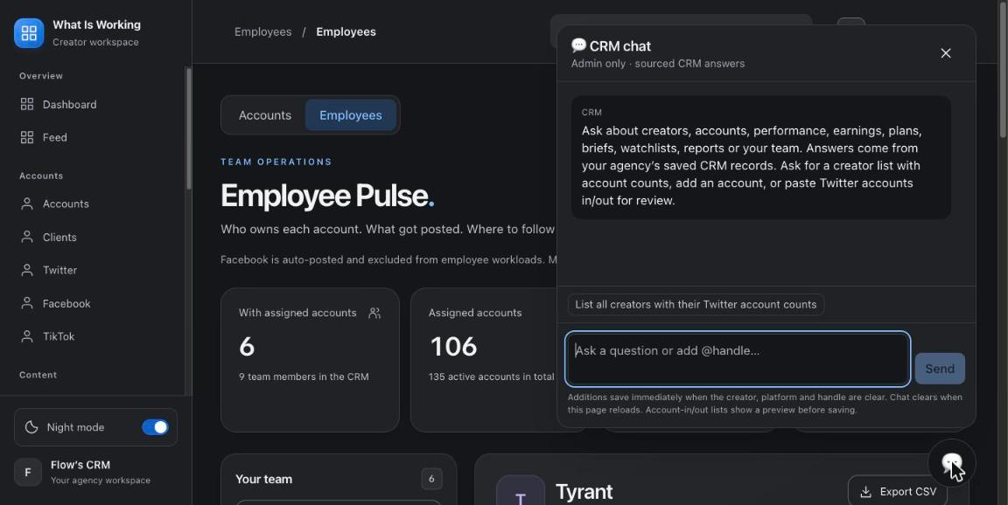
CRITICAL 05
CORE ACTIONS
Core operations live inside a chat box
The dashboard's own help text: “Ask chat ‘Refresh Instagram analytics’ to pull new data.” Adding accounts and refreshing data route through an admin-only chat whose fine print says “additions save immediately” — instant CRM writes, no confirm, invisible to new users, unavailable to employees.
SUGGESTED CHANGE
Every chat-only operation gets a real button in the UI; chat additions show a preview + confirm before saving.

Slide 8
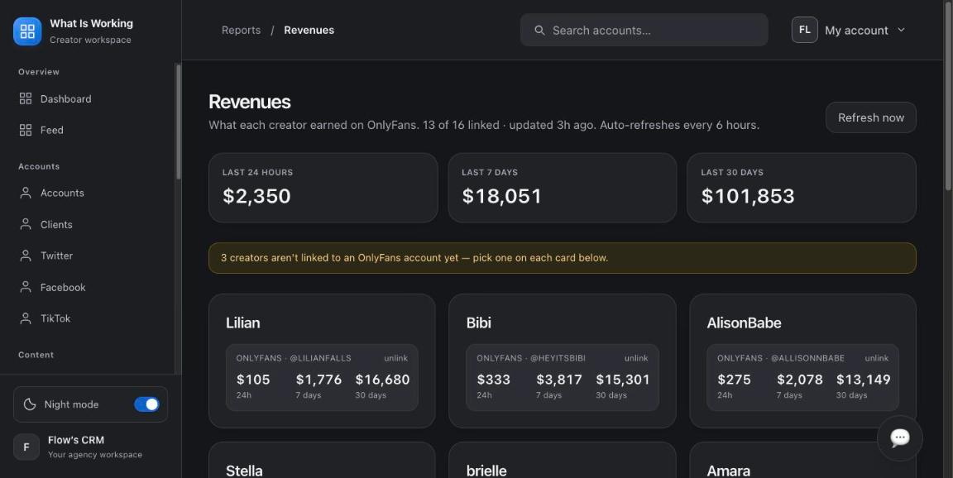
CRITICAL 06
MONEY OPS
Money-in and money-out live in different worlds
Revenues is a proper page. Expenses is an external link into a separate app on another domain (flow-crm-private.vercel.app) with separate access.
So the platform can never answer the owner's real question: profit per model — revenue minus chatting labor, traffic spend and tools.
SUGGESTED CHANGE
Bring expenses in-app (categorized ledger), then ship per-client P&L: OF revenue − attributed costs = margin per model. No competitor offers this.

Slide 9
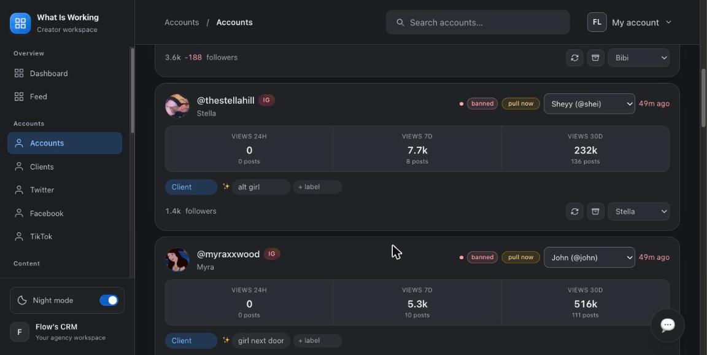
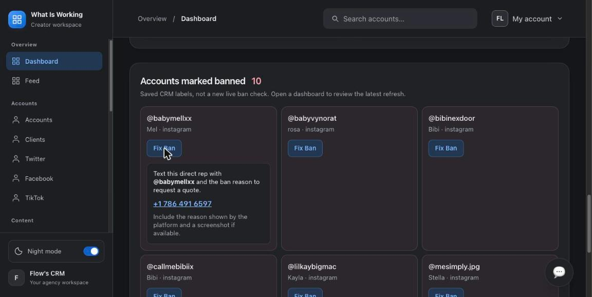
PRIORITY TWO
Friction & repetition in the daily loop
07
154 accounts, no compact view — every account is a huge card; no table view, no bulk assign/refresh
08
“Fix Ban” is a phone number × 10 — no recovery pipeline — no contacted / quoted / recovered status
09
The scroll fights back — scroll traps + a frozen page; night-mode toggle does nothing
10
Onboarding is a wall of zeros — the real setup path exists across 5 sections but is never shown
11
Search only knows accounts — no way to jump to a client, plan or report from the keyboard
12
404s with no way home — /feed dead-ends unbranded; Benchmark anchor lands at page top
13
Cloned control clusters — same 4 buttons repeated on every plan card; 10 identical ban cards
EVIDENCE: OVERSIZED CARDS · BAN TRIAGE BY SMS

Slide 10
RESEARCH · WHAT AGENCIES PAY FOR
Where WISFMA sits in the market
Agency need | WISFMA | Infloww | Supercreator | OnlyMonster
Traffic-account health (bans / shadowbans / cadence) | Best in class | Partial | — | Partial
AI content strategy per creator (niche, hooks, 30-day plan) | Yes — unique | — | — | —
White-label client reporting | Yes | — | — | Exports
Unified fan inbox / chatting | No | Core | Core | Core
Chatter shifts, performance & commission math | No | Yes | Yes | Yes
AI chat assist (the 2026 battleground) | No | Beta | “Izzy” | Suggest
Profit per model (revenue − costs) | Nearly — expenses off-platform | — | — | —
Team roles & permissions | Owner only | Yes | Basic | Yes
Compliance vault (2257 / releases) | No — nobody has it | — | — | —
Strategic read: don't chase Infloww's inbox first. The uncontested wins: per-model P&L, employee logins with roles, and a compliance vault no competitor ships. Today the niche playbooks tell staff to use Metricool, Notion & Dropbox — feature gaps wearing other logos.

Slide 11
RECOMMENDATION
Suggested order of attack
THIS WEEK — LAYOUT & BUGS
THIS MONTH — FLOW
THIS QUARTER — MOAT
Now
Next
Later
—
Revenue strip on the dashboard (data exists)
—
Persistent client switcher + stable client tabs
—
Per-model P&L (bring expenses in-app)
—
Sidebar: add Instagram + Employees
—
Accounts table view + bulk actions
—
Employee accounts with roles
—
Fix theme toggle, scroll trap, /feed 404, anchors
—
Ban-recovery pipeline with statuses
—
Compliance vault (2257 / releases / IDs)
—
Plain-language errors (no HikerAPI / Apify strings)
—
Onboarding checklist on empty clients
—
Data export everywhere + simple API
—
Confirm-guard the OnlyFans “unlink”
—
⌘K global search; buttons for every chat-only op
—
Only then: chatting module or Infloww integration

Slide 12
BOTTOM LINE
The intelligence layer is already ahead of the market.
Now make it flow.
Shadowban evidence, AI niche playbooks, white-label reports and Pulse are genuinely differentiated — competitors charging $40+/creator don't have them. The fixes in this deck are mostly navigation, layout and copy: put money on the dashboard, give Instagram and the team a home, remember the selected client, and retire the chat box as the only path to core actions.
Full interactive report: wisfma-ux-review.html — 29 annotated screenshots, live-recorded GIF evidence, complete polish list & method notes.

