Slide 1
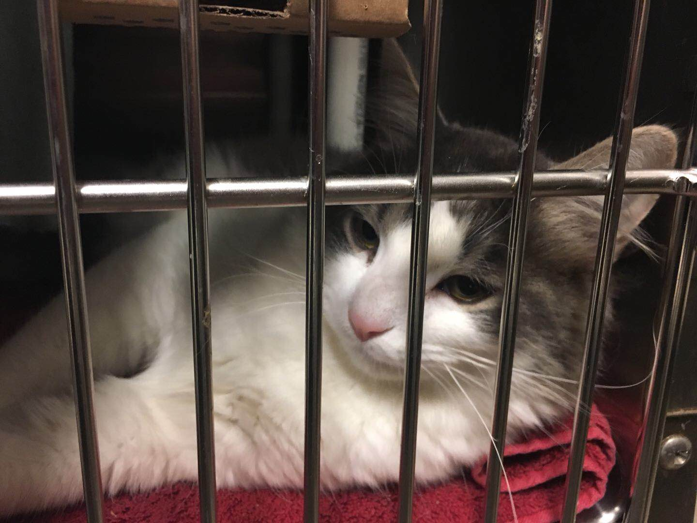
Shelter Animal Outcomes
Xinning Chu
DATS 6202
George Washington University

Slide 2
PART 1
Data Description

Slide 3
Or0-p
Background
Source
Many animals are given up as unwanted by their owners, while others are picked up after getting lost taken out of cruelty situations.
Every year, approximately 7.6 million companion animals end up in US shelters, and 2.7 million dogs and cats are euthanized in the US .
https://www.kaggle.com/c/shelter-animal-outcomes
Objective
Our aim is to investigate the cause of unwantedness in animal shelter, thereby to help shelters focus their energy on specific animals who need a little extra help finding a new home and promote protection on these animals.
Collected in 2016
Training Dataset & Testing Dataset
10 variables, 9 features
26730 Observations

Slide 4
 | Animal ID | Name | DateTime | OutcomeType | OutcomeSubtype | AnimalType | SexuponpOutcome | AgeuponOutcome | Breed | Color
count | 26729 | 19308 | 26729 | 26729 | 13117 | 26729 | 26728 | 26711 | 26729 | 26729
unique | 26729 | 6374 | 22918 | 5 | 16 | 2 | 5 | 44 | 1380 | 366
top | A719262 | Max | 2015-08-11 00:00:00 | Adoption | Partner | Dog | Neutered Male | 1 year | Domestic Shorthair Mix | Black/White
freq | 1 | 136 | 19 | 10769 | 7816 | 15595 | 9779 | 3969 | 8810 | 2824

Slide 5
PART 2
Exploratory Data Analysis

Slide 6
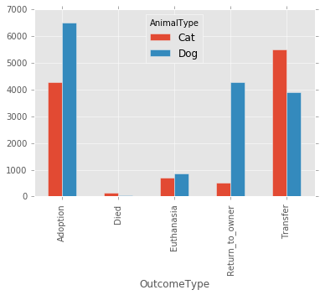

Slide 7
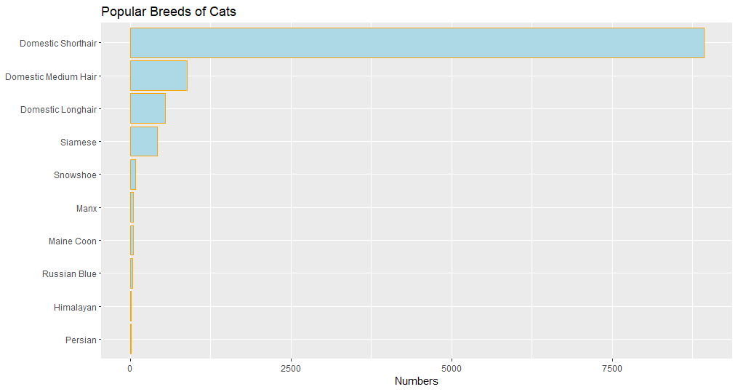

Slide 8
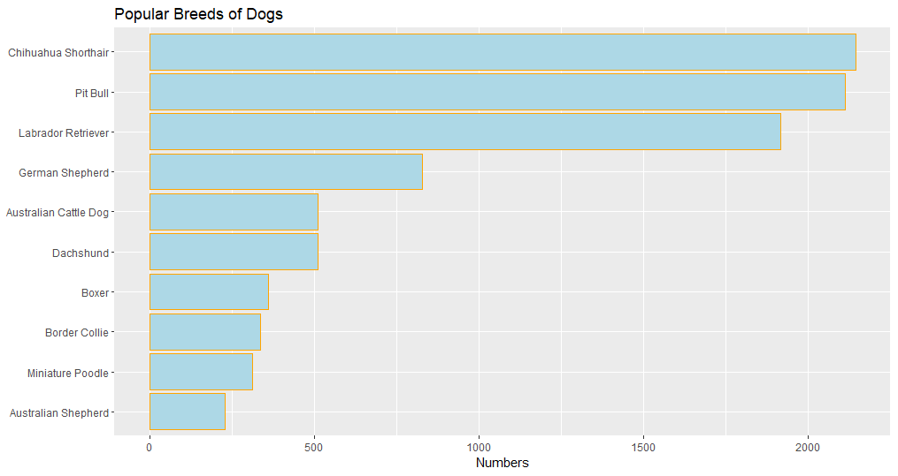

Slide 9
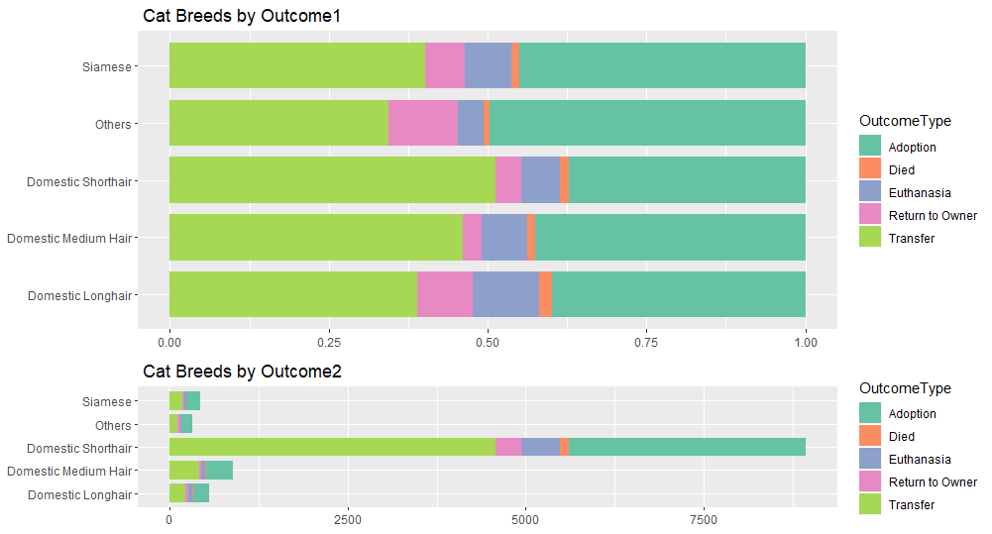

Slide 10
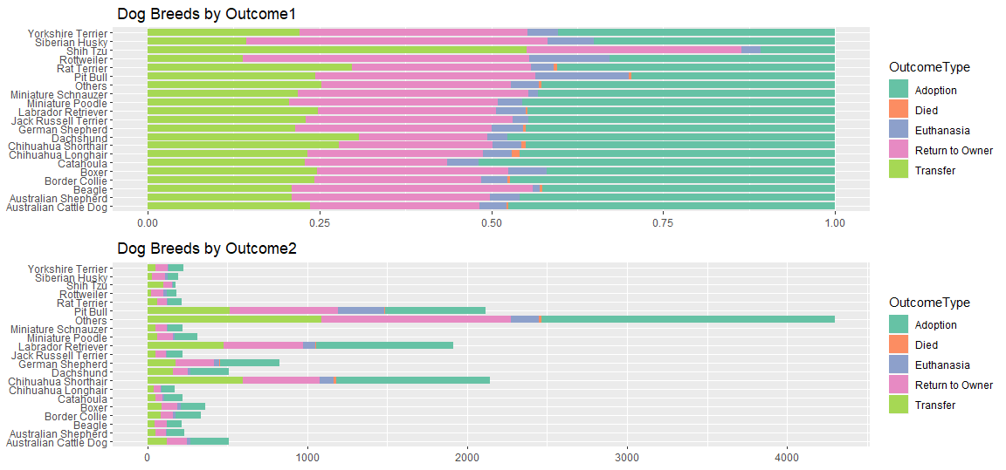

Slide 11
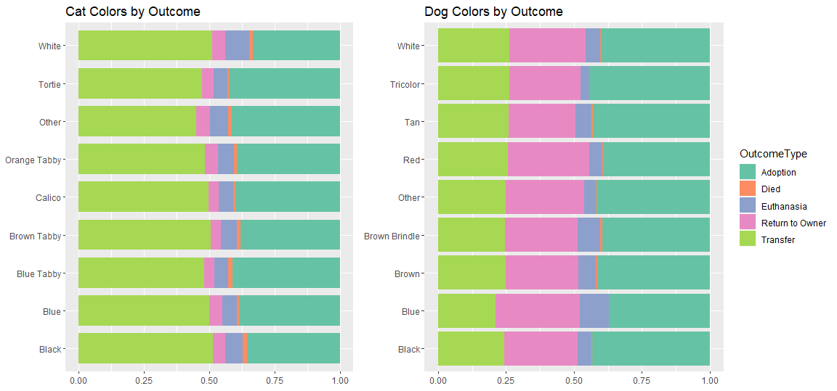

Slide 12
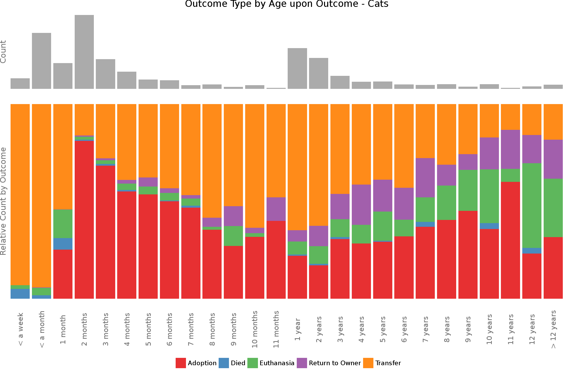

Slide 13
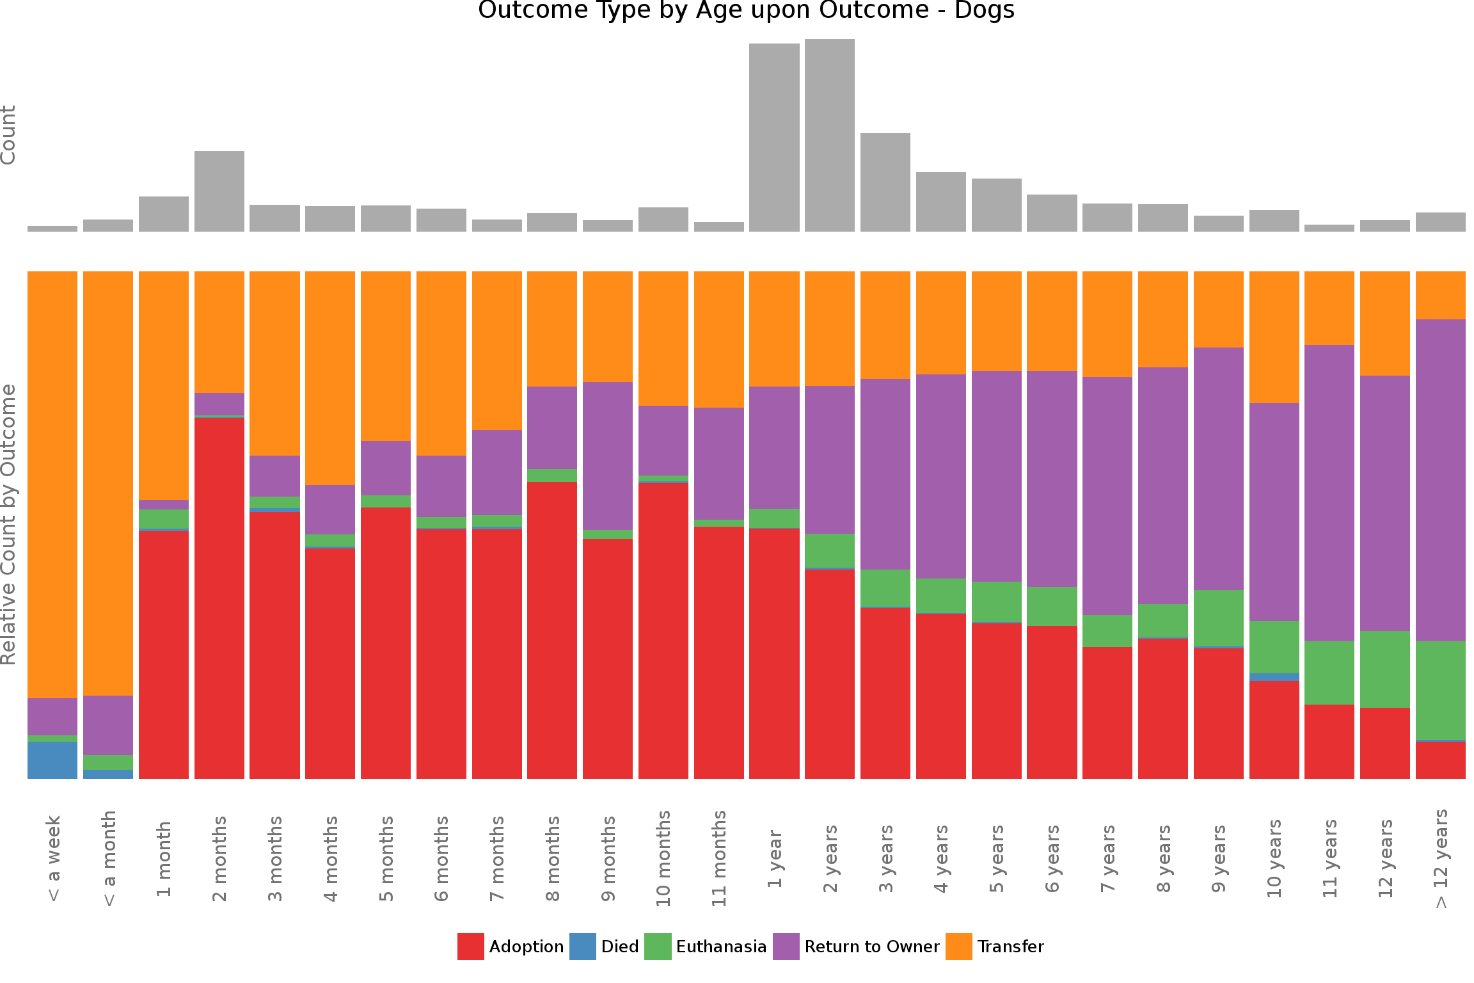

Slide 14
PART 3
Data Preparation

Slide 15
Label Encoding
Delete OutcomeSubtype & DateTime
2. Create Some New Features
NameC (Name); sex / fertility (SexuponOutcome);
Main Breed / Mix Breed (Breed);
ColorC / Main Color (Color); OutcomeG (Outcome);
ageD / ageY (AgeuponOutcome)

Slide 16
Variable | Description | Encoding to Numeric
outcome | Adoption, Died, Euthanasia, Return to owner and Transfer | Adoption: 0 Transfer: 1 Return_to_owner: 2 Euthanasia: 3 Died: 4
outcome | Generalized categorization of outcome | 1: Survived; 0: Died
NameC | Whether this animal has name | 1: yes; 0: no
Animal | The type of animal | 1: dog; 2: cat
sex | Gender | 0: male; 1: female; 2: unknown
fertility | Fertility ability | 0: intact; 1: spayed; 2: unknown
Main Breed | Ecoded main breed for animal | Assumed main breed for each animal. Defined as the first breed before “/” and “Mix”.
MixBreed | Whether the breed of animal is mix | 1: mix; 2: pure
ColorC | The classifier code for main color | There are 57 different color, we encode color to the numerical type data. For example, 0 stands for Black, 1 stands for White.
MixColor | Whether the color of animal is mix | 1: mix; 0: pure
ageY | Age by day | ageC = i when i years, i are in [1,9] ageC=0 when year <1
ageD | The classifier code for age | For example: 1, 3, 5, 7, 9, 11

Slide 17
One-hot Encoding
• A process by which categorical variables are converted into a numeric form.
• Many machine learning algorithms cannot operate on label data directly. They require all input variables and output variables to be numeric.
Data Cleaning
• Delete rows for missing data

Slide 18
Analysis on Outcome
PART 4

Slide 19
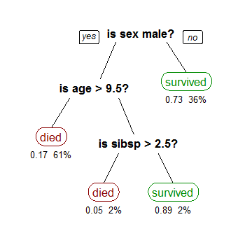
Decision Tree
A decision tree is a decision support tool that uses a tree-like model of decisions and their possible consequences, including chance event outcomes, resource costs, and utility. It is one way to display an algorithm that only contains conditional control statements.

Slide 20
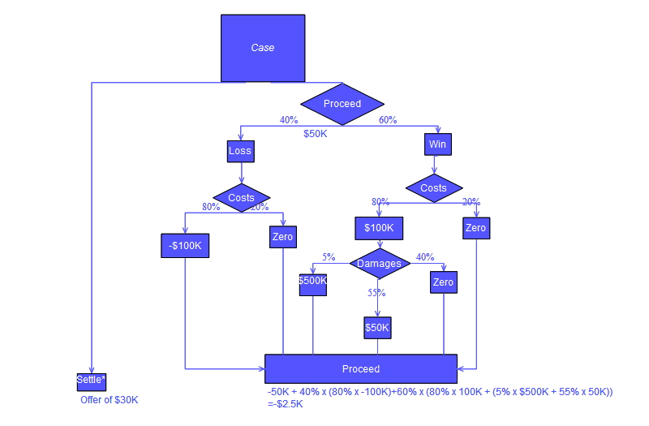
It’s a simple and widely used classification technique to build classification models form an input dataset, which applies a straightforward idea to solve the classification problem.
It organizes a series of test questions and conditions in a tree structure.
Each time it receives an answer, a follow-up question is asked until a conclusion about the class label of the record is reached.
The root and internal nodes contain attribute test conditions to separate records that have different characteristics. All the terminal node is assigned a class label Yes or No.

Slide 21
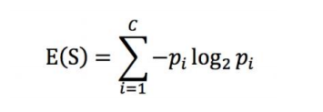
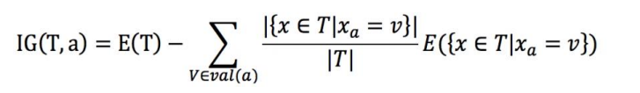
criterion：The function to measure the quality of a split.
Entropy:
where c is the number of classes in feature.
max_depth: The maximum depth of the tree.
min_samples_leaf : The minimum number of samples required to be at a leaf node.
Information Gain:
calculate it to decide how to split the nodes of the decision tree

Slide 22
Grid Search CV
•It builds a model for every combination of hyperparameters specified and evaluates each model.
•Use it to gain the best parameters for decision tree:
max_depth : 7 ; min_samples_leaf : 19,

Slide 23
Confusion Matrix
 | Actual |  | Measure
Predicted | TP | FP | Positive Predictive: TP/(TP+FP)
 | FN | TN | Negative Predictive: TN/(FN+TN)
Measure | Sensitivity/Recall TP/(TP + FN) | Specificity: TN/(FP + TN) | Accuracy: TP+TN/(TP+FN+FP+TN)

Slide 24
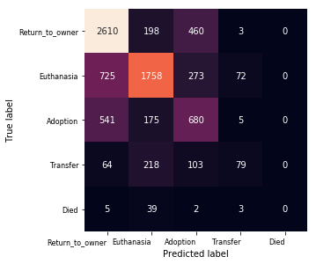

Slide 25
Classfication Reports
 | Definition | Measure
precision | Among positive samples, how many of them that we actually predict correct. | True Positive/(True Positive + False Positive)
recall | Among all the samples, how many positive of them that we actually predict correct. | True Positive/(True Positive + False Negative)
F1 – score | The F1 score is the harmonic average of the precision and recall. | 2/F1 = 1/P + 1/R
ROC - AUC | AUC is the probability a randomly-chosen positive example is ranked more highly than a randomly-chosen negative example. | False Positive Rate= Number of False Positive / Number of real negative True Positive Rate= Number of True Positive / Number of real positive

Slide 26
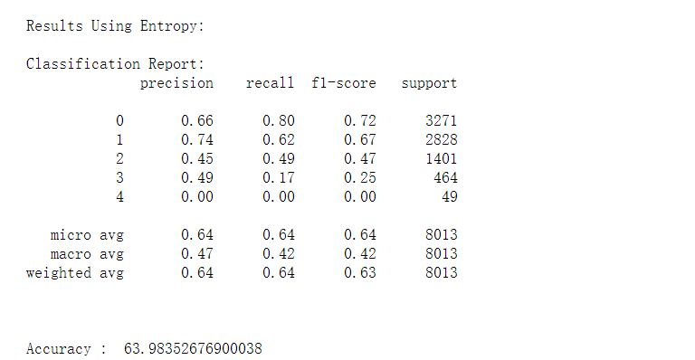

Slide 27
Analysis on OutcomeG
PART 5

Slide 28
 | Level | Label | Count
Survived | Adoption / Transfer / Return to the owner | 1 | 24960
Died | Died / Euthanasia | 0 | 1750
By Grid Search CV,
We find the best parameters:
max_depth = 15, min_samples_leaf = 11

Slide 29
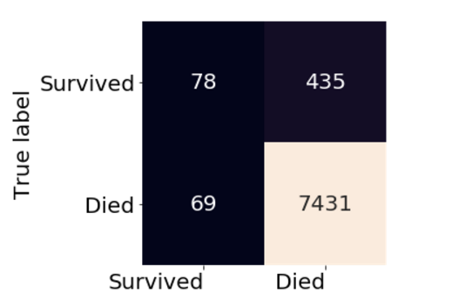
Confusion Matrix

Slide 30
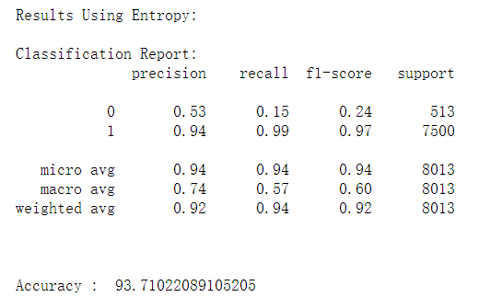

Slide 31
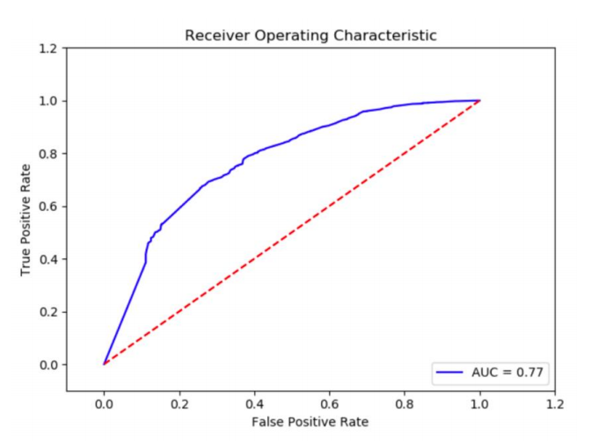
Training dataset: 93.38% Survived; 6.62% Died
Testing dataset: 6.40% Survived; 93.60% Died
Question:
The high accuracy was caused by successful decision tree, or unbalanced dataset?

Slide 32
fertility_1 0.25013
ageY_0 0.15456
NameC_1 0.06069
Main Breed_159 0.06027
ageY_1 0.05419
animal_1 0.0503
ageY_2 0.04157
MixColor_1 0.02396
sex_0 0.0235
ageY_3 0.01981
colorC_0 0.01967
ageY_10 0.01299
MixColor_0 0.01297
sex_1 0.0127
colorC_1 0.01185

Slide 33
Other Classifiers:
Model | Precision | Recall | Accuracy
Naïve Bayes | 0.90 | 0.71 | 0.71
Logistic Regression | 0.91 | 0.88 | 0.90
Decision Tree | 0.92 | 0.92 | 0.94

Slide 34
Thank you!

