Slide 1
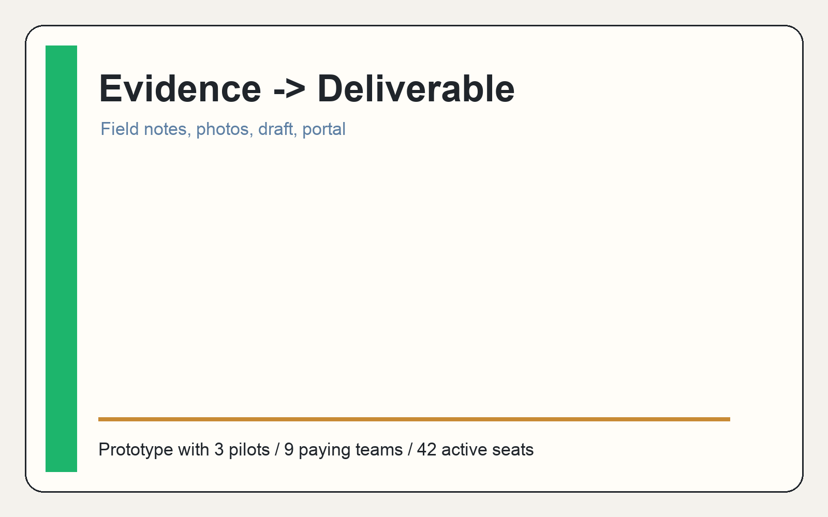
Tracepad.ai
Capture the work. Ship the report.
AI workspace for high-context service businesses turning field context into client-ready deliverables.
$1.5M seed
3 pilots
$3.2k MRR
Tracepad.ai / Seed Deck / 1

Slide 2
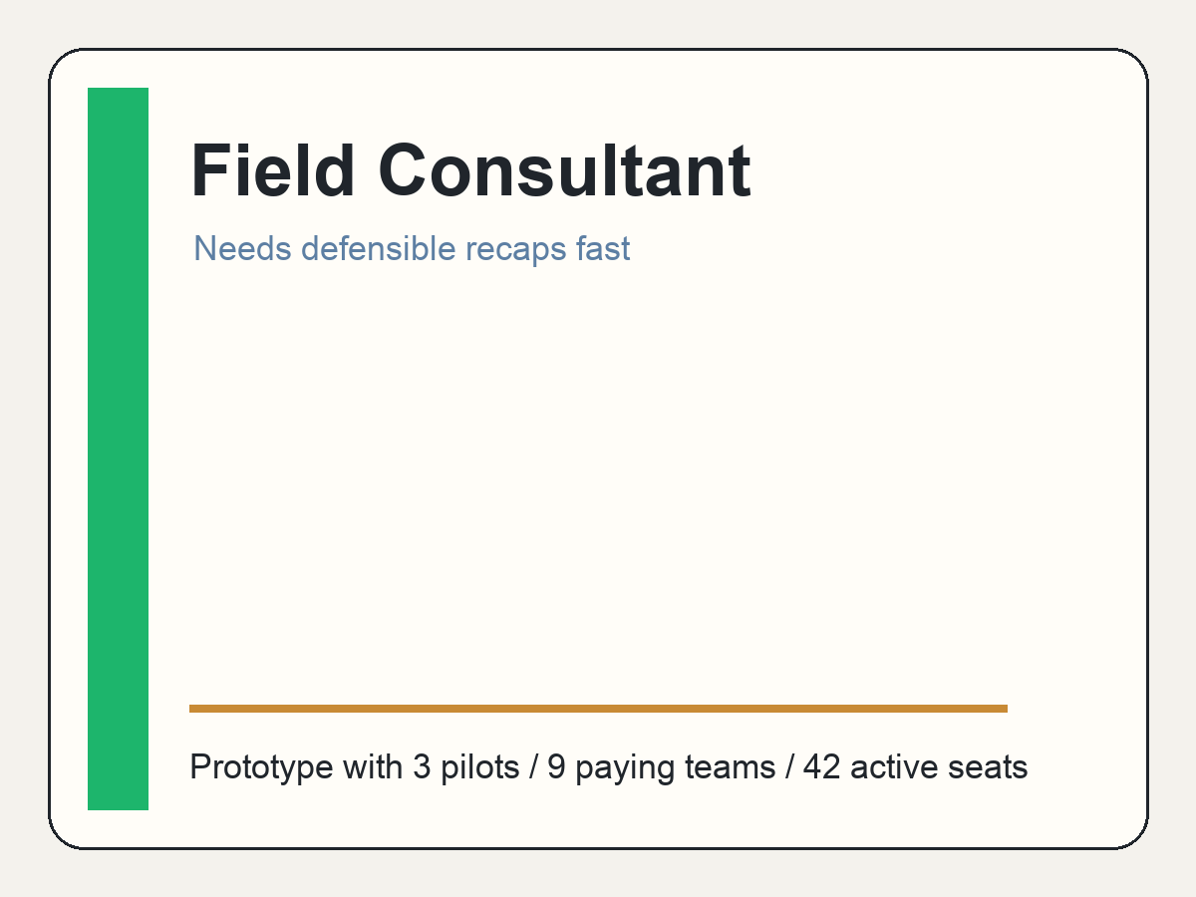
High-context service work gets trapped before it becomes a deliverable.
Problem
Voice notes, site photos, texts, and meeting memory scatter across tools.
The expensive work is reconstructing the story for a client-ready recap, proposal, or task plan.
Generic note tools capture information but do not ship the final professional output.
Tracepad.ai / Seed Deck / 2

Slide 3
The insight: AI is most useful when evidence and review stay attached.
Insight
1
2
3
4
5
Capture
Organize
Generate
Review
Deliver
Tracepad.ai is not a black-box writer. It is a reviewable workspace where source context, draft language, and final delivery live together.
Tracepad.ai / Seed Deck / 3

Slide 4
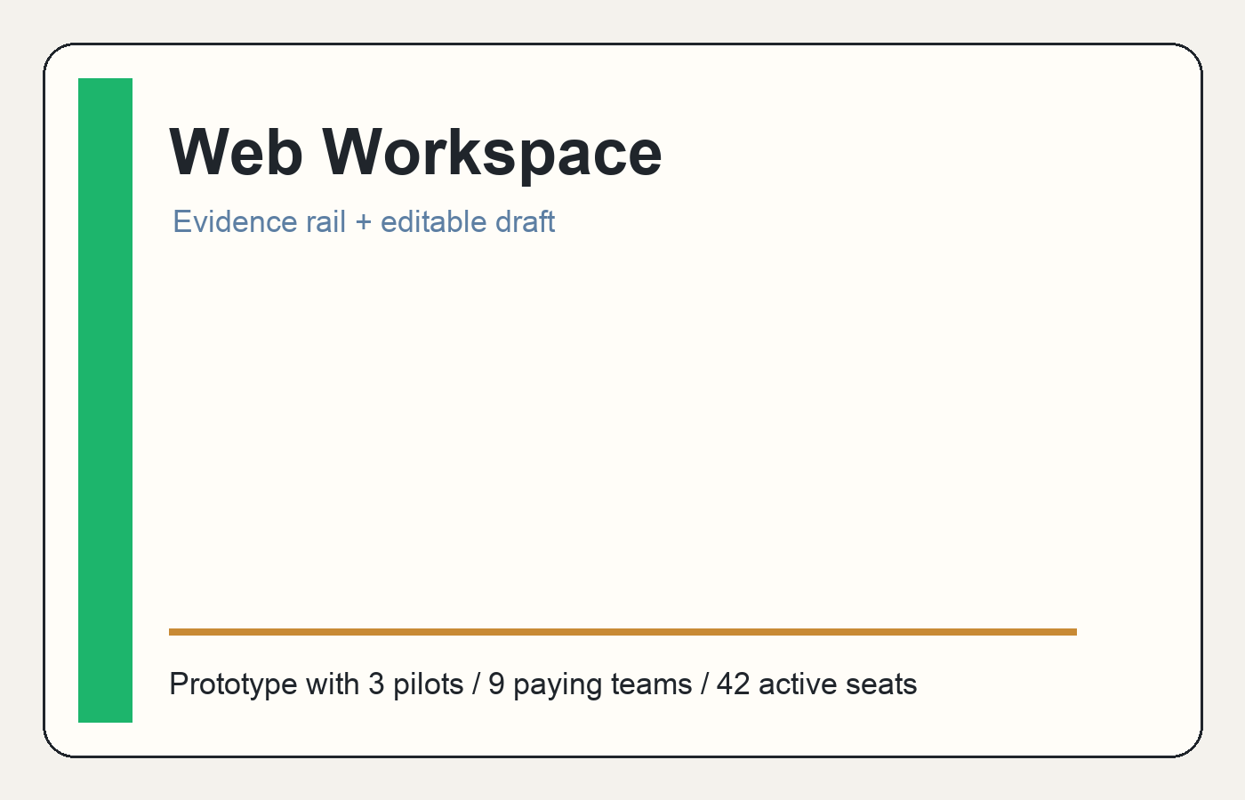
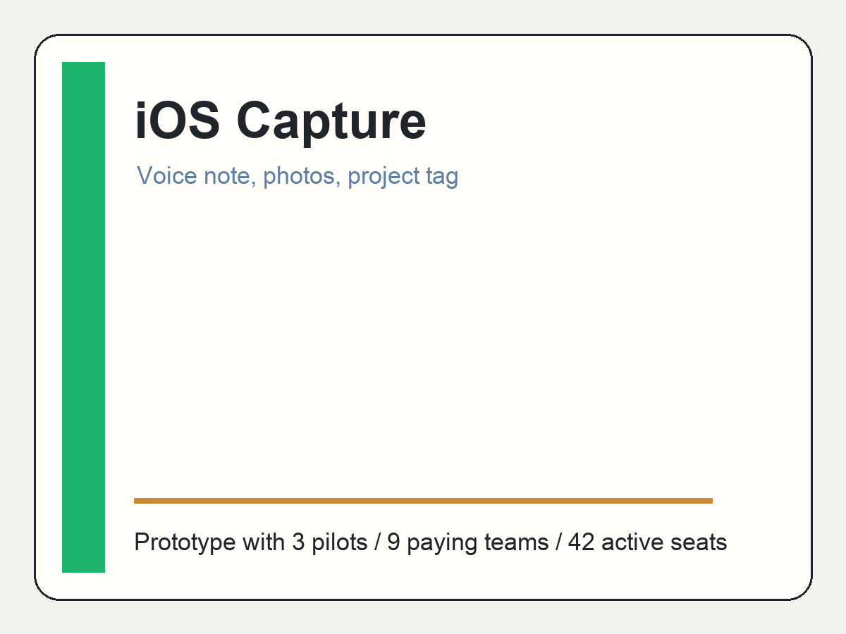
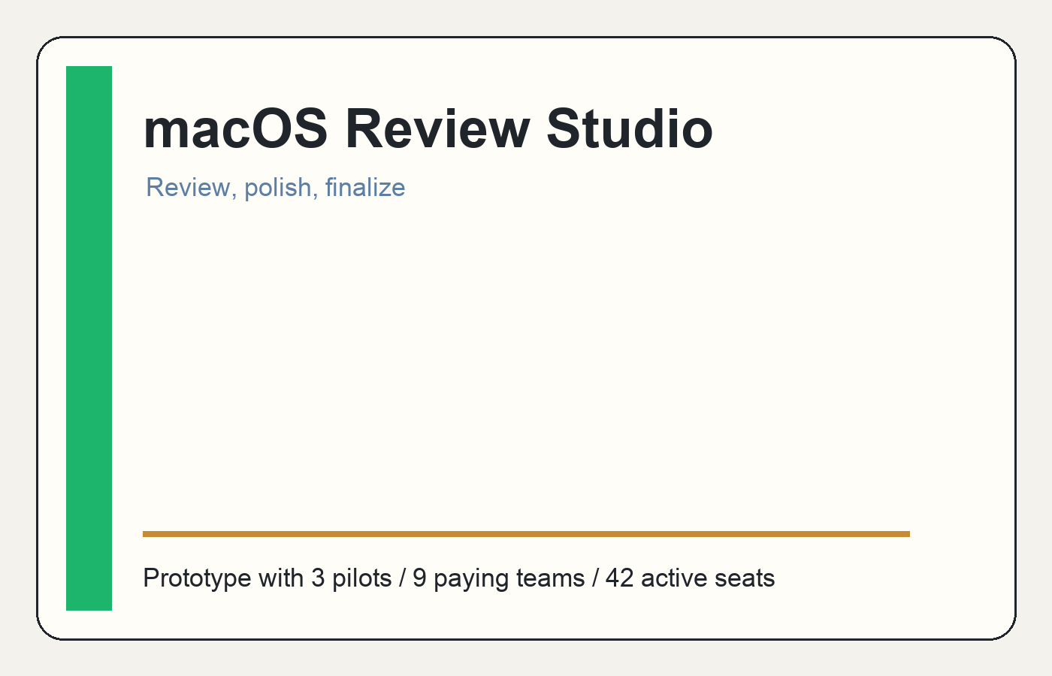
Product: capture app + workspace + desktop studio.
Product
iOS captures field context fast. Web coordinates clients, projects, and portals. macOS supports deep review, editing, and finalization.
Tracepad.ai / Seed Deck / 4

Slide 5
Workflow: from raw context to client-ready deliverable.
Workflow
Capture
Organize
Generate
Review
Deliver
Voice notes, photos, project tags
Client, project, visit, source context
Report, proposal, follow-up, task list
Edit draft with evidence visible
Portal/export and internal handoff
Tracepad.ai / Seed Deck / 5

Slide 6
Market wedge: service businesses where deliverables are the product.
Market
5-50 person service businesses with repeatable but messy deliverables.
Environmental consultants, field inspection teams, remodelers, boutique implementation agencies, fractional operators.
Buyer is founder-led or operator-led and feels the follow-up bottleneck directly.
5-50
person ICP
4
core outputs
1
reviewable workspace
Tracepad.ai / Seed Deck / 6

Slide 7
Business model: subscriptions plus usage expansion.
Business model
Solo
Team
Business
$69/mo
$249/mo
$599+/mo
Independent consultant
Small service team
Higher-volume operator
Expansion comes from seats, AI-heavy generation, storage, onboarding, and higher-volume portal workflows.
Tracepad.ai / Seed Deck / 7

Slide 8
Plausible prototype traction, not pretend scale.
Traction model
3
9
42
$3.2k
$1.5M
pilot accounts
paying teams
active seats
MRR
seed ask
The traction story is intentionally early: real pull from service teams, enough usage to learn, and a clear path to stronger onboarding and product hardening.
Tracepad.ai / Seed Deck / 8

Slide 9
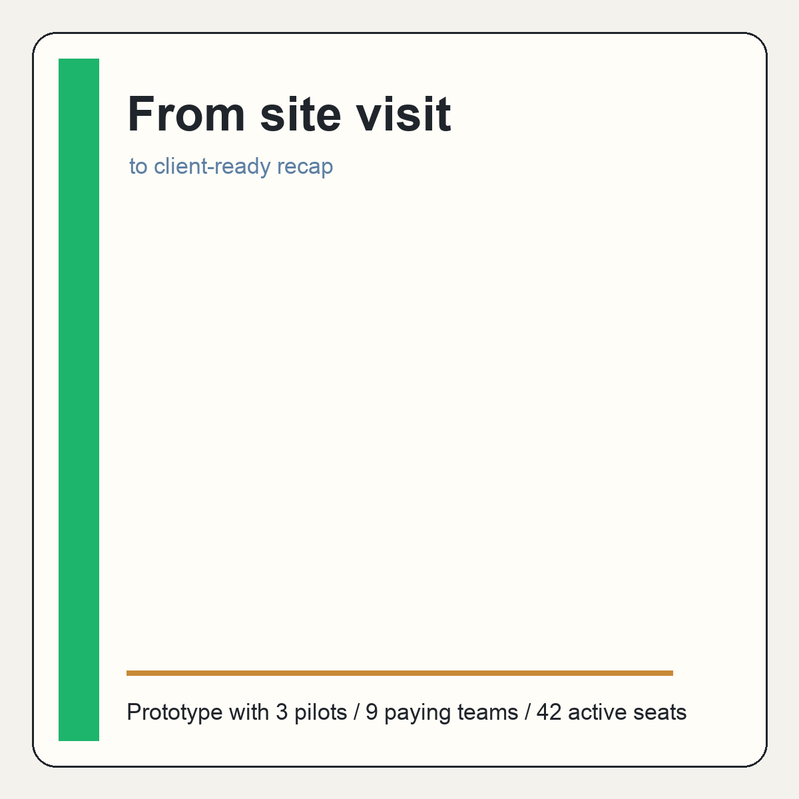
GTM: wedge into repeated high-context deliverables.
Go-to-market
Start founder-led with boutique consultants, inspection teams, agencies, and remodelers.
Sell a narrow promise: ship the recap, proposal, or follow-up before context decays.
Convert pilots through guided onboarding and measurable reduction in deliverable cycle time.
Tracepad.ai / Seed Deck / 9

Slide 10
Competition: notes, CRMs, docs, and vertical tools each miss the full loop.
Competition
Notes apps
Capture without deliverable workflow
CRMs
Track accounts, not field evidence
Docs
Flexible but manual
Vertical tools
Deep but narrow
Tracepad.ai
Evidence to reviewed deliverable
Tracepad.ai / Seed Deck / 10

Slide 11
Financial summary: seed dollars buy product hardening and pilot conversion.
Financial summary
Base case reaches about $1.6M ARR in 2028.
Gross margin improves as templates, onboarding, and AI cost controls mature.
Runway supports focused product and GTM validation, with a planned follow-on raise after stronger usage proof.
Tracepad.ai / Seed Deck / 11

Slide 12
Ask: $1.5M seed to turn field context into the system of record for deliverables.
Ask and use of funds
$1.5M
Hire first engineer.
Add product and design support.
Improve onboarding and customer success.
Harden AI and document generation pipeline.
Run early GTM experiments.
seed target
Tracepad.ai wins by staying practical: capture the messy work, keep evidence attached, and help service teams ship the professional output clients actually pay for.
Tracepad.ai / Seed Deck / 12

