Slide 1
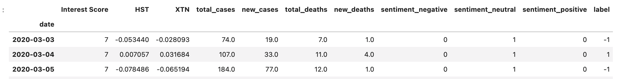
Supervised Learning - Dataset
HST: Host Hotels & Resorts, Inc. is an S&P 500 company and is the largest lodging REIT.
XTN: The S&P Transportation Select Industry Index represents the transportation segment of the S&P Total Market Index (“S&P TMI”).
Interest Score: Google search trends on COVID
Sentiment: Twitter sentiment based on usage of the "COVID" word for the day. Results are obtained by applying VADER sentiment analysis to 1000 tweets per day.
Total_cases: Total COVID cases since inception.
New_cases: Number of new cases reported for the day.
Total_deaths: Total deaths since inception.
New_deaths: Number of new deaths reported for the day.
Label: This is the daily percentchange of the S&P index.

Slide 2
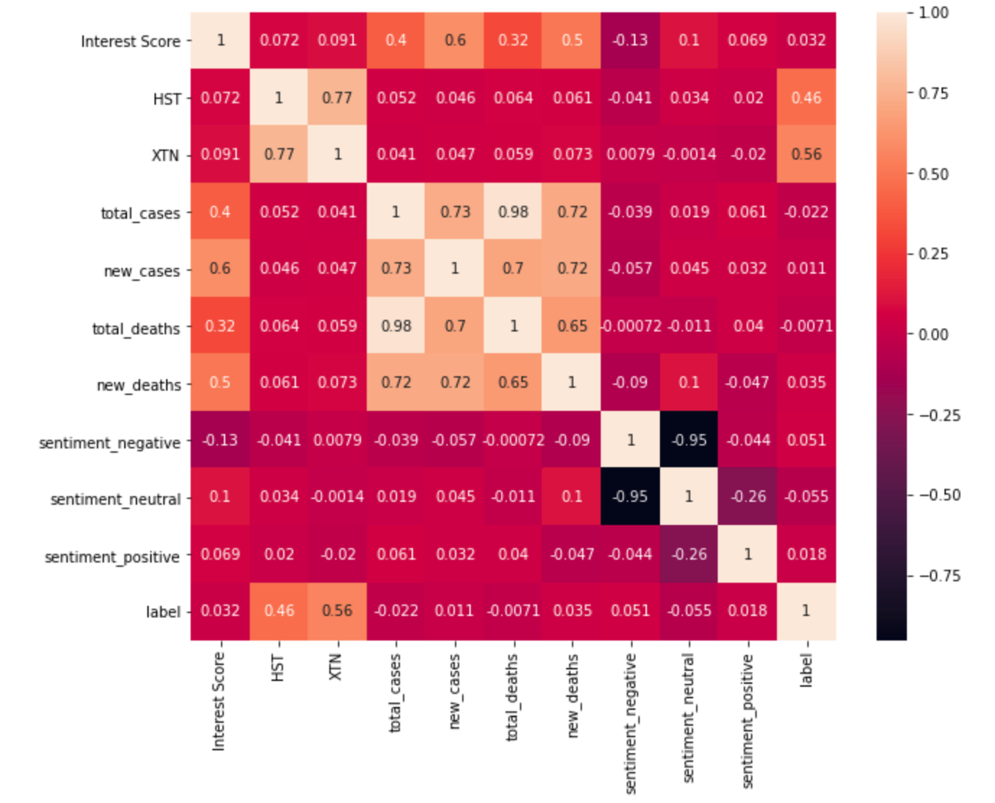
Supervised Learning - Explore
Correlation between Interest Score and COVID stats
Correlation between HST and XTN with the label column (S&P index percentchange)
Correlation between HST and XTN

Slide 3
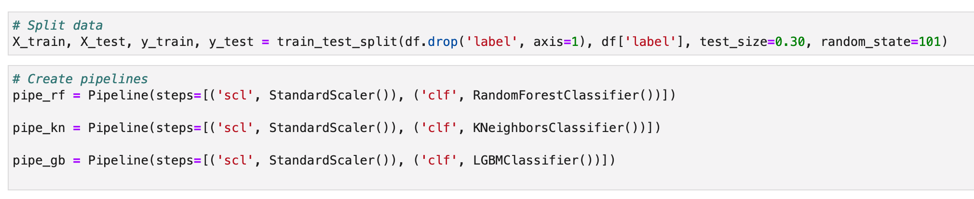
Supervised Learning - Pipeline

Slide 4
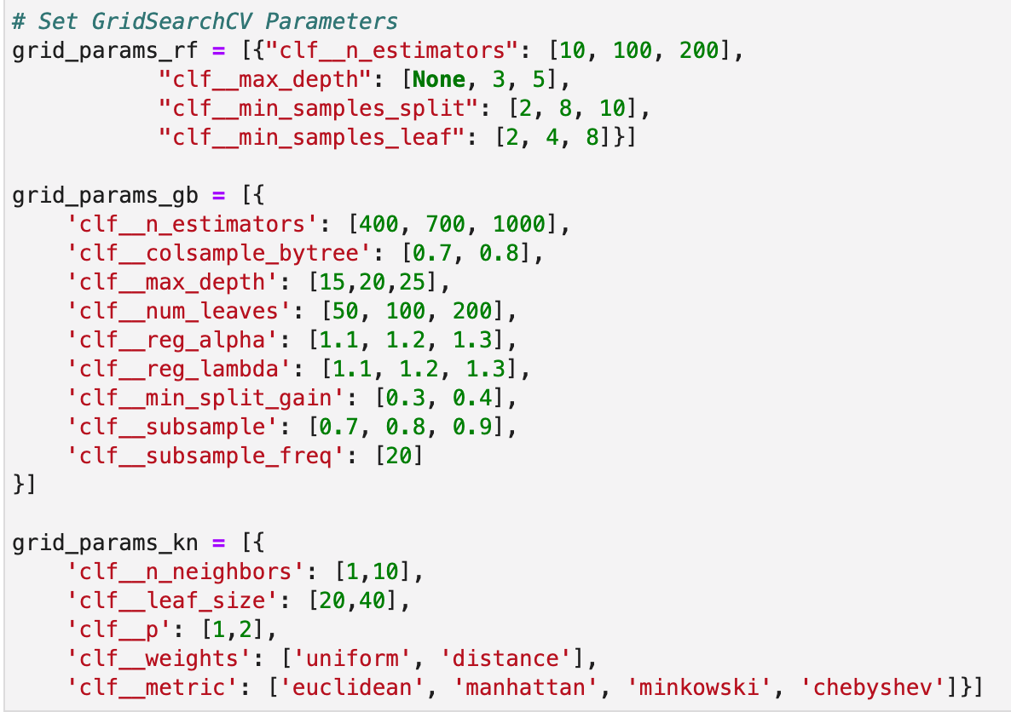
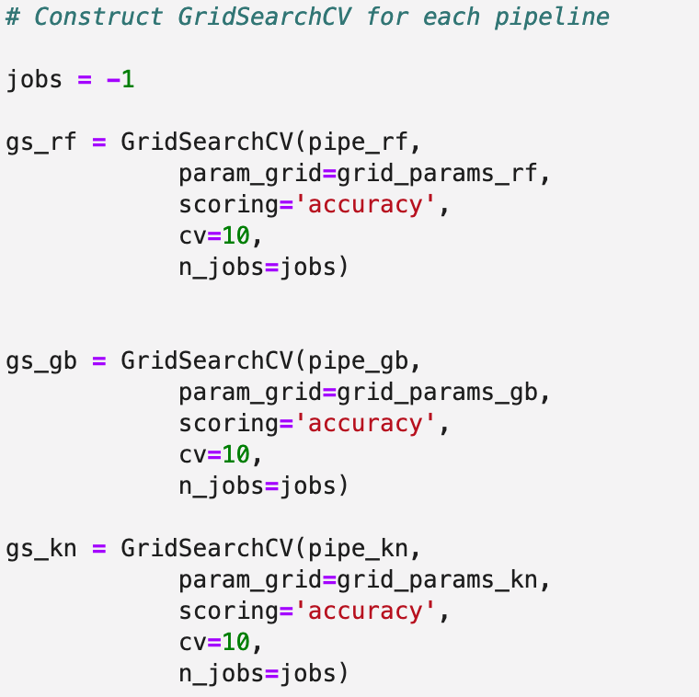
Supervised Learning – Hyperparameter Tunning

Slide 5
Supervised Learning – Fit and Predict
Fit the model
Best performing parameters
Calculate the best training data accuracy
Perform predictions on test data
Calculate test data accuracy of our model
Print Classification Report
Plot Confusion Matrix
Plot ROC/AUC
Plot Feature Importance

Slide 6
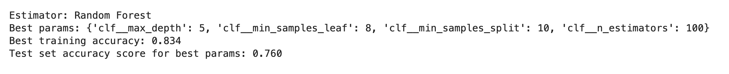
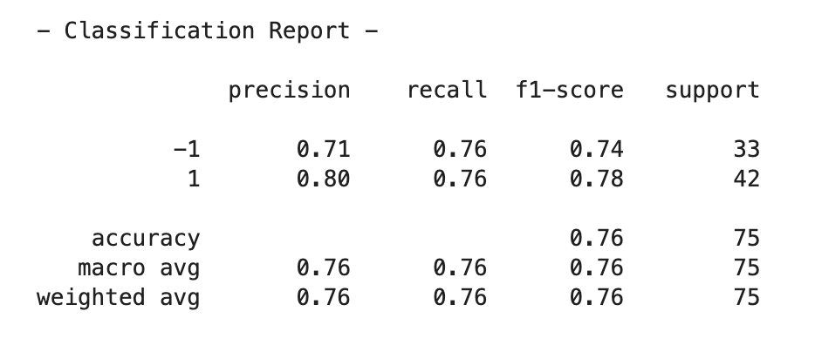
Supervised Learning – Results Random Forest

Slide 7
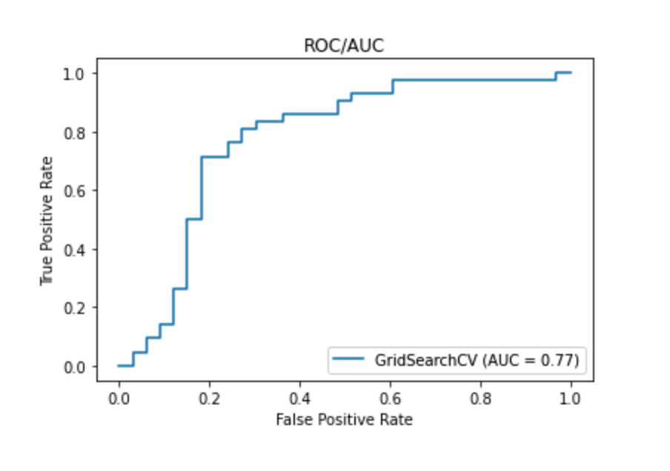
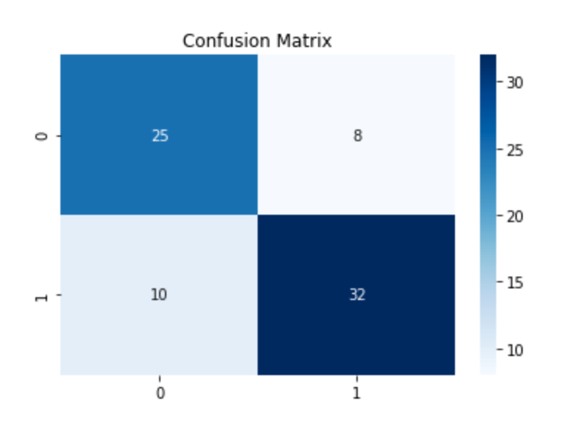
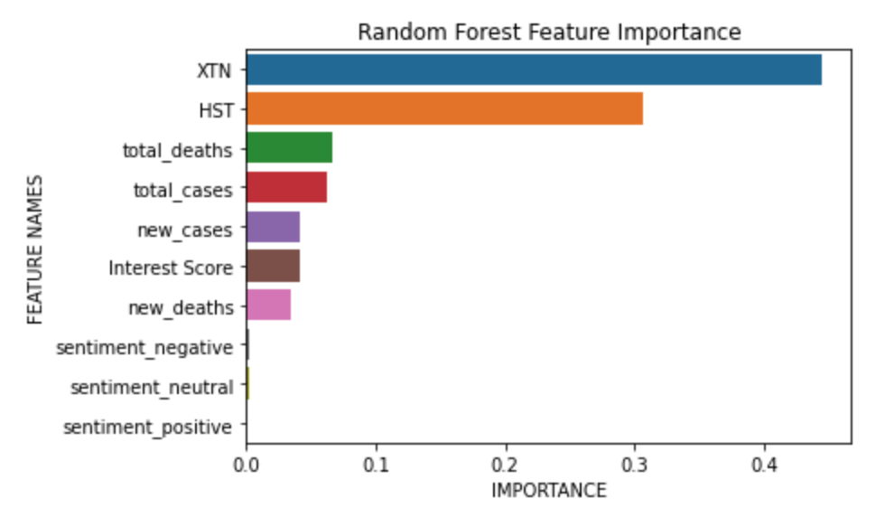
Supervised Learning – Results Random Forest

Slide 8
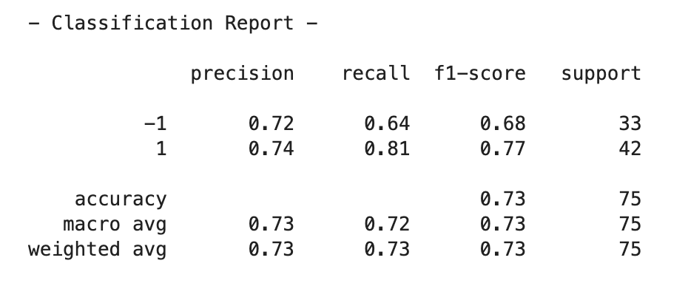
Supervised Learning – Results KNeighbor

Slide 9
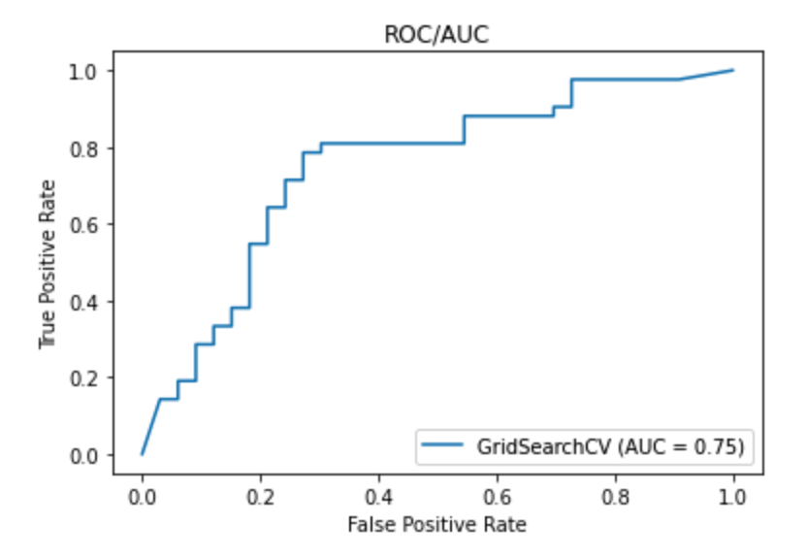
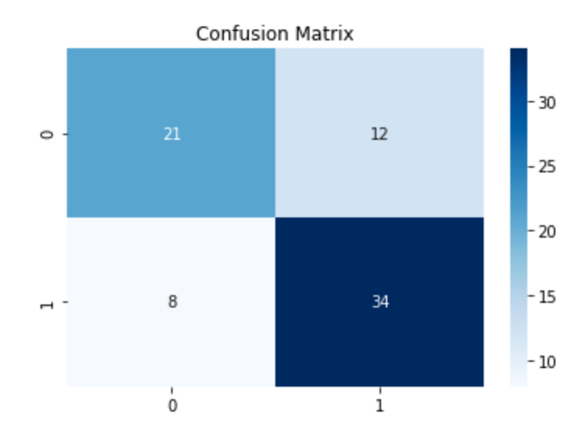
Supervised Learning – Results Kneighbor

Slide 10
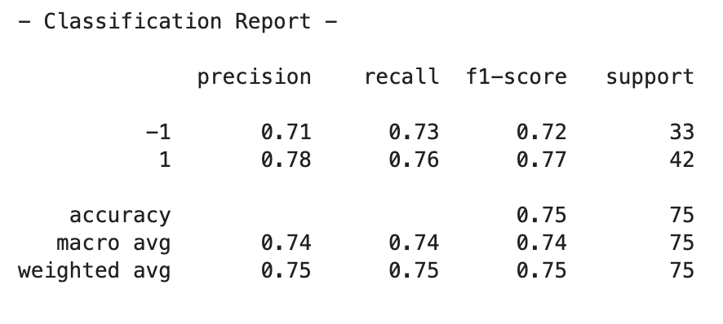
Supervised Learning – Results Gradient Boost

Slide 11
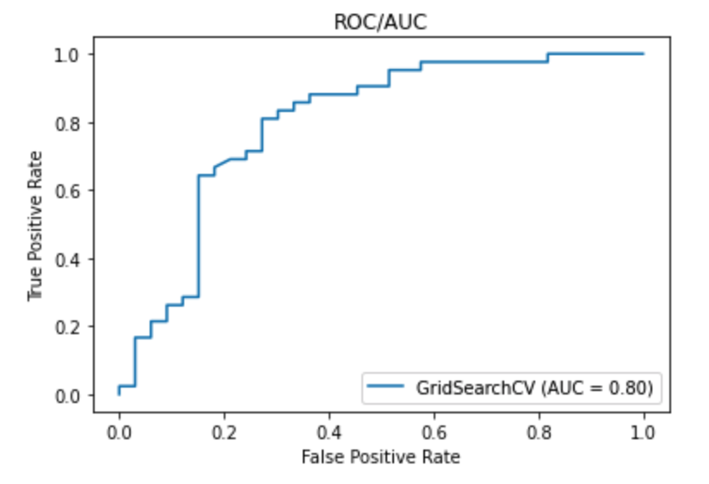
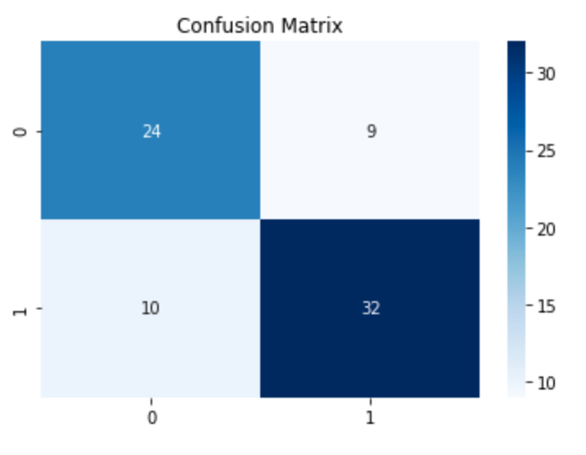
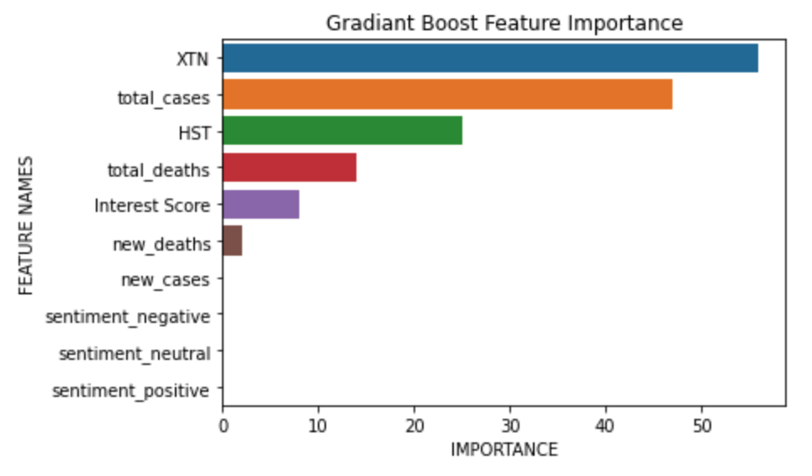
Supervised Learning – Results Gradient Boost

