Slide 1
Capstone

Slide 2
Problem statement :
To create a sentiment analysis estimator tools for traders using news headlines based on VIX (Fear index) via Google Chrome Extension.
We will be using sentiment reviews on our news headlines to predict the volatility of VIX.

Slide 3
Reddit News (X Variables)
Historical news headlines from Reddit WorldNews Channel (/r/worldnews). They are ranked by reddit users' votes, and only the top 25 headlines are considered for a single date. (Range: 2008-06-08 to 2016-07-01)
All news are ranked from top to bottom based on how hot they are.Hence, there are 25 lines for each date. The first column is "Date", the second is "Label", and the following ones are news headlines ranging from "Top1" to "Top25".
Link : https://www.kaggle.com/aaron7sun/stocknews

Slide 4
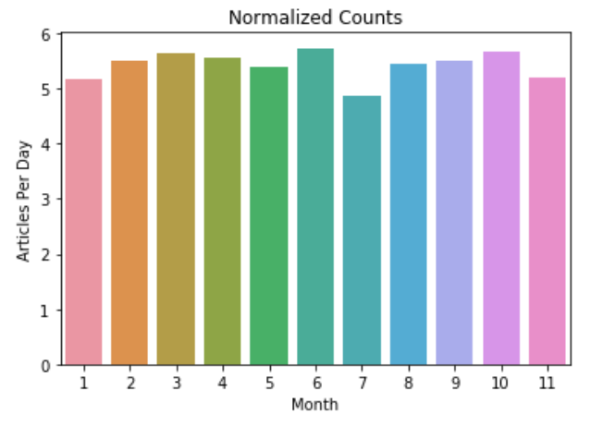
Reddit News

Slide 5
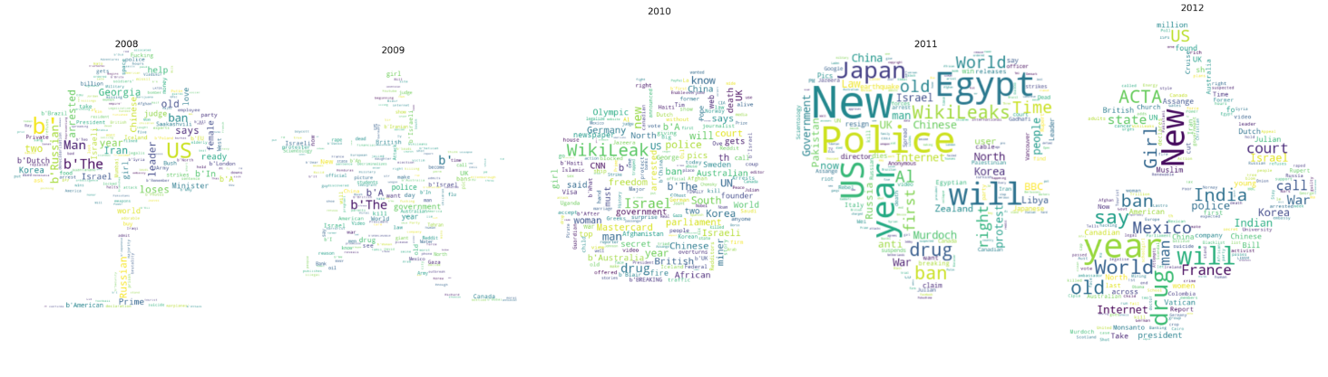
For year 2008 to 2012

Slide 6
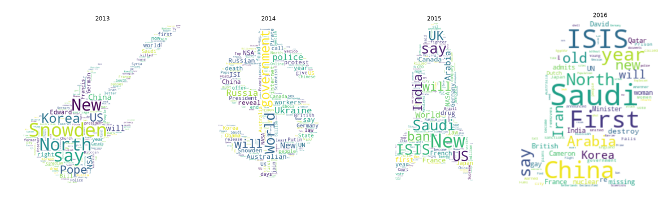
2013 to 2016

Slide 7
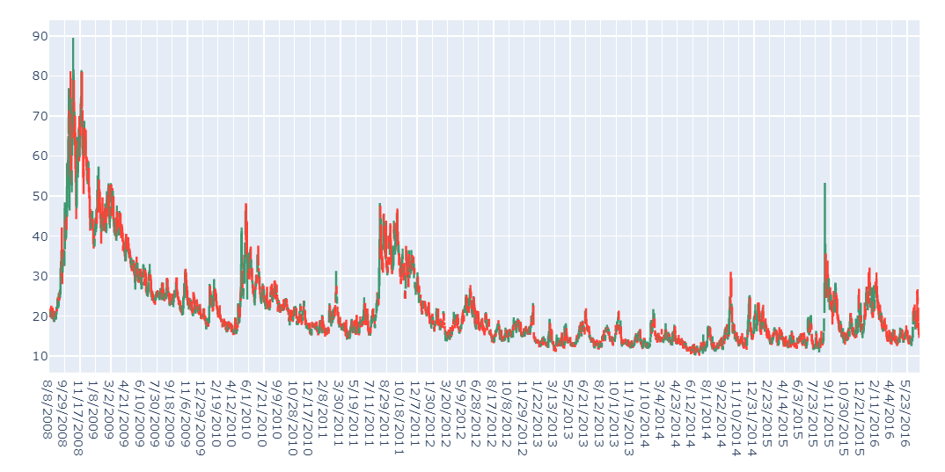
Candlesticks

Slide 8
VIX Price (Y – Variables)
Vix Historical data : VIX data for 2004 to 2020
Source : http://www.cboe.com/products/vix-index-volatility/vix-options-and-futures/vix-index/vix-historical-data

Slide 9
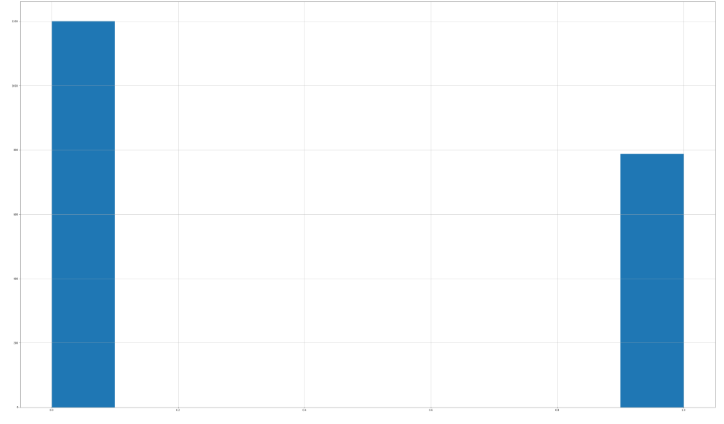
VIX Price (Y – Variables)

Slide 10
1st part
Create a modelling to predict if the VIX is going to go up or down on that day itself.

Slide 11
Preprocessing and Train Test Split
Text preprocessing - remove punctuation, stopwords and malformed words, lowercase, lemmatize and finally tokenize words
Train Test Split - Randomly shuffled and split the processed data into 80% training and 20% test set.

Slide 12
Modelling
Create Model for training - we defined these models:
Logistic Regression with CountVectorizer
Logistic Regression with TFID
Naive Bayes with TFID
Random Forest with TFID
3 layers of Stacked LSTM
LSTM with Convolutional Neural Network for Sequence Classification

Slide 13
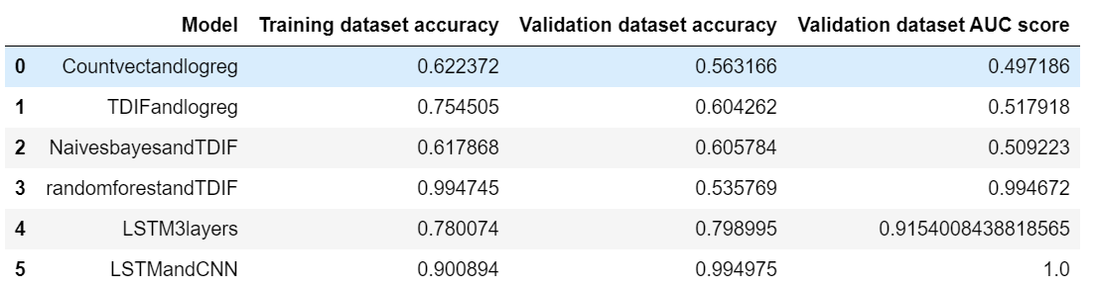
Modelling Results

Slide 14
2nd model
Create a sentiment tool for traders to indicate how bad is the price on that day.

Slide 15
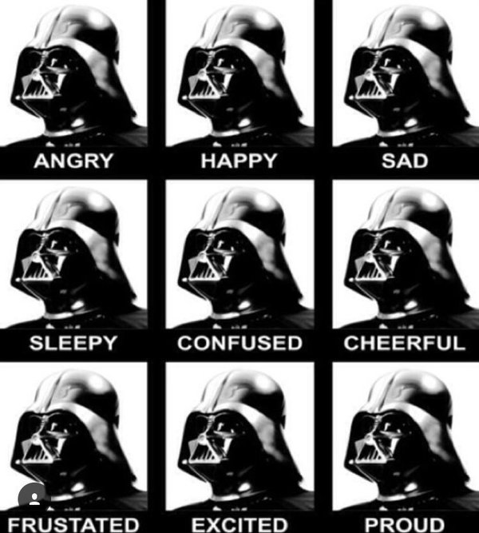
Vader Sentiment Analysis

Slide 16
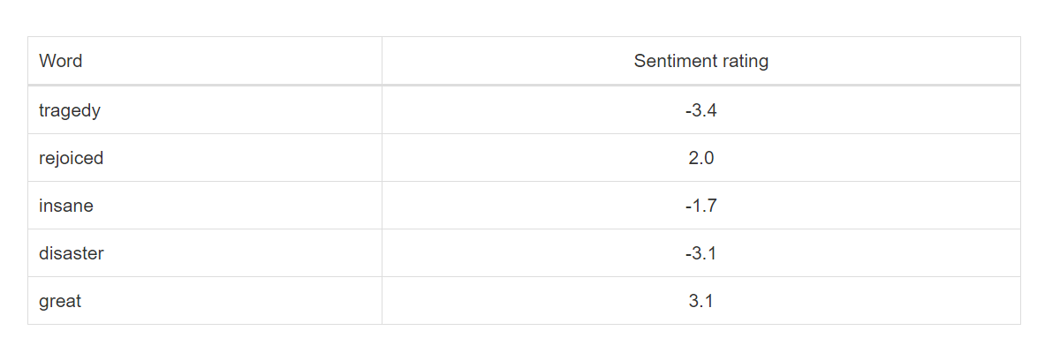
Vader Sentiment Rating

Slide 17
Why Vader
Advantages of using VADER
VADER has a lot of advantages over traditional methods of Sentiment Analysis, including:
It works exceedingly well on social media type text, yet readily generalizes to multiple domains
It doesn’t require any training data but is constructed from a generalizable, valence-based, human-curated gold standard sentiment lexicon
It is fast enough to be used online with streaming data, and
It does not severely suffer from a speed-performance tradeoff

Slide 18

Text blob

Slide 19
Textblob
TextBlob is a Python (2 and 3) library for processing textual data. It a simple API for diving into common natural language proprovidescessing (NLP) tasks such as part-of-speech tagging, noun phrase extraction, sentiment analysis, classification, translation, and more.

Slide 20
Sample of Textblob
>>> testimonial = TextBlob("Textblob is amazingly simple to use. What great fun!")
>>> testimonial.sentiment
Sentiment(polarity=0.39166666666666666, subjectivity=0.4357142857142857)
>>> testimonial.sentiment.polarity
0.39166666666666666

Slide 21
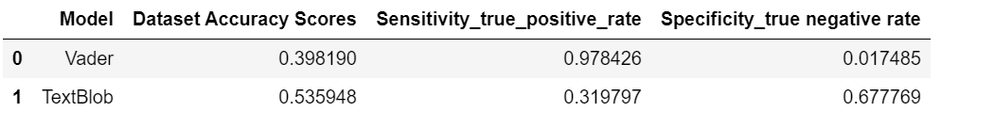
Textblob Modelling
Text Blob has better accuracy than Vader however Vader perform better at predicting Vix when price goes up and Text Blob is better at predicting vix when prices goes down.

