Slide 1
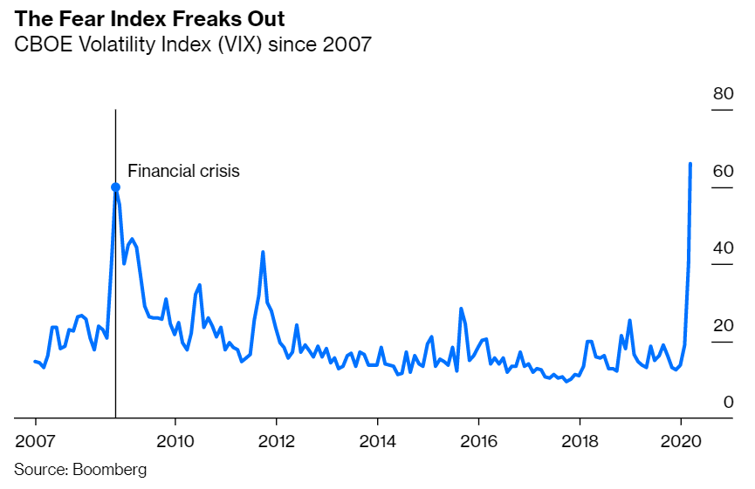

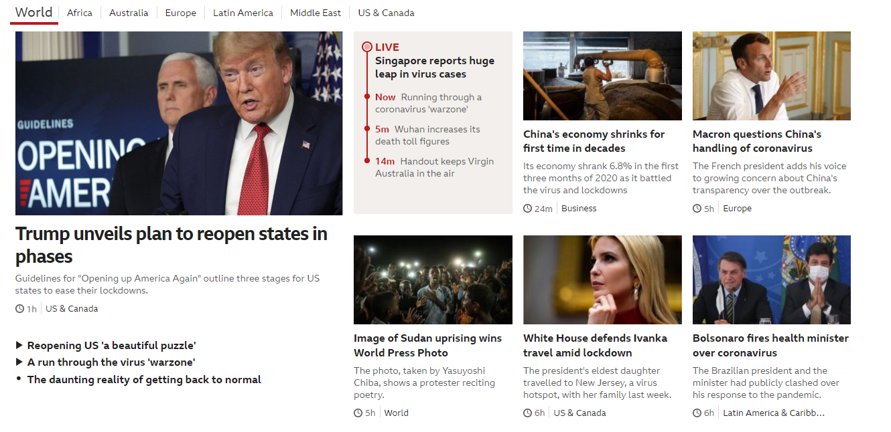
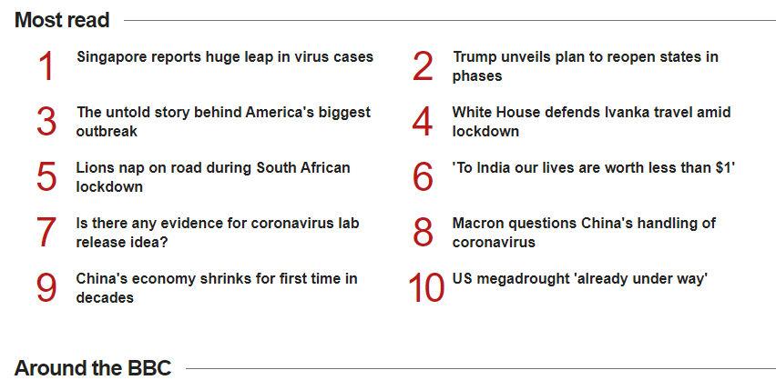

Fear Index

Slide 2
Problem statement :
To create a sentiment analysis estimator tools for traders using news headlines based on VIX (Fear index) via Google Chrome Extension.
We will be using sentiment reviews on our news headlines to predict the volatility of VIX.

Slide 3
Reddit News (X Variables)
Historical news headlines from Reddit WorldNews Channel (/r/worldnews). They are ranked by reddit users' votes, and only the top 25 headlines are considered for a single date. (Range: 2008-06-08 to 2016-07-01)
All news are ranked from top to bottom based on how hot they are.Hence, there are 25 lines for each date. The first column is "Date", the second is "Label", and the following ones are news headlines ranging from "Top1" to "Top25".
Link : https://www.kaggle.com/aaron7sun/stocknews

Slide 4
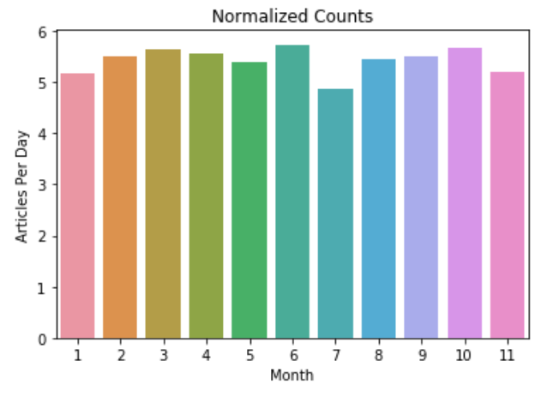
Reddit News

Slide 5
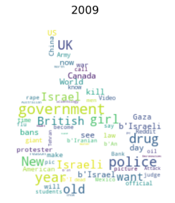
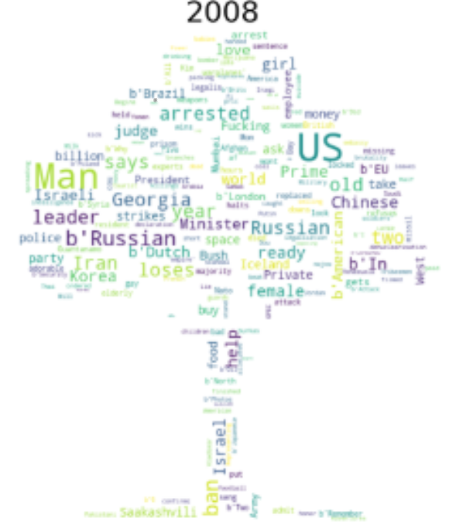
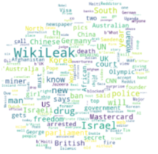
Year 2008 to 2010

Slide 6

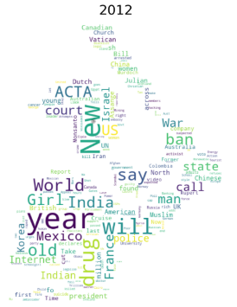
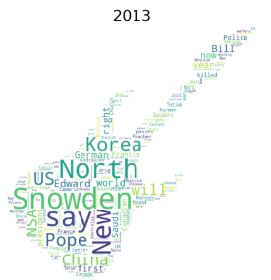
Year 2011 to 2013

Slide 7


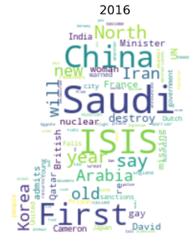
Year 2014 to 2016

Slide 8
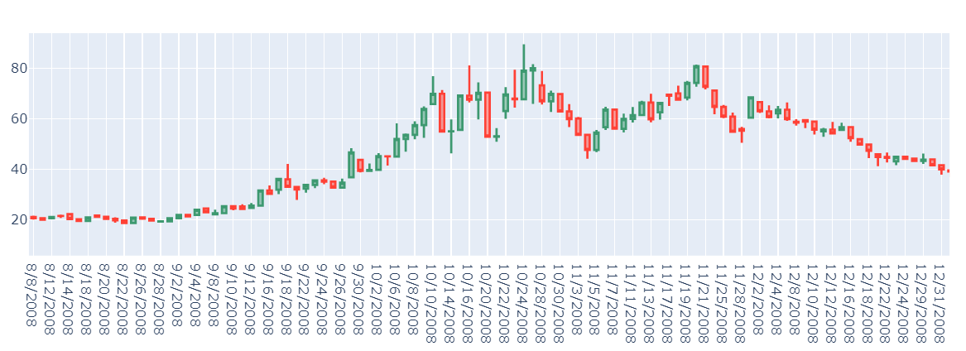
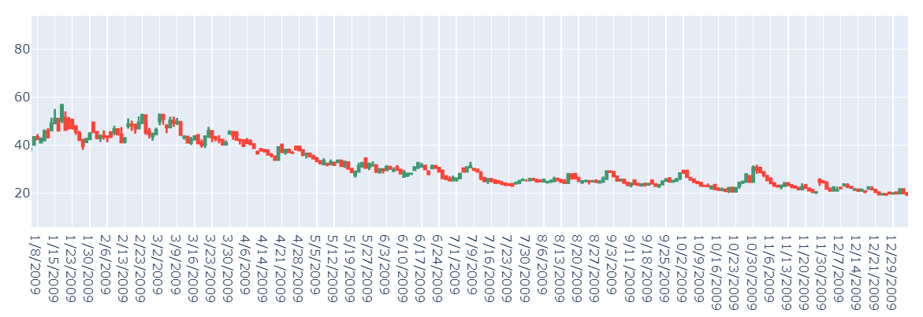
Candlesticks
2008 : US , Man, Georgia, Russian, leader
2009 : Israel, police, drug, British, goverment

Slide 9
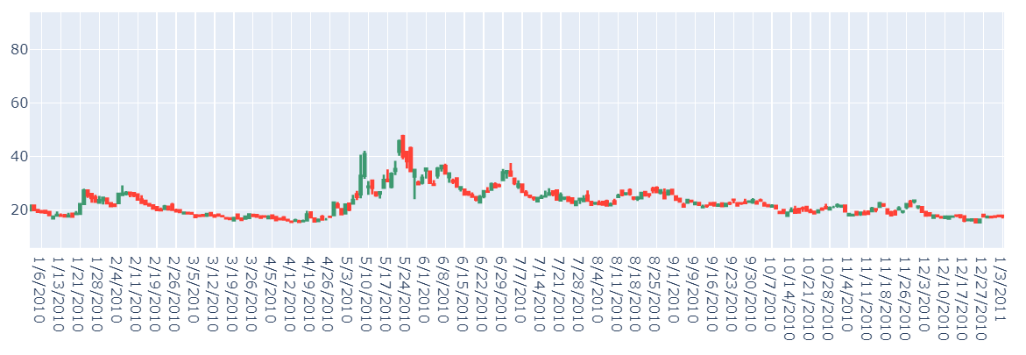
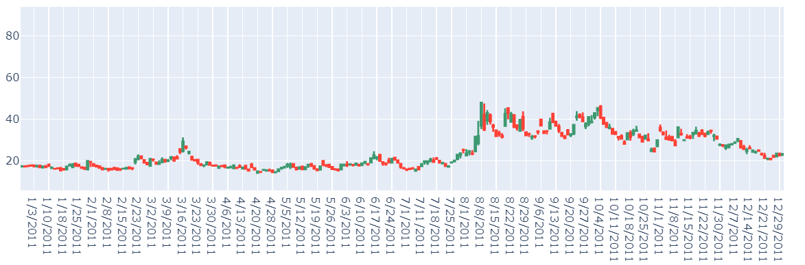
Candlesticks
2010 : Wikileaks, Israel, Korea, Chinese, Australian
2011 : Police, Egypt, Japan, US, Wikileaks

Slide 10
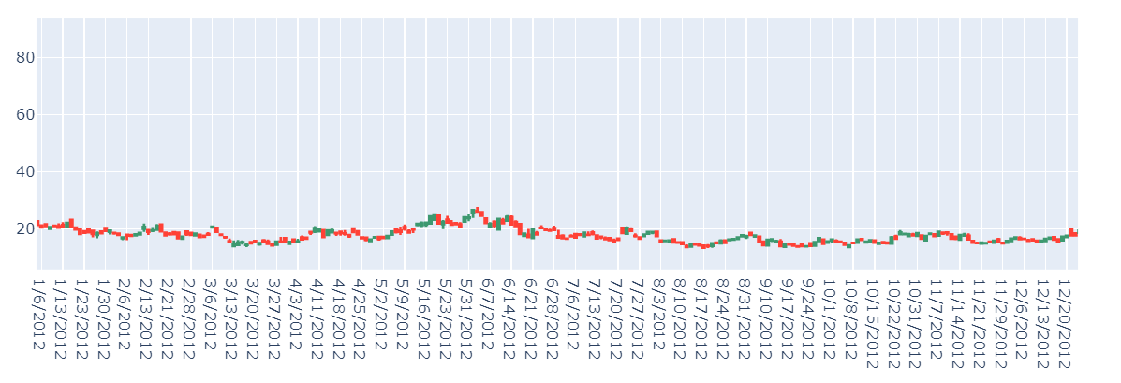
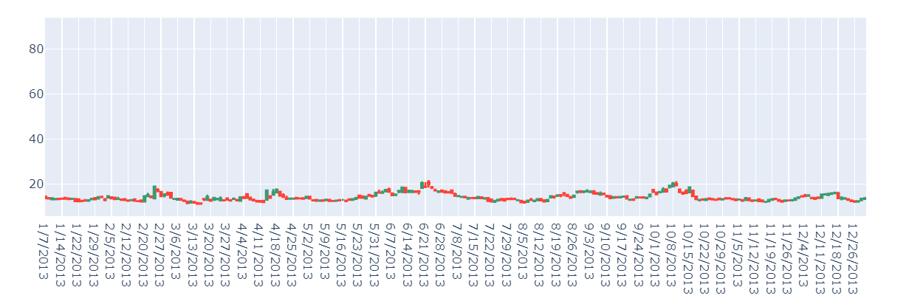
2012 : India, Girl, World, ACTA, Drug
2013 : Snowden, say, New, North, Korea

Slide 11
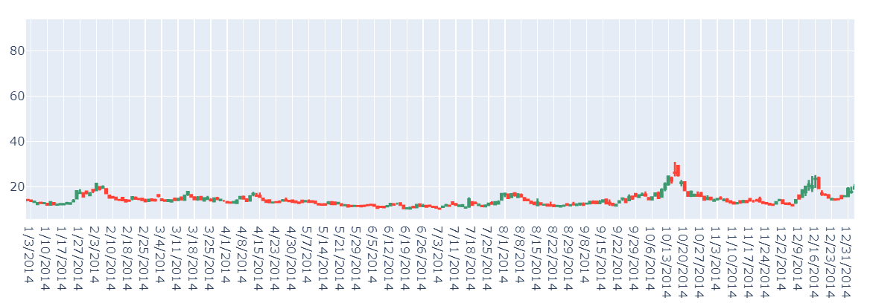
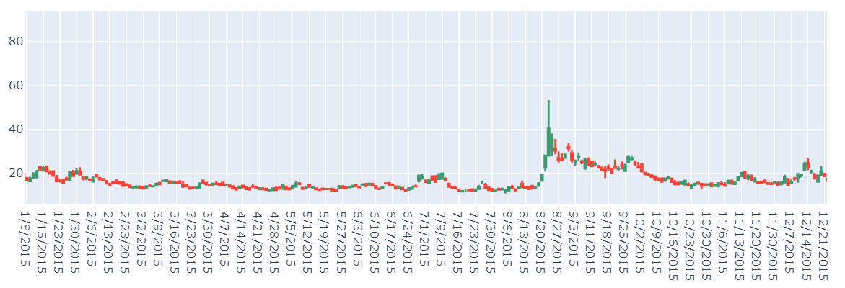
2014 : government, Russia, World, Ukraine, police
2015 : ISIS, Saudi, UK, India, ban

Slide 12
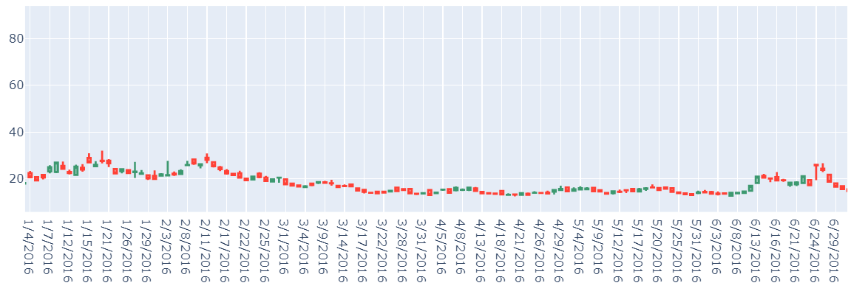
2016
2016 : Saudi, China, ISIS, Iran,Korea

Slide 13
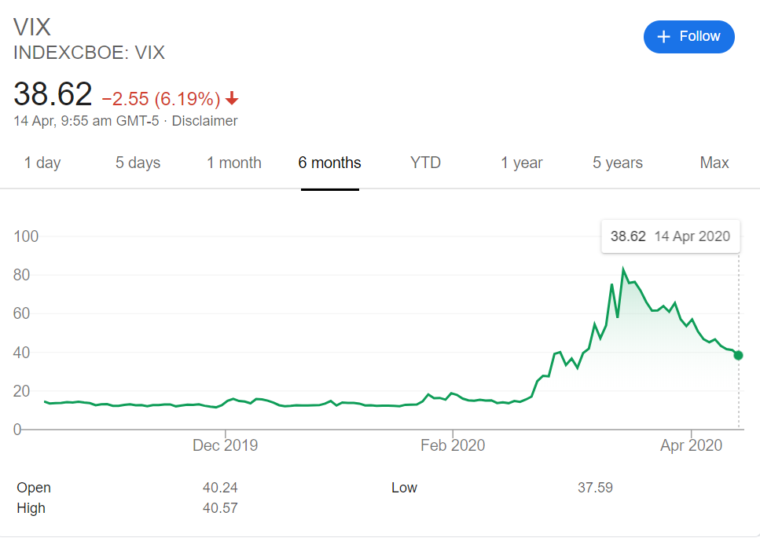

Slide 14
VIX Price (Y – Variables)
Vix Historical data : VIX data for 2004 to 2020
Source : http://www.cboe.com/products/vix-index-volatility/vix-options-and-futures/vix-index/vix-historical-data

Slide 15
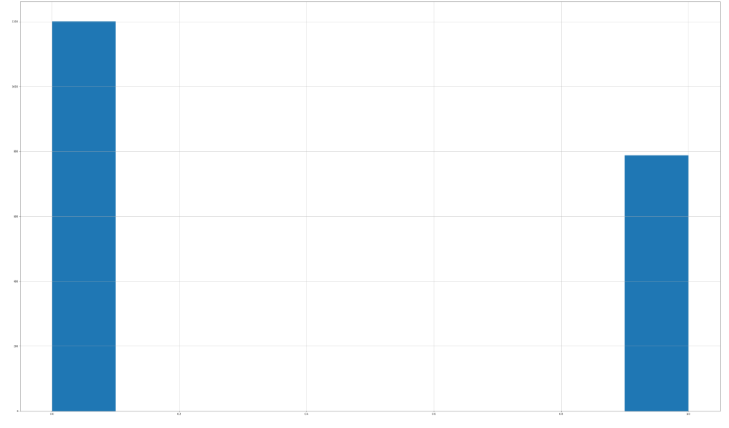
VIX Price (Y – Variables)

Slide 16
1st part
Create a modelling to predict if the VIX is going to go up or down on that day itself.

Slide 17
Preprocessing and Train Test Split
Text preprocessing - remove punctuation, stopwords and malformed words, lowercase, lemmatize and finally tokenize words
Train Test Split - Randomly shuffled and split the processed data into 80% training and 20% test set.

Slide 18
Modelling
Create Model for training - we defined these models:
Logistic Regression with CountVectorizer
Logistic Regression with TFID
Naive Bayes with TFID
Random Forest with TFID
3 layers of Stacked LSTM
LSTM with Convolutional Neural Network for Sequence Classification

Slide 19
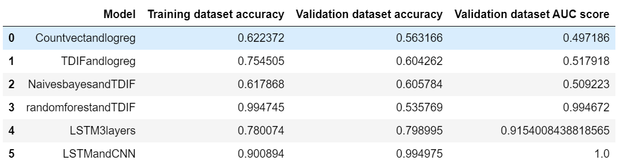
Modelling Results

Slide 20
2nd model
Create a sentiment tool for traders to indicate how bad is the price on that day.

Slide 21
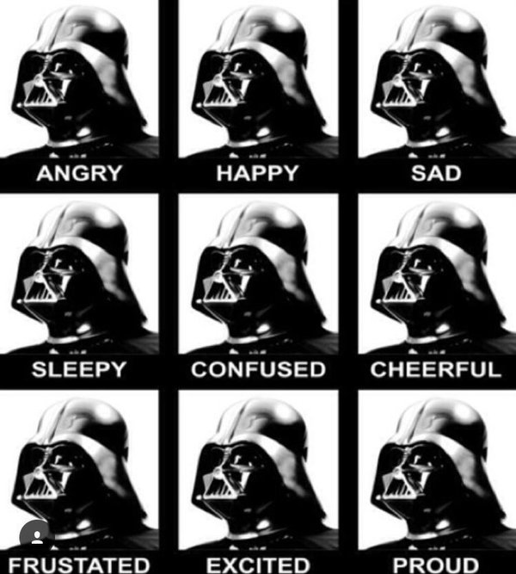
Vader Sentiment Analysis

Slide 22
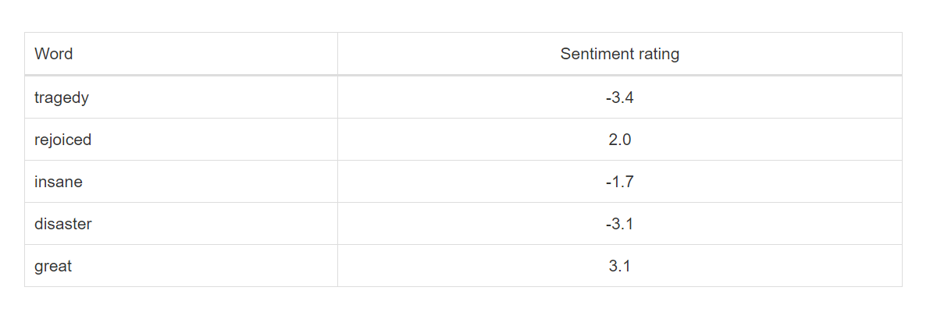
Vader Sentiment Rating

Slide 23
Why Vader
Advantages of using VADER
VADER has a lot of advantages over traditional methods of Sentiment Analysis, including:
It works exceedingly well on social media type text, yet readily generalizes to multiple domains
It doesn’t require any training data but is constructed from a generalizable, valence-based, human-curated gold standard sentiment lexicon
It is fast enough to be used online with streaming data, and
It does not severely suffer from a speed-performance tradeoff

Slide 24

Text blob

Slide 25
Textblob
TextBlob is a Python (2 and 3) library for processing textual data. It a simple API for diving into common natural language proprovidescessing (NLP) tasks such as part-of-speech tagging, noun phrase extraction, sentiment analysis, classification, translation, and more.

Slide 26
Sample of Textblob
>>> testimonial = TextBlob("Textblob is amazingly simple to use. What great fun!")
>>> testimonial.sentiment
Sentiment(polarity=0.39166666666666666, subjectivity=0.4357142857142857)
>>> testimonial.sentiment.polarity
0.39166666666666666

Slide 27
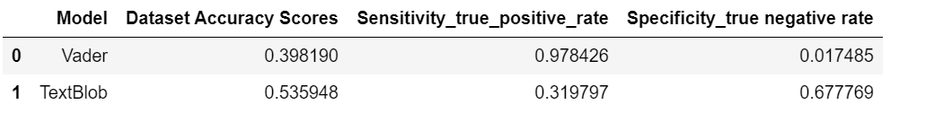
Textblob Modelling
Text Blob has better accuracy than Vader however Vader perform better at predicting Vix when price goes up and Text Blob is better at predicting vix when prices goes down.

