Slide 1
Chapter 27 - Java Object-Oriented Programming
Outline
27.1 Introduction
27.2 Superclasses and Subclasses
27.3 protected Members
27.4 Relationship between Superclass Objects and Subclass Objects
27.5 Implicit Subclass-Object-to-Superclass-Object Conversion
27.6 Software Engineering with Inheritance
27.7 Composition vs. Inheritance
27.8 Introduction to Polymorphism
27.9 Type Fields and switch Statements
27.10 Dynamic Method Binding
27.11 final Methods and Classes
27.12 Abstract Superclasses and Concrete Classes
27.13 Polymorphism Example
27.14 New Classes and Dynamic Binding
27.15 Case Study: Inheriting Interface and Implementation
27.16 Case Study: Creating and Using Interfaces
27.17 Inner Class Definitions
27.18 Notes on Inner Class Definitions
27.19 Type-Wrapper Classes for Primitive Classes

Slide 2
Objectives
In this chapter, you will learn:
  To understand inheritance and software reusability.
  To understand superclasses and subclasses.
  To appreciate how polymorphism makes systems extensible and maintainable.
  To understand the distinction between abstract classes and concrete classes.
  To learn how to create abstract classes and interfaces.

Slide 3
27.1 Introduction
Object-Oriented Programming (OOP)
  Inheritance - form of software reusability
    New classes created from existing ones
      Absorb attributes and behaviors, and add in their own
    Subclass inherits from superclass
      Direct superclass - subclass explicitly inherits
      Indirect superclass - subclass inherits from two or more levels up the class hierarchy
  Polymorphism
    Write programs in a general fashion to handle a wide variety of classes

Slide 4
27.1 Introduction
Object-Oriented Programming
  Introduce protected member access
    Subclass methods and methods of other classes in the same package can access protected superclass members.
  Abstraction - Seeing the big picture
  Relationships
    "is a" - inheritance
      Object of subclass "is an" object of the superclass
    "has a" - composition
      Object "has an" object of another class as a member

Slide 5
27.1 Introduction
Object-Oriented Programming
  A subclass cannot directly access private members of its superclass.
  Class libraries
    Someday software may be constructed from standardized, reusable components (like hardware)
    Create more powerful software

Slide 6
27.2 Superclasses and Subclasses
Inheritance example
  A rectangle "is a" quadrilateral
    Rectangle is a specific type of quadrilateral
    Quadrilateral is the superclass, rectangle is the subclass
    Incorrect to say quadrilateral "is a" rectangle
  Naming can be confusing because subclass has more features than superclass
    Subclass more specific than superclass
    Every subclass "is an" object of its superclass, but not vice-versa

Slide 7
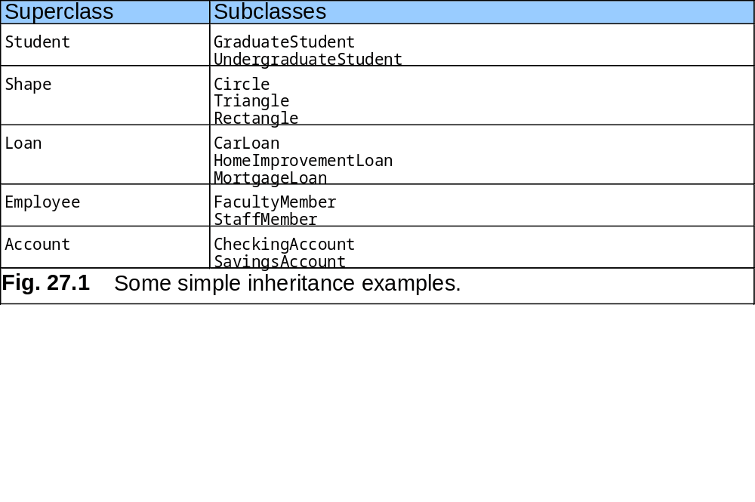
27.2 Superclasses and Subclasses

Slide 8
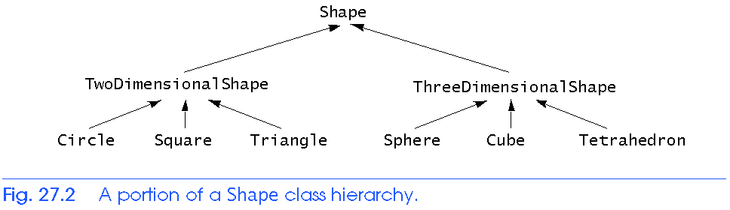
27.2 Superclasses and Subclasses
  Form tree-like hierarchal structures
    Create a hierarchy for class Shape

Slide 9
27.2 Superclasses and Subclasses
Using inheritance
  Use keyword extends
  class TwoDimensionalShape extends Shape{ ... }
  private members of superclass not directly accessible to subclass
  All other variables keep their member access

Slide 10
27.3 protected Members
In a superclass
  public members
    Accessible anywhere program has a reference to a superclass or subclass type
  private members
    Accessible only in methods of the superclass
  protected members
    Intermediate protection between private and public
    Only accessible by methods of superclass, of subclass, or classes in the same package
Subclass methods
  Can refer to public or protected members by name
  Overridden methods accessible with super.methodName

Slide 11
27.4 Relationship between Superclass Objects and Subclass Objects
Object of subclass
  Can be treated as object of superclass
    Reverse not true
  Suppose many classes inherit from one superclass
    Can make an array of superclass references
    Treat all objects like superclass objects
  Explicit cast
    Convert superclass reference to a subclass reference (downcasting)
    Can only be done when superclass reference actually referring to a subclass object

Slide 12
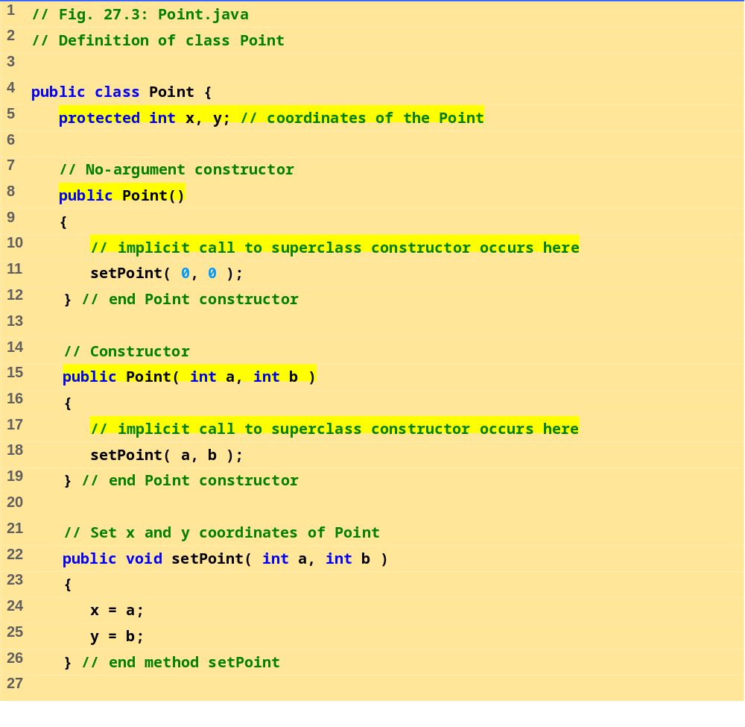
Point.java (1 of 2)

Slide 13
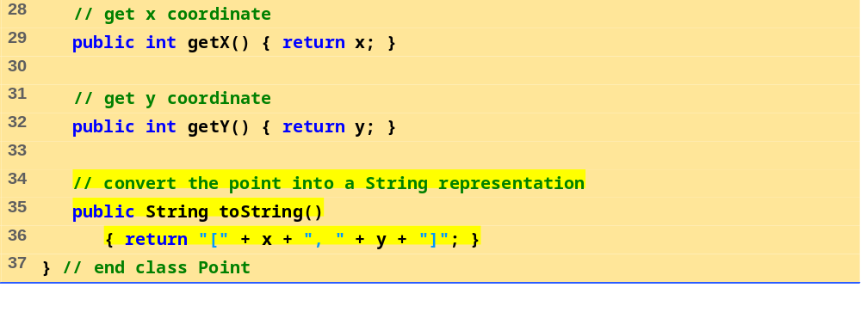
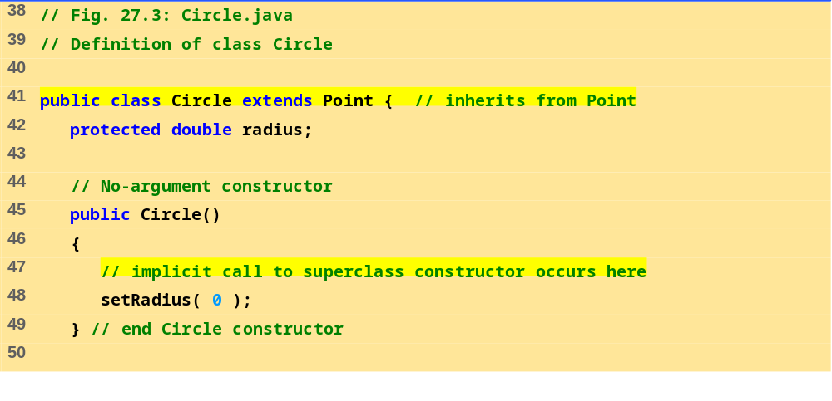
Point.java (2 of 2)
Circle.java (1 of 2)

Slide 14
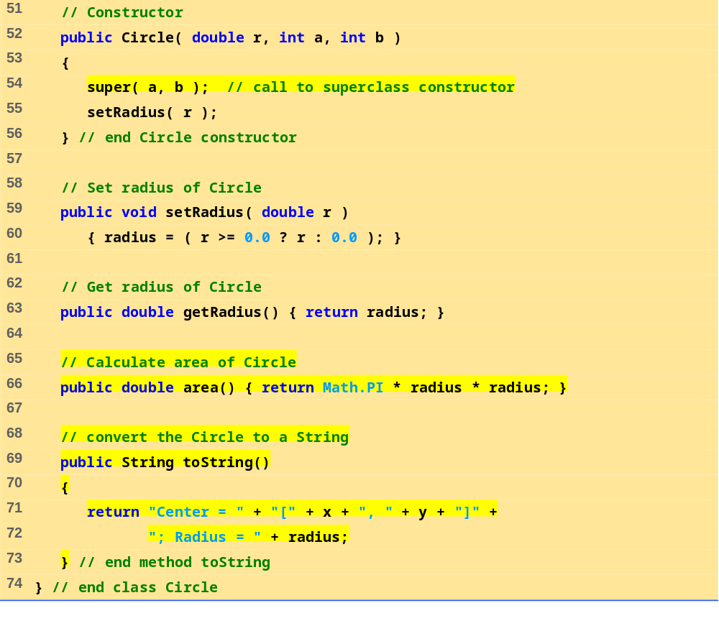
Circle.java (2 of 2)

Slide 15
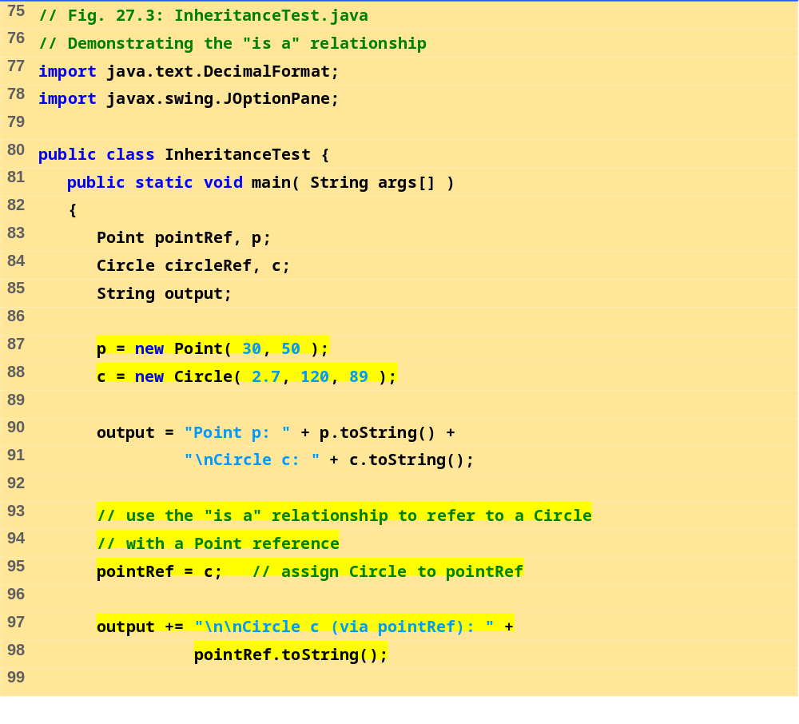
InheritanceTest.java
(1 of 2)

Slide 16
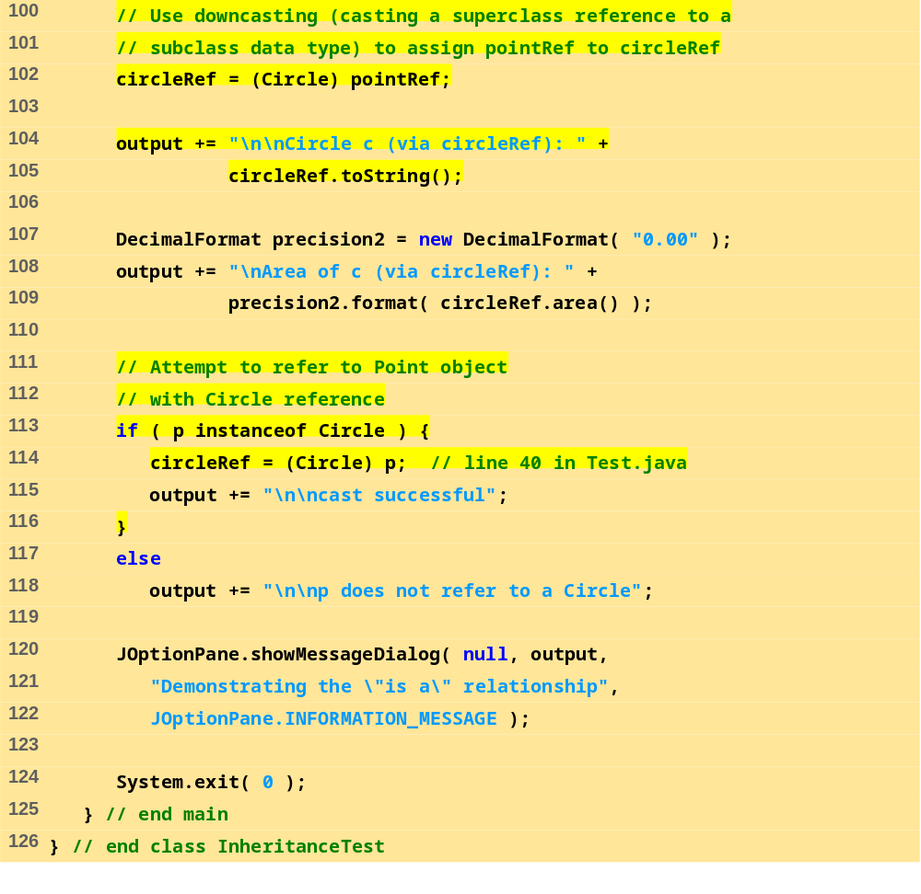
InheritanceTest.java
(2 of 2)

Slide 17
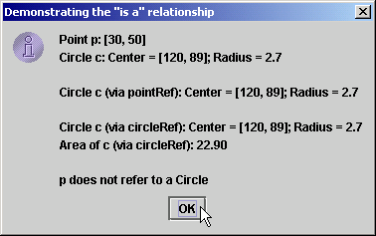
27.4 Relationship between Superclass Objects and Subclass Objects
Figure 27.3 Assigning subclass references to superclass references - InheritanceTest.java

Slide 18
27.4 Relationship between Superclass Objects and Subclass Objects
Extending a class
  To invoke superclass constructor explicitly (called implicitly by default)
    super(); //can pass arguments if needed
    If called explicitly, must be first statement
Overriding methods
  Subclass can redefine superclass method
    When method mentioned in subclass, subclass version called
    Access original superclass method with super.methodName

Slide 19
27.4 Relationship between Superclass Objects and Subclass Objects
Every Applet has used these techniques
  Java implicitly uses class Object as superclass for all classes
  We have overridden init and paint when we extended JApplet
instanceof operator
  if (p instanceof Circle)
  Returns true if the object to which p points "is a" Circle

Slide 20
27.5 Implicit Subclass-Object-to-Superclass-Object Conversion
References to subclass objects
  May be implicitly converted to superclass references
    Makes sense - subclass contains members corresponding to those of superclass
  Referring to a subclass object with a superclass reference
    Allowed - a subclass object "is a" superclass object
    Can only refer to superclass members
  Referring to a superclass object with a subclass reference
    Error
    Must first be cast to a superclass reference
  Need way to use superclass references but call subclass methods
    Discussed later in the chapter

Slide 21
27.6 Software Engineering with Inheritance
Inheritance
  Customize existing software
    Create a new class, add attributes and behaviors as needed
Software reuse key to large-scale projects
  Java and OOP does this
  Availability of class libraries and inheritance
Superclass
  Specifies commonality
  Look for commonality among a set of classes
    "Factor it out" to form the superclass
  Subclasses are then customized

Slide 22
27.7 Composition vs. Inheritance
"is a" relationship
  Inheritance
"has a" relationship
  Composition, having other objects as members
Example
Employee “is a” BirthDate; //Wrong!
Employee “has a” BirthDate; //Composition

Slide 23
27.8 Introduction to Polymorphism
With polymorphism
  Design and implement extensible programs
  Generically process superclass objects
  Easy to add classes to hierarchy
    Little or no modification required
    Only parts of program that need direct knowledge of new class must be changed

Slide 24
27.9 Type Fields and switch Statements
switch statements
  Can be used to deal with many objects of different types
    Appropriate action based on type
Problems
  Programmer may forget to include a type
  Might forget to test all possible cases
  Every addition/deletion of a class requires all switch statements to be changed
    Tracking all these changes is time consuming and error prone
  Polymorphic programming can eliminate the need for switch logic
    Avoids all these problems

Slide 25
27.10 Dynamic Method Binding
Dynamic Method Binding
  At execution time, method calls routed to appropriate version
Example
  Circle, Triangle, Rectangle and Square all subclasses of Shape
    Each has an overridden draw method
  Call draw using superclass references
    At execution time, program determines to which class the reference is actually pointing
    Calls appropriate draw method

Slide 26
27.11 final Methods and Classes
Defining variables final
  Indicates they cannot be modified after definition
  Must be initialized when defined
Defining methods final
  Cannot be overridden in a subclass
  static and private methods are implicitly final
  Program can inline final methods
    Actually inserts method code at method call locations
    Improves program performance
Defining classes final
  Cannot be a superclass (cannot inherit from it)
  All methods in class are implicitly final

Slide 27
27.12 Abstract Superclasses and Concrete Classes
Abstract classes (abstract superclasses)
  Contain one or more abstract methods
  Cannot be instantiated
    Causes syntax error
    Can still have instance data and non-abstract methods
    Can still define constructor
  Sole purpose is to be a superclass
    Other classes inherit from it
  Too generic to define real objects
  Declare class with keyword abstract

Slide 28
27.12 Abstract Superclasses and Concrete Classes
Concrete class
  Can instantiate objects
  Provide specifics
Class hierarchies
  Most general classes are usually abstract
    TwoDimensionalShape - too generic to be concrete

Slide 29
27.13 Polymorphism Example
Class Quadrilateral
  Rectangle "is a" Quadrilateral
  getPerimeter method can be performed on any subclass
    Square, Parallelogram, Trapezoid
    Same method takes on "many forms" - polymorphism
  Can method is called with superclass reference
    Java chooses correct overriden method
References
  Can create references to abstract classes

Slide 30
27.13 Polymorphism Example
Iterator classes
  Walks through all the objects in a container (such as an array)
  Used in polymorphic programming
    Walk through an array of superclass references
    Call draw method for each reference

Slide 31
27.14 New Classes and Dynamic Binding
Dynamic binding (late binding)
  Accommodates new classes
  Object's type does not need to be known at compile time
  At execution time, method call matched with object

Slide 32
27.15 Case Study: Inheriting Interface and Implementation
Polymorphism example
  abstract superclass Shape
    Subclasses Point, Circle, Cylinder
    abstract method
      getName
    non-abstract methods
      area (return 0.0)
      volume (return 0.0)
  Class Shape used to define a set of common methods
    Interface is the three common methods
    Implementation of area and volume used for first levels of hierarchy
  Create an array of Shape references
    Point them to various subclass objects
    Call methods through the Shape reference

Slide 33
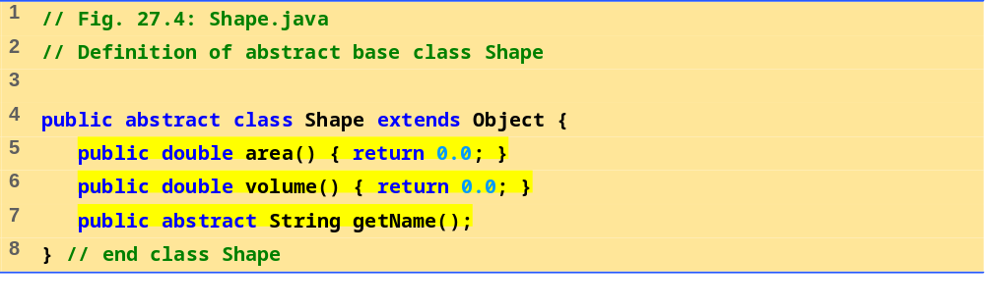
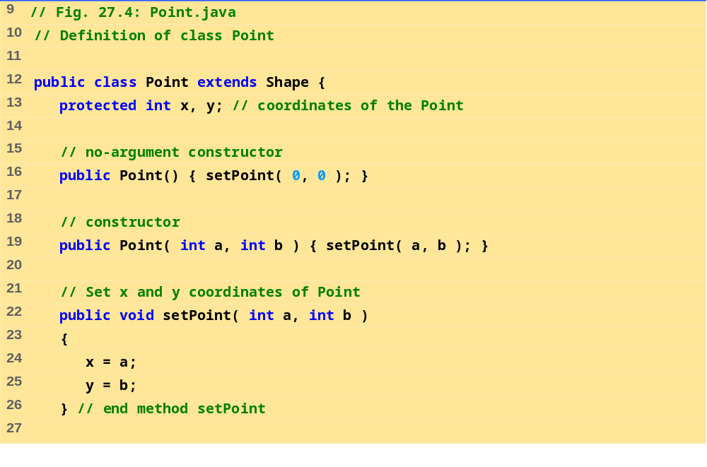
Shape.java
Point.java (1 of 2)

Slide 34
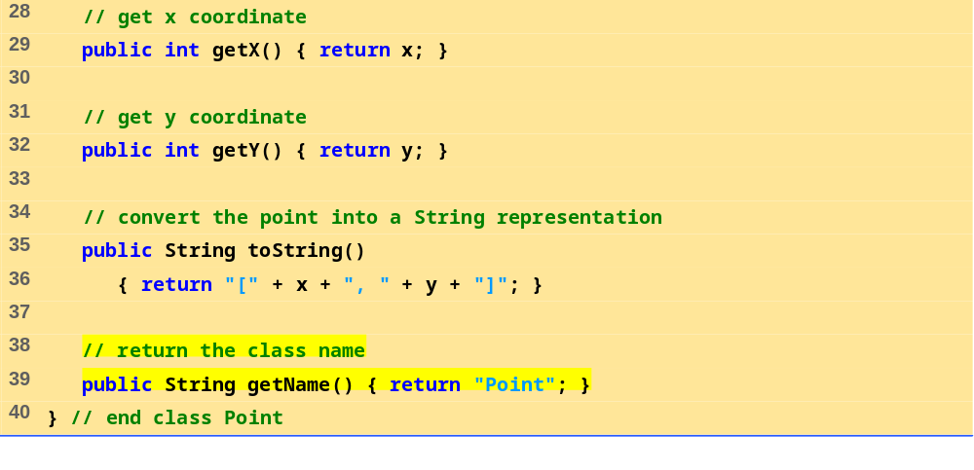
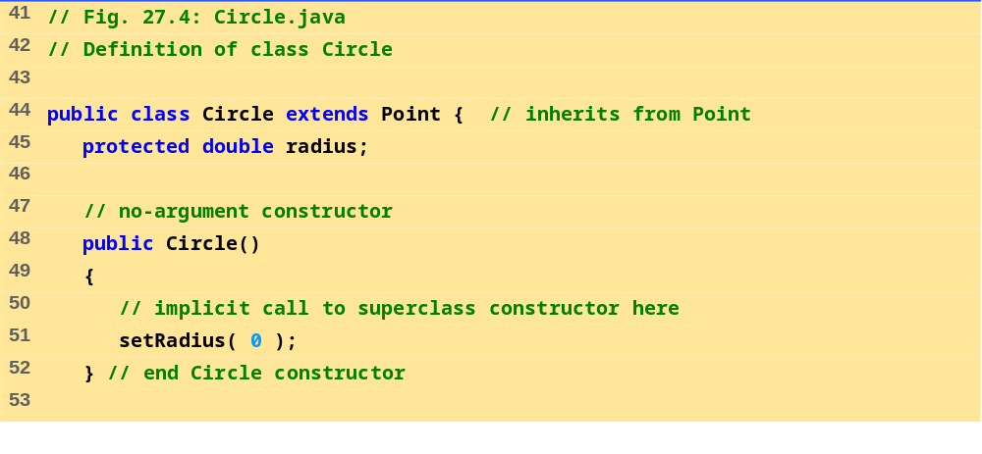
Point.java (2 of 2)
Circle.java (1 of 2)

Slide 35
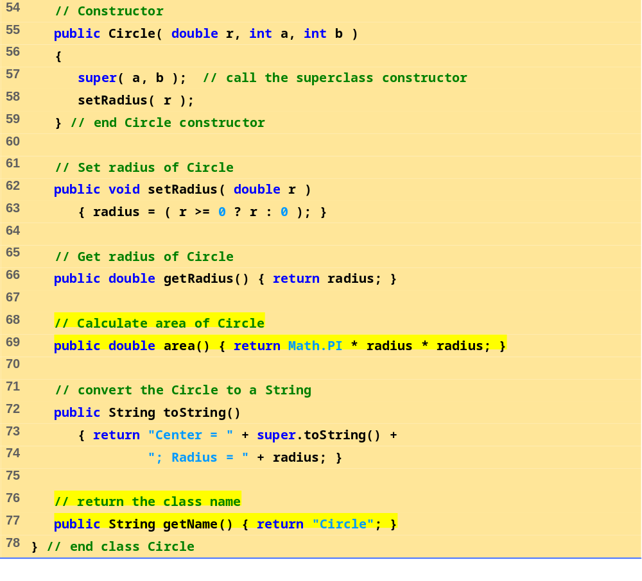
Circle.java (2 of 2)

Slide 36
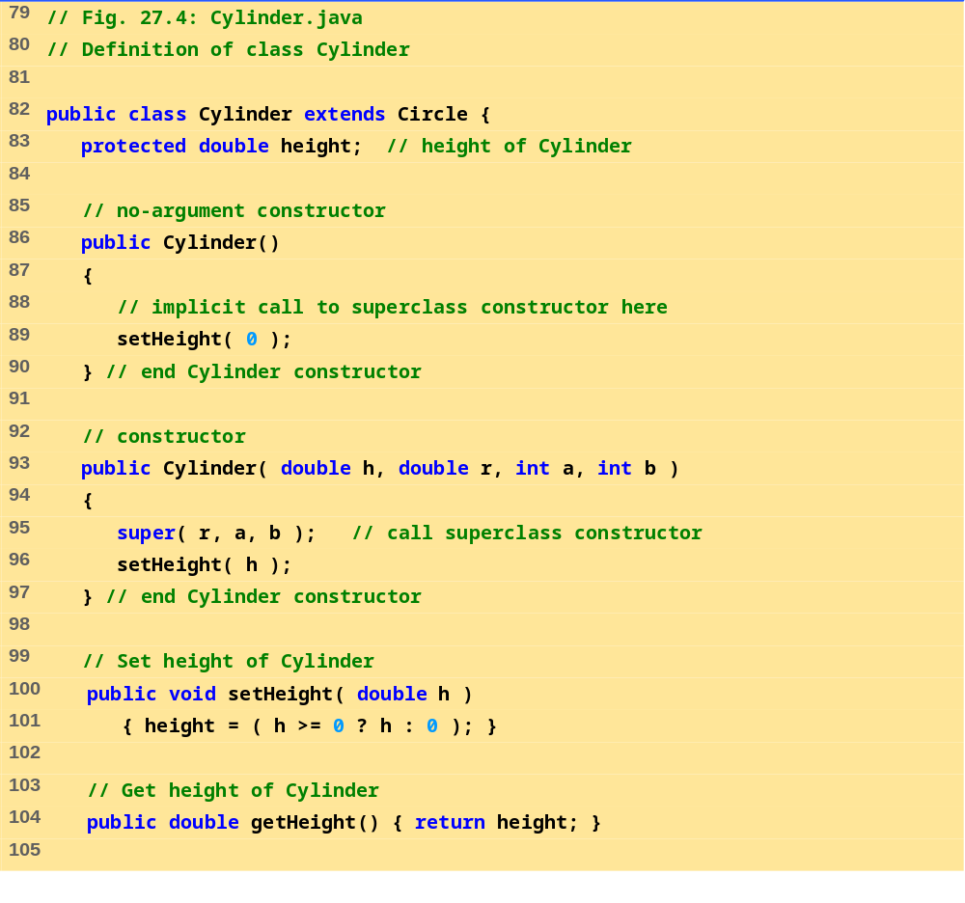
Cylinder.java (1 of 2)

Slide 37
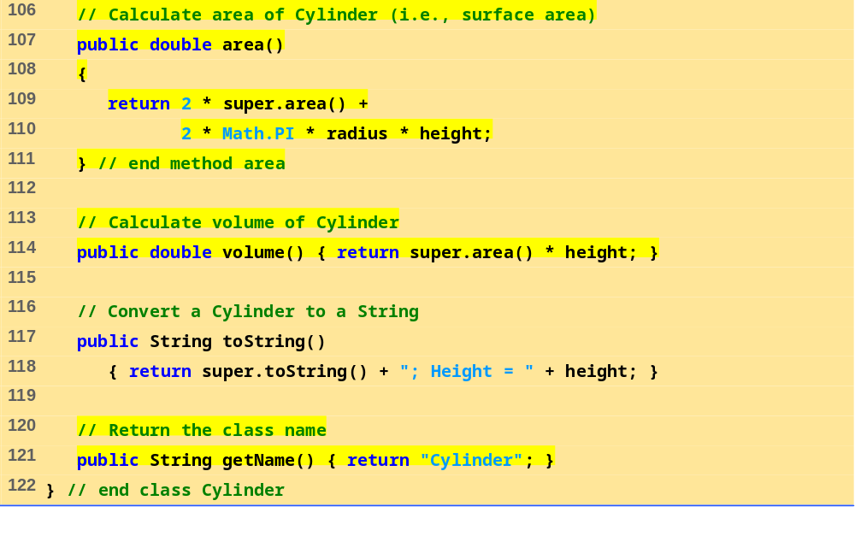
Cylinder.java (2 of 2)

Slide 38
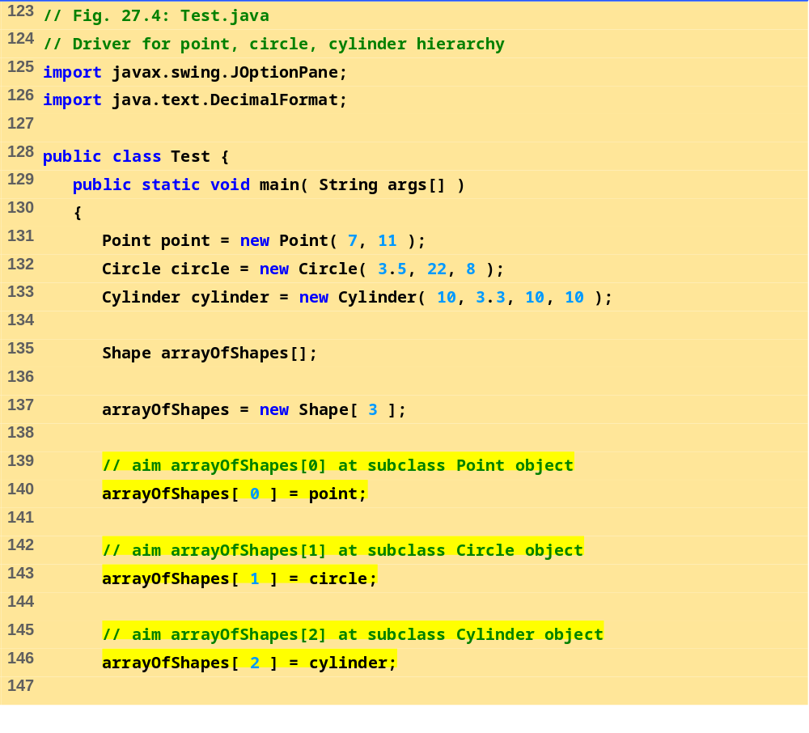
Test.java (1 of 2)

Slide 39
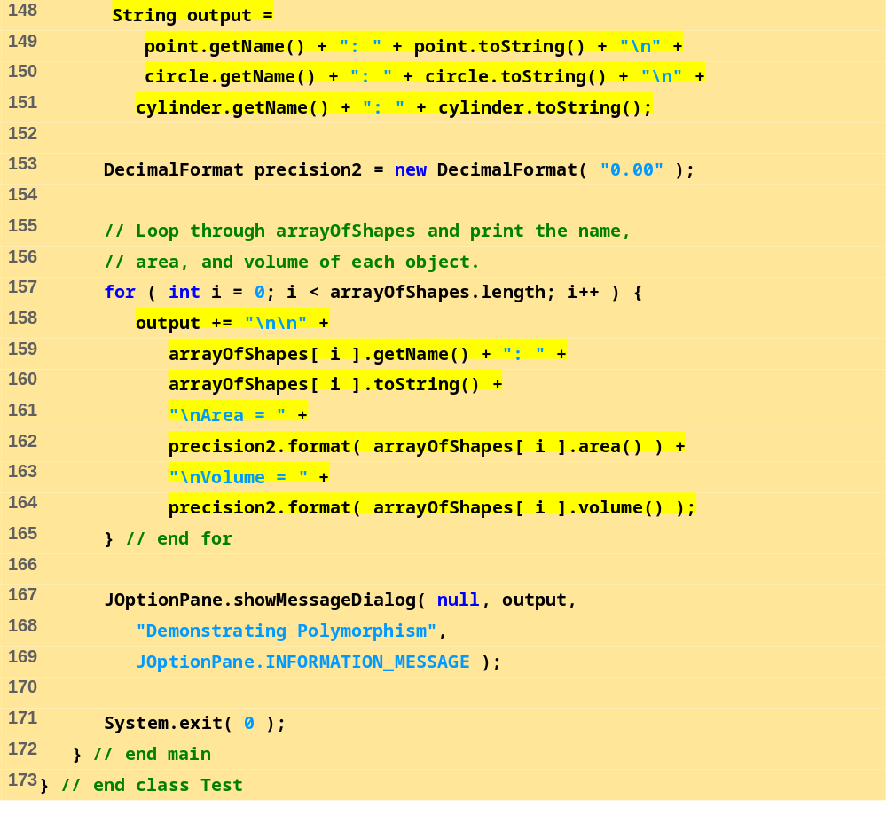
Test.java (2 of 2)

Slide 40
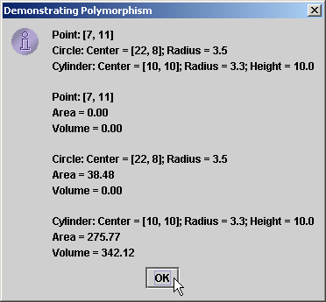
27.15 Case Study: Inheriting Interface and Implementation
Figure 27.4 Shape, point, circle, cylinder hierarchy - Test.java

Slide 41
27.16 Case Study: Creating and Using Interfaces
Creating an interface
  Keyword interface
  Has set of public abstract methods
  Can contain public final static data
Using interfaces
  Class specifies it uses interface with keyword implements
  Class must define all abstract methods in interface
    Must use same number of arguments, same return type
  Using interface like signing a contract
    "I will define all methods specified in the interface"

Slide 42
27.16 Case Study: Creating and Using Interfaces
Using interfaces (continued)
  Interfaces used in place of abstract classes
    Used when no default implementation
  Typically public data types
    Interface defined in its own .java file
    Interface name same as file name
  Same "is a" relationship as inheritance
Reexamine previous hierarchy
  Replace abstract class Shape with interface Shape

Slide 43
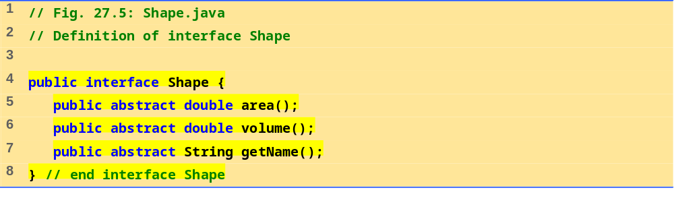
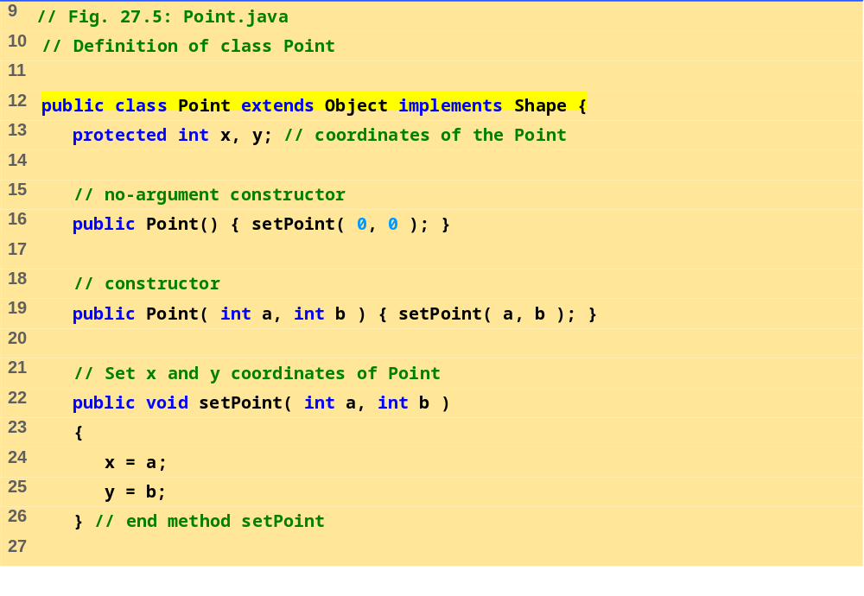
Shape.java
Point.java (1 of 2)

Slide 44
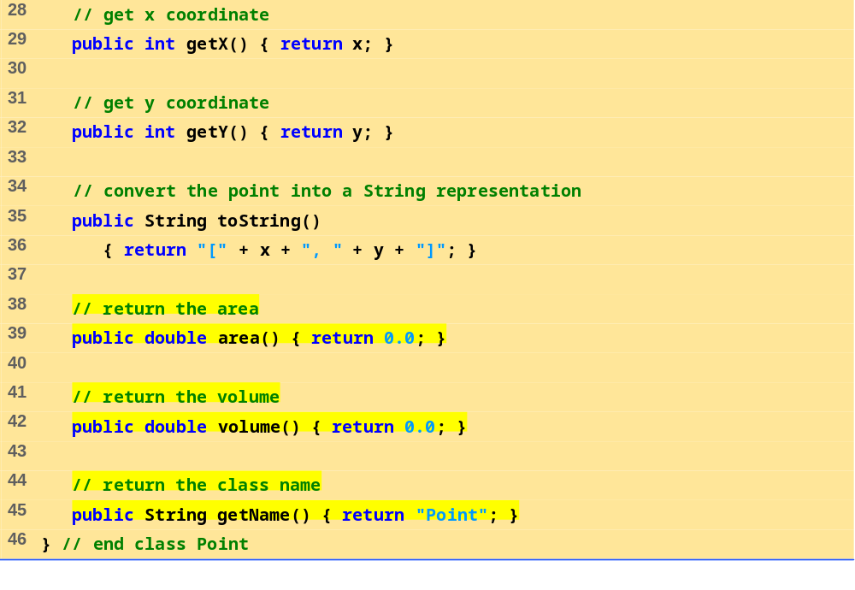
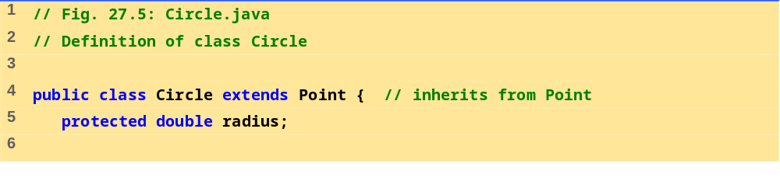
Point.java (2 of 2)
Circle.java (1 of 3)

Slide 45
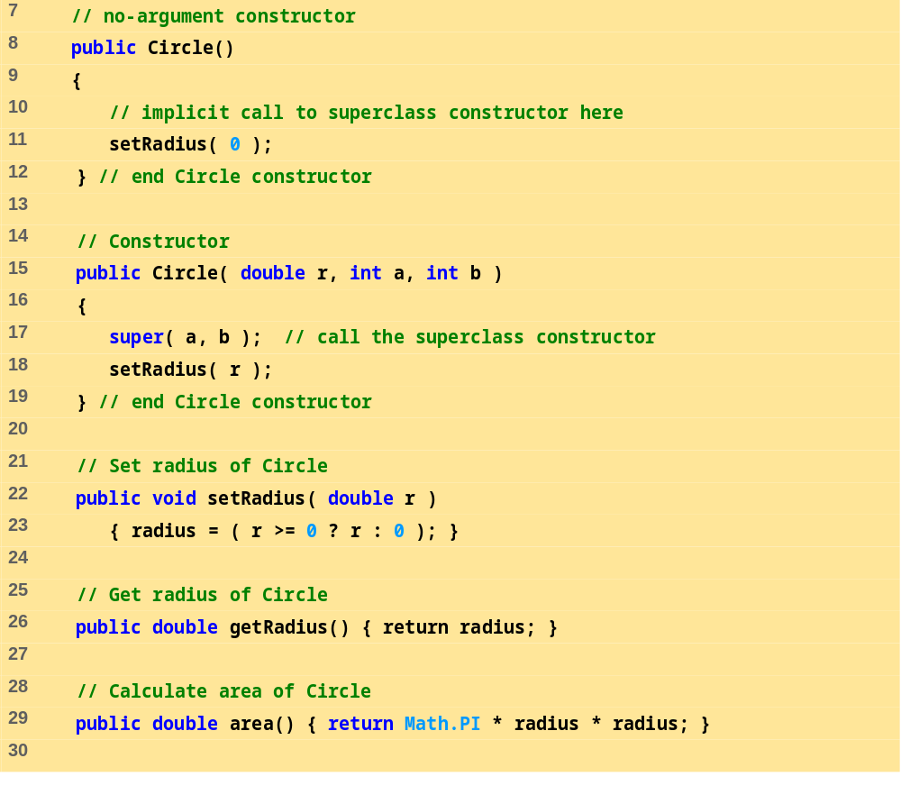
Circle.java (2 of 3)

Slide 46
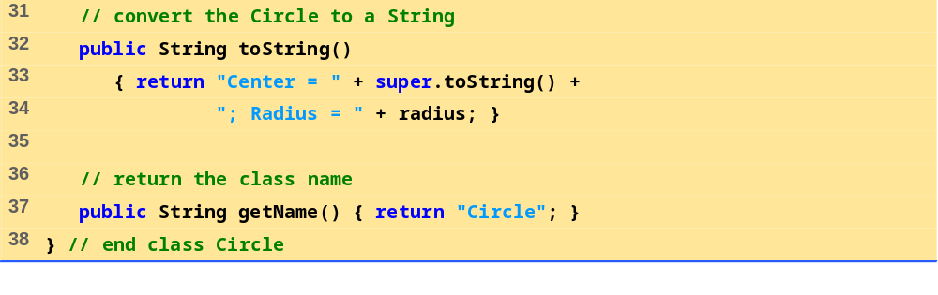
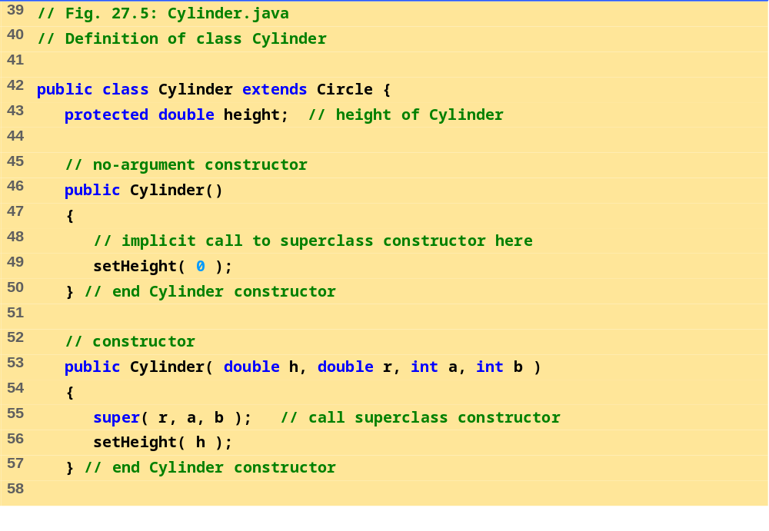
Circle.java (3 of 3)
Cylinder.java (1 of 2)

Slide 47
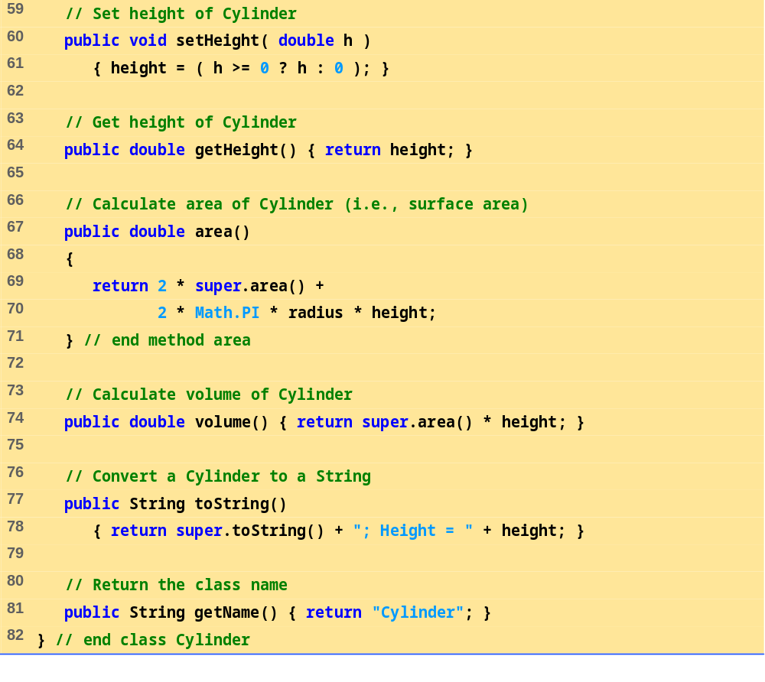
Cylinder.java (2 of 2)

Slide 48
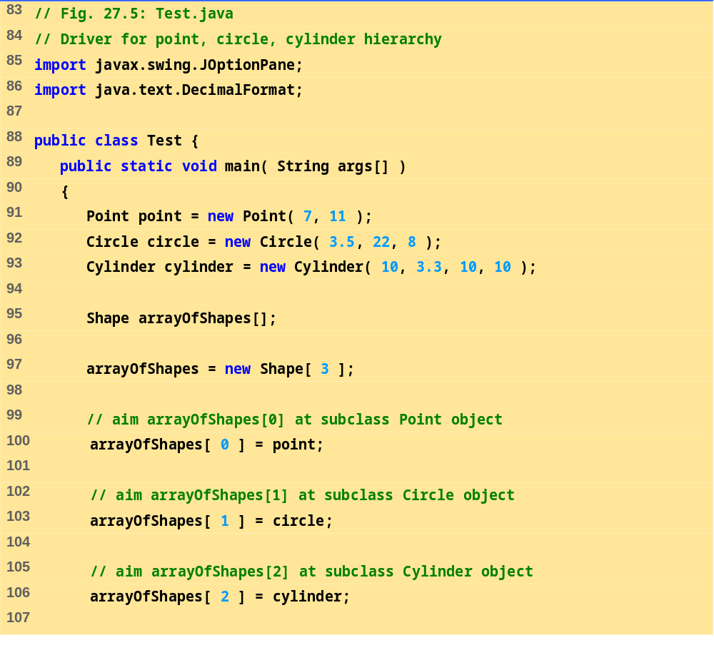
Test.java (1 of 2)

Slide 49
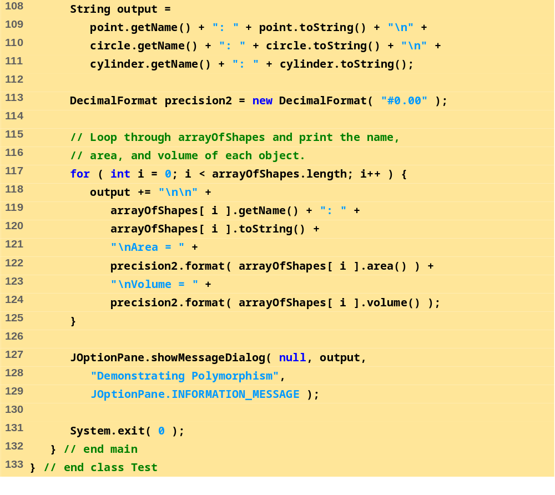
Test.java (2 of 2)

Slide 50

27.16 Case Study: Creating and Using Interfaces
Figure 27.5 Point, circle, cylinder hierarchy with a Shape interface—Circle.java

Slide 51
27.17 Inner Class Definitions
Inner classes
  Till now, all classes defined at file scope (not inside other classes)
  Inner classes defined inside other classes
  Anonymous inner class
    Has no name
    Frequently used with GUI event handling

Slide 52
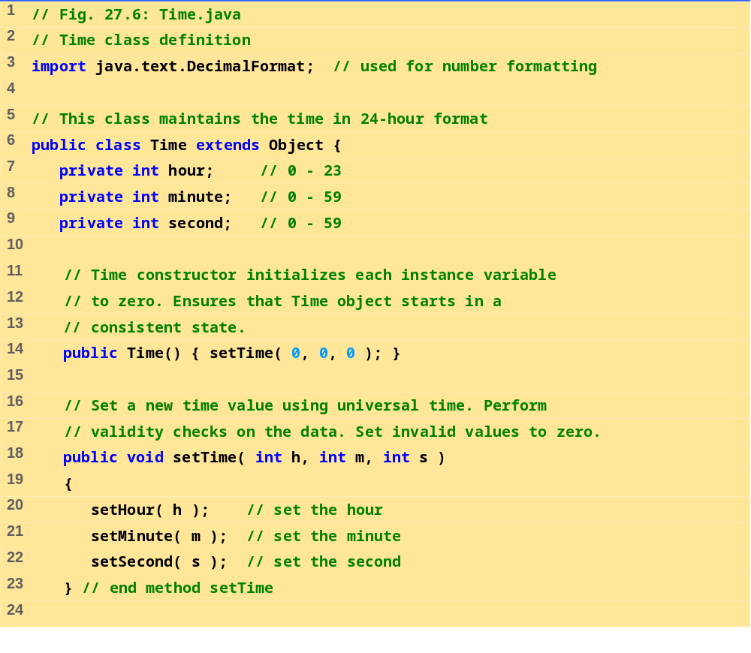
Time.java (1 of 3)

Slide 53
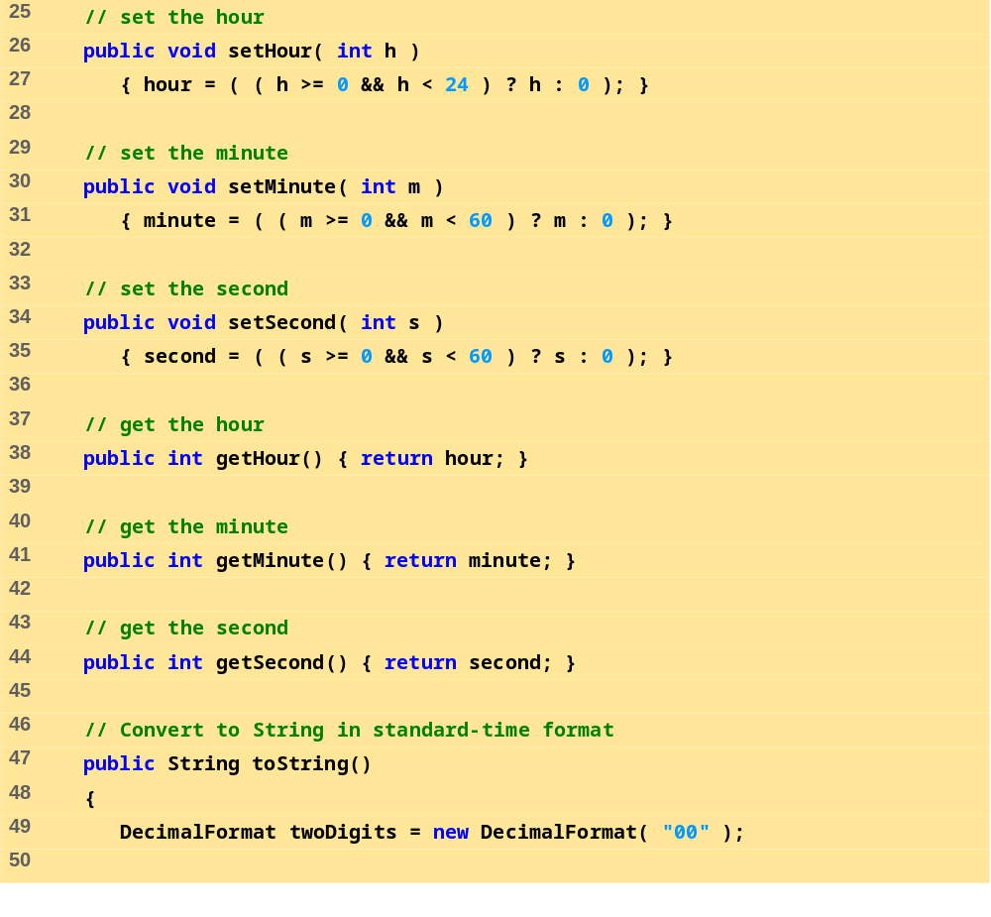
Time.java (2 of 3)

Slide 54
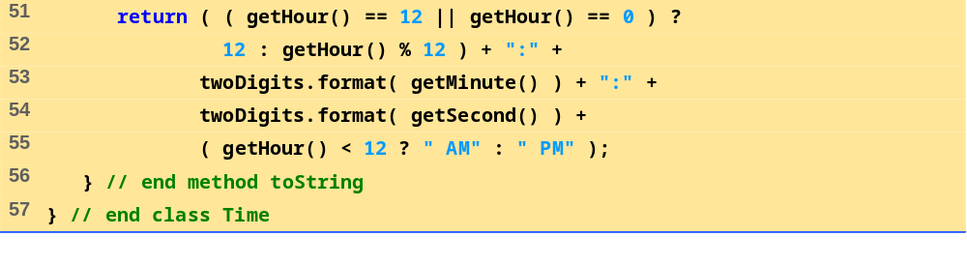
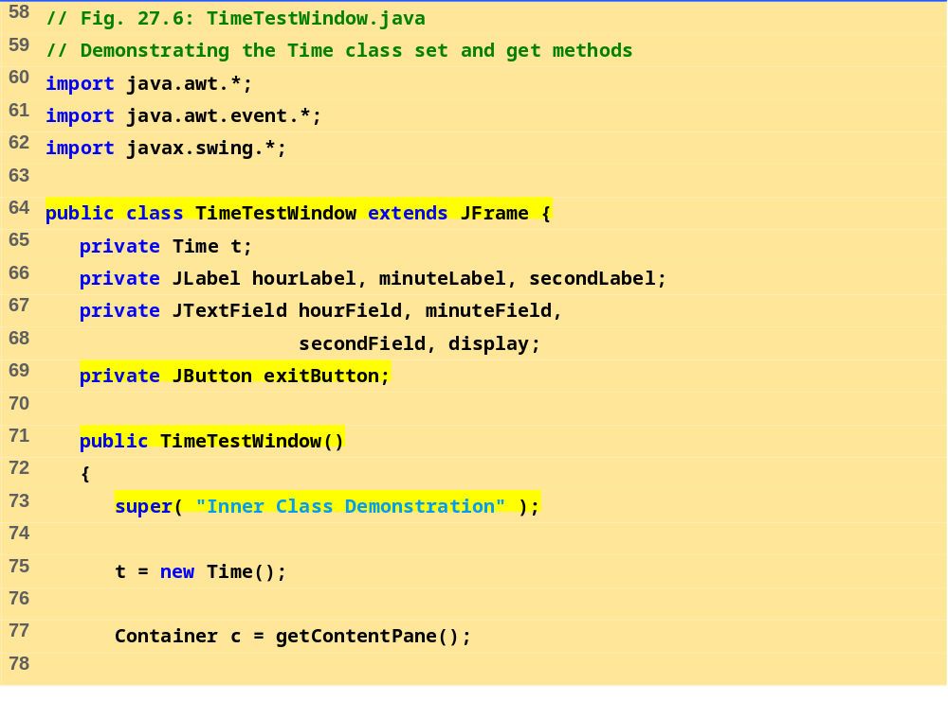
Time.java (3 of 3)
TimeTest-Window.java (1 of 4)

Slide 55
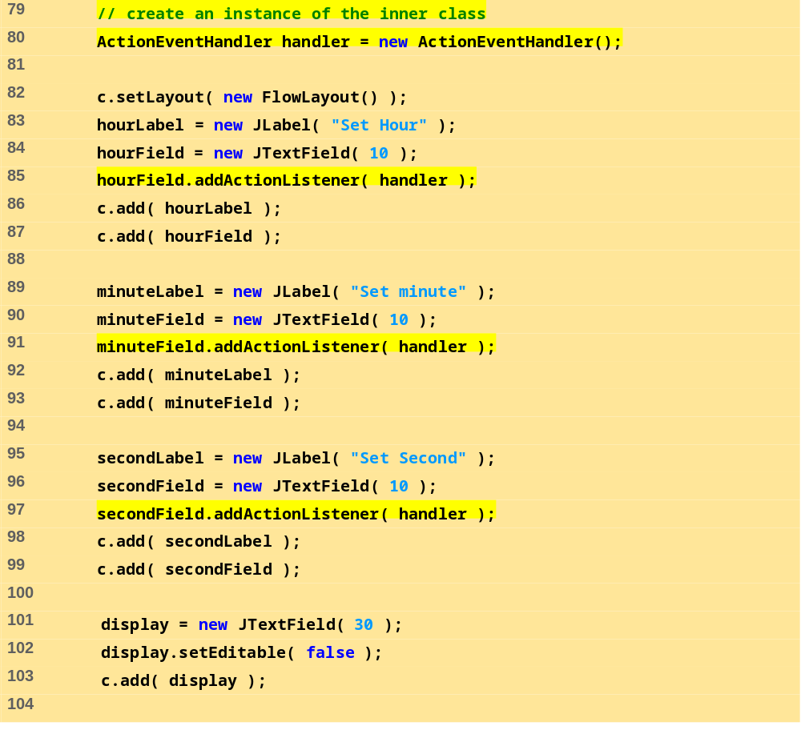
TimeTest-Window.java (2 of 4)

Slide 56
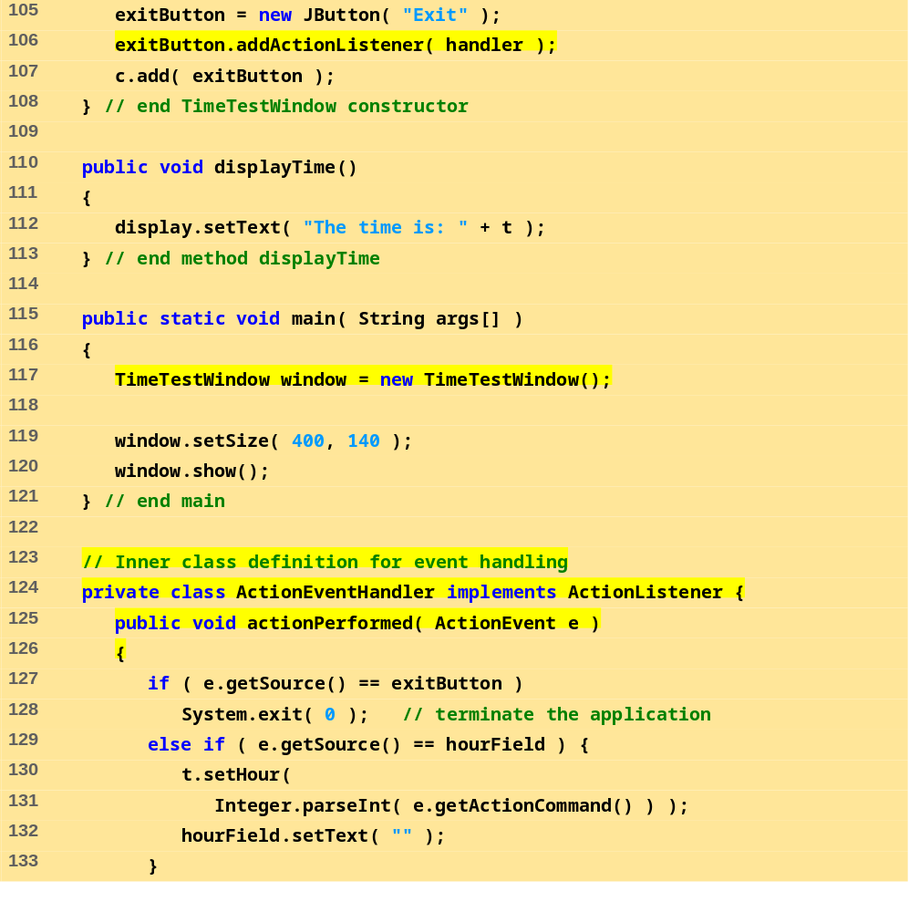
TimeTest-Window.java (3 of 4)

Slide 57
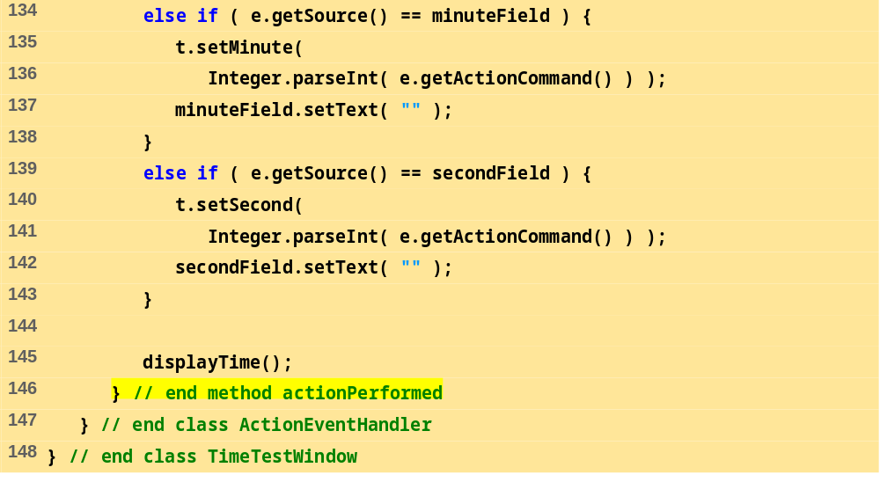
TimeTest-Window.java (4 of 4)

Slide 58
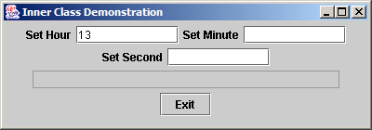
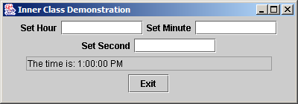

27.17 Inner Class Definitions
Figure 27.6 Demonstrating an inner class in a windowed application—TimeTestWindow.java.
Title Bar
Close box
Maximize
Minimize

Slide 59

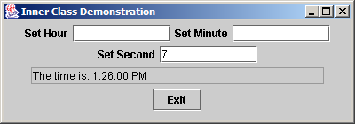

27.17 Inner Class Definitions
Figure 27.6 Demonstrating an inner class in a windowed application—TimeTestWindow.java.

Slide 60
27.17 Inner Class Definitions
Windowed applications
  Execute an application in its own window (like an Applet)
    Inherit from class JFrame (javax.swing) rather than JApplet
  init method replaced by constructor
    Instead, create GUI components in constructor
    Instantiate object in main (guaranteed to be called)

Slide 61
27.17 Inner Class Definitions
Event handling
  Some class must implement interface ActionListener
    Must define method actionPerformed
    Class that implements ActionListener "is an" ActionListener
  Method addActionListener
    Takes object of type ActionListener
    We can pass it an instance of the class that implements ActionListener ("is a" relationship)

Slide 62
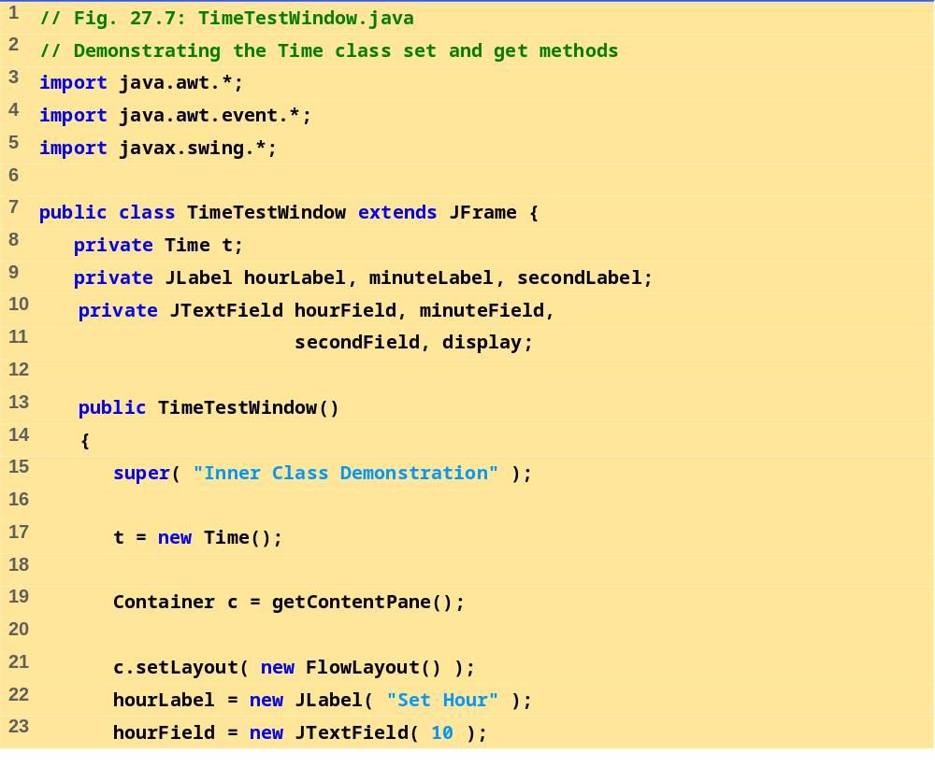
TimeTest-Window.java (1 of 4)

Slide 63
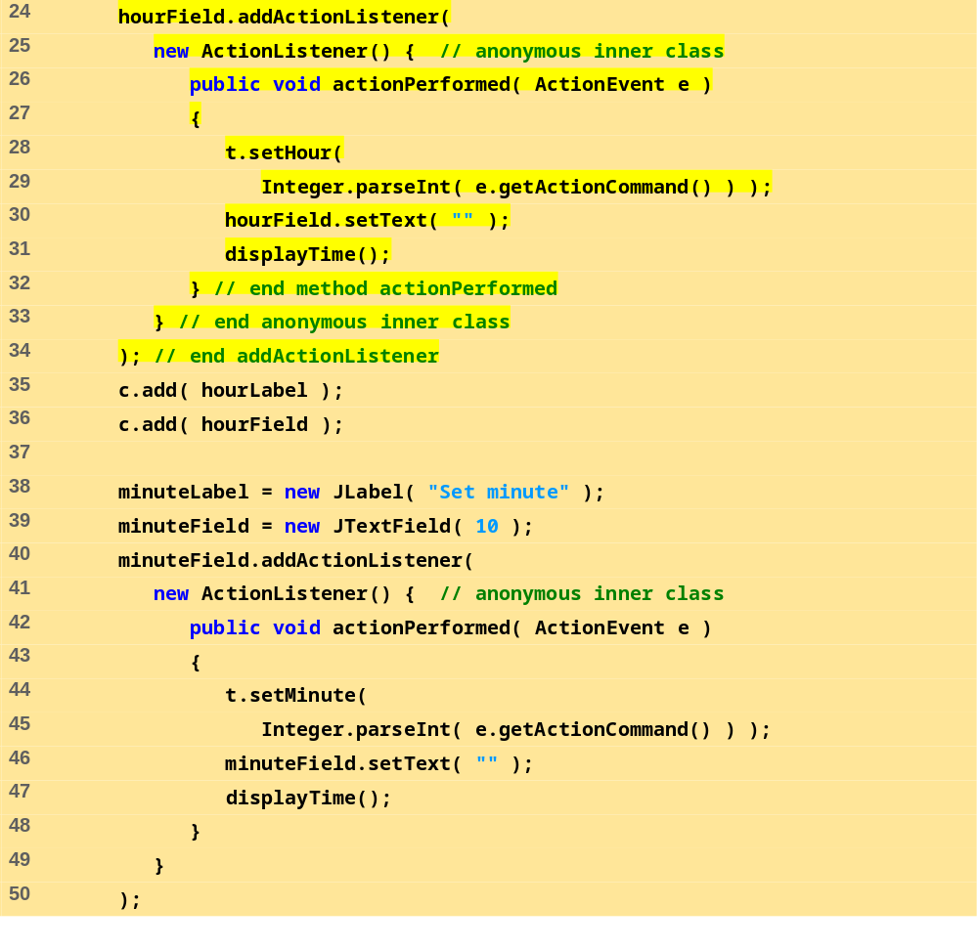
TimeTest-Window.java (2 of 4)

Slide 64
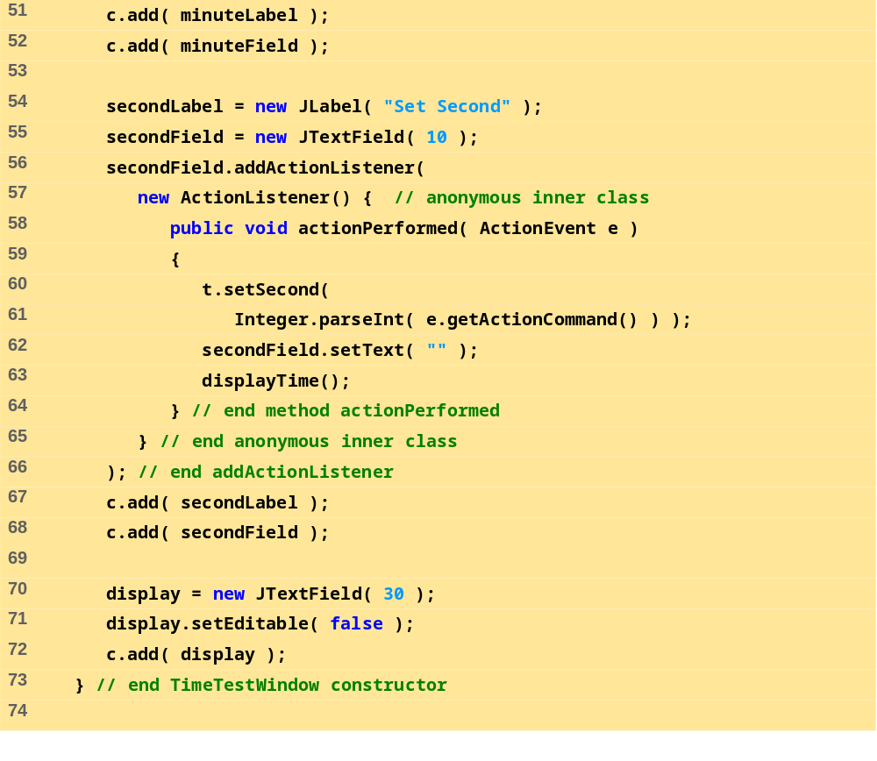
TimeTest-Window.java (3 of 4)

Slide 65
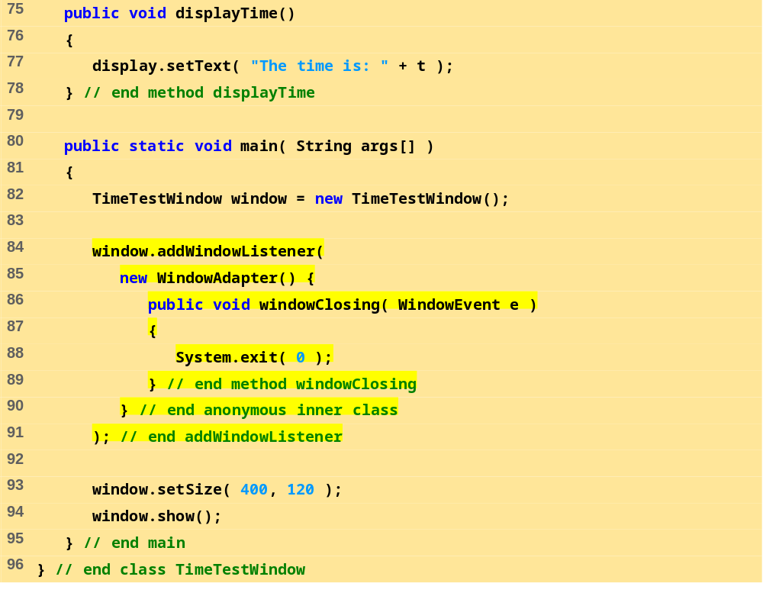
TimeTest-Window.java (4 of 4)

Slide 66
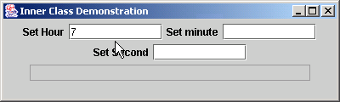
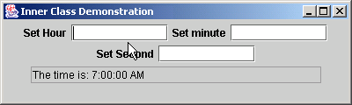
Close box
Program Output

Slide 67

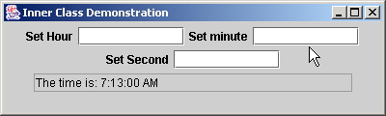
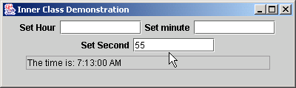

27.17 Inner Class Definitions
Figure 27.7 Demonstrating anonymous inner class - TimeTestWindow.java

Slide 68
27.17 Inner Class Definitions
Event handling with anonymous Inner classes
  Define the inner class inside the call to addActionListener
    Create an instance of the class inside the method call
    addActionListener takes an object of class ActionListener

Slide 69
27.17 Inner Class Definitions
Example:
myField.addActionListener(
new ActionListener() { // anonymous inner class
public void actionPerformed( ActionEvent e)
{
Actions
}
}
);
  new creates an object
  ActionListener() begins definition of anonymous class and calls default constructor
    Similar to public class myHandler implements ActionListener
  Brace ( { ) begins class definition

Slide 70
27.17 Inner Class Definitions
Use the following code to allow the user to close windows using the close button:
window.addWindowListener(
new WindowAdapter() {
public void windowClosing( WindowEvent e )
{
System.exit( 0 );
}
}
);

Slide 71
27.18 Notes on Inner Class Definitions
Notes
  Every class (including inner classes) have their own .class file
  Named inner classes can be public, protected, private, or have package access
    Same restrictions as other members of a class
  To access outer class's this reference
    OuterClassName.this
  To create an object of another class's inner class
    Create an object of outer class and assign it a reference (ref)
    Type statement of form:
    OuterClassName.InnerClassName innerRef = ref.new InnerClassName();

Slide 72
27.18 Notes on Inner Class Definitions
Notes (continued)
  Inner class can be static
    Does not require object of outer class to be defined
    Does not have access to outer class's non-static members

Slide 73
27.19 Type-Wrapper Classes for Primitive Types
Each primitive type has a type-wrapper class
  Enables manipulation of primitive types as objects of class Object
  Each type wrapper is declared final, so their methods are implicitly final and may not be overridden
  To manipulate a primitive value in your program, first refer to the documentation for the type-wrapper classes—the required method may already be defined.

