Slide 1
Synthetic Profile Generation
simple model
simple model plus metadata

Slide 2
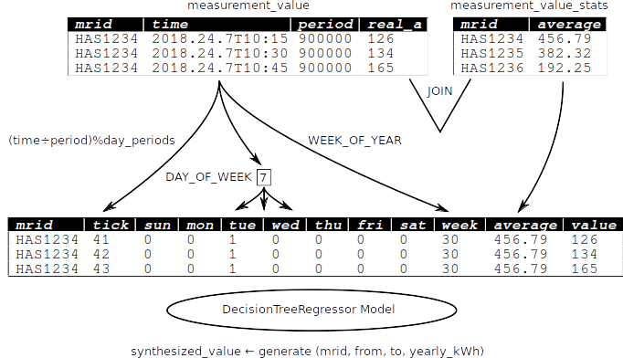
Simple Model

Slide 3
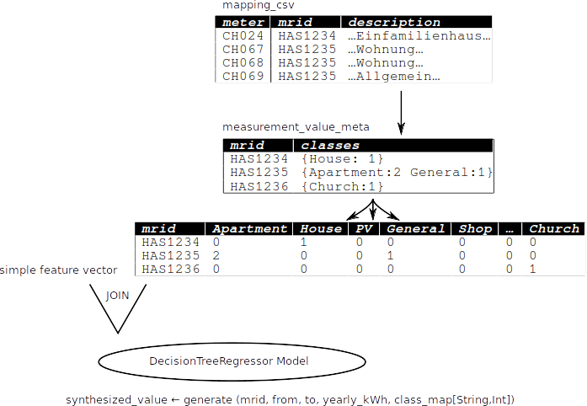
Meta Model

Slide 4
Next Steps
evaluate and validate existing models,
hyperparameter tuning
integrate into CIMApplication,
fill gaps, find outliers, add new mrids
pattern recognition to avoid manual classification
use location lon,lat to estimate temperature
using gridded 10min data from MeteoSchweiz
use Intel BigDL or Google TensorFlow package
for Neural Network approach

